Slide 1
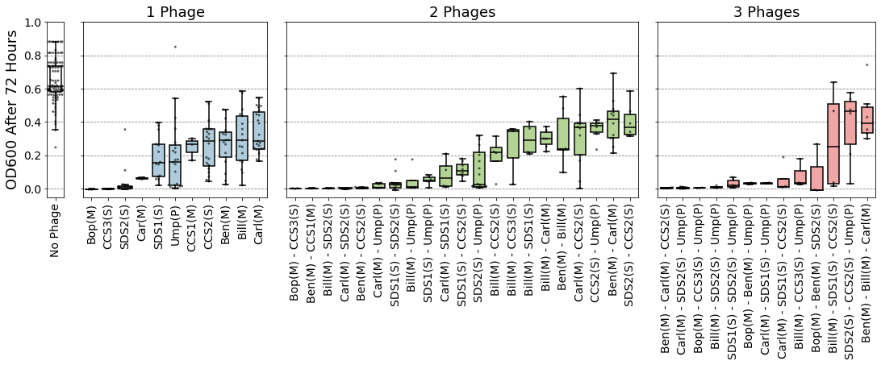
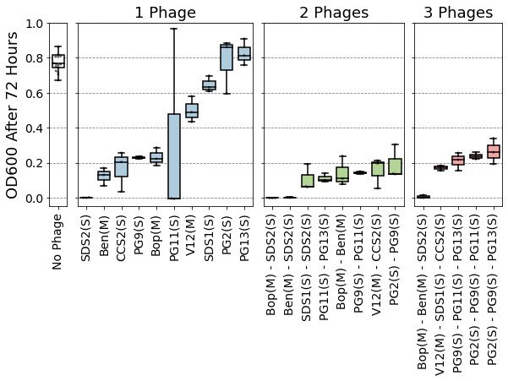
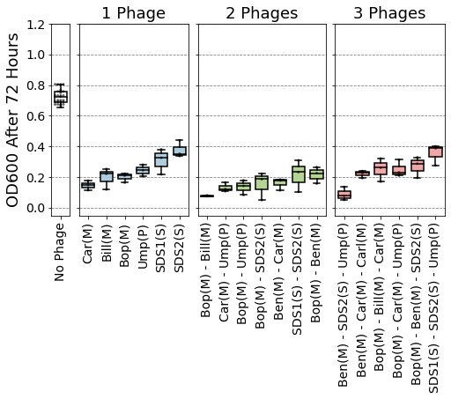
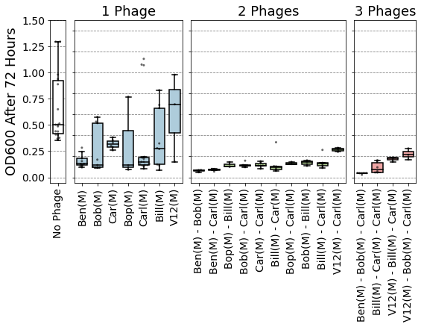
a) YI6
b) EF06
c) Ef11
d) V587

Slide 2
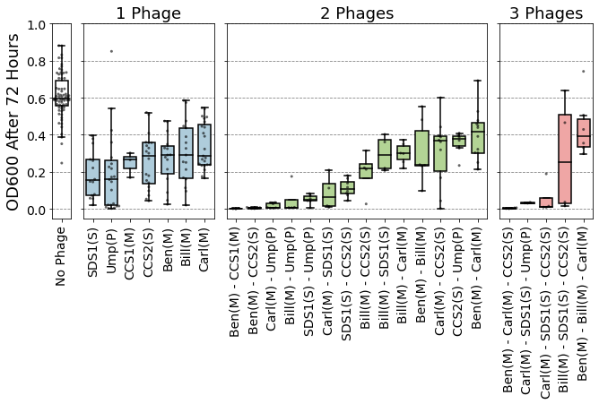
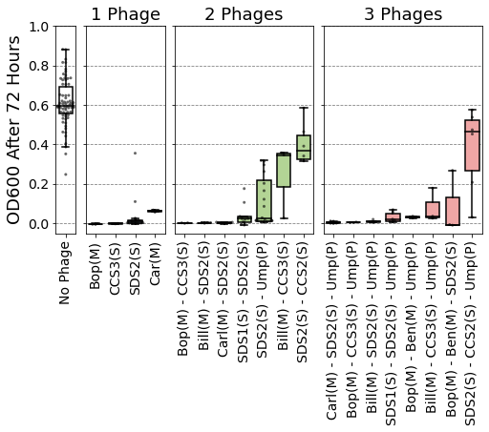
a) E. faecalis YI6
Individual phages don’t clear host
b) E. faecalis YI6
Individual phages do clear host
c) E. faecalis EF06
d) E. faecalis Ef11
e) E. faecalis V587

Slide 3
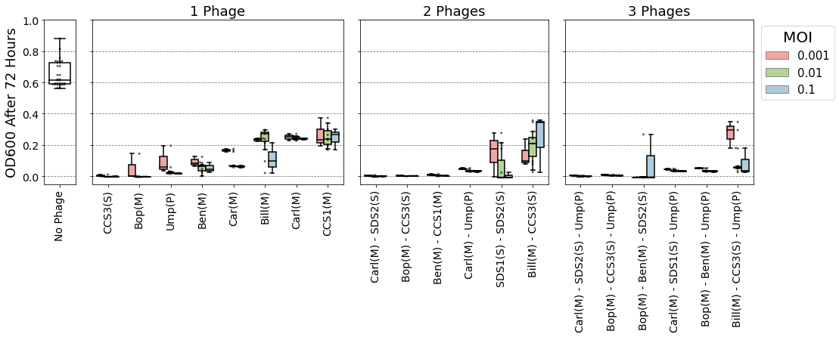
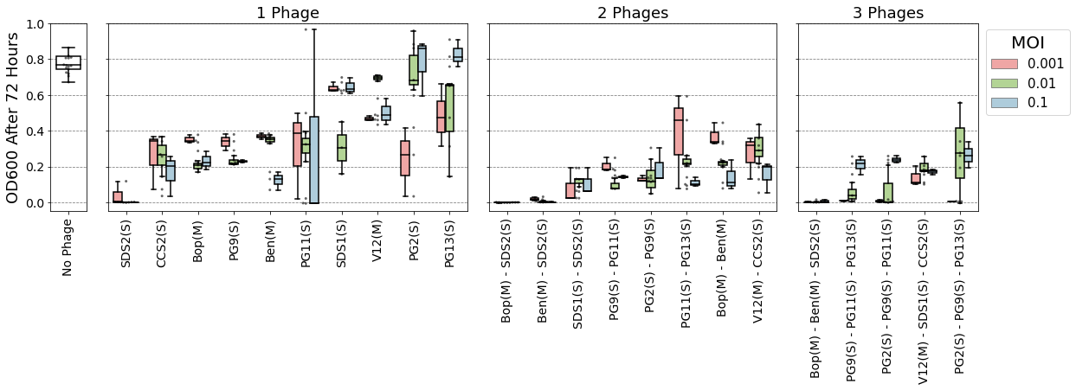
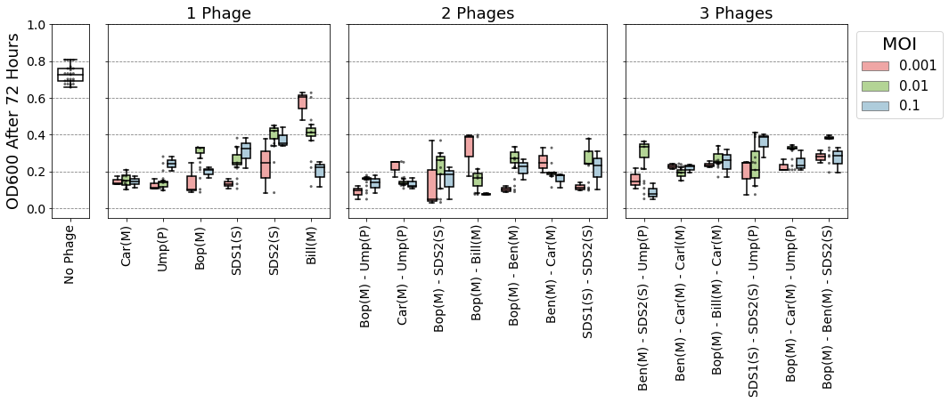
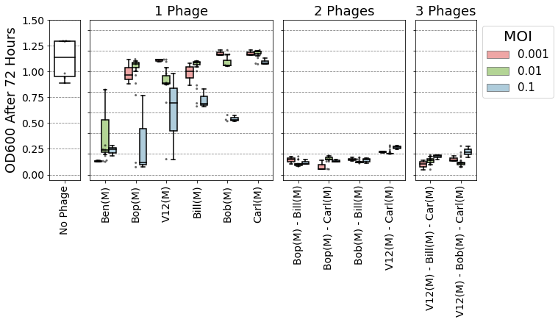
A) E. faecalis Yi6-1
B) E. faecalis EF06
C) E. faecalis EF11
D) E. faecalis V587

