Slide 1
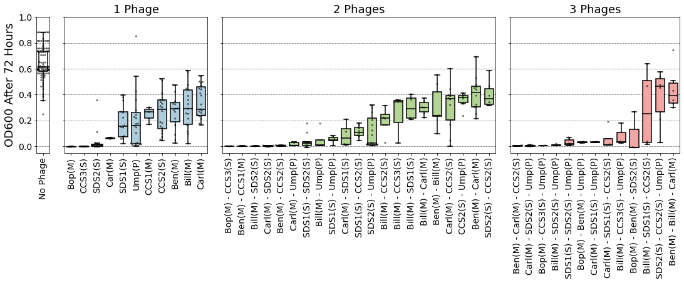
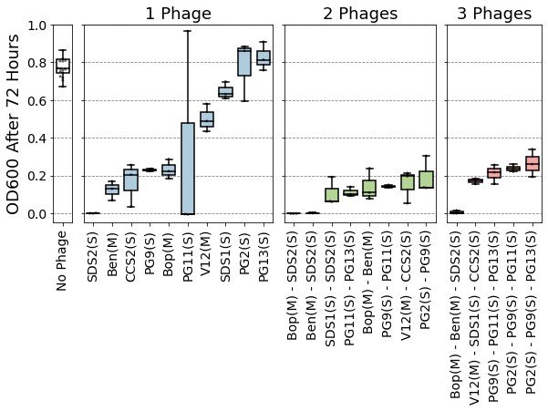
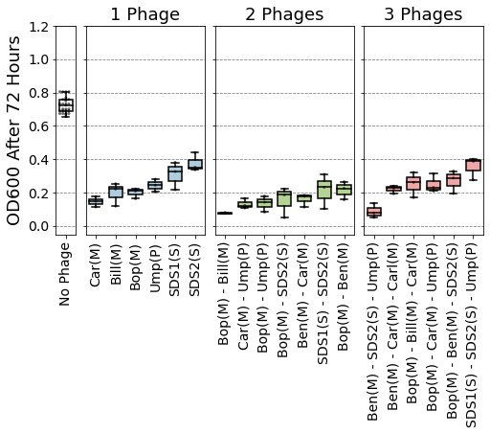
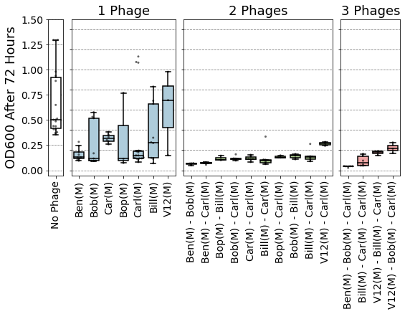
a) YI6
b) EF06
c) Ef11
d) V587

Slide 2
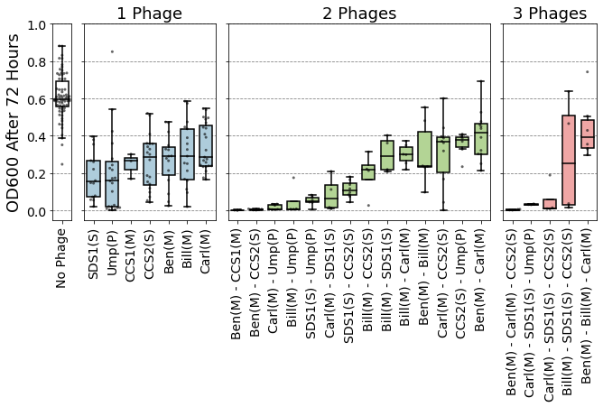
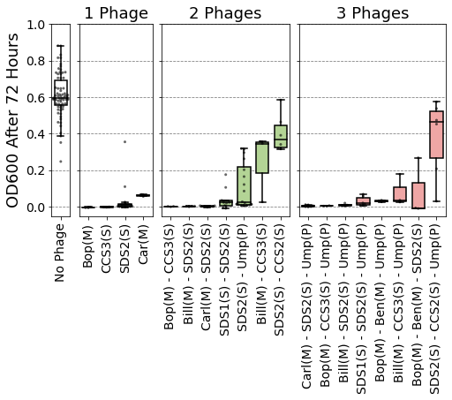
A) E. faecalis Yi6-1
Individual phages don’t clear host
B) E. faecalis Yi6-1
Individual phages do clear host
C) E. faecalis EF06
D) E. faecalis Ef11
E) E. faecalis V587

Slide 3
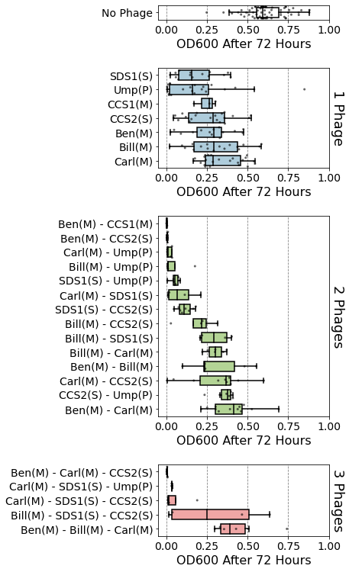
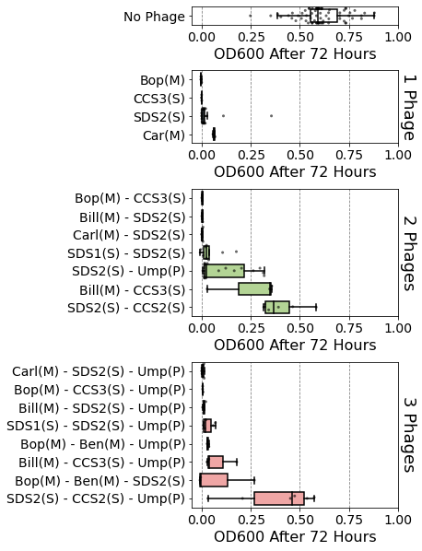
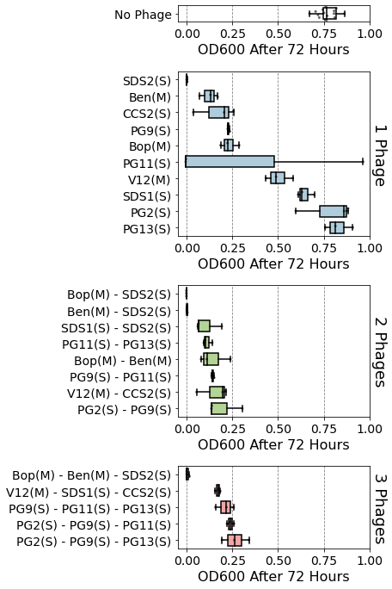
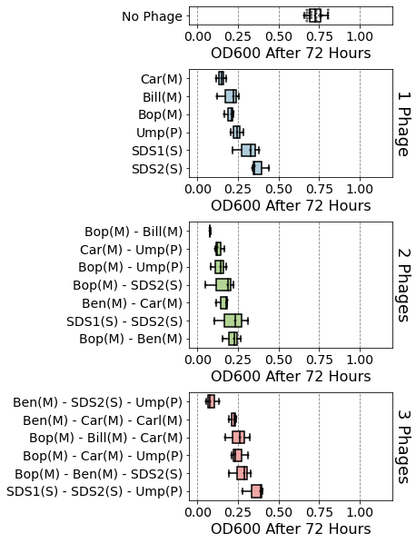
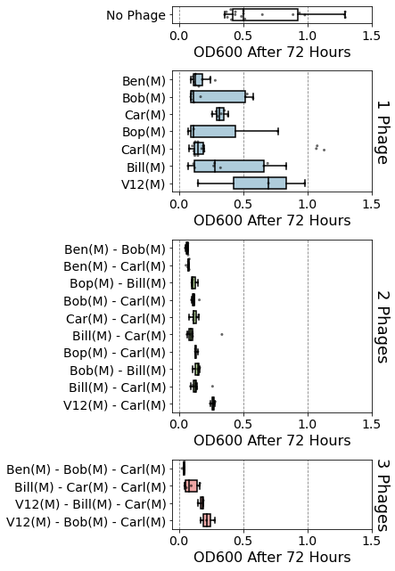
A) E. faecalis Yi6-1
Individual phages don’t clear host
B) E. faecalis Yi6-1
Individual phages do clear host
C) E. faecalis EF06
D) E. faecalis Ef11
E) E. faecalis V587

Slide 4
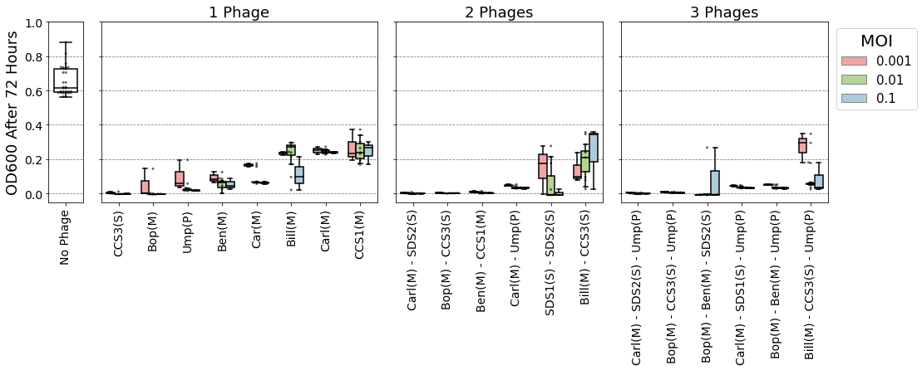
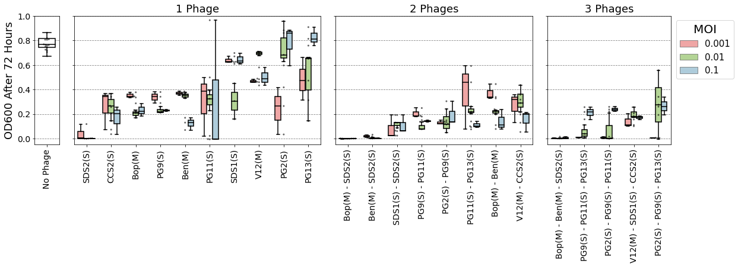
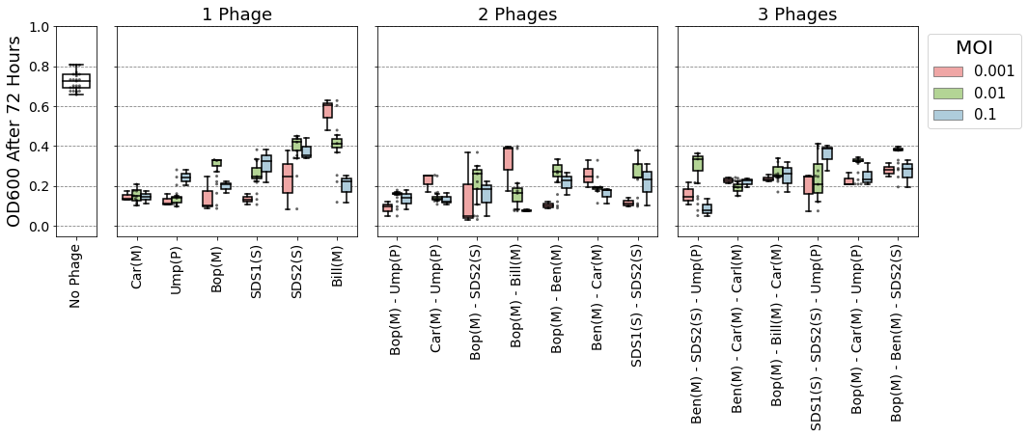
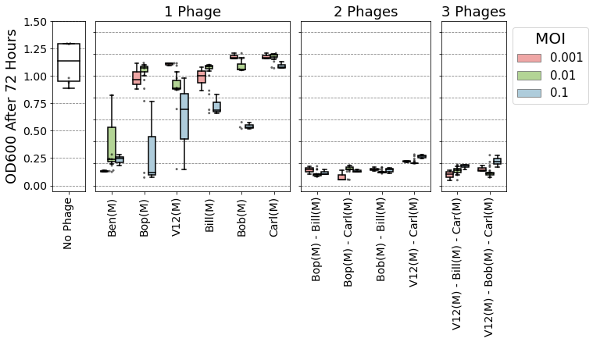
A) E. faecalis Yi6-1
B) E. faecalis EF06
C) E. faecalis EF11
D) E. faecalis V587

