Slide 1
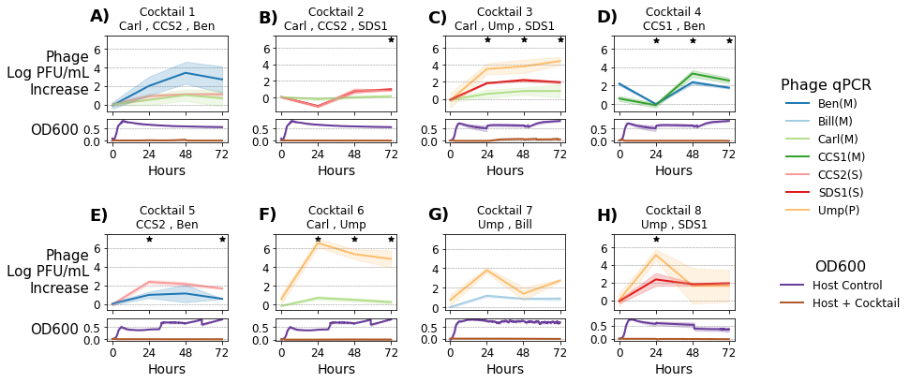
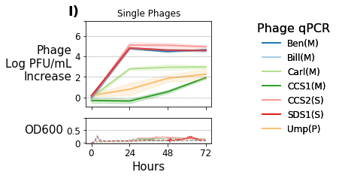

Slide 2
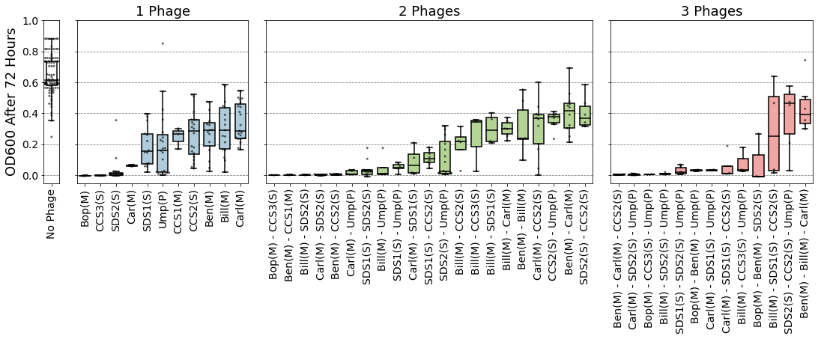
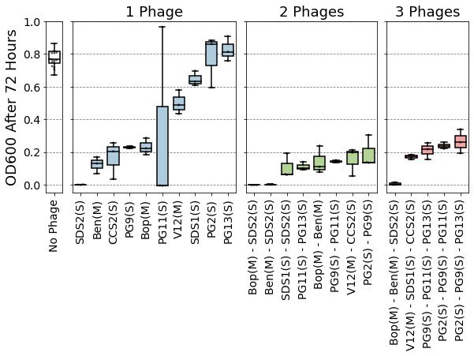
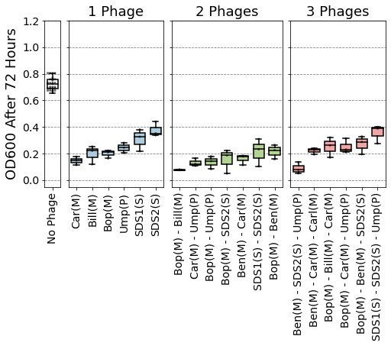
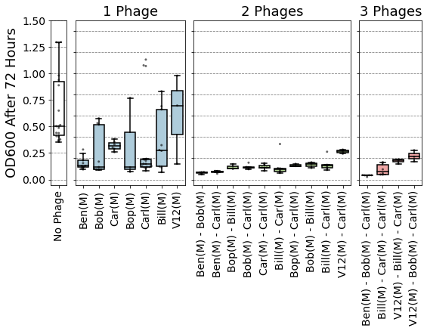
a) YI6
b) EF06
c) Ef11
d) V587

Slide 3
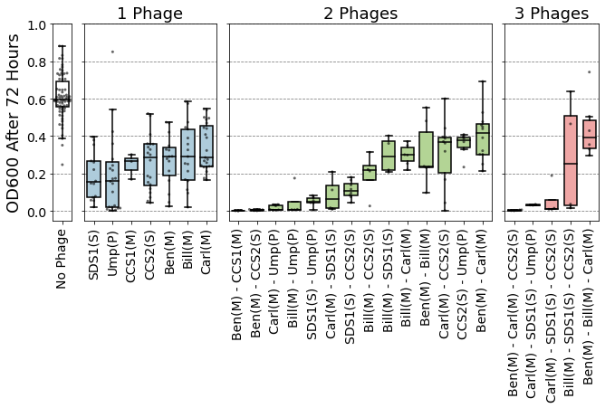
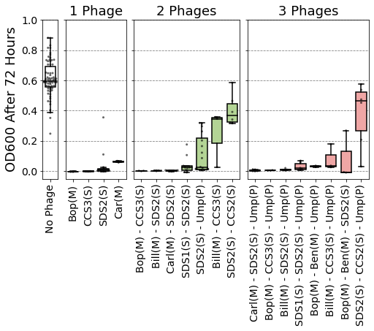
A) E. faecalis Yi6-1
Individual phages don’t clear host
B) E. faecalis Yi6-1
Individual phages do clear host
C) E. faecalis EF06
D) E. faecalis Ef11
E) E. faecalis V587

Slide 4
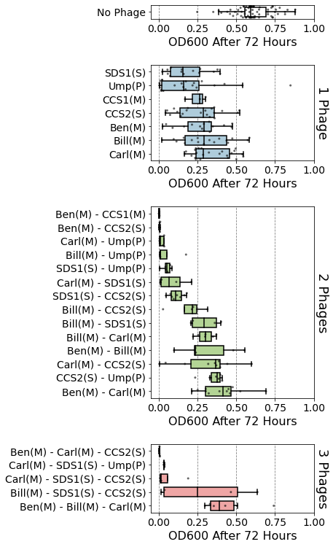
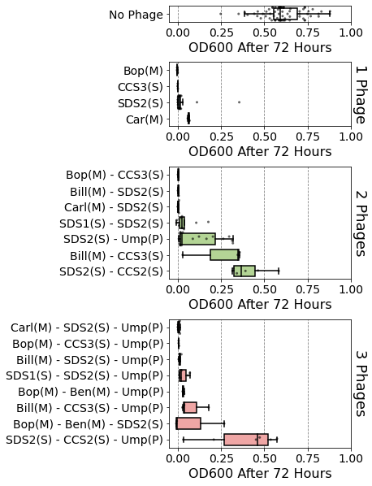
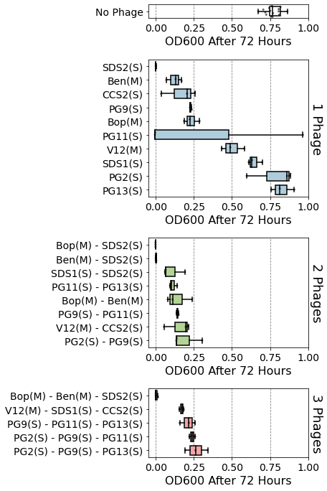
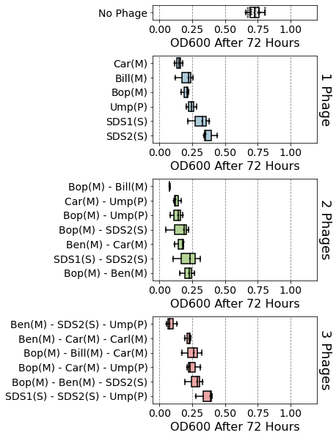
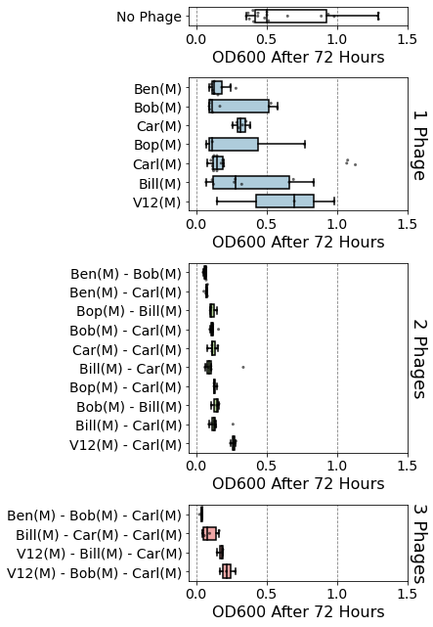
A) E. faecalis Yi6-1
Individual phages don’t clear host
B) E. faecalis Yi6-1
Individual phages do clear host
C) E. faecalis EF06
D) E. faecalis EF11
E) E. faecalis V587

Slide 5
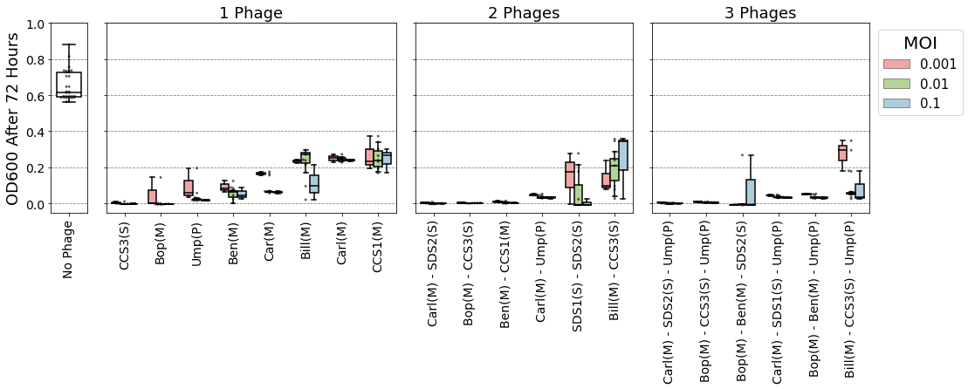
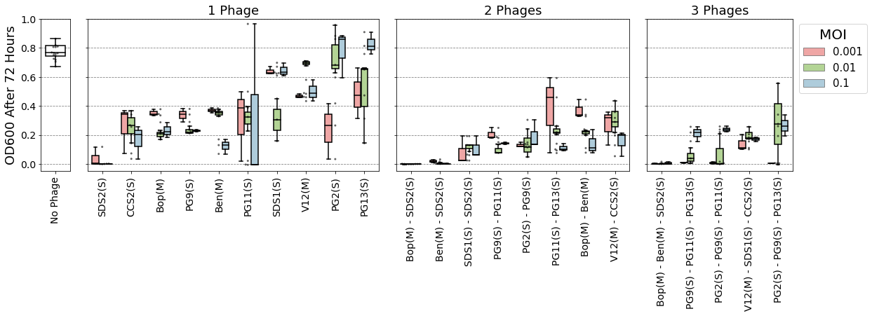
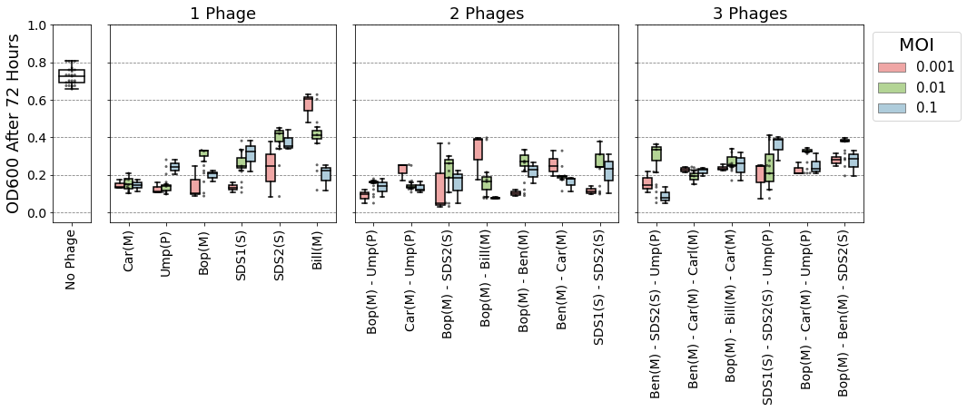
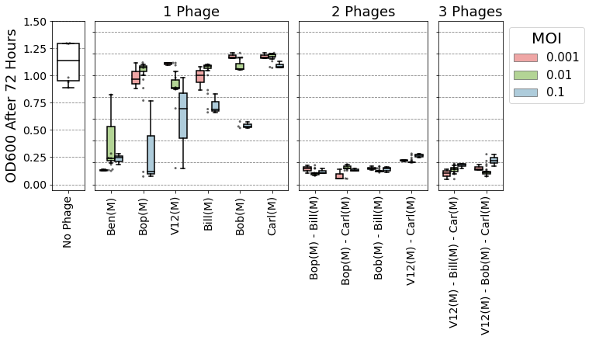
A) E. faecalis Yi6-1
B) E. faecalis EF06
C) E. faecalis EF11
D) E. faecalis V587

Slide 6
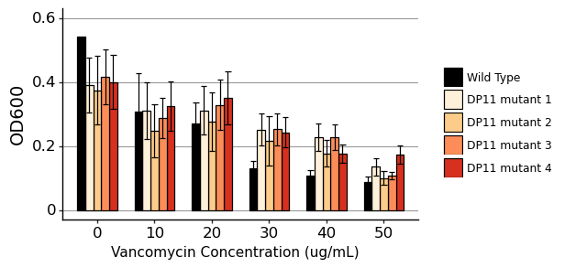
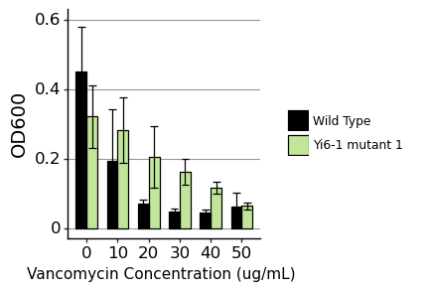
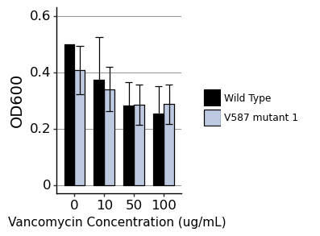
A) E. faecalis DP11
B) E. faecalis Yi6-1
C) E. faecalis V587

Slide 7
A)
B)
Brockvirinae (myoviridae)
Core vs Accessory Genome
Tree
Pct Identity

Slide 8
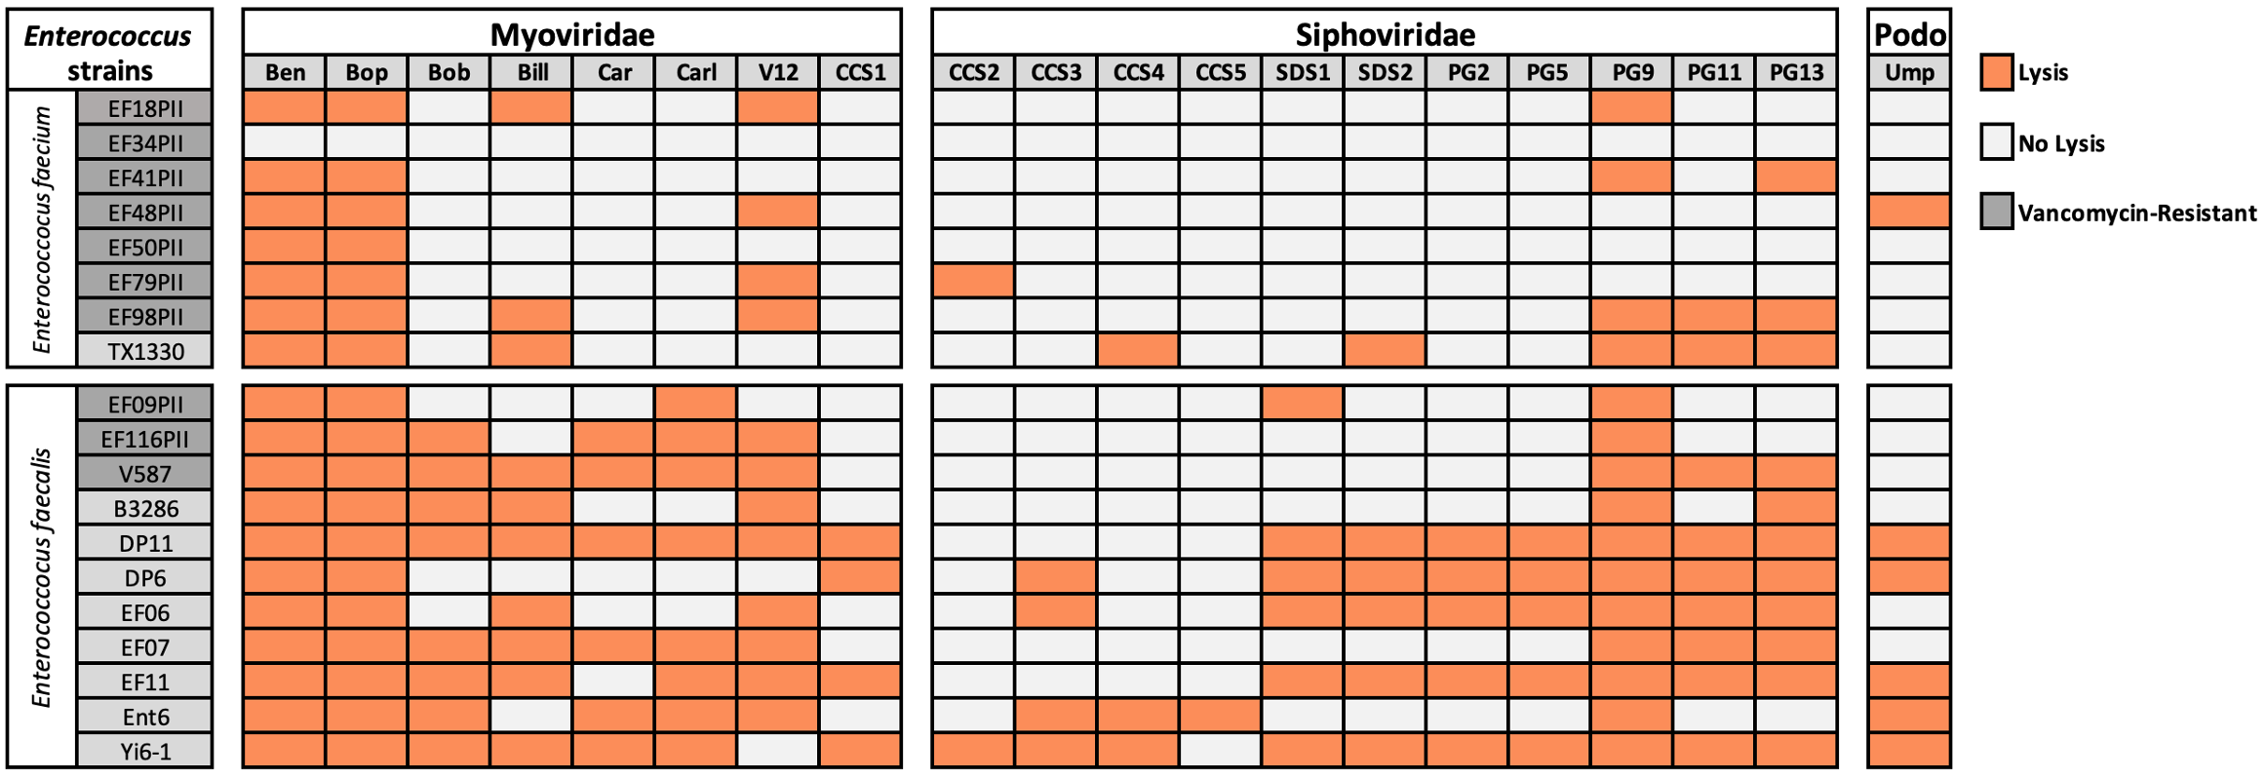
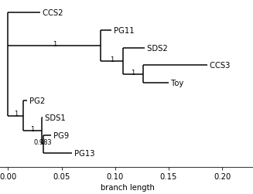
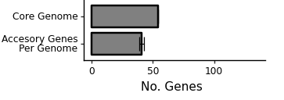

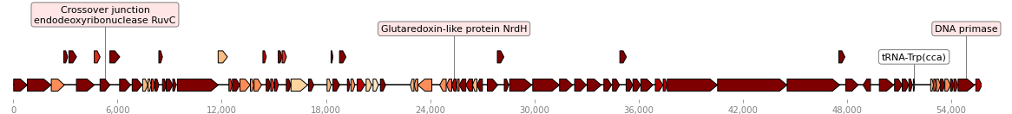
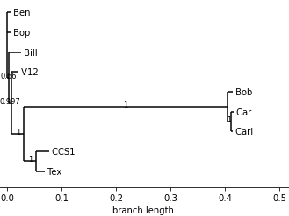
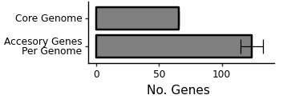
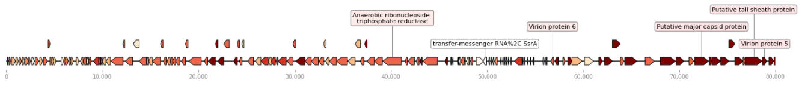
A)
B)
C)
Number of phages containing gene
D)
E)
F)
Number of phages containing gene

