Slide 1
SWAN – sensing framework for android
VU University Amsterdam

Slide 2
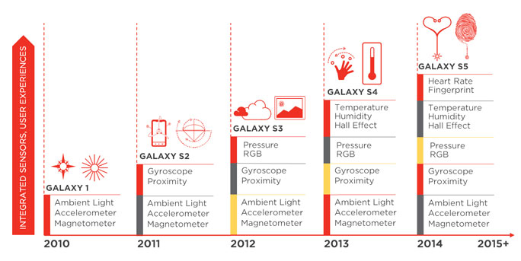
Sensor growth in smartphones

Slide 3
Sensor-based apps
Some examples
AirTouch – use your breath to interact with the phone (humidity sensor)
Runtastic – counts your steps (accelerometer)
Thermometer – check the temperature (temperature sensor)
Fingerprint Lock Screen – unlock screen with your fingerprint (fingerprint sensor)
Dimmer – auto-adjust screen brightness (light sensor)
Less than 0.5% of all apps use sensors
Poor abstractions for sensor access
Poor programming support

Slide 4


A different kind of app
Wind speed
Heart rate
Road quality
Location
Pedalig frequency
Humidity
“Due to strong wind, high fatigue level and poor road quality on chosen route, it’s recommended to take alternative route through Amsterdamse Bos.”

Slide 5
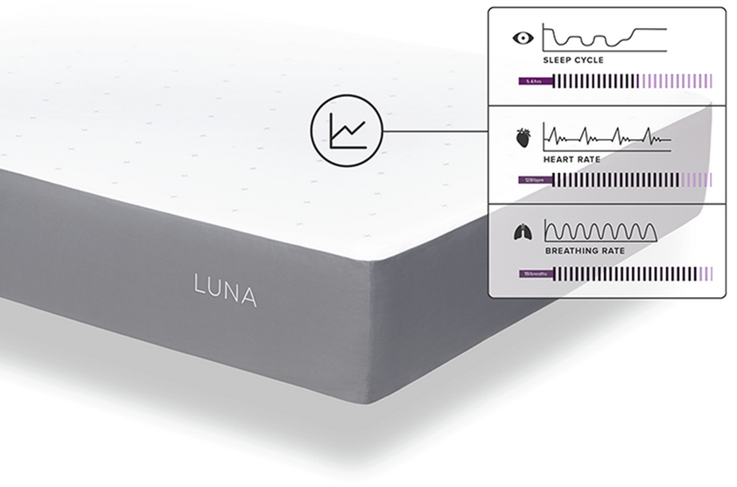
The smart mattress
Smart mattress that adjust light, music volume and room temperature based on:
Sleep cycle
Heart rate
breathing

Slide 6
The smart mattress
Smart mattress that adjust light, music volume and room temperature based on:
Sleep cycle
Heart rate
breathing
Price: $200
The same can be achieved with a smartphone placed on a regular mattress

Slide 7
Combining information from many sensors
Why it’s difficult:
Fragmentation in how sensor are accessed
Difficult to program hundreds of context rules
Solution = SWAN
Middleware between apps and sensors
SWAN-Song – easy to define context expressions
Sensor readings are shared among apps
It supports by default 20+ sensors
Integrates with 3rd party sensors

Slide 8



SWAN-Song
“Let me know if the battery drops more than 25% within 1h with the screen turned off.”
screen:on {ALL, 1h} == false && (battery:level {MAX, 1h} -
battery:level {MIN, 1h}) > 25
IntentFilter ifilter = new IntentFilter(Intent.ACTION_BATTERY_CHANGED);
Intent batteryStatus = context.registerReceiver(null, ifilter);
… (10 more lines of code)

Slide 9
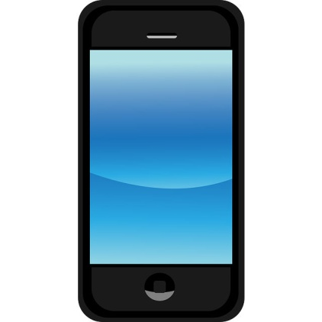
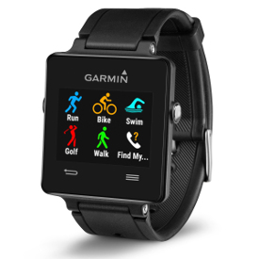
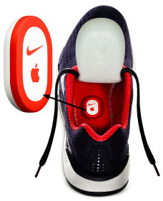
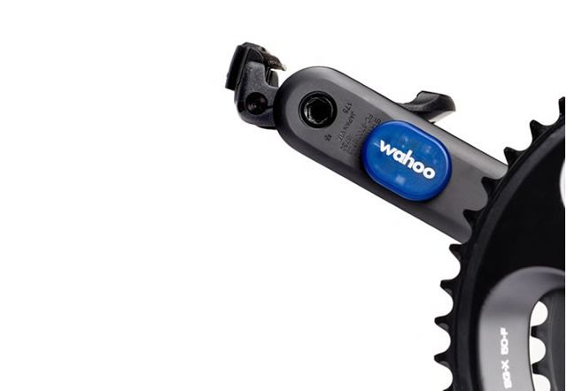
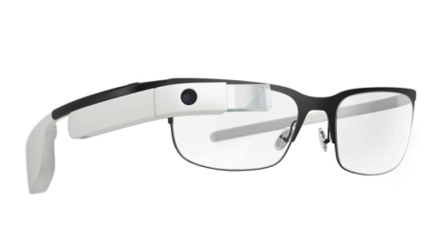
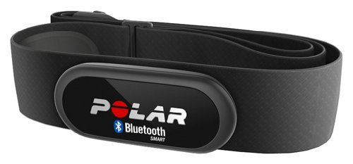
Distributed sensing

Slide 10
Cloud-ready
Sensor readings periodically saved in SenseOS cloud
Intelligent data offloading
Layered approach => better performance
Adapts to battery level => energy efficient
Batching mechanism
Customizable
Works over 3G, 4G, Wifi
Easily adaptable to other cloud providers

