Slide 1
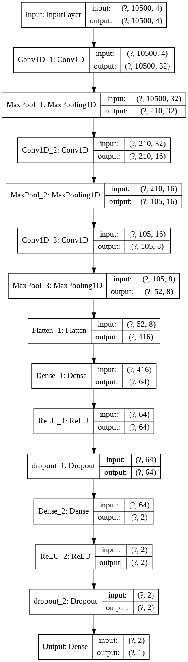
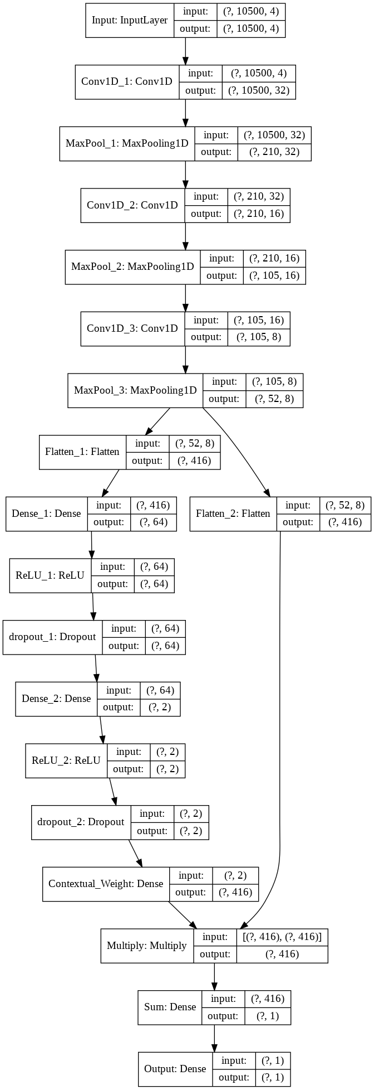
Differences
CR-model
Non-CR-model
Notes:
The database used in this script is from "Predicting mRNA Abundance Directly from Genomic Sequence Using Deep Convolutional Neural Networks". The difference between contextual model and regular model is whether there is contextual weight layer (it is actually just a Dense layer). Attached slice shows the figures of CR model and non CR model. You can easily compare their differences. The script of CR doesn't have special points. Just pay attention the setting of "Sum" layer and let the parameters of "Sum" layer be NOT trainable, otherwise the correspondence between weighted features and results will be lost.

