Slide 1

Predicting If a Client Will Subscribe a Term Deposit
Shan Wang

Slide 2
Problem
Portuguese banking institution ran a direct telemarketing campaign to promote its term deposit to its clients. We want to predict if a client will subscribe a term deposit or not after a call.

Slide 3



Factors to Consider:
WHO
(Demographic Information)
WHEN
(Economic Index)
HOW
(Phone Call Behavior)
Employment Variation Rate
Consumer Price Index
Consumer Confidence Index
…
Day of the Call
Month of the Call
Number of contacts Performed
…
Age
Education
Job
Having a Loan
…

Slide 4
Data Acquisition
Bank Marketing Data Set from UCI Machine Learning Repository.
The dataset is collected from a Portuguese banking institution’s direct telemarketing campaigns implemented from May 2008 to November 2010.

Slide 5
Data Cleaning
‘unknown’ and ‘nonexistent’
‘Pday’ Column
NAN
To Categorical values
E.g. ‘999’ is converted
to ‘client was not
previously contacted’

Slide 6
Data Exploration and ANOVA
Demographic Info | Economic Index | Phone Call Attributes
Age | Emp.var.rate | Previous
Education | Cons.price.idx | Month
Job | Duribor3m | Pdays_cat
 | Nr.employed | Poutcome

Slide 7
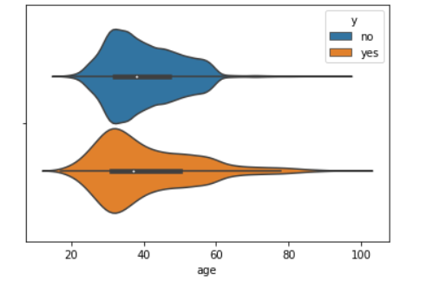
Age

Slide 8
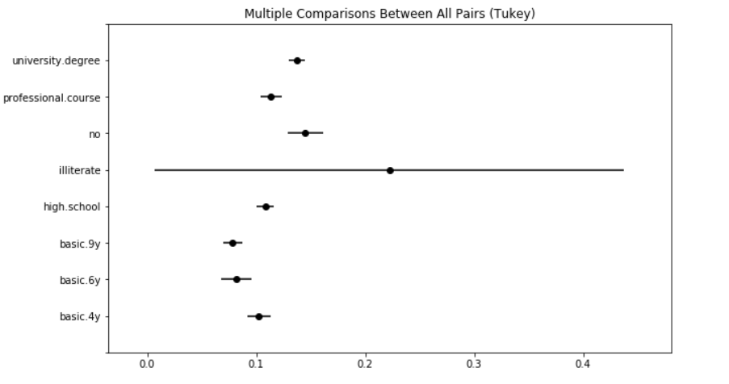
Education

Slide 9
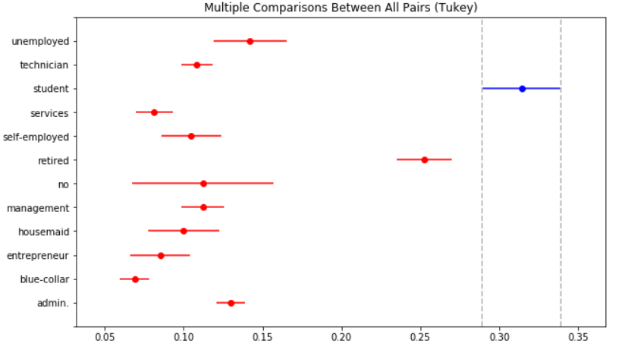
Job

Slide 10
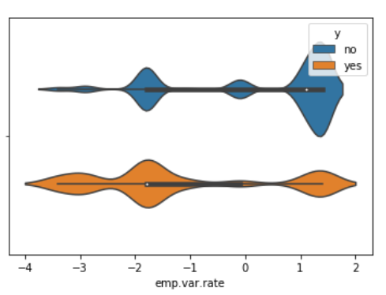
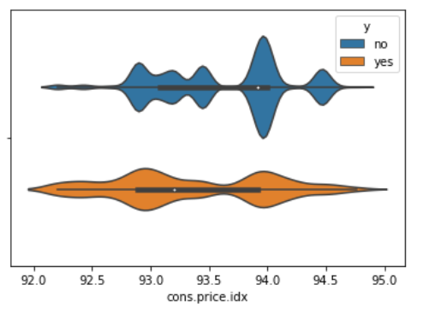
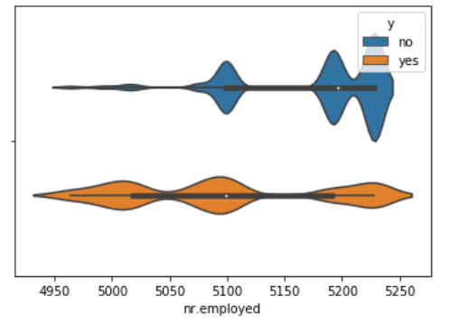
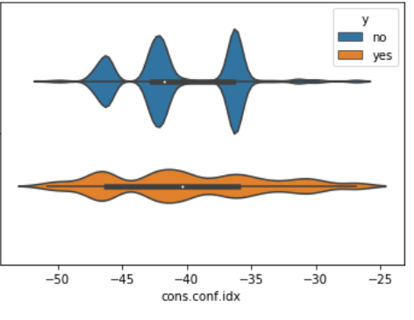
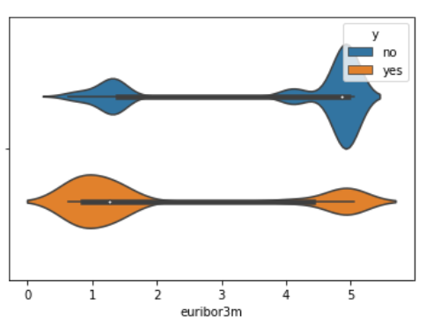
Economic Indexes

Slide 11
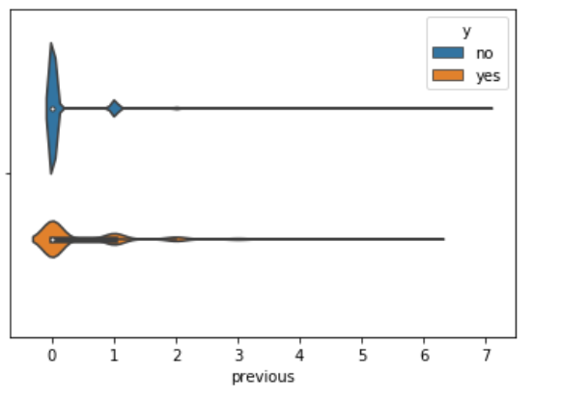
Previous

Slide 12
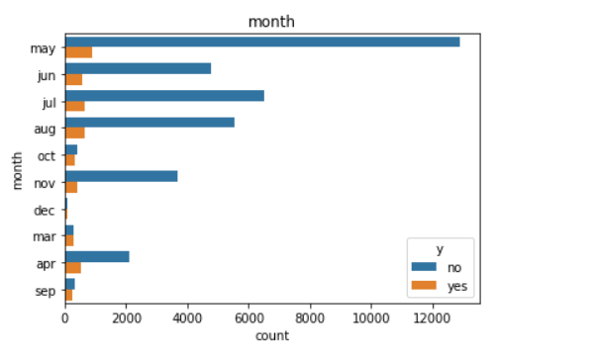
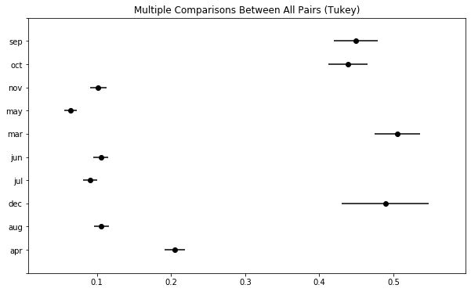
Month

Slide 13
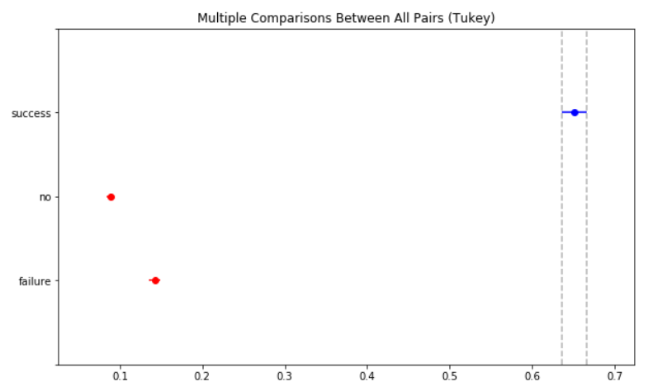
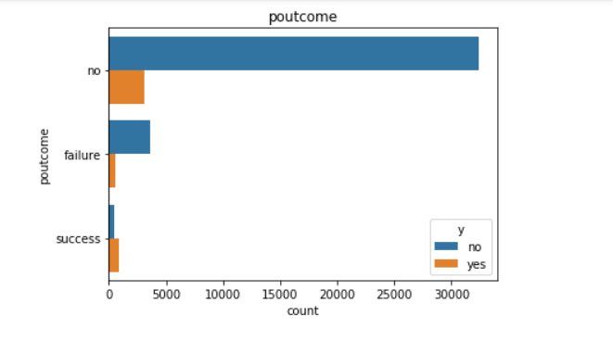
Poutcome

Slide 14
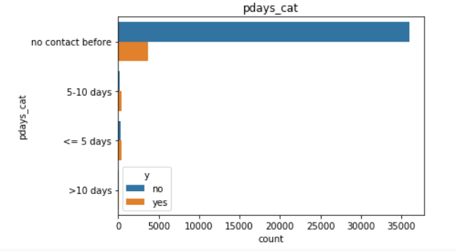
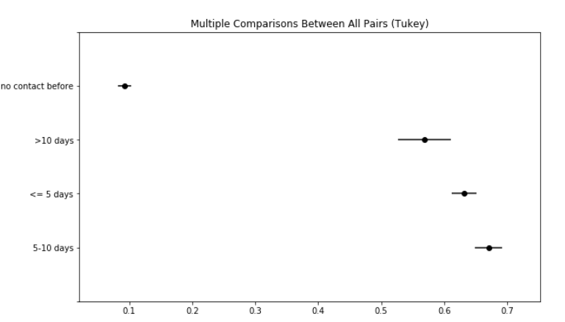
Pdays_cat

Slide 15
Data Preprocessing
80% train data, 20% Test Data
One-hot Encoding
Scaling
SMOTE Resampling

Slide 16
Modeling Overview
Type: Supervised Learning
Highly Imbalanced Data: Using SMOTE
Packages: Sklearn, imblearn
Target Value: 1 for yes, 0 for no

Slide 17
Data Modeling
Random Forest
Logistic Regression
Gradient Boosting Classifier

Slide 18
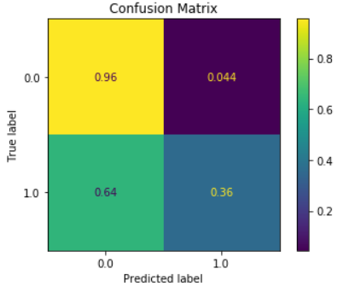
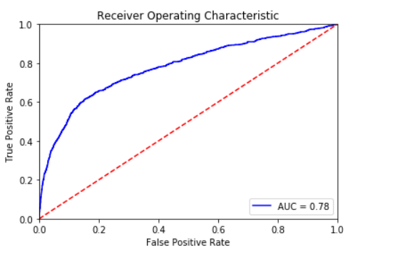
Random Forest
Hyperparameter Tuning: grid search with 5 fold cross validation

Slide 19
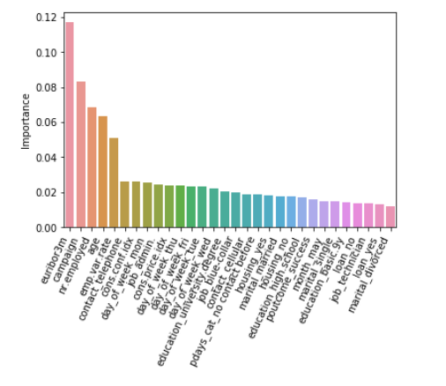
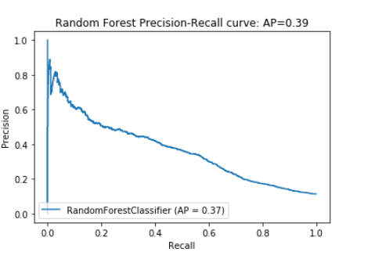
Random Forest

Slide 20
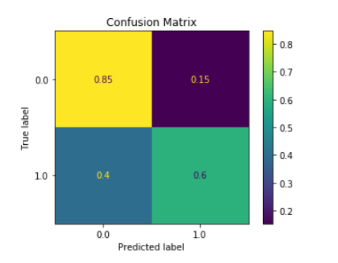
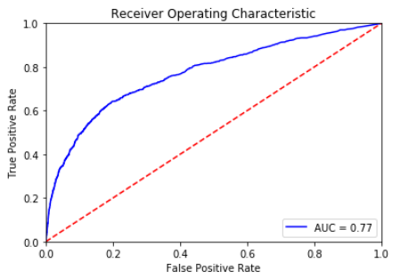
Logistic Regression
Hyperparameter Tuning: grid search with 5 fold cross validation

Slide 21
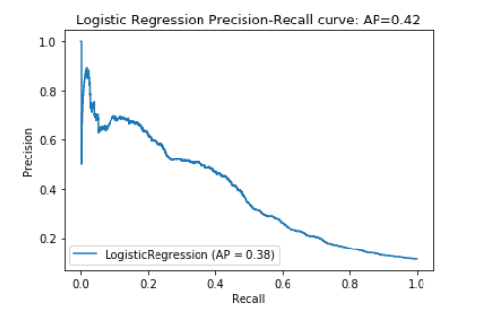
Logistic Regression: Precision-Recall Curve

Slide 22
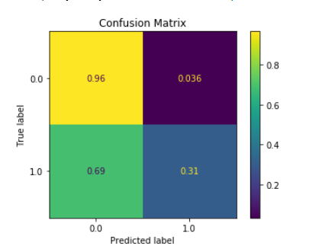
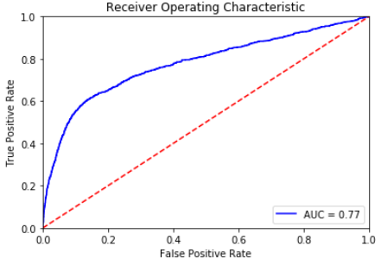
Gradient Boosting Classifier
Hyperparameter Tuning: grid search with 5 fold cross validation

Slide 23
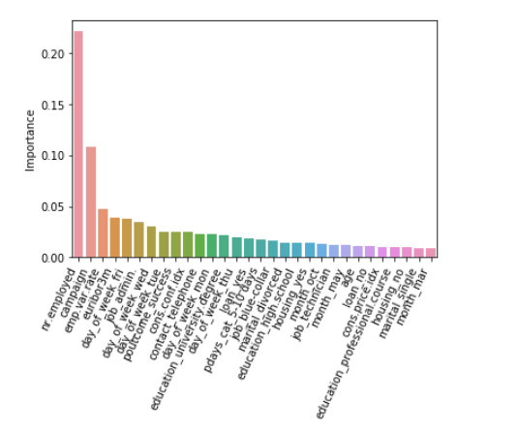
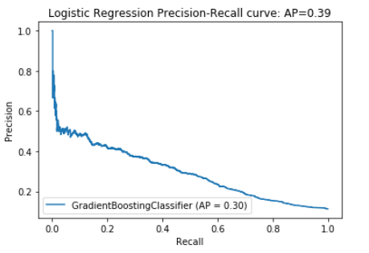
Gradient Boosting

Slide 24
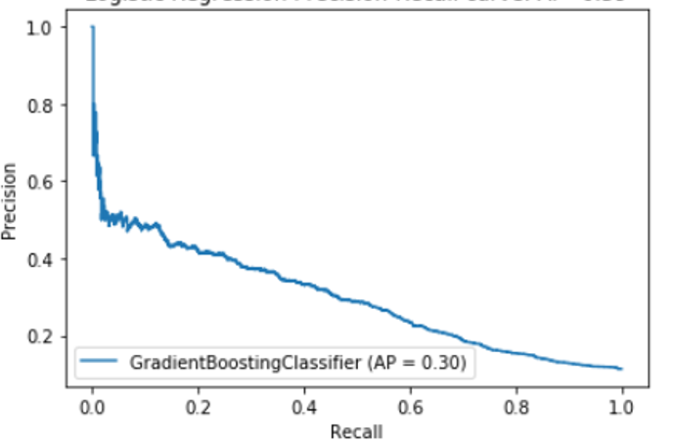
Gradient Boosting: Precision-Recall Curve

Slide 25
Model Comparision
 | ACCURACY SCORE | ROC AUC | AP
Random Forest | 0.88 | 0.78 | 0.39
Logistic Regression | 0.81 | 0.77 | 0.42
Gradient Boosting | 0.89 | 0.77 | 0.39

Slide 26
Recommendation
WHEN: Generally, when the economic is down, and the employment rate is low, people are more likely to subscribe the term. The bank should invest more on this direct phone call campaign during this time.
WHO: When considering segmenting clients, clients with higher education degree are more likely to subscribe.
HOW: As for the calling strategy, making multiple phone calls to a same client can help to increase the possibility of subscription.

