Slide 1
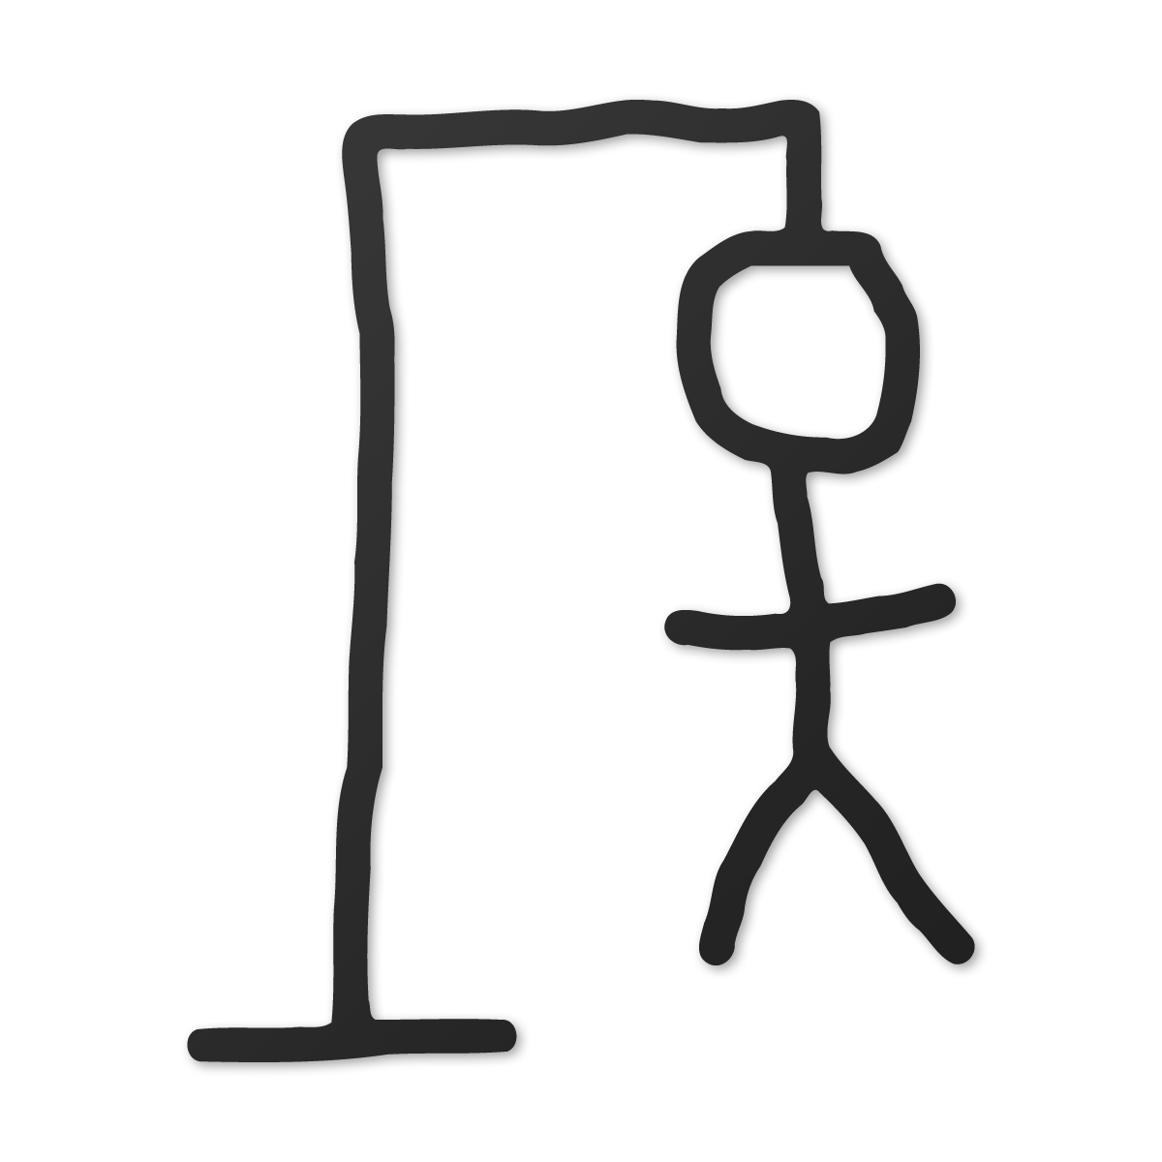
HangMan
Michael Sim
Stanley wang

Slide 2
User
General Requirements:
- Input – difficulty selection, number of hints, letter to guess, use hint, game mode, etc.
- Output – “display” the word, display the hint(s), hangman visuals, etc.

Slide 3
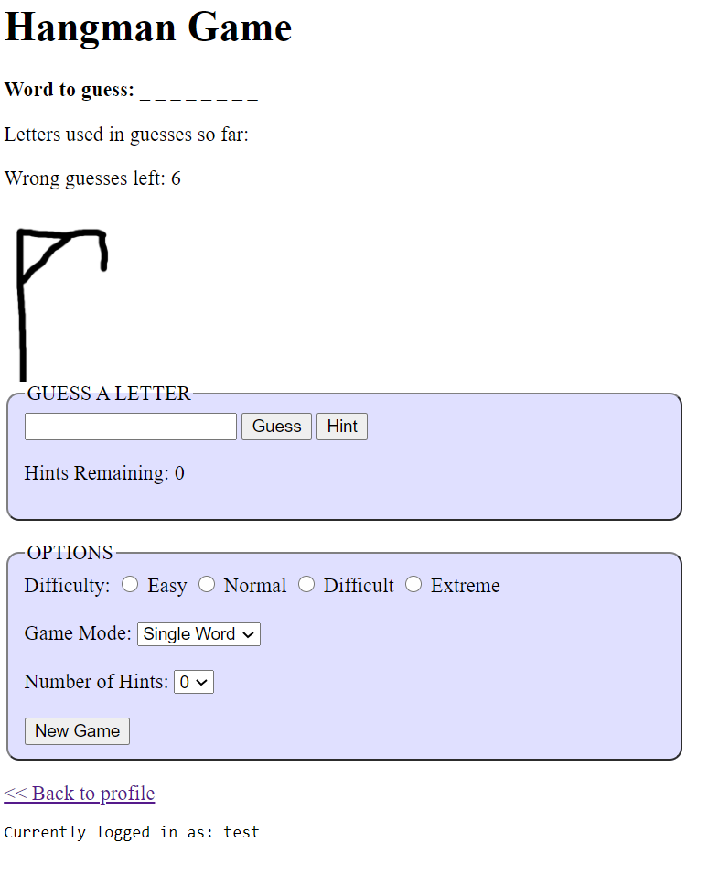
Design
Simple, compact and user-friendly interface. Top section of the game contains information correlating to the game (word, letters guessed, amount of incorrect guesses, visuals). Mid section contains area to guess letters/ask for hints. After any guess is made, it will update the visuals for the game. Bottom section displays option to create a different game, escape to profile, and who is currently logged in.

Slide 4
Testing
Our approach to testing for bugs was to make sure there were many checks in the UI that would prevent any bugs such as only allowing guesses to handle alphabetical inputs, only allowing for 1-character inputs, only allow alphanumeric characters for account information.
In order to keep track/report bugs and prioritize which we can upload the project to GitHub and all users can test and report any bugs in the issues tab. All game-breaking bugs will be prioritized.

Slide 5
Task Division
Michael Sim
Stanley Wang
Leaderboard
Implemented function to pull data from user information file and sort by wins
Login and Registration
Password protected access and stores session data
Cookies/Sessions
Saves users information and record of games
Created common functions under common.php for repetitive tasks. i.e. ( adding wins/losses, checking if users exist, and retrieving user data)
Hangman Display
Sourced images and coded display of hangman
Form processing
Created config.php for setting game parameters
Game logic
Created logic for selecting difficulties as well as game mode to generate specific words tailored to each mode
Implemented the hints feature and logic behind randomized hints
Created template for displaying single word and phrase information
Created UML diagram
Included logic for previous guesses as well as limited input to alphabet characters

Slide 6
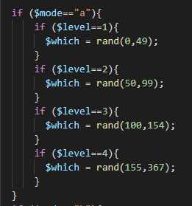
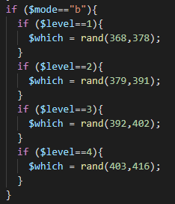

Difficulty and Game Mode
The word list exists in a single file with various partitions of the list existing at different lines.
The difficulty of the word is determined by selecting a random value within these ranges.
An additional game mode including phrases was included here
Game difficulty for single words were gathered from online sources

Slide 7
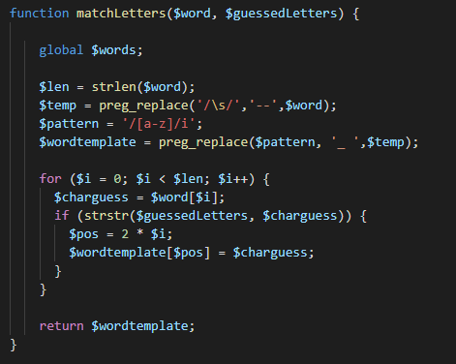
Game Logic
During gameplay, each additional guessed letter will be cross-referenced with the selected word.
A regular expression search and replace is utilized to display the word in an unknown format. i.e. { _ _ _ _ _ } for the player to guess. This is known as $wordtemplate
Matched letters will then be updated for players to make additional moves.
{ H _ L L _ } ex. HELLO

Slide 8
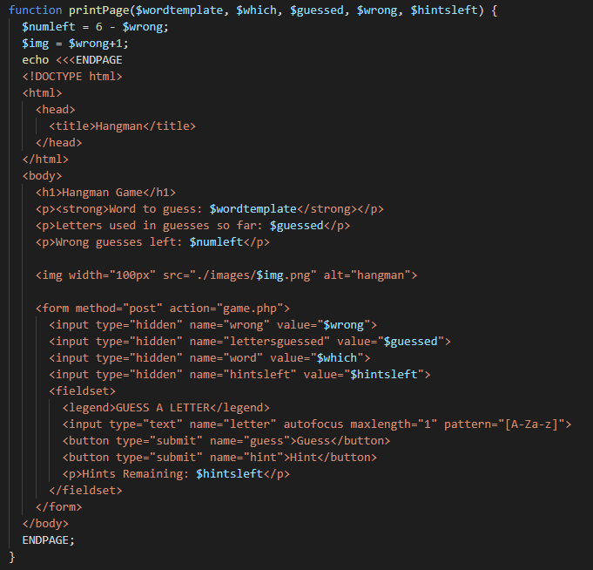
Print Page
The $wordtemplate will be printed on each page as well as the number of hints left, the letters guessed, and the current hangman image.
There are hidden form values passed along that last the duration of the round.
Once the round is completed, different win and lose game scenarios are printed for the user.

Slide 9
Project planning scrum framework
SCRUM is a framework that gives general ideas of how a project should be completed. It is very common in software development as a type of project management tool.
Key factors
Task Assignment
Modular software design
Testing and Update
Deliverables
Sprint

Slide 10
Hangman UI
Config PHP
New Game
Gameplay
printPage()
difficulty() – int gamemode() – str numhints() – int
selectLibrary() - .txt
start()
playerHint()
playerGuess()
matchLetters()
printPage()
$wordtemplate – string
$hintsleft - int
$wrong – int
$lettersguessed – string
$which – int
Login
registerUser()
loginUser()
playerHint()
playerGuess()
matchLetters()
$words – string array
$lettersguessed – char array
$hintcache – string
$hintsleft – int
$which – int
$words – string array
$lettersguessed – char array
$guess – char
$which – int
$wrong – int
$word – string
$lettersguessed – char array
$wordtemplate – string
Profile
Leaderboard
loseGame()
winGame()
userInfo()
userRecord()
allUsers()
userRecord()
Session Data
$word – string
addLoss()
$word – string
addWin()
Username – String
Password – String
Wins – Int
Losses – Int

