Slide 1


Blackjack Game
Michael Sim Stanley Wang

Slide 2
User
General Requirements:
Input – selection of card back, placing of bet, choice of hitting/staying, etc.
Output – correct card back, adjusted bank balance after game has ended, etc.

Slide 3
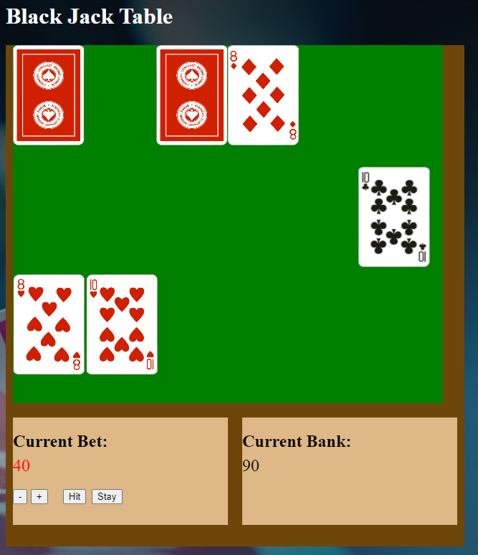
Design
This game features a user-friendly interface. The table is the main section of the page followed by the bet, hit/stay, bank directly under it. The cards currently move to their designated places by using keyframes, translations, and animations.

Slide 4
Blackjack UI
Bet
Bank
+increase() – int
+decrease() – int
+placebet() – int
+checkfunds() – bool
+subtractbet() – int
+updatebank() – int
Random Number Generator
+randomints() – int
+countcards() – int
+reshuffle() – bool
Lose Round
Win Round
Push
Convert image
+updatebank() - int
+updatebank() – int
+checkBlackjack() – bool
+updatebank() - int
+convertimage() - string
Display image
Normal Win
BlackJack
+sendimage() – string
+updatebank() – int
+updatebank() – int
+betmultipler() – bool

Slide 5
Testing
In order to test for bugs, you could run it through some tests to try and see if there are any issues with things like betting the correct amount, choosing an incorrect card back, or checking to see if all cards only show up once. To track and report these bugs, we can upload the project to GitHub where all bugs can be reported in the issues tab.

