Slide 1
Bit Sequence Compression
Swanith Upadhye
(23/04/2024)

Slide 2
Outline
Motivation
Shannon’s Source Coding theorem
Huffman Coding
Examples
Alternatives and Scope?

Slide 3
References
Matthew V. Mahoney, “Text Compression as a Test for Artificial Intelligence”, AAAI/IAA, 1999( https://api.semanticscholar.org/CorpusID:1023392)
https://en.wikipedia.org/wiki/Shannon%27s_source_coding_theorem
https://en.wikipedia.org/wiki/Huffman_coding
https://chat.openai.com/

Slide 4
Introduction
“Degree” of randomness of a sequence of bits.(Disorder)
Flip side, large compression → better info.
Especially text compressors⁽¹⁾:
  Human text-prediction tests – 1.3 bits/char
  Best algorithms 1.87 bits/char
AI Test

Slide 5
Shannon’s Source Coding
Lossless Compression
N iid random variable, each with entropy H if compressed into fewer than NH (for large N) bits guarantees loss of information.
Theoretical limit to lossless compressibility
Insight to the proof : , and
Problems arise: as discussed in class.
Incompressability → Randomness

Slide 6
RLE Technique
For a sequence:
111110000111…
Compressed:
(5) x 1, (4) x 0, (3) x 1,……
Example:code
Problems? Merits?

Slide 7
H1)Huffman Coding
Highly compressibility
How to?
  Give smallest bit seq. to most frequent character
  Prefix code to avoid overlapping messages:
Prefixing Eg: suppose a→ 0, b→ 1, c→ 01
Then 0101: either abab or abc or cab or cc.

Slide 8
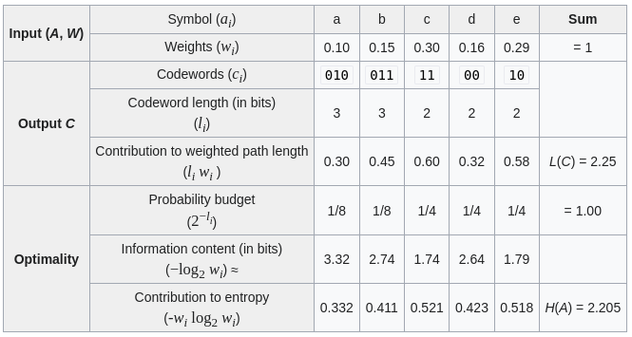
H2) Example
https://en.wikipedia.org/wiki/Huffman_coding

Slide 9
H3) Prefix tree
https://demo.tinyray.com/huffman
aaaaaaaaaabbbbbbbbbbbbbbbccccccccccccccccccccccccccccccddddddddddddddddeeeeeeeeeeeeeeeeeeeeeeeeeeeee

Slide 10
H4)Huffman Bit Seq
Problem?
https://demo.tinyray.com/huffman
How to approach? → Repeating Pattern naming maybe?

Slide 11
Closing Remarks
Compression problem → Pattern Recognition problem(AI)
  Eg: Arithmetic (N – point correlator)
Some methods - more suited to particular bit seq
Randomness dispute: Unsettled
  (Hidden patterns? Other techniques?)

