Slide 1
Development of Python based Statistical Process Control Software
Presented By
Shivranjan Kolvankar
M.Sc. Instrumentation (University of Pune)

Slide 2
What is SPC?
A Statistical Process Control(SPC), is technique which involves comparing the output of the process or a service with a standard and taking remedial actions in case discrepancy between the two.
A process quality is a true measure of ability of process to produce quality product.
The measurement of this quality is proper function of Quality Control and SPC.

Slide 3
SPC – Why & Where
To maintain the quality of the product as well as the manufacturing process.
Almost everywhere…
I work with development of SPC for Automotive gauge check Industry.

Slide 4
Computerized SPC
Benefits –
Error Free Calculations
Data Storage
Widespread Data Access
Faster Computation
Timed data Collection

Slide 5
Investments
Planning Time
Training
Cultural Change
Hardware Purchase
Software Purchase

Slide 6
Checklist of Computerized SPC
Capability Studies
Appropriate Charts
Logs Assignable Causes
Logs Corrective Actions
Speed of Execution
User Friendly
Help Screens
Support

Slide 7
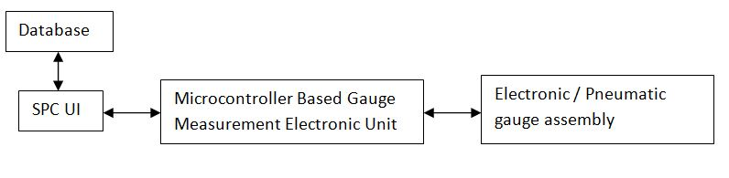
BLOCK DIAGRAM

Slide 8
CONTROL CHARTS
To Control the Quality we use Control Charts
Always visual inspection is good… Really Good
There are control limits
Control Limits
Specification Limits

Slide 9
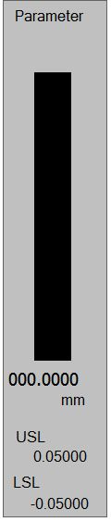
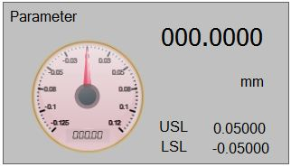
Some ScreenShots

Slide 10
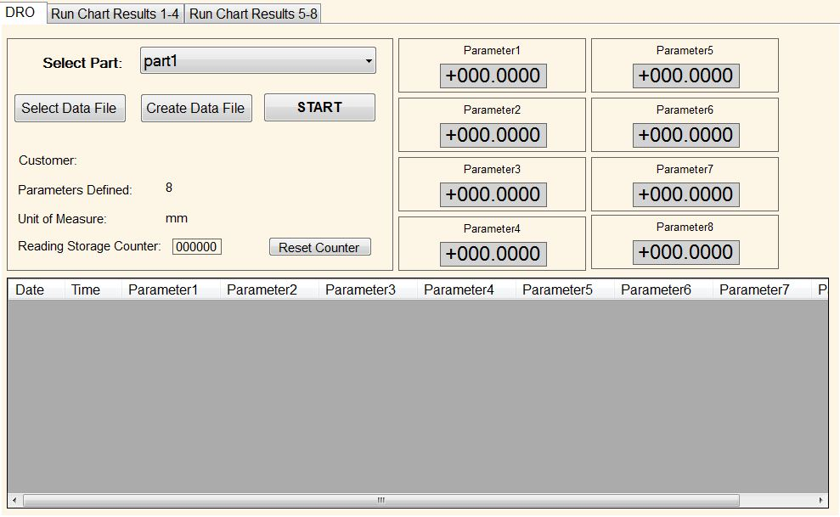
Few More

Slide 11
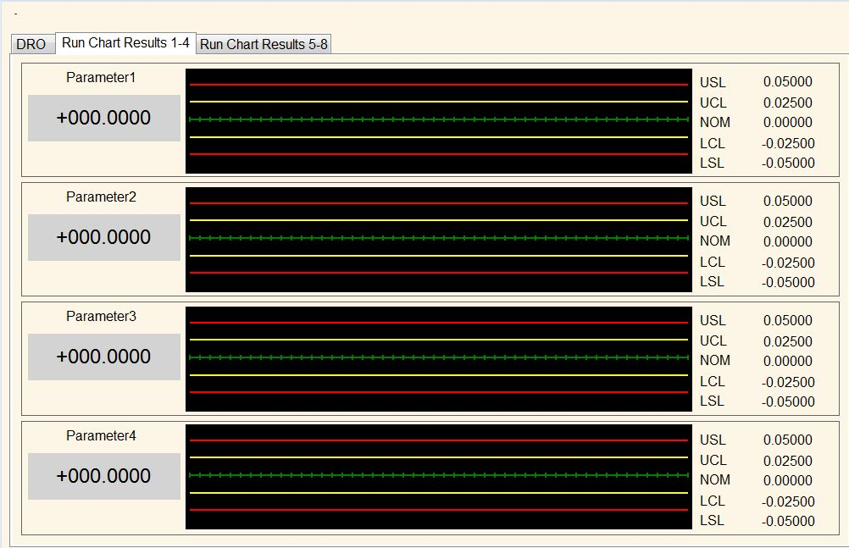

Slide 12
System I work with
Everything is developed using
Visual Basic
.NET 2.0
MS-Access 2000
COST is a BIG problem.

Slide 13
Current System :
VB.NET + Visual Studio + MS-OFFICE
WIN CE 6.0
Problems I faced :
Cost + Cost + Cost = More Cost
Not affordable for Small Scale Industries
Setting up development platform is a difficult task
Code traceability

Slide 14
What if I am able to design a SPC using Open Source Tools ?

Slide 15
What Next ?
No idea as what tool to be used…
Thought about it only 15 days ago when I actually submit the abstract…
Searched on web… Found “matplotlib”
But, don’t know how to use it…

Slide 16
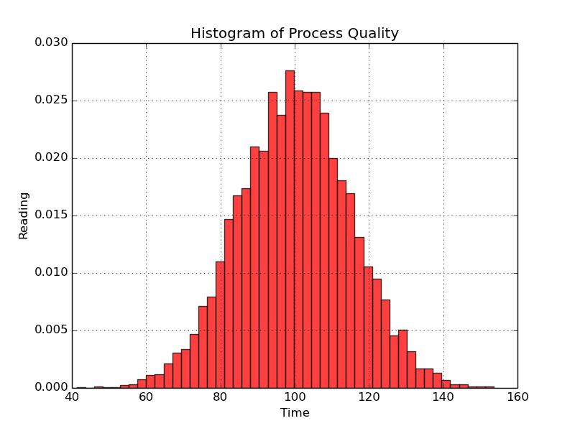
From Last two days
Histogram
Not to scale
Not dynamic, only some predefined values

Slide 17
What next?
Next task is to make it work with microcontroller… more dynamically
Implement Graphics ?

Slide 18
Suggestions…!!! Your Views!!! Any other tools…

