Slide 1
谭雅公众号

Slide 2
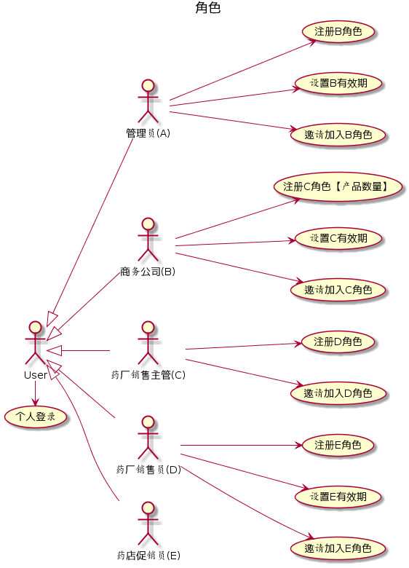
各角色生命周期
http://www.plantuml.com/plantuml/uml/TP91Ji9058RtSugtR1UzG6CCdMcFu068L6s2a9GnRbnK32X41PH6JKYKXS4OKumk92NeOUXhooq4Yyqq3Ri_xvl__rychr3ZHPiV7PO9jtZPX7Xq4xS-22cRUnnu5Mnh_u13oRBDNMvLAuIeaJUCkatitKkQ32eKQw0H5TqcjeVOUCFEHABhEILgV3N6w_gYxs3V2oRJfLTYQygoT1Meotz4JuX_5_oShU2I66kJGNPgfWtADaZ1v3Nm_UXXYZDNJiPR9ue2cg2fe9cWTK4RH0EbL3skAAlKyFC5cvSq-GOvWsBlEvfvD1oqGlSY73ncwQBknEClR3zXupcrqrmoIz3SwGR-26zFG_TzSTwPEpqP2CsLCQ6CRYXZ_sKiLwPdKTwRFj1pNaD4sQqCOIjzGt9gBvYLqlAyVW40

Slide 3
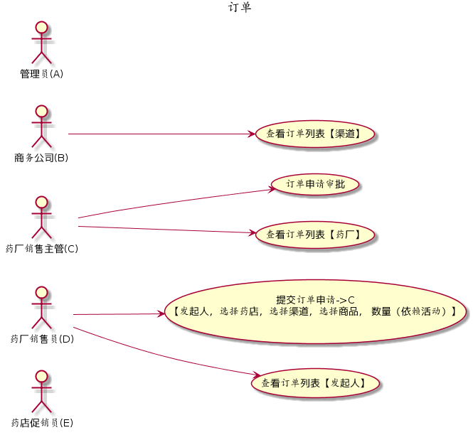
订单
http://www.plantuml.com/plantuml/uml/XL5DJi905DxFAMPP5hr05mGetC8DaQfDi2GmnctHYFo8fQ4L5ngjqGGJKqoKK4kZXw4pdQvw1TjEWtMZo-_dVU-RUQKEghVHqM4J81ar9KZj1pms0MXAUmYY5cpB-mS8DkIsj8labWA0GCSBxCxyhzFGKB5-pTKAK83r3gmnwV8auGqxaQg5LAd-Ldnd7TWM9sPp8X2msSD32v-zOCtXAXbV0K9i2oQz9AcSaMK0G0NoZTQnmlD5o96xf-1cn4hZ_enQyuqw8Svzs9rkLBq0n9oNkGBZZIvMsBR8u8FfVsQnucbMDU_L9hxxc4_aYoBSKU89hEbqkV9TD_8kGdL0Hi_inxQGrTl2vF7JRWmXCL_3Soto-lxdBLrUaVSr7iuZRy2s_zFqPszgBqbA8xxgDm00

Slide 4
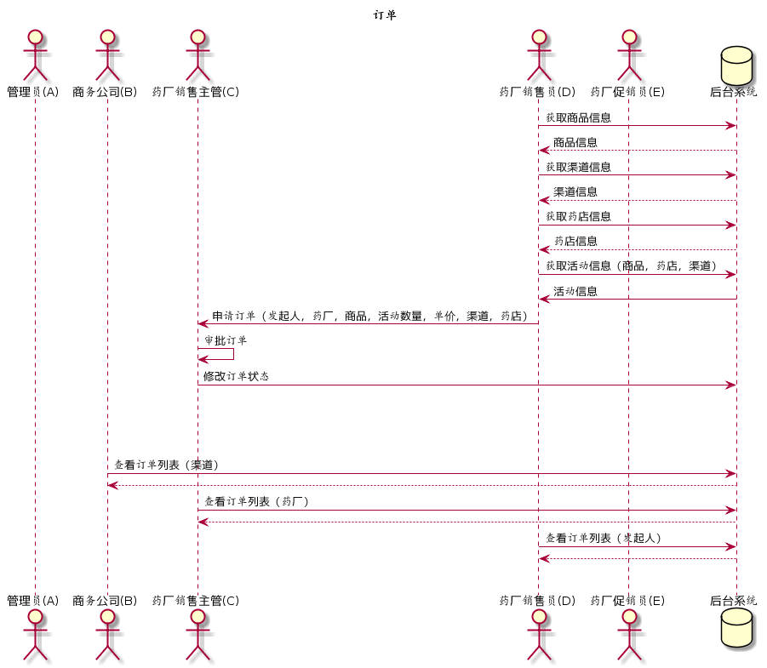
订单
http://www.plantuml.com/plantuml/uml/VTFDQkf050Vm_Jp5uCgx4BmVT-D2l1zza2IJHS5MYEdEXR7Kggs9ObAxADWK2YvA56mRQmHV9fF4bQ_G6Kym3BHT18Opl_cVCmcfr7L9qyzEgaW_rgigJhm7sdSGGfAYrpISI_epQhR2pVdMRjBXRVxeMmvBTQpYcaPK3Vyk5aN9cUrn-HyaIUMlZsMu36BFpVy3hE1K_ymqTTgqvzAB9sejyt_1oIdxaJ6M4W_QlF4VC59glZE3YAHBibHNCHsOr9h7Yo0E9bmHEMD5H0fb8fTmOlhKkk6DHqQuSIDZXeXSO7ibeIReQ7c_DKQY5cg2vgzWDHQrM1EodmFQcyBERjs18NRhQpZ15j1ej-xoB1Q5inEGfPHmR2-IcG_VbuTOm-J53rUhDCTiiSKX6Sv7pdnxQV5wtma3FskKjUuYPPzEFJVgla4wKc3uSED5TbgBUwzHqq2DHkFmoA2YoMDyTmMATiQ9EsNJ2HSgb6MaV85X_0DM4FaCY_TEFTbFKr5F2ViDtW40

Slide 5
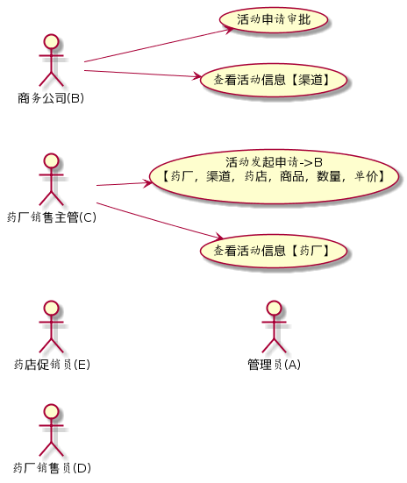
活动(2B)
http://www.plantuml.com/plantuml/uml/SoWkIImgAStDuSf9JIjHACbNACfCpoXHICaiIaqkoSpFu-AoUj6x_kckwK_sDx-Sql1quWmDLqq5AuN4OWLNY5HV4qXyoZgGb8icMCO5LUR9ZjtFrotKS8RgS-QoUZgrxMdNmgUjQvxsxz1mWeexSLa1bJsVq0OooH4gwCZ5vQIWcv9VdgThfw3nRClkfrqhda_P_6BzzgVh5ZxhtAc98Zr_wVCvtH15J_OlVDQu_d73X6Sx5hnidFouOQ8cbpEwIK_x9xxOkXrYdgwTKqmUK3t4vU_tz40q0XcG000oGCwUt0YIchhXPNi_IAHtwfFTso66utC7t5omKeVKl1HWc0C0

Slide 6
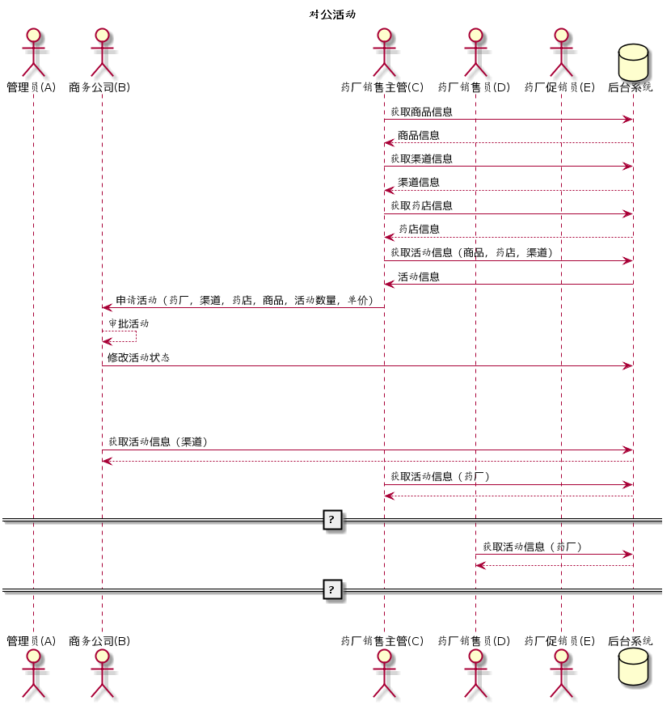
活动(2B)
http://www.plantuml.com/plantuml/uml/ZTFDJi9040Vm-px5XXCUck275v8YVlWWtMuF9YX9gJSEL2CA4OgXg3VjpODfIJ02beINwRPmuXNSTHhg9ePu827Jt_ndkfkMQvPcMfVd5MITMHK3is3ARjxZZv2rtn12ccvLJPnRT0BMlOhcrqktmHwUywTREQpLi86h9ZLCl5yeo58mrnVo12HDvTxVCfg4YU_bZm7hEDMxcMQ39cjxV3NcJF97u4ZATZB6Kv9UKmm-1AEbPfiRH3LB8rhDmApNPSum6OL9-28K9Hah85qfKLB4Y-wOEOzYSD-Evbvi1uWIHIdfHQacwNZokhJxifPgaXP7yFKaQwacQRWKUBAQtS4IgzazTF0_C6WrQ_4i4OMX8ylYKOaxMWHZUC13u1Aotbzfwtp0yM2ul7L4lJE8mh6OGfIVIEPxSMiA2X7OE9hxiPlMalPdtB1HlLvV_yY6zvBUWW_OS0ZP_YdMaQeUg2gY_s-XQOjOgsnSKFufV0C0

Slide 7
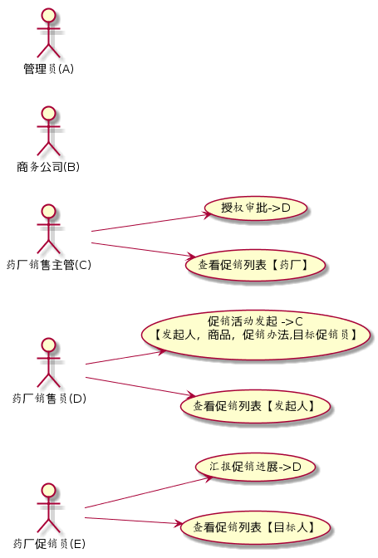
促销(2C)
http://www.plantuml.com/plantuml/uml/SoWkIImgAStDuSf9JIjHACbNACfCpoXHICaiIaqkoSpFu-AoUj6x_cbVqvFzpI-dD3oTE4F3LLF1IY6nMC4L9WKIdx8E9EMY2PPnGPLvicFtytKBDPoX-fovh9vERNlQjV1fwvgd_JiqdA3YJbnMG6NF9xI1J7A42ZfoSJahwARab-VfsYbeFElhU3Qt-UcwXSywT-hQkMYYoCrV-dnEDzIP7TDVB5pnk642n1cF6oPgShaWb48KFTko-sdNYgVz4rzitQwWQ-SSawS0r07XFzcrw_sU7f0p9pS26L1Jk-OzspnLv_diTSyMjCF30s8uVdSWJ0MhTaLIlR7zMTTIYEeN-sS_tJWLx2zN0kP1t00ppo4rBmKOXm00

Slide 8
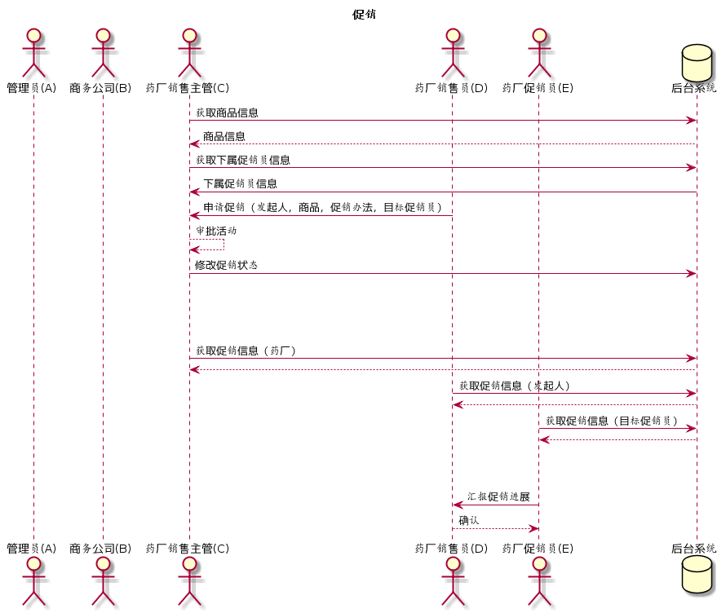
促销(2C)
http://www.plantuml.com/plantuml/uml/VTBBJkf060Vm_Jp5X1LdGSAvd4qN12y-IDlfmWGbANN70ZI2LAKGYp4XGPjeui8K2IgNalHbEZDrnIiumzJ1nikYIJlp-xxlFssB5KirhOEz4h1shP81e_3erQq105JTAfim4vyFSVjGhEBkLNRdLmQg5MZ0ieaC4_xFvzEICzVdSbj8bCX_Nyje6b3Vosu9hCD4_rrht6jWsyF73zYPPZU5qnBsPyrO5zffyC4RmgY9-SqCGAgbQch5WBZJniuZ7GSqkEOAQP8nf-SAI5DWt9vWvv8FlgX7eKVgGu2qNAwWAwcrb8wcftWqa2zAbl4g-CtcQe-wutWu4NlBnGbskl7p99hFbuipCOtT99NsW8nxx97sVNBJbEsMYnRBicg6VO-qPkGfmFRzUxuez8ax4vhQBwHM1zLgLLwfKmWbyh4mualn_kBy07t4Oep4Chdq21W_-C-d45M6ZCQh5KX6JMBV2HU7VJpg0SIPGZq_zcz1qTX7x0T-0m00

Slide 9
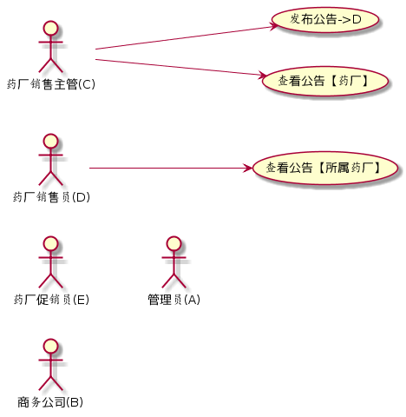
公告
http://www.plantuml.com/plantuml/uml/SoWkIImgAStDuSf9JIjHACbNACfCpoXHICaiIaqkoSpFu-AoUj6x_cbVqvFzpI-dD3oTE4F3LLF1IY6nMC4L9WKIdx8E9EMY2PPnGPLvicFtytKBDPoX-fovh9vERNlQjV1fwvgd_JiqdA3YJbnMG6NF9xI1J7A42ZfoSJahwARab-VfwjefQ3pjd_XqHpD8uyGkNJiNJHJ9P_ENFf_J3P5yt301ueJ73HCrkLnmgthMsV1qupmajGwfUId00040

Slide 10
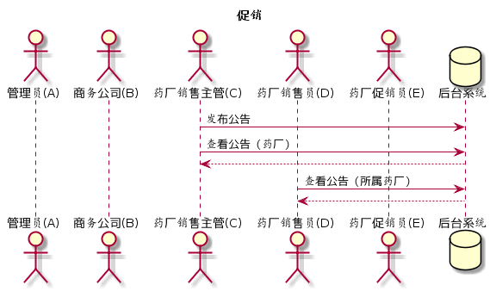
公告
http://www.plantuml.com/plantuml/uml/SoWkIImgAStDuIh9BCb9LNYol_dbb0OkBgx4v9By8WMb5xthd_OrGKIVJfoXuQgff91Oh92ga5-KabgaO6fWWAeIf6pAEf1A5uZA5AXA4-mgd-pO_NpTGWrdYE9a1QXgOuJgfrFRddOjVDgwvcd_3WqdYBeag38ZX3AWASydj84iTeIeIOIgCGIguKf9B4bCIYnELNWweUzf_uRdctS_tpqVxBmak3AWkcHTkvGaAuMd_HEVxcW6MJcn2oRsRFxIvtEw8MBlztH0_F1-JoTNIfAkhbqoLmfMPSyw6vvkd8UcE8NB8JKl1HZc0000

Slide 11
统计
E->D 促销进展
调用商务公司(B) IT接口 <依赖商务公司实现>

Slide 12
额外说明
活动 需要起始结束时间
发起申请 管理员控制权限

Slide 13
问题
D是否需要有效期设置
对公活动 由C发起 是否对所有下属D都可见

