Slide 1



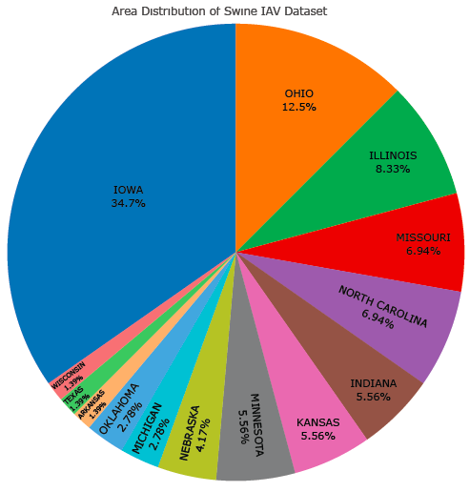
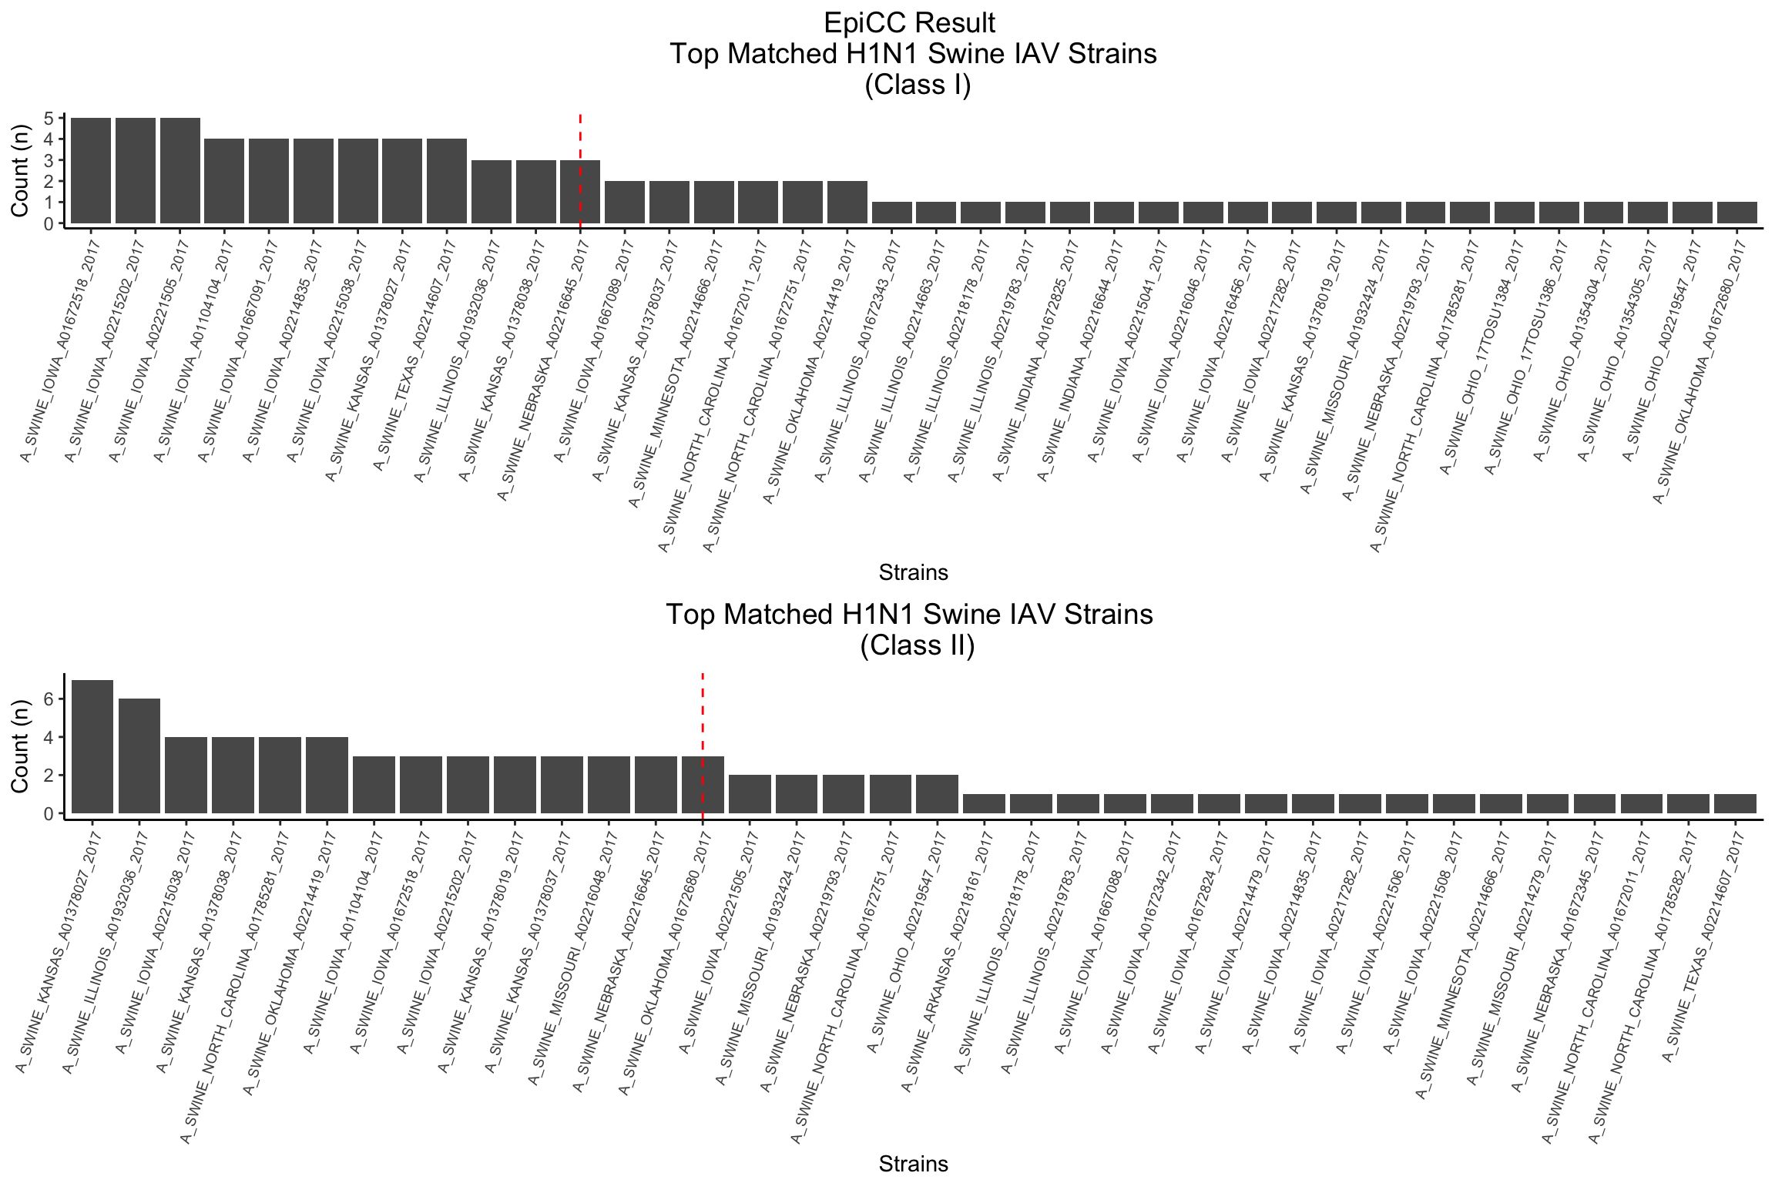
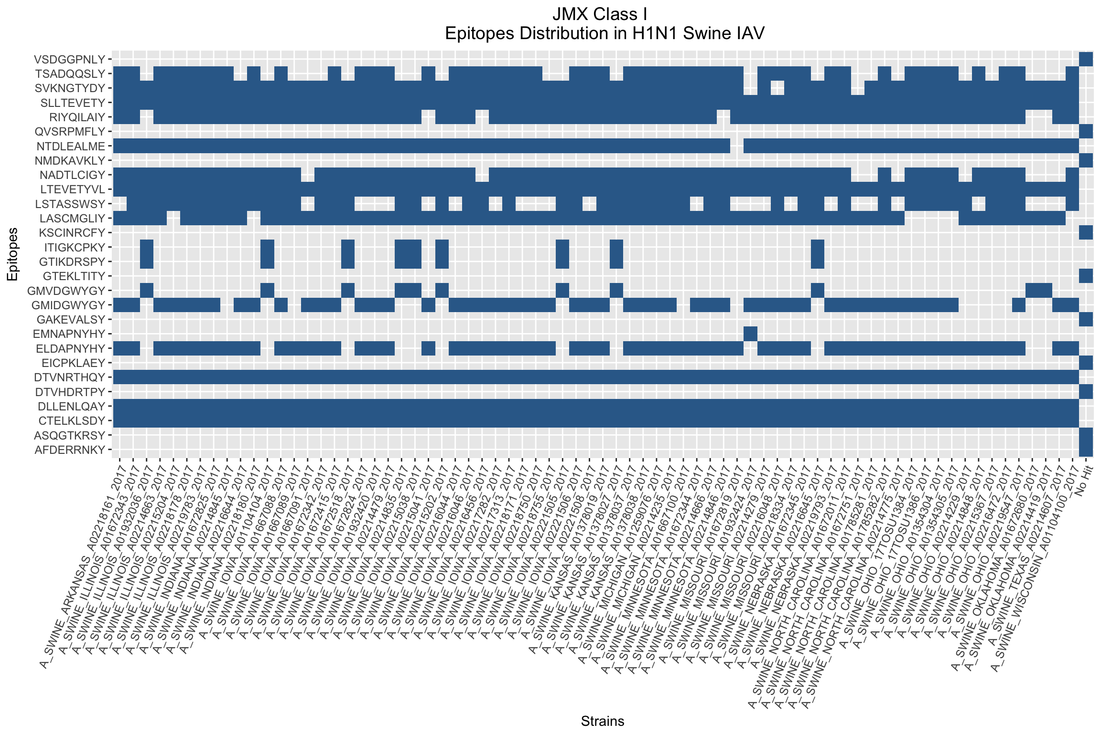
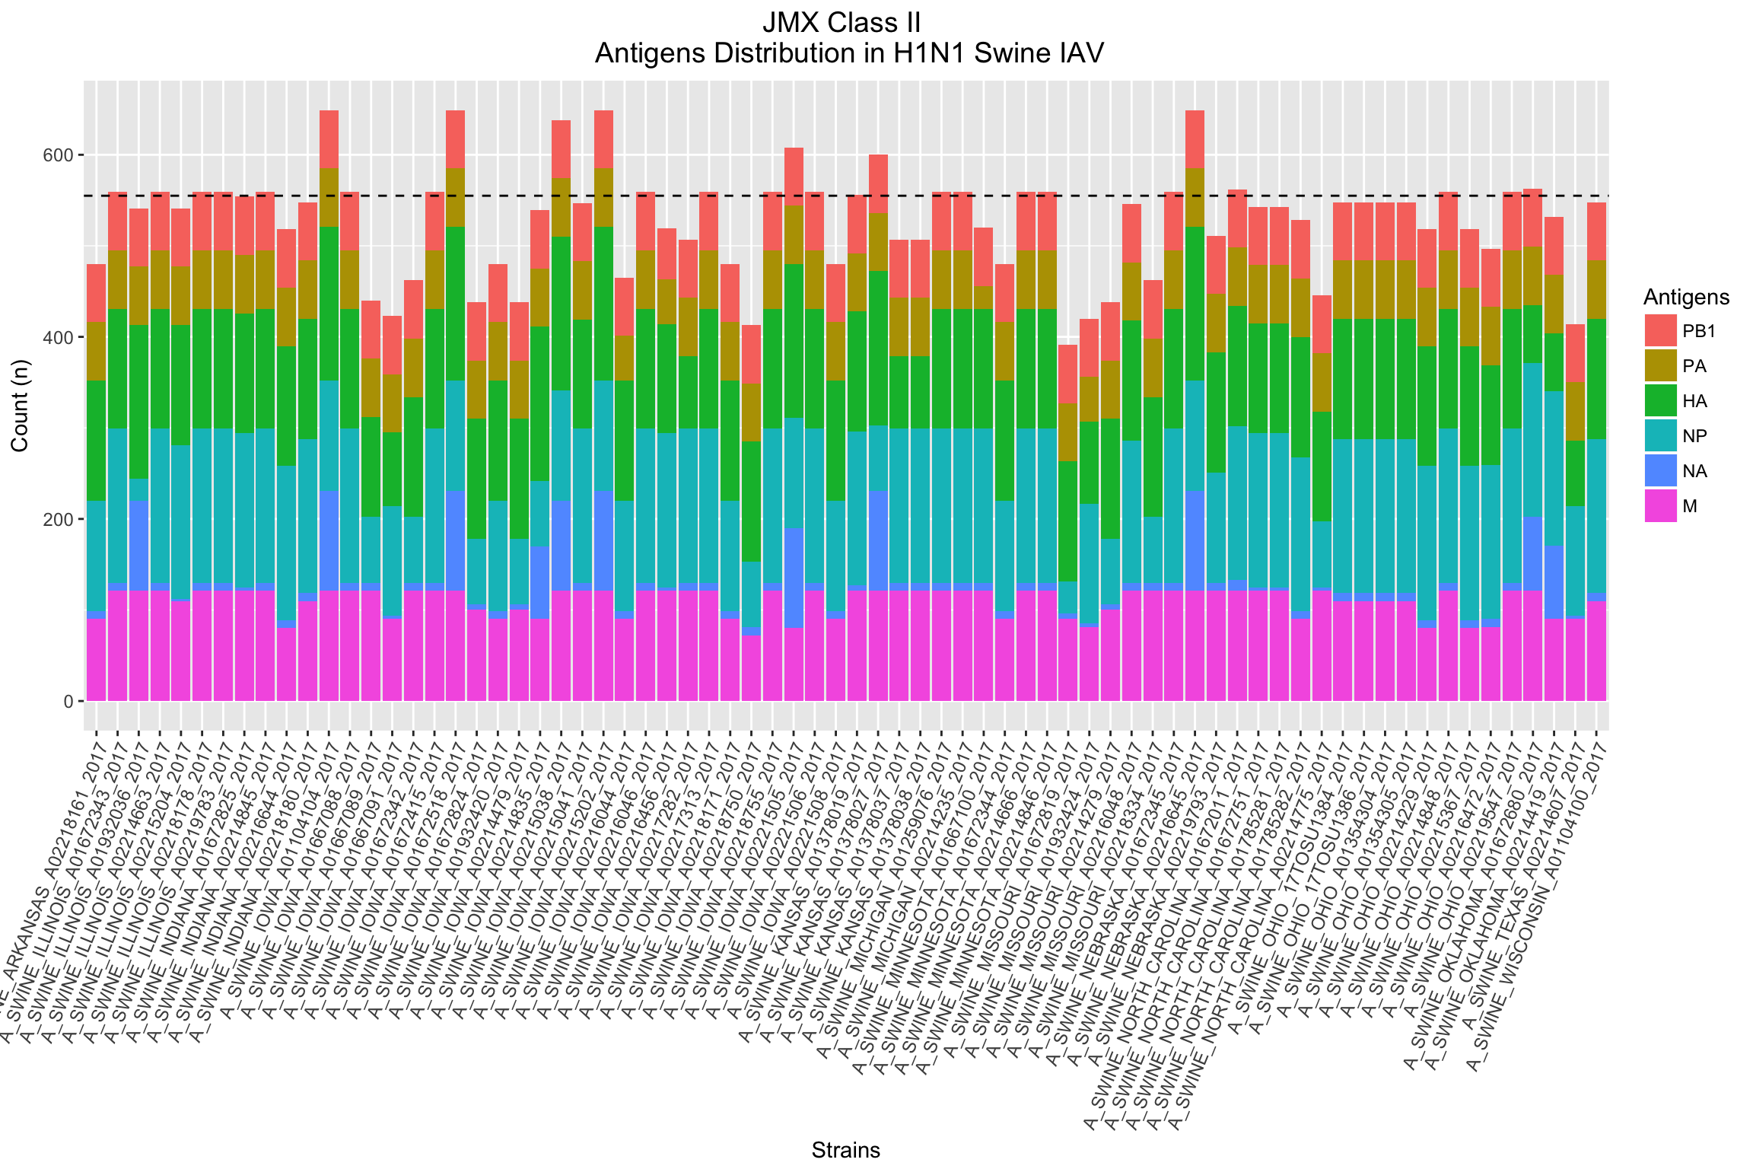
Swine Influenza A Virus (IAV) Epitope Analysis
Swan Tan¹, Leonard Moise^{1,2}, Anne S. De Groot^{1,2}
¹Institute for Immunology and Informatics, University of Rhode Island. ²EpiVax,Inc., Providence, RI.
Correspondence: Dr.Annie.DeGroot@gmail.com
Abstract
Results
Background: Predicting vaccine efficacy against emerging or circulating pathogen strains is a significant problem in human as well as animal vaccine design. T cell epitope cross-conservation may play an important role in cross-strain vaccine efficacy [1]. In order to evaluate vaccine efficacy, animal has to be challenged with a virus strain so that it can trigger the test vaccine to confer protective immune responses. To define the criteria in selection for a challenge strain, it has to obtain maximum coverage in term of epitopes identity as well as epitope content, using previously published swine DNA vaccine as the reference. In this study, we aim to shortlist H1N1 influenza A virus (IAV) sequences and identify candidates for the challenge strain.
Methodology: There are two approaches to achieving the goal: 1.) by comparing T cell epitope content using Epitope Content Comparison (EpiCC); 2.) by screening based on epitope scored matrices, JanusMatrix (JMX) to find exact epitope sequence match. A brief explanation about these web-based immunoinformatics tools. EpiCC facilitates pairwise comparison of protein sequences based on immunological property, i.e. T cell epitope content, rather than sequence identity, and evaluated its ability to classify swine IAV strain relatedness to estimate cross-protective potential of a vaccine strain [1]. On the other hand, JMX incorporated a well-established method for MHC (major histocompatibility complex), in this case, will be swine leukocyte antigen (SLA) binding prediction, with a novel assessment of the potential for T cell receptor (TCR) binding based on similarity with self [2]. In this case, we are looking for identical epitope sequences compared to swine DNA vaccine. EpiCC will only be able to compute how much relatedness (EpiCC score) in terms of epitope content but not be able to present what are the epitope sequences, and JMX does.
Results: Analyses were carried on both SLA Class I and Class II via two approaches respectively and final results from both means were combined to obtain shortlisted candidates for challenge strain.
Conclusion: A total of 6 shortlisted candidates (A/SWINE/KANSAS/A01378027/2017, A_SWINE/IOWA/A02215038/2017, A/SWINE/IOWA/A01104104/2017, A/SWINE/IOWA/A01672518/2017, A/SWINE/IOWA/A02215202/2017, A/SWINE/NEBRASKA/A02216645/2017) being identified. 4 of them were from IOWA and other two were Kansas and Nebraska. These strains can potentially be considered as challenge strain.
Figure 2 | Exploratory analysis on H1N1 swine IAV geographical distribution. The pie chart shows area distribution of swine IAV dataset. More than 30% of swine IAV strains are from Iowa. Second abundance being OHIO, followed by Illinois, Missouri and North Carolina.
Figure 3 | Strains that are found in the top 10 list of every proteins and their frequencies were counted. This is to identify strains that are constantly having top EpiCC score across the whole genome. A reference line is drawn and strains were shortlisted based on the cut off point. Strains on the left of the dotted line were selected and there were a total of 12 and 14 strains of SLA class I and II respectively. There were 8 common strains between both classes .
Figure 4 | Heat map shown presence of DNA vaccine epitopes found in H1N1 swine IAV strains. Blue spots indicate the presence of the epitope, whereas blank spots indicate the opposite. Horizontal view will tell which epitopes are conserved across the strains,
while vertical view shows the number of epitopes found in a particular IAV strain. Strains that have more than or equal 15 blue spots get selected. From here, we have 52 strains that matched the requirement.
Data processing, translating and grouping according to 8 protein segments
Score DNA vaccine sequences based on Class I and Class II SLA alleles on EpiMatrix [3]
JanusMatrix Analysis
Query: scored DNA vaccine
Database: 72 swine H1N1 sequences (for each protein)
EpiCC Analysis
Methodology
Workflow
Figure 5 | The stacked bar chart showed the total epitopes (in each antigen) found in H1N1 swine IAV strains. A reference line is drawn across
the bar plot and strains that have total frequency equal or above the reference line will be considered, and we have 28 strains in the list.
Figure 1. Analysis workflow
References
1 Gutiérrez et al., 2017. PMID: 29054116 | 2 He et al., 2013. PMID: 25104221 | 3 Moise et. al., 2015. PMID: 26155959

