Slide 1
The Beer Project
Carlos Swanton
Data Analyst

Slide 2
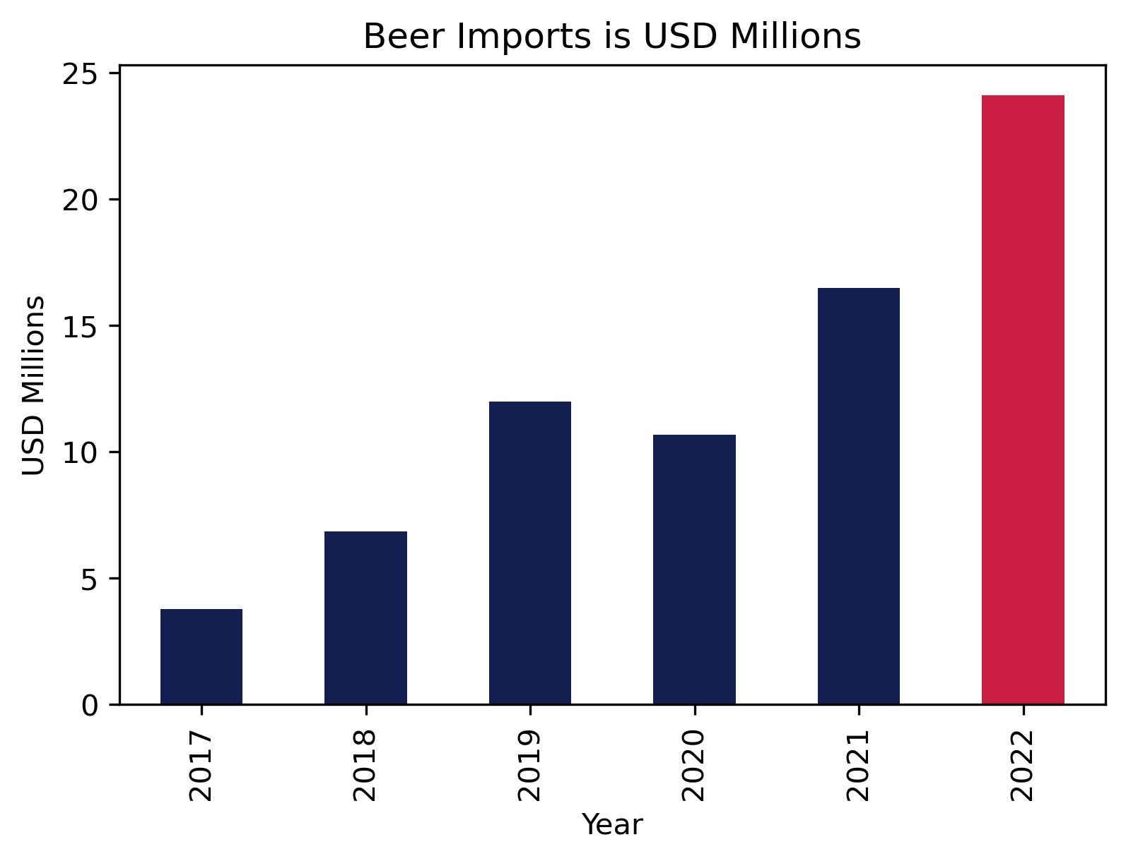
Beer imports throughout the years
From January to August, 2022 has been the year with the highest amount spent in beer imports.

Slide 3
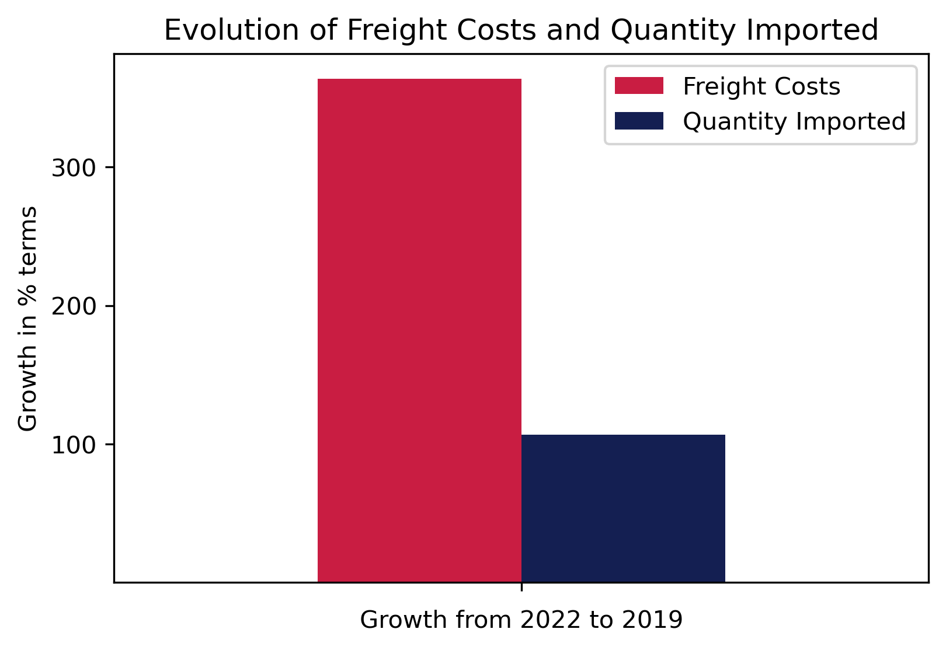
Are we importing more beer or is just that beer is getting more expensive?
- Both. Since 2019, the quantity of beer imported went up 106 percent. On the other hand, the freight costs went up 363 percent.
- That means that Ecuador has been importing beer, but it also means that shipping costs went up.

Slide 4
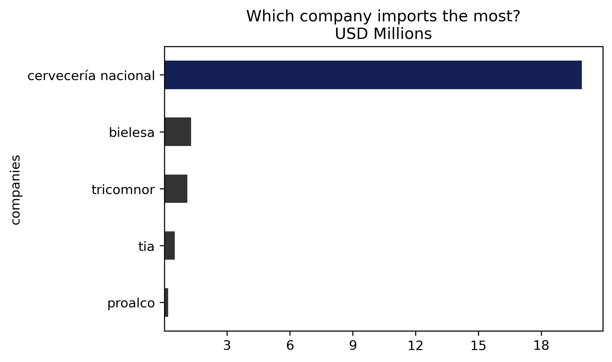
The leading companies in the beer industry
Cervecería Nacional is the leading company in beer production andbeer imports in Ecuador. During the first 8 months of 2022, they imported more than $18 millions in beers.

Slide 5
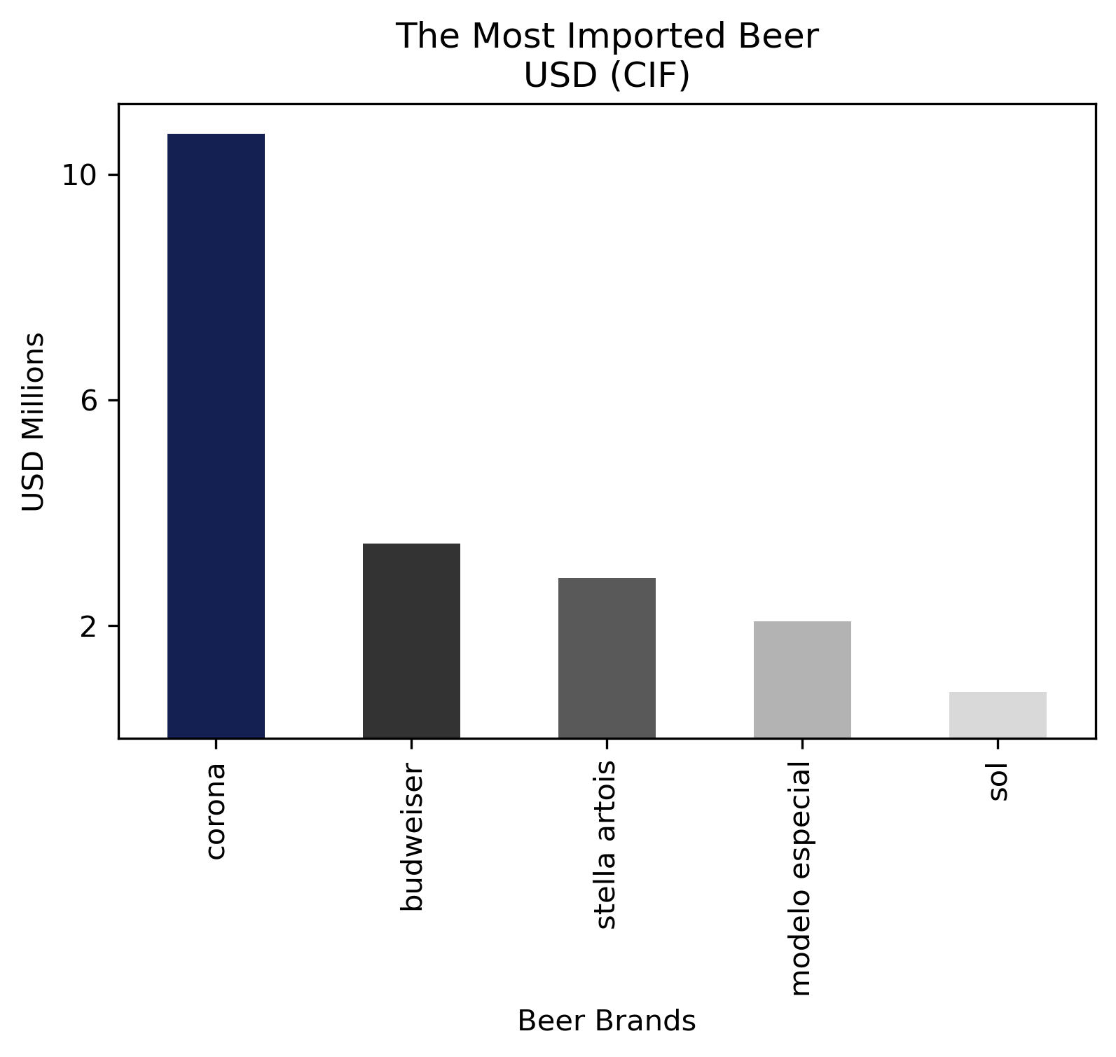
The most popular beer in Ecuador
Corona Extra is the most imported beer in Ecuador. During the first 8 months of 2022, more than $10 million of Corona beer were imported.

Slide 6
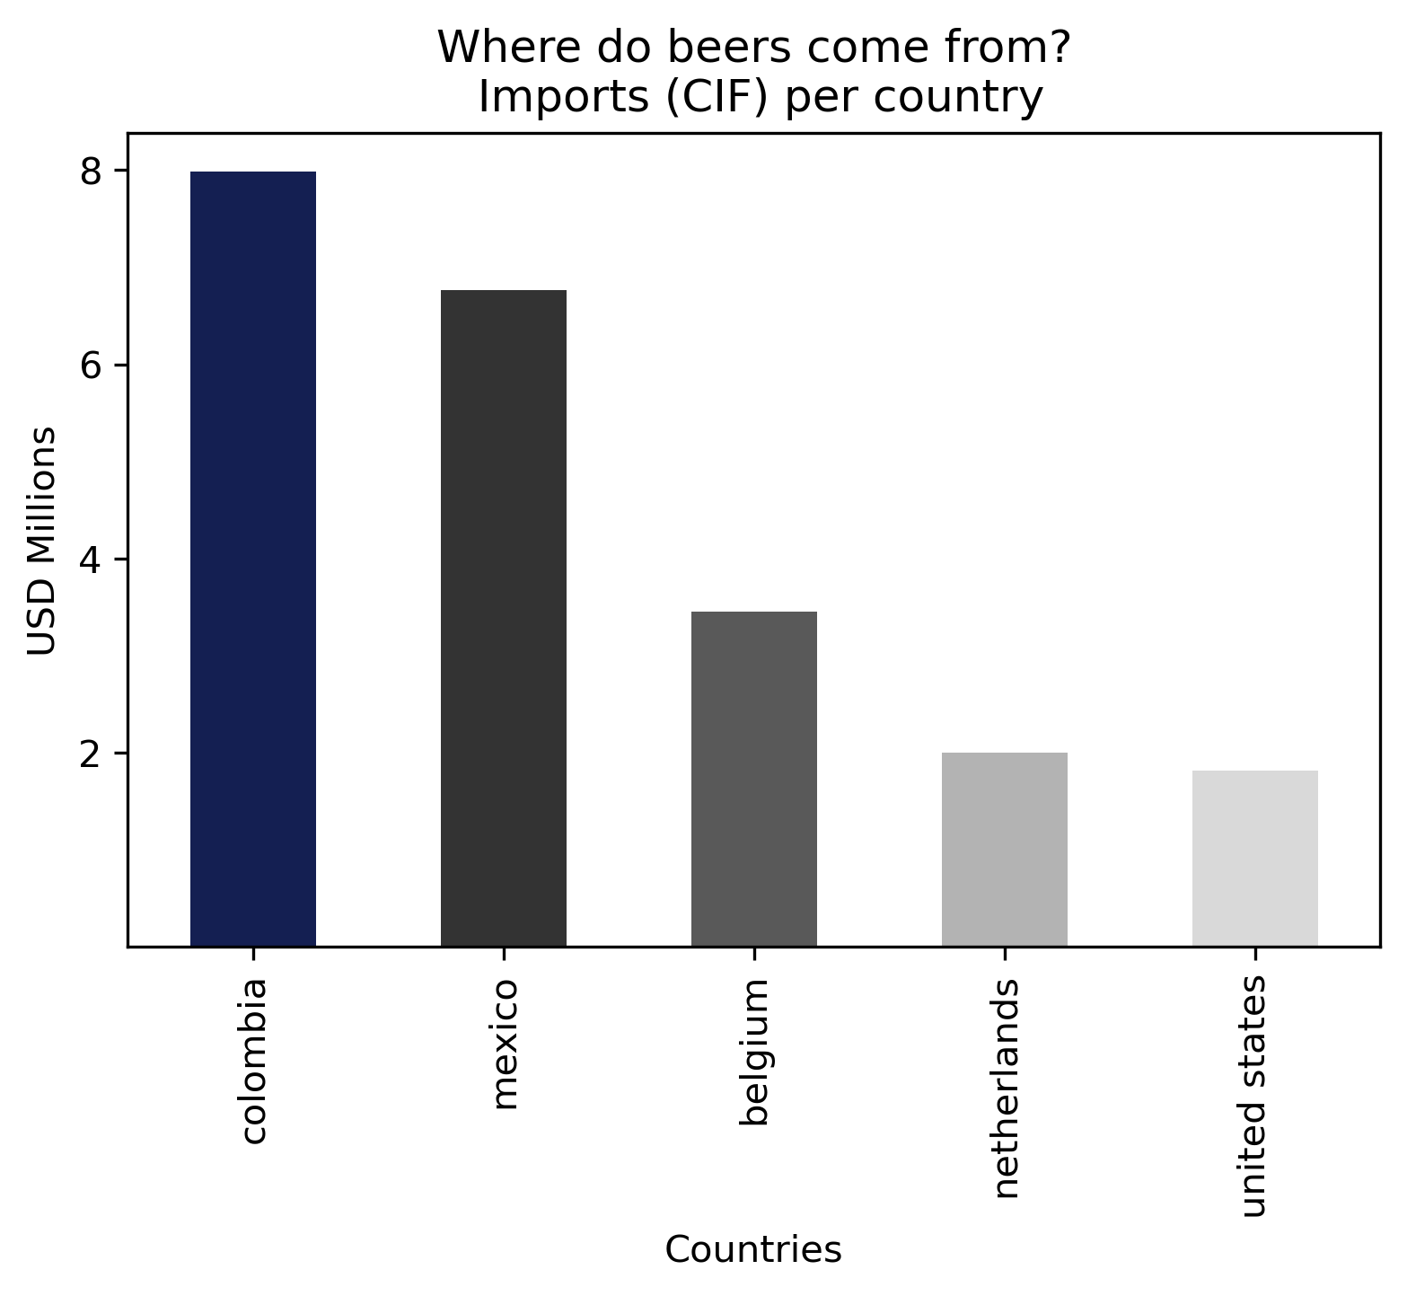
Where do beer imports come from?
In the first 8 months of 2022, beers come predominantly from Colombia and Mexico.
That is because Corona, the most imported beer, is made in Colombia and Mexico.

