Slide 1
PriaccEnterprise.AI - Project Presentation
Project Name: PriaccEnterprise.AI
Tagline: AI-powered Enterprise Platform for Smart Business Workflows
Team Name / Members (optional)
Logo / Relevant Image

Slide 2
Project Objective
Build a smart Slack-like web platform integrating:
AI Assistant (Natural Language → Action)
SAP-style business workflows (HR, Procurement, Inventory)
Live chat & workflow status tracking
Power BI dashboards
Dockerized CI/CD pipeline
Automated testing

Slide 3
System Overview
Architecture Diagram (from doc's folder, or create a simple flow diagram)
High-level components:
Frontend (React)
Backend (Spring Boot)
AI Assistant (Python + LangChain)
SAP Simulation Module
PostgreSQL Database
Power BI Dashboards
CI/CD (Docker + GitHub Actions)
Testing (Selenium, PyTest, JUnit)

Slide 4
Key Features
Real-time Chat Interface
AI-driven Command Execution
SAP Workflow Simulation (HR, Procurement, Inventory)
Business Intelligence via Power BI
Fully Dockerized Deployment
Automated UI, API, and Functional Testing

Slide 5
Module Breakdown
Frontend Developer (React.js)
Chat UI, workflow trigger forms
Real-time status updates
Backend Developer (Spring Boot)
REST APIs, WebSocket backend
AI Assistant Developer (Python + LangChain)
Natural Language to Action using FastAPI
SAP Simulation Developer
HR, Procurement, Inventory, Vendor workflows
Database Engineer (PostgreSQL)
Data schemas, logs, BI views
Power BI Developer
Workflow dashboards, AI usage analytics
QA Tester
UI/API tests using Selenium, JUnit, PyTest
DevOps Engineer
Dockerfiles, CI/CD with GitHub Actions

Slide 6
SAP Workflow Modules
HR Module: Apply Leave, View Profile
Procurement Module: Create/Cancel PO
Inventory Module: View/Update Stock
Vendor Management Module: Add/View Vendors
(Consider adding icons or simple diagrams to explain)

Slide 7
AI Assistant Capabilities
Intent recognition (6+ natural commands)
Converts chat requests to backend actions
Built using Python FastAPI + LangChain

Slide 8
Power BI Dashboards
Requests by Type/Department
Workflow Completion Times
Status Trends (Approved, Pending, Rejected)
AI Assistant Usage Statistics (Add sample screenshots if available)

Slide 9
Frontend Technologies
Built using React.js
Fully responsive, single-page dashboard layout
Modules supported: Chat, HR, Procurement, Inventory, Vendors
Integrated WebSocket for real-time communication
Clean and modern UI using only React + inline CSS
Visual: Screenshot of your full UI with sidebar + chat +
workflow

Slide 10
Core UI Features
⚙️ Key Components of the Interface
Content:
Sidebar Navigation: Switch between modules (Chat, HR, etc.)
Header Bar: Displays current module context
Workflow Trigger Panel: Buttons like Apply Leave, Create PO
Chat Window: Real-time chat with AI and workflow system
Message Input: Supports typing + Enter key + Send button

Slide 11
How Frontend Talks to Backend
🔗 Frontend-Backend Communication
Content:
WebSocket connection (ws://localhost:8080/ws)
Sends user messages
Receives AI or workflow responses
Trigger workflows like:
Apply Leave → Goes to backend → Responds back in chat
OpenAI GPT integrated via backend → Responses shown in chat UI

Slide 12
Backend Development
Why Spring Boot Web?
Simplifies creating REST APIs and web applications
Provides embedded server (Tomcat)
Easy integration with frontend
Faster development with auto-configuration
Using WebSockets
Enables real-time, bi-directional communication
Useful for chat apps, notifications, live updates
Integrated seamlessly with Spring framework
Reduced latency compared to polling

Slide 13
Architecture Overview
Controller Layer
Receives requests from frontend
Maps URLs to methods using @RestController and @RequestMapping
Calls service layer to process data
Returns responses or forwards messages
Service Layer
Contains business logic
Decouples controllers from data processing
Promotes reusability and easier testing
Example: Validation, database operations, calculations

Slide 14
Model Layer
Defines data objects (entities or DTOs)
Used to transfer data between layers
Example: User, Message, Order, etc.
Annotated with @Entity (if using JPA) or POJOs for API responses
WebSocket Implementation
Configured using @EnableWebSocket
Handles real-time message exchange
Example: Chat messages broadcast to connected clients
Spring abstracts complexity using SimpMessagingTemplate

Slide 15
Developing Custom SAP Table
Develop Application Program
4
Build a program to interact with the table.
Generate Maintenance View
3
Develop a user interface for managing table data.
Create Table
2
Implement the table structure in SAP ABAP.
Design Table Structure
1
Define the fields and data types for the custom table.

Slide 16
Automate Workflows with AI
Plain Language Request
Backend Action
Automated Workflow
Manual Workflow
AI Conversion
Inefficient, error-prone task execution
User describes desired action
AI translates text to action
System executes the requested task
Efficient, accurate task execution

Slide 17
Software components
FastAPI
Runs REST API.
Pandas, scikit-learn
LangChain + OpenAI GPT
Provides workflow insights and prediction.
Understands user intent.
VS Code, Git, Docker
PostgreSQL
Used to build, test, and deploy the application.
Stores tasks and logs.

Slide 18
Streamlined Leave Application Process
User initiates leave request
AI identifies request type
User sends message: *“Apply leave for 2 days”
LangChain + GPT classifies it → `apply_leave`
User receives leave status
Status returned to chat UI
FastAPI receives request at `/process- message`
JSON payload triggers backend SAP simulation
Backend system simulates leave
Request routed to backend

Slide 19
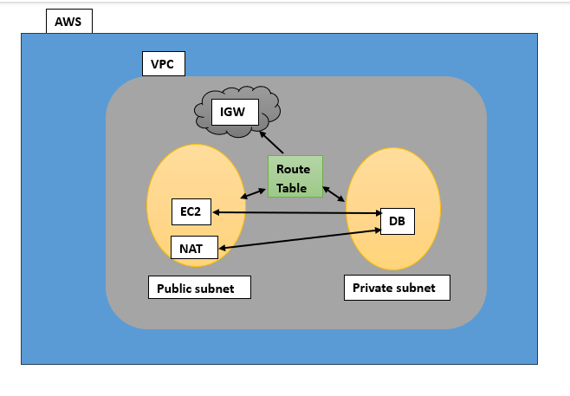
DevOps
Networking And Server Setup​
VPC & Subnets​
PUBLIC SUBNETS
Two public subnets, techtitan-1 and techtitan-2, are configured for accessible resources, allowing seamless communication while ensuring isolation within the VPC framework.​
VPC DESIGN​
The VPC, named Tech-Titan, provides a secure and robust network environment vital for application hosting, enhanceing performance and security through effective design principles.​
FIG.VPC

Slide 20
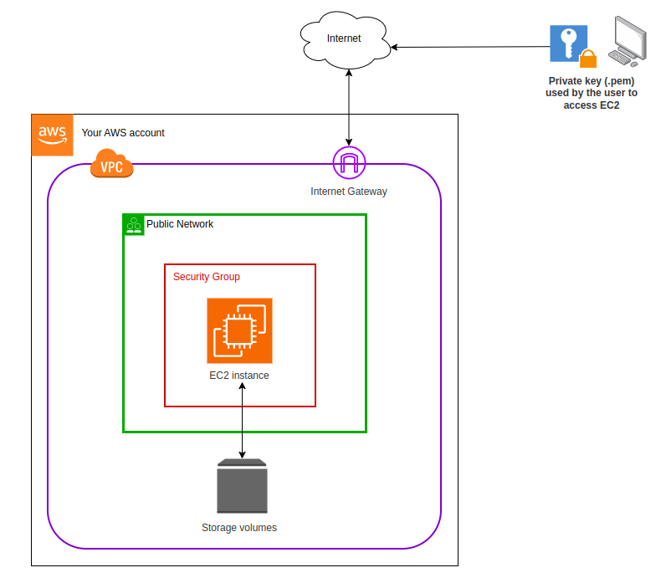
EC2 Instance Launch
LAUNCH STEPS​
To launch an EC2 instance, log into AWS, select EC2 from services, click 'Launch Instance', choose Ubuntu from Amazon Machine Images, and configure the instance settings.​
NETWORK SETTINGS​
For networking, select the VPC named Tech-Titan, and use the subnet identified as Tech-Titan-1 to ensure proper connectivity and resource allocation for your instance.​

Slide 21
Server Preparation & Security​
CONNECTION METHOD
To manage your servers, use MobaXterm for a secure connection, entering the public IP of the server.​​
SYSTEM UPDATE​
Ensure all systems are current by running necessary updates before proceeding with software installations.​
SECURITY GROUP RULES​
Set up specific inbound and outbound rules in the security group to manage network traffic effectively.​

Slide 22
System Update & Tools​
SYSTEM UPDATE COMMANDS​
To ensure your server is up-to-date and secure, use these commands: ​ - sudo apt update: Refreshes package index.​ - sudo apt upgrade –y: Installs available upgrades automatically. This maintains optimal server performance and stability.​
INSTALLING DOCKER & JAVA​
Install essential tools with the following commands: ​ - sudo apt install docker.io -y: Sets up Docker for easy container management. ​ - sudo apt install openjdk-21-jdk –y: Installs Java Development Kit for Jenkins. Both enhance CI/CD processes.​

Slide 23

Software Installation & Configuration​
JENKINS REPOSITORY​
To setup Jenkins, add the official Jenkins repository and its key for secure installation on your server. This ensures all packages are trusted.​
INSTALLATIONS​
Proceed to install Jenkins alongside Docker and JDK 21. This combination enables robust CI/CD pipelines and containerization for development.​
PERMISSIONS SETUP​
Configure permissions by granting Docker access rights to the Jenkins user. This allows Jenkins jobs to run Docker commands without issues.​

Slide 24
Configure Jenkins Repository​
ADDING JENKINS REPOSITORY​
To install Jenkins securely, first add its official repository.Execute these commands: 1. `sudo wget -O/etc/apt/keyrings/jenkins-keyring.aschttps://pkg.jenkins.io/debian-stable/jenkins.io-2023.key`.2. `echo "deb [signed-by=/etc/apt/keyrings/jenkins-keyring.asc] https://pkg.jenkins.io/debian-stable binary/ |sudo tee /etc/apt/sources.list.d/jenkins.list > /dev/null`. 3.Update with `sudo apt-get update`.​
SECURE INSTALLATION​
The keyring prevents tampering by ensuring the installedJenkins packages are authentic and maintained by the officialJenkins repository. This step is critical for securing your CI/CDpipeline.​

Slide 25
Install Jenkins & Permissions​
Granting Permissions​
To enable Docker access for Jenkins and the current user, add themto the Docker group. Use 'sudo usermod -aG docker $USER' and’ sudo usermod -aG docker jenkins' to modify group memberships.​
INSTALLING JENKINS​
Install Jenkins on your server using the command: 'sudo apt-get install jenkins'. This will set up Jenkins for automation and CI/CD environments. Ensure prerequisites are met beforehand.​

Slide 26
Testing
To test the webpage on chrome browser with positive test case and negative test case and check the all the flow of application
UI/UX Testing-to test the user interface on webpage
Functional Testing-
To test the functionals of the application as per our requirement is working or not
API Testing
-to test the request from front end and test the response from backend
Database Testing
-to test data the data is correctly load in database or not

Slide 27
Final Demo Overview
Live Chat → AI Assistant → SAP Workflow → DB Update → Power BI Refresh
Automated Tests Execution
System Integration Proof

Slide 28
Project Folder Structure
(Visual or list view of folder structure)
PriaccEnterpriseAI/
├── frontend/
├── backend/
├── ai-assistant/
├── sap-simulation/
├── database/
├── powerbi/
├── testing/
├── devops/
├── docs/
└── README.md

Slide 29
Conclusion & Team Contribution
Summary of completed work
Key learnings / challenges faced
Next steps or future improvements

