Slide 1

Breast Cancer Prediction
GIVE UP is NOT an OPTION
By:
Swapnali Hongekar
July 29 2023

Slide 2

Introduction
Data Collection
Data Analysis
Machine Learning Algorithms
Performance Comparison
Future Scope
Conclusion
By:
Swapnali Hongekar
July 29 2023
GIVE UP is NOT an OPTION

Slide 3
Introduction
Breast cancer and its prevalence
Importance of early detection and prediction
Overview of machine learning in medical applications
Machine Learning and Breast Cancer Prediction
By:
Swapnali Hongekar
July 29 2023
GIVE UP is NOT an OPTION

Slide 4
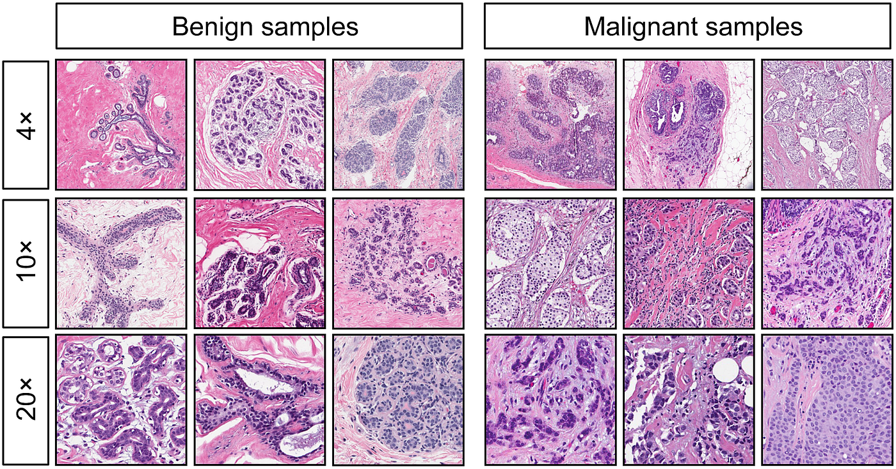
Data Collection
Breast Cancer Wisconsin (Diagnostic)
It includes variables such as radius, texture, perimeter, area, smoothness, compactness, concavity, concave points, symmetry, and fractal dimension.
Data Preprocessing
Missing data
Outliers detection
By:
Swapnali Hongekar
July 29 2023
GIVE UP is NOT an OPTION

Slide 5
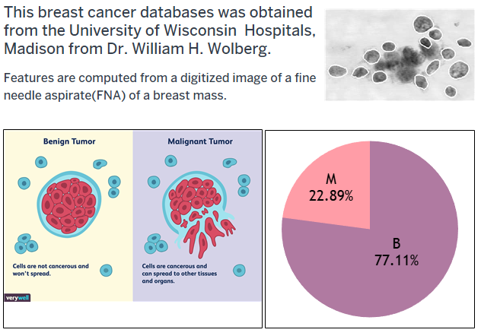
Data Analysis
By:
Swapnali Hongekar
July 29 2023
GIVE UP is NOT an OPTION

Slide 6
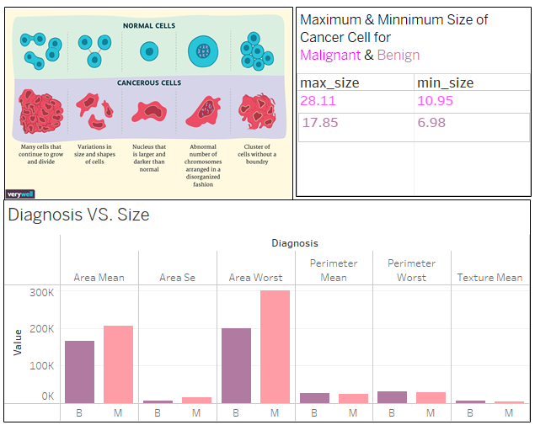
By:
Swapnali Hongekar
July 29 2023
GIVE UP is NOT an OPTION

Slide 7
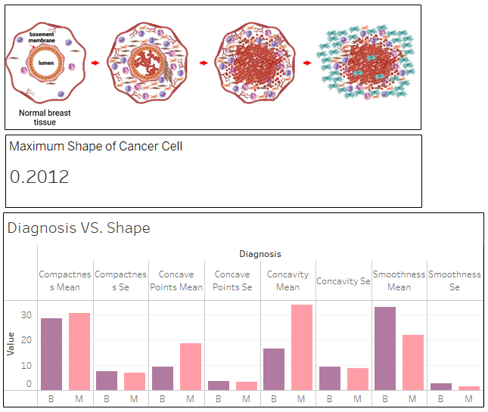
By:
Swapnali Hongekar
July 29 2023
GIVE UP is NOT an OPTION

Slide 8
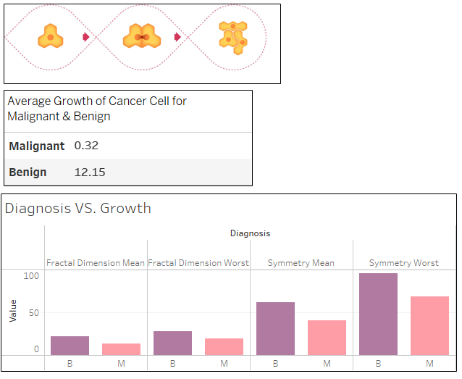
By:
Swapnali Hongekar
July 29 2023
GIVE UP is NOT an OPTION

Slide 9
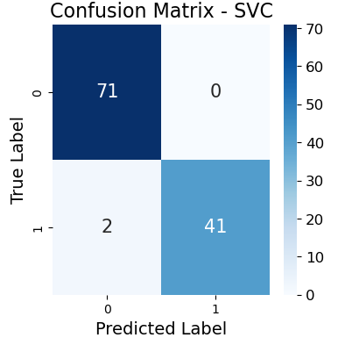
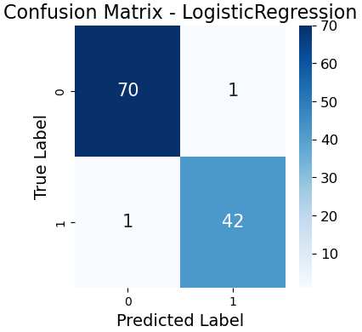
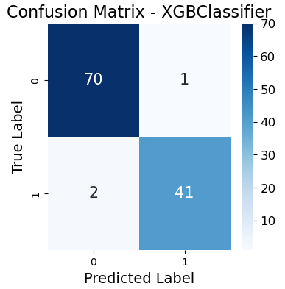
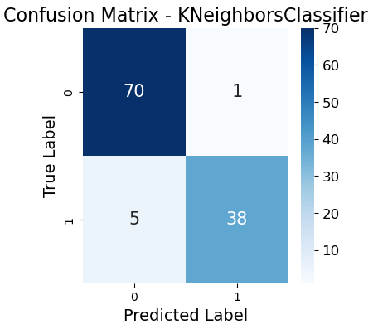
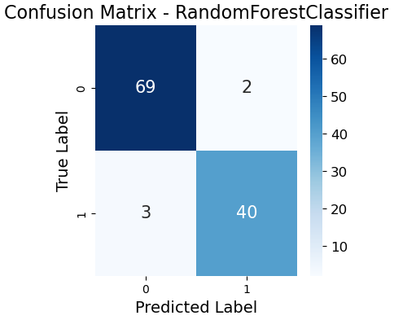
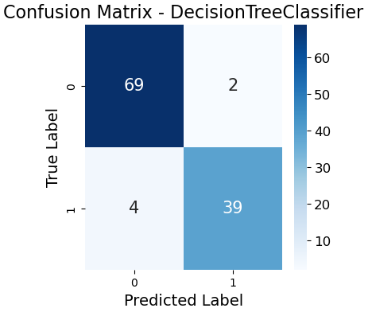
Machine Learning Algorithms
ANOVA test, Standard Scalar , Random Over-Sampling
0.98 %
0.98 %
0.97 %
By:
Swapnali Hongekar
July 29 2023
0.95 %
0.96 %
0.95 %
GIVE UP is NOT an OPTION

Slide 10
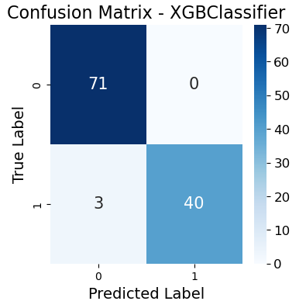
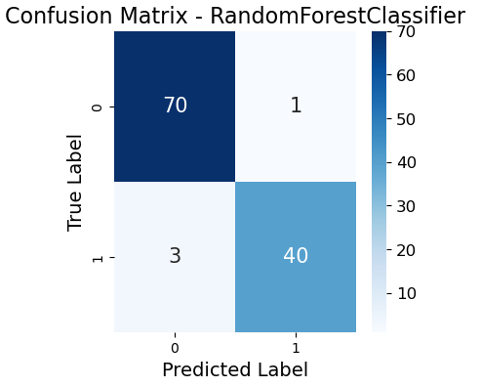
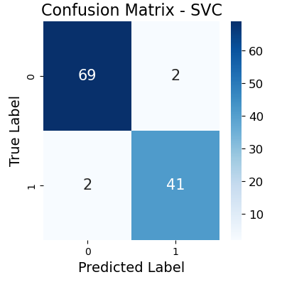
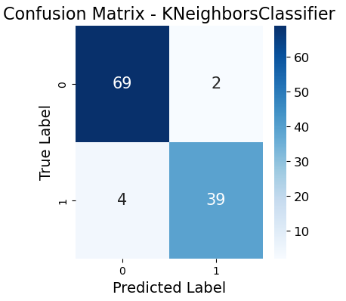
Machine Learning Algorithms after enhancement
Feature Importance and Hyper parameter tuning
0.97 %
0.97 % (1)
0.97 %
By:
Swapnali Hongekar
July 29 2023
0.98 %
0.96 % (1)
GIVE UP is NOT an OPTION

Slide 11
Future Scope
Modeling:
More data (personal info, digitized images of cells)
Database based on Liquid biopsies.
Deep learning algorithms (eg: keras - sigmoid, CNNs, GANs)
By:
Swapnali Hongekar
July 29 2023
GIVE UP is NOT an OPTION

Slide 12
Conclusion
Github repository link :
https://github.com/swap1688/Final_Project.git
By:
Swapnali Hongekar
July 29 2023
GIVE UP is NOT an OPTION

