Slide 1
SYNTHETIC DEMO
Nonprofit Impact
Intelligence Lab
Quality, funding lookup, migration readiness,
and bounded analytics on one local dataset.
Synthetic demonstration · not affiliated with buildOn
1 / 12

Slide 2
Why impact data gets hard to trust
Late files
Broken links
Submissions arrive after the cutoff or sit stale.
A funding row can point at a site that does not exist.
Unclear movement
Migration risk
A spike can be operations or a data defect.
Source and target keys disagree more often than a slide admits.
Synthetic demonstration · not affiliated with buildOn
2 / 12

Slide 3
What this lab demonstrates
Deterministic synthetic data, seed 20260923
PostgreSQL 16 and a SQLite fallback
Seven quality dimensions with a visible issue ledger
FastAPI plus seven Streamlit pages
CSV, XLSX, and PDF preset exports
One-command Windows start and GitHub Actions
Synthetic demonstration · not affiliated with buildOn
3 / 12

Slide 4
Architecture
Generator
PostgreSQL
or SQLite
FastAPI
Streamlit
7 pages
Exports
Both the API and the dashboard read DATABASE_URL. There is no arbitrary SQL endpoint.
Synthetic demonstration · not affiliated with buildOn
4 / 12

Slide 5
Synthetic scale
8
6
240
countries
programs
sites
24
5,760
23,745
months
enrollment rows
fact rows
Synthetic demonstration · not affiliated with buildOn
5 / 12

Slide 6
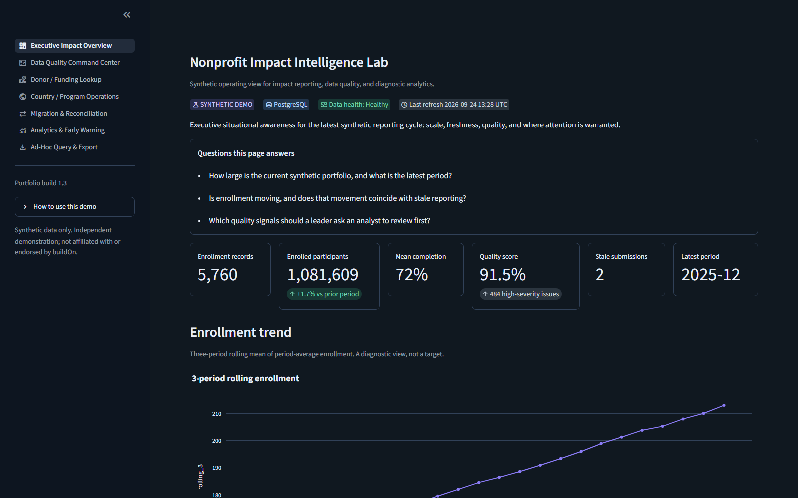
Executive Impact Overview
Scale, freshness, quality score, and a rolling enrollment view.
Synthetic demonstration · not affiliated with buildOn
6 / 12

Slide 7
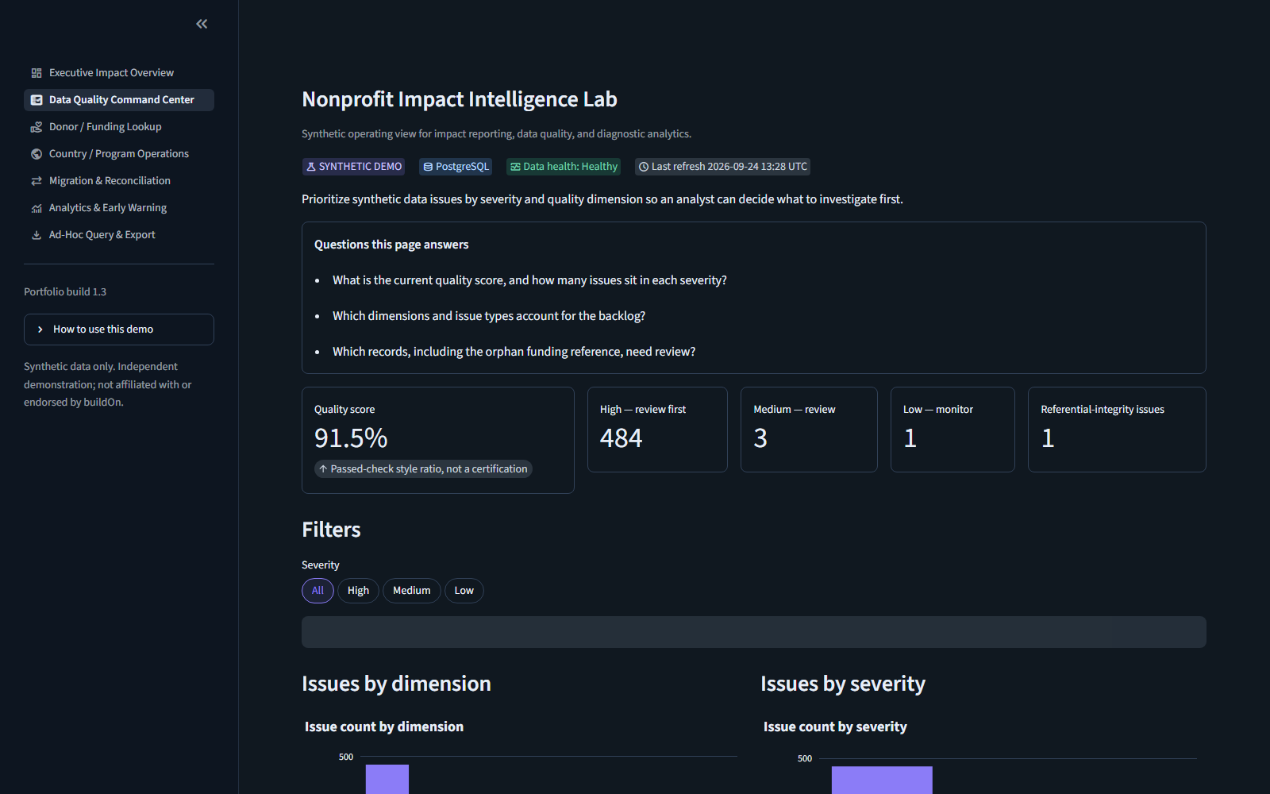
Data Quality Command Center
High, medium, and low are labeled in words. Record 97 is an orphan site reference.
Synthetic demonstration · not affiliated with buildOn
7 / 12

Slide 8
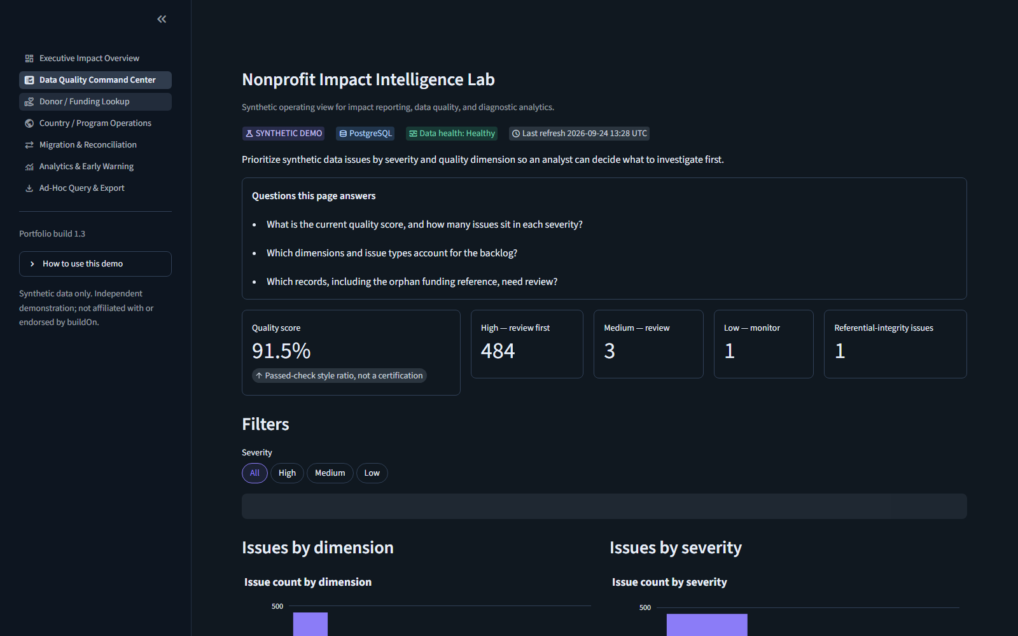
Donor / Funding Lookup
A filtered briefing. Diagnostic demo, not a donor-ready certification.
Synthetic demonstration · not affiliated with buildOn
8 / 12

Slide 9
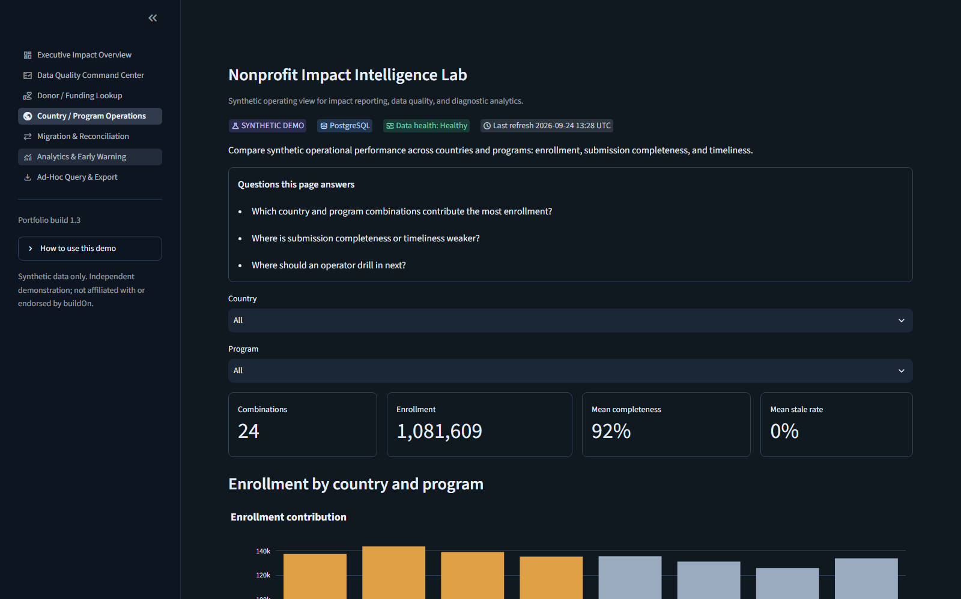
Analytics and early warning
Trend, IQR markers, and a one-period band. Not a causal claim.
Synthetic demonstration · not affiliated with buildOn
9 / 12

Slide 10

Migration and reconciliation
Readiness is about 10.8% because unresolved keys are planted.
Synthetic demonstration · not affiliated with buildOn
10 / 12

Slide 11
Run it, then prove it
.\scripts\windows\Start-ImpactLab.ps1
Dashboard 127.0.0.1:8501 API docs 127.0.0.1:8000/docs
CI runs the same pytest suite on SQLite and on PostgreSQL 16.
Synthetic demonstration · not affiliated with buildOn
11 / 12

Slide 12
Limits and a next step
Synthetic only. No real donors, sites, or participants.
Forecasts are illustrative ranges, not commitments.
Low migration readiness is an intentional scenario.
No production authentication or notification channels.
Extension path: configurable rules, authenticated database access, optional alerts.
Synthetic demonstration · not affiliated with buildOn
12 / 12

