Slide 1
Hackathon 2 – Group 3 Predict the Segment – Hotstar Github Profile - https://github.com/swapcy/hackathon_hotstar
SWAPNIL CHAUDHARI
KISHAN Enjapuri
Neeha khalfay
Calvin castelino

Slide 2
Agenda
Problem Statement
Data Sources and EDA
Feature Engineering
Machine Learning Model
Conclusion and Recommendations.

Slide 3
Problem Statement
In the advertising domain, to determine the demographics of customers is a key challenge. To target the right advertisement we need to identify a customers content segment.
Goal – Implement a Machine Learning Solution to identify watch patterns in specific customer segments.
Problem Analysis – Classify the Interest Segment based on segment target variable. Pos = 1 and Neg = 0.

Slide 4
Data Source
Data Available at: https://drive.google.com/file/d/1YPVPife9QCCQPBcT5yOYi-gCpV6NABMR/view?usp=sharing
Data Consists of:
6 Features
Training Data Set: 200,000 customers
Test Data Set: 100,000 customers
Description ID considered as Index.

Slide 5
Feature Description:
Titles – “title : watch_time” Example: “JOLLY LLB:23” (Note: Watch Time is in secs)
Genres – “genre : watch_time” Example: “Cricket:82379”, “Action:963”
Cities – “cities : watch_time” Example: “Gurgaon:55494”
Tod (24 hours format) – “time_of_day : watch_time” Example: “1:454”, “17:5444”
Dow (7 days format) – “day_of_week : watch_time” Example: “1:454”, “6:5444”
Segment Target Variable – Pos:1 and Neg:0 Example: “To target the right advertisement in a particular customer watch segment”.

Slide 6
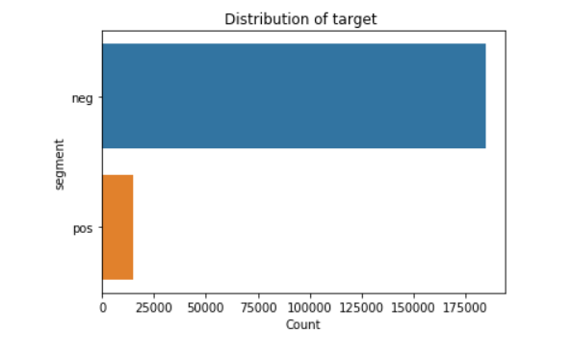
Segment Target Variable.
To target the right advertisement in a particular customer watch segment.
Encode Target Variable Count:
Neg: 0 – {Count – 184,745}
Pos:1 – {Count – 15,254}

Slide 7
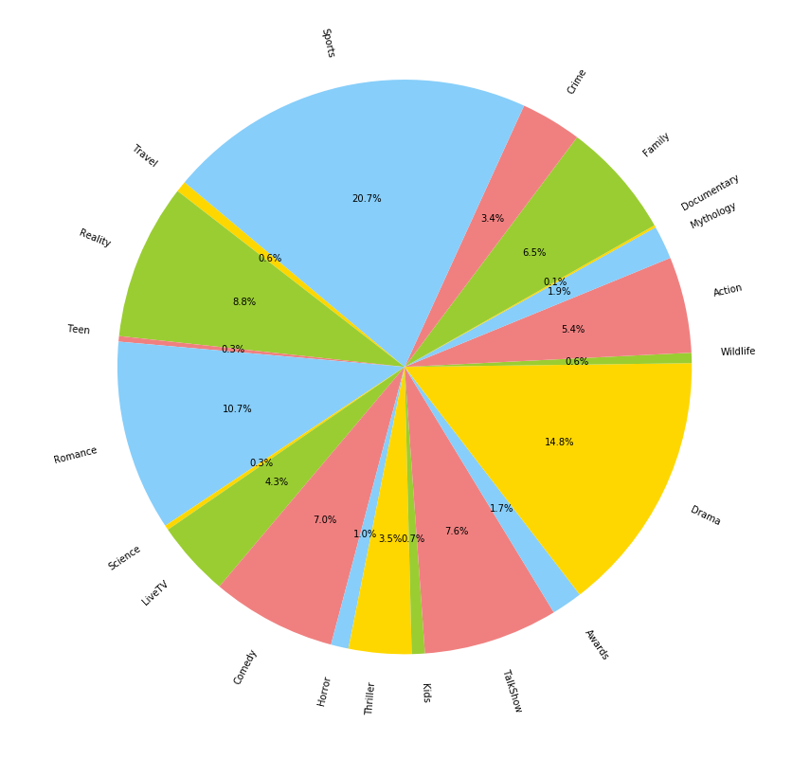
Genres -
Genres have been considered given that customers watch pattern based on specific genres. Advertisements could be targeted in specific genre segments as below:
Sports – 20.7%
Drama – 14.8%
Romance – 10.7%

Slide 8
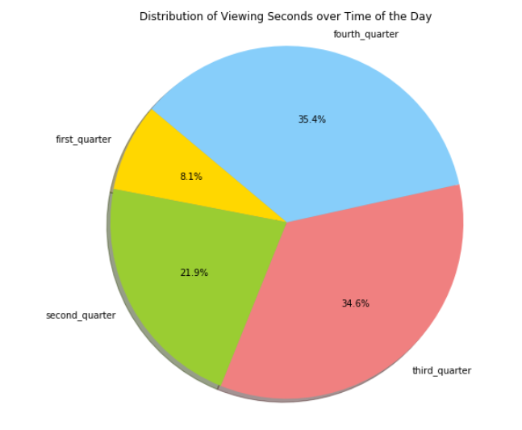
Tod (24 hours format) – time of the day
Divided based on quarterly intervals to identify count of customer watch patterns in these intervals.
first_quarter (1:00 am to 7:00 am) – 8.1%
Second_quarter (7:00 am to 1:00 pm) – 21.9%
Third_quarter (1:00 pm to 7:00 pm) – 34.6%
Fourth_quarter (7:00 pm to 1:00am) – 35.4%

Slide 9
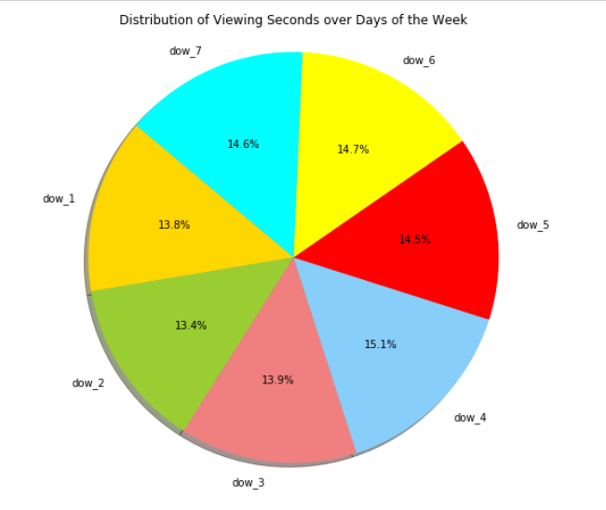
dow (7 day format) – day of the week
Day of the week have been considered to identify particular days where there is increase in customer watch patterns.
dow_4 – 15.1%
dow_6 – 14.7%
dow_7 – 14.6%

Slide 10
Key Findings
Features Considered:
Genres, Titles, dow, tod.
Zero NaN and No Missing Values.
More EDA based on data and selective features.

Slide 11
Feature Engineering

Slide 12
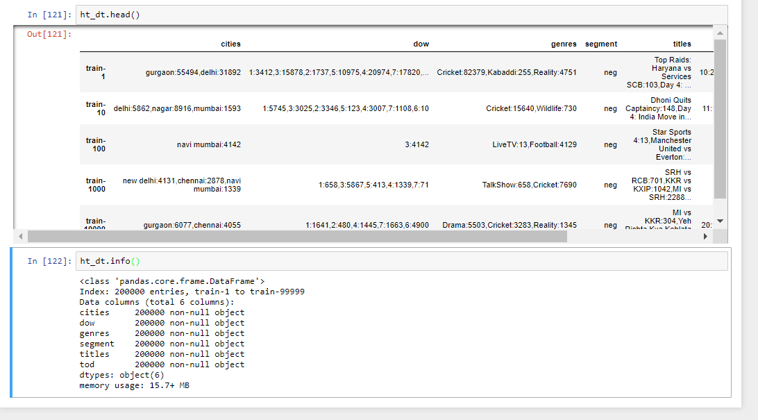
Raw Data
Each row represents a segment of customers with their watch patterns.
Segment – A customer from delhi city watched cricket on the 3rd day of the week during a given time of the day between 1:00 pm to 7:00 pm.

Slide 13
Pre-Processing and engineering
Feature 1 – Genre
Separated all the unique genres.
Clubbed the redundant genres. Example: Cricket, Boxing - > Sports.
Counted occurrence of each genre per segment.
New features
Genres_count, Travel, Reality, Comedy, ………35.
Feature 2 – Titles
New Features
Title_count
Feature 3 – dow
Divide dow into 7 columns. One for each day.
New Features
Dow_1, dow_2, ……….

Slide 14
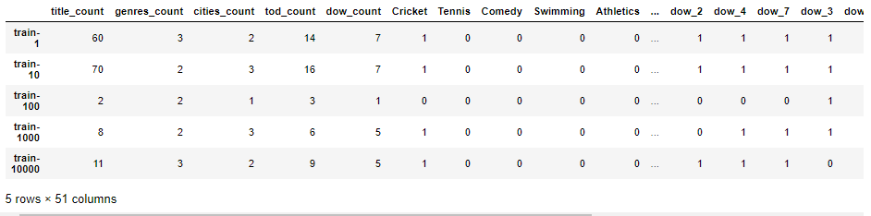
Pre-Processing and engineering
Feature 4 – tod
Divide time of the day in four quarters.
New features
tod count
First_quarter, Second_quarter………

Slide 15
Pre-Processing and engineering
Features engineering for future modeling
Watch time for each genre and weightage
Cities
Generalizing number of cities by replacing city name with state name in India and country name for else
Adding count for top cities for each row
We generalized 1358 unique cities into 120 most occurring cities.

Slide 16
Train – Validation – Test Split
+ Data is divided into train and test set with 80% and 20% respectively.
+ Further, train is divided into train and validation set with 70% and 30% respectively.
 | Neg | Pos | Total
Train | 103491 | 8509 | 112,000
Test | 36863 | 3137 | 40,000
Validation | 44391 | 3609 | 48,000

Slide 17
Undersampling – Oversampling using SMOTETomek Technique.
We have performed Undersampling and Oversampling on train data using SMOTETomek Technique.
 | Neg | Pos | Total
Train | 103449 | 103449 | 206,898

Slide 18
Model

Slide 19
XGBoost Model:
Reasons to use:
1. works well with sparse dataset
2. works well with large dataset
3. computationally fast
4. less prone to overfitting.

Slide 20
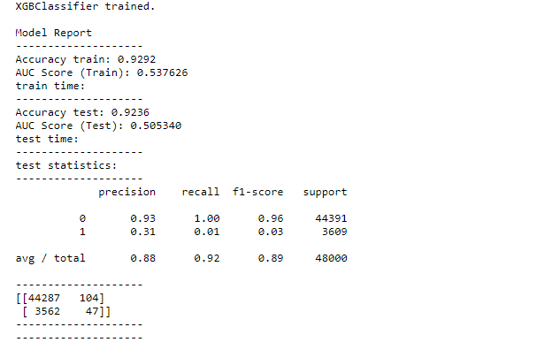
XGBoost on dataset without sampling:

Slide 21
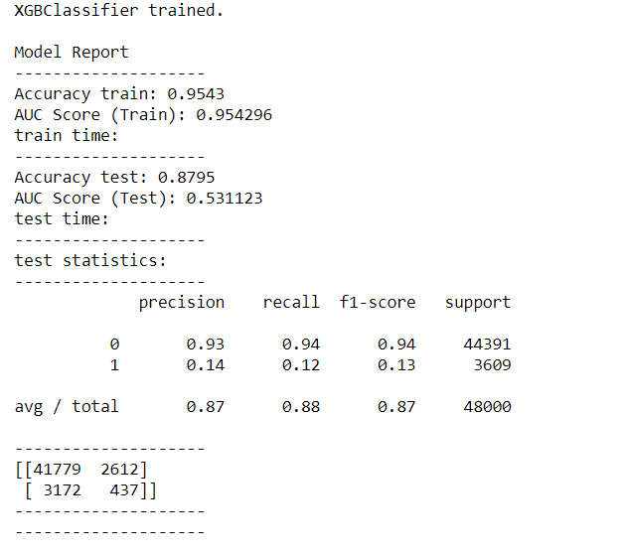
XGBoost on dataset with sampling:

Slide 22
Future Work
Can do more of EDA
Better Feature Engineering which will contribute to better results.
Watch_time could be included instead of count.
Other Machine Learning Models could be tried to know the structure of the data.
The present XGBoost model can be tuned further.
Github Profile - https://github.com/swapcy/hackathon_hotstar

