Slide 1
ML Model Training

Slide 2
TensorFlow

Slide 3
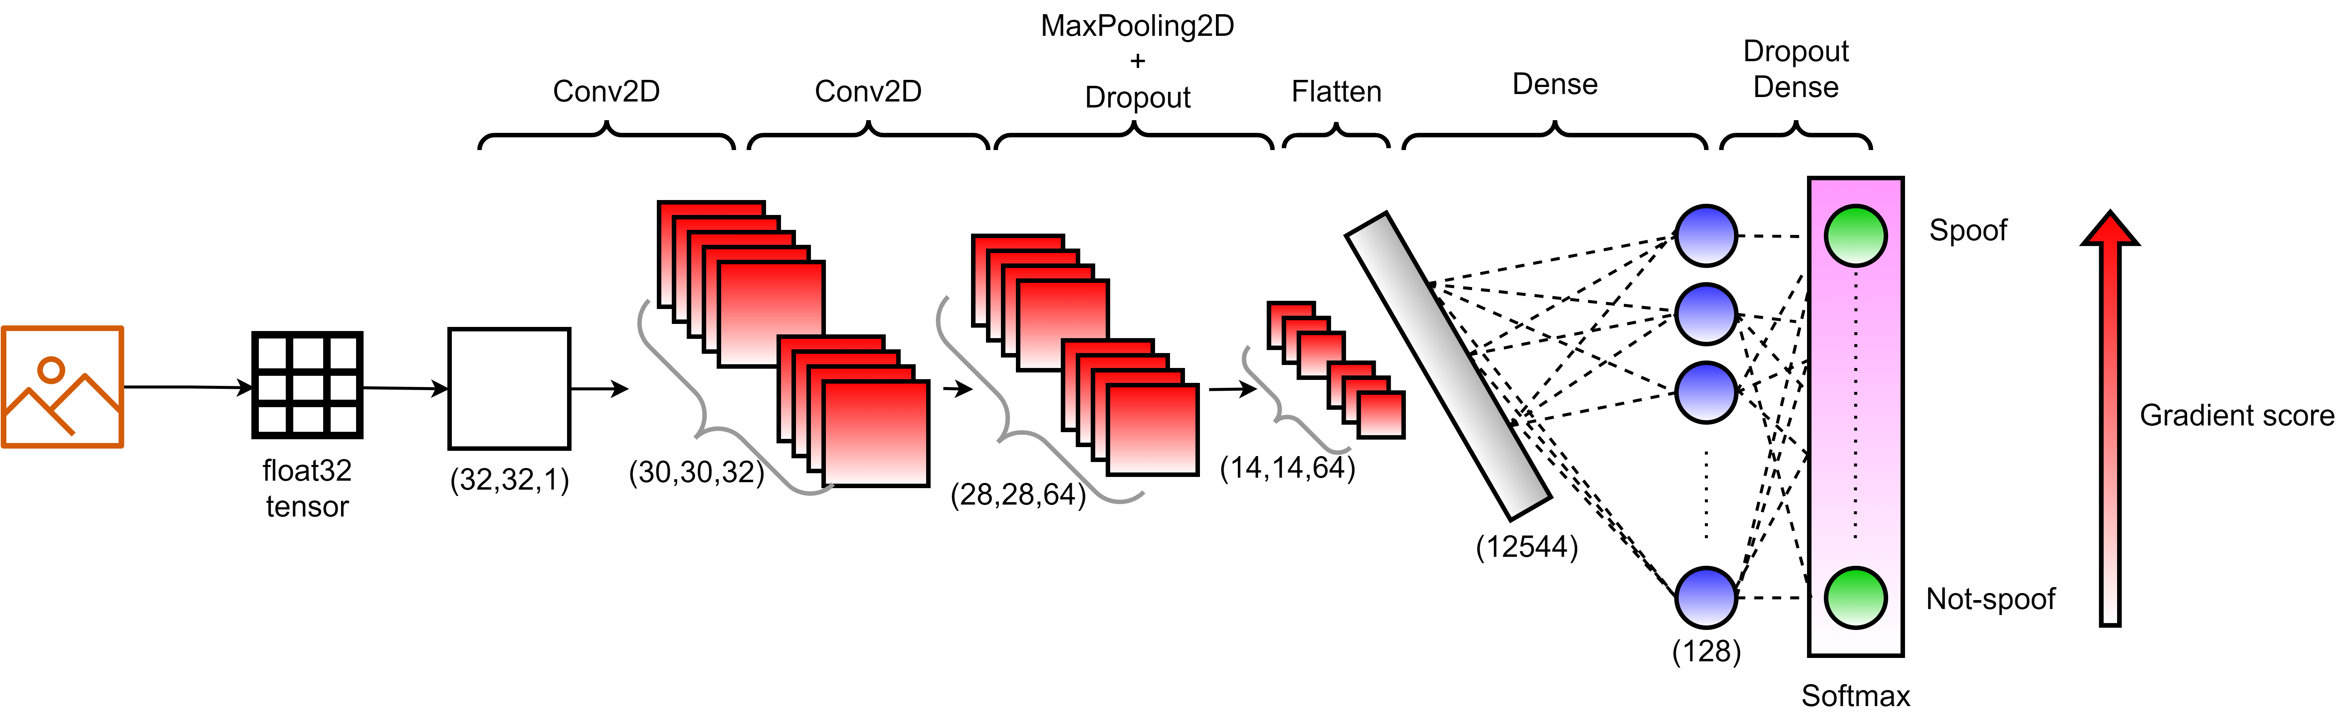
CNN-based approach
Use of the TensorFlow framework for the model training.
Need of cloud compute capabilities.
Amazon AWS (EC4), Google Collab, etc….
Model structure (simplified representation).
Notes:
Note, NVIDIA TAO Provides all of the model optimizations.

Slide 4
CNN-based approach
Model Optimizations recommended
Quantization
Quantization-aware-training (QAT)
Sparsity removal
etc
If needed, to optimize even more.
Replace Conv2D by Depthwise
Replace flatten by 1-by-1 convolutions.
Model Testing
Use of different materials : Alginate, BodyDouble, EcoFlex, Gelatin, Glue, Latex, Printed Photo, Play Doh, Silicone, etc
Notes:
Note, NVIDIA TAO Provides all of the model optimizations.

Slide 5
Software Environment

Slide 6




Microchip MPU Software Support
Making MPU Software Easier!
Dedicated Linux4Microchip Distribution
Mainline Linux® developed and supported internally
Target Long-Term Support (LTS) Linux releases​
Two updates per year
AT91RM9200 (introduced in 2002) is still supported in the latest LTS kernel​
Yocto Project, BuildRoot and OpenWrt® supported

Slide 7
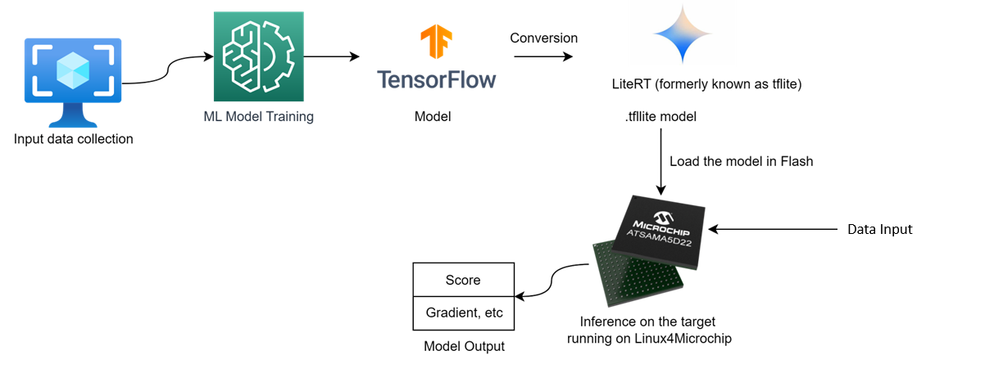
Typical flow for a Linux AI/ML Application

Slide 8

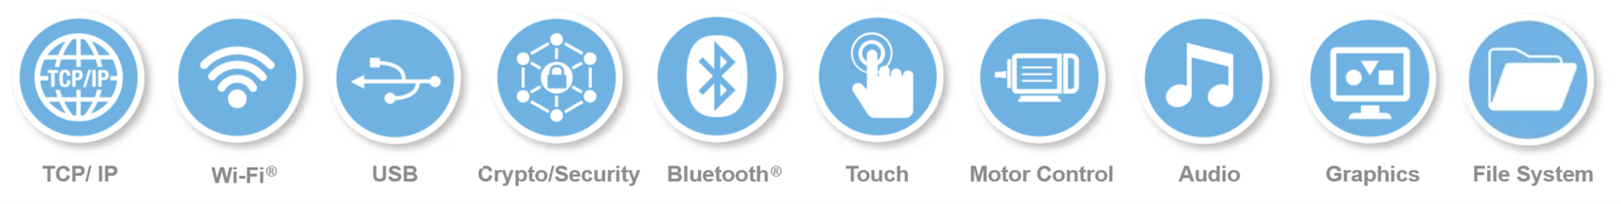
Microchip MPU Software Support
Bare-Metal/RTOS via MPLAB®X and MPLAB® Harmony​
Single toolchain to easily migrate between MCU and MPU​
Integrated support for FreeRTOS™ and Azure IoT

Slide 9
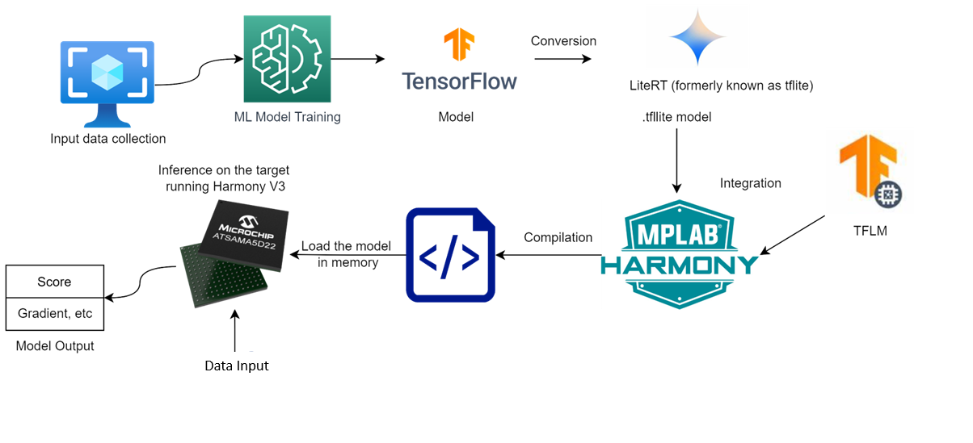
Typical flow for a MPLAB Harmony v3 Application
Notes:
Add TFLM library functions this model uses. Allocate appropriate tensor memory.
There are predefined functions

Slide 10


Bring Your Own Model
Harmony 3.x TensorFlow Lite Plugin

Slide 11

What is TensorFlow Lite for Microcontrollers?
TensorFlow Lite is an open-source, production ready, cross-platform framework for deploying ML on mobile devices and embedded systems
Compatible with the TensorFlow training environment
Designed to run Google ML models on microcontrollers
Built to fit on embedded systems
Designed for 32B platform, including MPUs
Small binary footprint
Output are C++ files
No operating system dependencies, can run on bare metal
Designed to be portable across a wide variety of systems
Micro

Slide 12
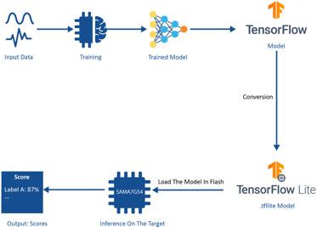
Harmony 3 Examples - v1.0.0 Release
Harmony support for TensorFlow Lite for Microcontroller (TFLM):
Harmony 3 component to easily configure and generate code for TFLM runtime engine
Example applications to demonstrate how to deploy TensorFlow Lite model for inferencing on Microcontrollers with TFLM run time engine
# | Example | Description | SAM E70 XULT | SAM E51 IGaT | SAM E54 CULT | SAM A5D2 XULT
1 | Hello World | This example demonstrates end to end workflow of creating and deploying model to predict sin function output | Yes | Yes | - | Yes
2 | Micro Speech | This example classifies speech input into one of 4 classes ('yes', 'no’, ‘silence’, ‘unknown’) | Yes | - | Yes | -
3 | Handwritten Digit Recognition | This example classifies handwritten digit into one of 10 classes (0 to 9) | Yes | Yes | - | Yes
4 | Magic Wand | This example classifies accelerometer data into one of 4 classes of gestures (Wing, Ring, Slop, unknown) | Yes | - | Yes | -

Slide 13
Add TFLite Micro to your project
Download the 2 tensorflow lite repositories from microchip harmony github:
https://github.com/Microchip-MPLAB-Harmony/tflite-micro-apps
https://github.com/Microchip-MPLAB-Harmony/tflite-micro

Slide 14
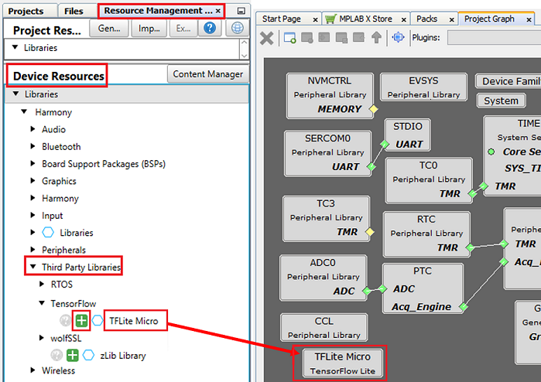
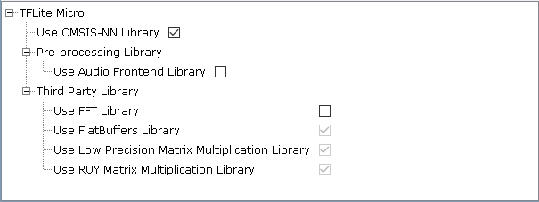
Add TFLite Micro to your project
1. Create an MPLAB project using Harmony
2. Configure Tflite library

Slide 15
Model Creation, Training, Evaluation and Deployment
General Steps - Summary
Open <your_project.ipynb> in Google Colab or Jupyter Notebook.
Load and preprocess the dataset.
Build and train an CNN model using Keras API in TensorFlow.
Convert the trained model to a quantized TensorFlow Lite model.
Convert the TensorFlow Lite model to a C source file for target (Ex. SAMA5D22) deployment.
Deploy the Model to the SAMA5D22.
Note: Steps 3 to 6 are detailed in the next slides.

Slide 16
Step 3: Build and Train an ANN Model
Using Keras, an Artificial Neural Network (ANN) model is built with three hidden dense layers, a dropout layer, and a final dense layer with softmax activation.
import tensorflow as tf
from keras import layers
Build the ANN model
model = tf.keras.Sequential([
layers.Dense(8, activation='LeakyReLU', input_shape=[xtrain.shape[1]]),
layers.Dense(16, activation='LeakyReLU'),
layers.Dropout(0.2),
layers.Dense(8, activation='LeakyReLU'),
layers.Dense(ytrain.shape[1], activation='softmax'),
])
model.summary()

Slide 17
Step 3: Build and Train a CNN Model
Using Keras, a Convolutional Neural Network (CNN) model is constructed with three convolutional layers, each followed by a max pooling layer, a flattening layer to convert the 2D feature maps into a 1D vector, a fully connected dense layer, and a final dense layer with softmax activation for classification.
import tensorflow as tf
from keras import layers
Build the CNN model
model = tf.keras.Sequential([
layers.Conv2D(32, (3, 3), activation='relu', input_shape=(height, width, channels)),
layers.MaxPooling2D((2, 2)),
layers.Conv2D(64, (3, 3), activation='relu'),
layers.MaxPooling2D((2, 2)),
layers.Conv2D(128, (3, 3), activation='relu'),
layers.MaxPooling2D((2, 2)),
layers.Flatten(),
layers.Dense(64, activation='relu'),
layers.Dense(num_classes, activation='softmax'),
])
model.summary()

Slide 18
Step 3: Build and Train a CNN Model
Compile and Train the Model
from keras.callbacks import EarlyStopping
Compile the model
For classification:
model.compile(loss='categorical_crossentropy', optimizer='adam', metrics=['accuracy’])
For regression:
model.compile(loss=‘mse', optimizer=‘rmsprop', metrics=[‘mae’])
Define early stopping callback
earlystop = EarlyStopping(monitor='val_loss', min_delta=0.0001, patience=5, verbose=1, restore_best_weights=True)
Train the model
history = model.fit(xtrain, ytrain, validation_data=(xtest, ytest), epochs=100, batch_size=32, callbacks=[earlystop])
Evaluate the model
model.evaluate(xtest, ytest)

Slide 19
Step 4: Convert to TensorFlow Lite and Optimize for MPUs
Define a representative dataset function for quantization
def representative_dataset():
for i in x_scaled.index:
data = x_scaled.iloc[i].to_numpy()
data = data.reshape(1, data.shape[0])
yield [data.astype(np.float32)]
Convert the model to TensorFlow Lite format
converter = tf.lite.TFLiteConverter.from_saved_model(SAVED_MODEL_FILENAME)
model_no_quant_tflite = converter.convert()
Set the optimization flag for quantization
converter.optimizations = [tf.lite.Optimize.DEFAULT]
converter.target_spec.supported_ops = [tf.lite.OpsSet.TFLITE_BUILTINS_INT8]
converter.target_spec.supported_types = [tf.int8]
converter.inference_input_type = tf.int8
converter.inference_output_type = tf.int8
converter.representative_dataset = representative_dataset
Convert the model with quantization
model_tflite = converter.convert()
Save the quantized model to disk
open(QUANTIZED_TFL_MODEL_FILENAME, "wb").write(model_tflite)

Slide 20
Step 5: Convert TensorFlow Lite Model to C Source File
The TensorFlow Lite model is converted to a C source file for integration with TensorFlow Lite for Microcontrollers.
Install xxd if it is not available
!apt-get update && apt-get -qq install xxd
Convert the TensorFlow Lite model to a C source file
!xxd -i {QUANTIZED_TFL_MODEL_FILENAME} {TFL_CC_MODEL_FILENAME}
Print the source code
!cat {TFL_CC_MODEL_FILENAME}

Slide 21
Step 6: Deploy the Model on a Microprocessor
Include TensorFlow Lite Micro in Your Project
Download and add TensorFlow Lite Micro to your project.
Ensure necessary source files are included in your build system.
Load the TFLite Model in C++
Create a C++ file that:
Includes your model as a C array
Sets up the TensorFlow Lite Micro runtime

Slide 22
Example C++ Code
#include "tensorflow/lite/micro/all_ops_resolver.h"
#include "tensorflow/lite/micro/kernels/micro_ops.h"
#include "tensorflow/lite/micro/micro_error_reporter.h"
#include "tensorflow/lite/micro/micro_interpreter.h"
#include "tensorflow/lite/schema/schema_generated.h"
#include "tensorflow/lite/version.h"
// Model data: Include your quantized model as a C array
#include "mobilenet_v2_quantized_model_data.h"
// Set up TensorFlow Lite Micro environment
constexpr int kTensorArenaSize = 10 * 1024;
uint8_t tensor_arena[kTensorArenaSize];
int main() {
static tflite::MicroErrorReporter micro_error_reporter;
tflite::ErrorReporter* error_reporter = &micro_error_reporter;
const tflite::Model* model = tflite::GetModel(mobilenet_v2_quantized_model_data);
static tflite::MicroOpResolver<10> micro_op_resolver;
micro_op_resolver.AddBuiltin(tflite::BuiltinOperator_DEPTHWISE_CONV_2D, tflite::ops::micro::Register_DEPTHWISE_CONV_2D());
micro_op_resolver.AddBuiltin(tflite::BuiltinOperator_CONV_2D, tflite::ops::micro::Register_CONV_2D());
tflite::MicroInterpreter interpreter(model, micro_op_resolver, tensor_arena, kTensorArenaSize, error_reporter);
interpreter.AllocateTensors();
// Set input and run inference
TfLiteTensor* input = interpreter.input(0);
// Fill input data (e.g., input->data.f[0] = ...)
if (interpreter.Invoke() != kTfLiteOk) {
error_reporter->Report("Invoke failed.");
}
// Process the output
TfLiteTensor* output = interpreter.output(0);
// Read output (e.g., float output_value = output->data.f[0];)
return 0;
}

Slide 23
Reference Code & Porting
https://github.com/swapna-gg1/tfliteExamples
To port a different model:
Replace src/modelHW.cpp & src/modelHW.h with your model
Replace src/mlapp_HW.cpp with your application code
You may have some missing 3rd party libraries required by your model that you need to integrate

Slide 24
Other Resources
https://github.com/tensorflow/tflite-micro/blob/main/tensorflow/lite/micro/examples/person_detection/training_a_model.md

Slide 25
Warranties and Life Support Statement:
This publication and the information herein may be used only with Microchip products, including to design, test, and integrate Microchip products with your application. Use of this information in any other manner violates these terms. Information regarding device applications is provided only for your convenience and may be superseded by updates. It is your responsibility to ensure that your application meets with your specifications. Contact your local Microchip sales office for additional support or, obtain additional support at https://www.microchip.com/en-us/support/design-help/client-support-services.
THIS INFORMATION IS PROVIDED BY MICROCHIP "AS IS". MICROCHIP MAKES NO REPRESENTATIONS OR WAR- RANTIES OF ANY KIND WHETHER EXPRESS OR IMPLIED, WRITTEN OR ORAL, STATUTORY OR OTHERWISE, RELATED TO THE INFORMATION INCLUDING BUT NOT LIMITED TO ANY IMPLIED WARRANTIES OF NON- INFRINGEMENT, MERCHANTABILITY, AND FITNESS FOR A PARTICULAR PURPOSE, OR WARRANTIES RELATED TO ITS CONDITION, QUALITY, OR PERFORMANCE.
IN NO EVENT WILL MICROCHIP BE LIABLE FOR ANY INDIRECT, SPECIAL, PUNITIVE, INCIDENTAL, OR CONSEQUENTIAL LOSS, DAMAGE, COST, OR EXPENSE OF ANY KIND WHATSOEVER RELATED TO THE INFORMATION OR ITS USE, HOWEVER CAUSED, EVEN IF MICROCHIP HAS BEEN ADVISED OF THE POSSIBILITY OR THE DAMAGES ARE FORESEEABLE. TO THE FULLEST EXTENT ALLOWED BY LAW, MICROCHIP'S TOTAL LIABILITY ON ALL CLAIMS IN ANY WAY RELATED TO THE INFORMATION OR ITS USE WILL NOT EXCEED THE AMOUNT OF FEES, IF ANY, THAT YOU HAVE PAID DIRECTLY TO MICROCHIP FOR THE INFORMATION.
Use of Microchip devices in life support and/or safety applications is entirely at the buyer's risk, and the buyer agrees to defend, indemnify and hold harmless Microchip from any and all damages, claims, suits, or expenses resulting from such use. No licenses are conveyed, implicitly or otherwise, under any Microchip intellectual property rights unless otherwise stated.

