Slide 1

Data Analysis of Government Dataset Rainfall Records

Slide 2
Overview:
The dataset consists of 2,196 records with 7 columns, capturing daily rainfall data for various districts across India during January 2024. The columns include State and District, which specify the geographical location, and Date, representing the daily recorded values. The dataset also includes Year and Month, both of which are constant at 2024 and January, respectively.
A crucial attribute is Avg_rainfall, which records the average rainfall in millimeters for each district. However, this column has significant missing data, with only 111 non-null values out of 2,196, indicating that most records lack rainfall information. The Agency_name column identifies the data source, which is the IMD GRID MODEL.From a statistical perspective, the average recorded rainfall is 0.70 mm, with a minimum of 0.0006 mm and a maximum of 5.3 mm. The dataset suggests that rainfall was generally low, with the majority of values concentrated below 1 mm.

Slide 3
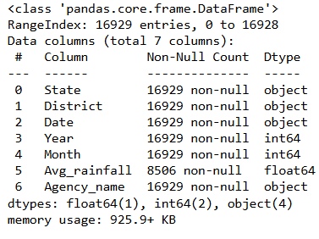
Dataset insight(info):

Slide 4
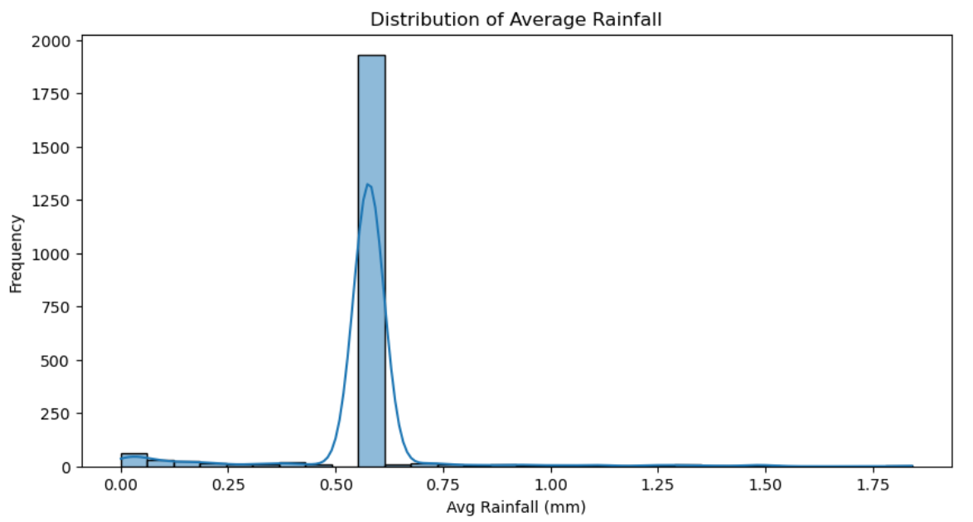
Data Analysis
It is a histogram with a kernel density estimation (KDE) curve, showing how frequently different rainfall values appear. The distribution is highly skewed, with most values concentrated around 0.5 mm, suggesting that the majority of recorded rainfall values are very low. There are a few instances of higher rainfall, but they appear infrequently.

Slide 5
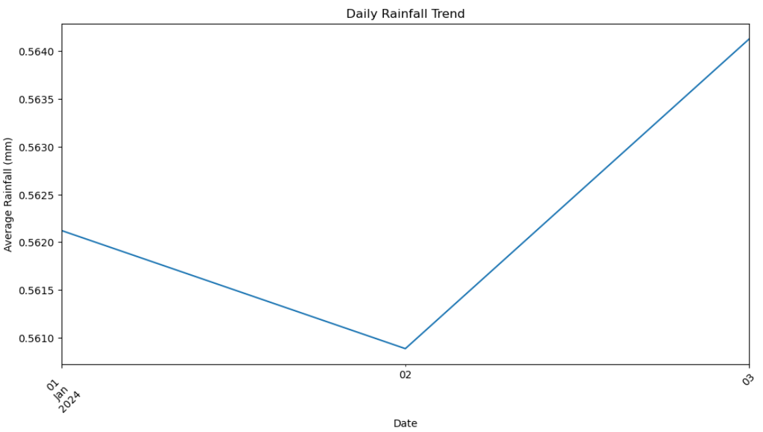
Daily Rainfall Trend
The plot shows the daily rainfall trend for the first three days of January 2024. The average rainfall initially decreases on January 2nd before rising again on January 3rd. The fluctuations suggest minor variations in daily precipitation levels during this period.

Slide 6
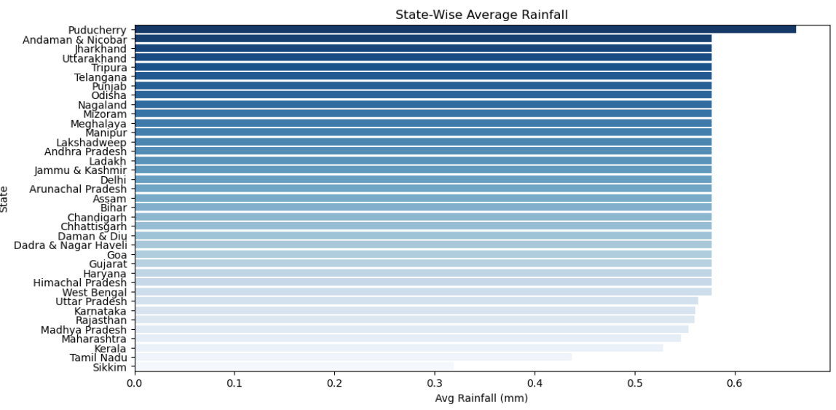
The provided plot displays the state-wise average rainfall across different regions in India. Puducherry has the highest average rainfall, followed by Andaman & Nicobar and Jharkhand, while states like Sikkim and Tamil Nadu have the lowest. The gradient shading highlights the variation in rainfall intensity across states.

Slide 7
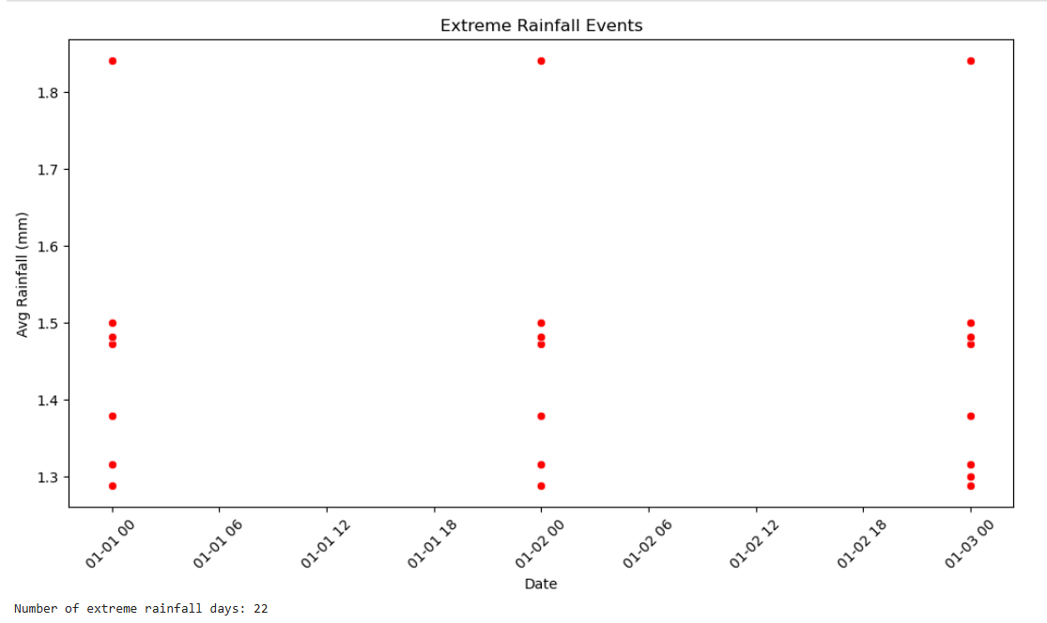
The scatter plot visualizes extreme rainfall events, highlighting 22 days with significantly high rainfall values. Each red dot represents an instance of extreme rainfall, showing clusters of events occurring at different time points. These events indicate potential anomalies or periods of intense precipitation that may require further analysis.

Slide 8
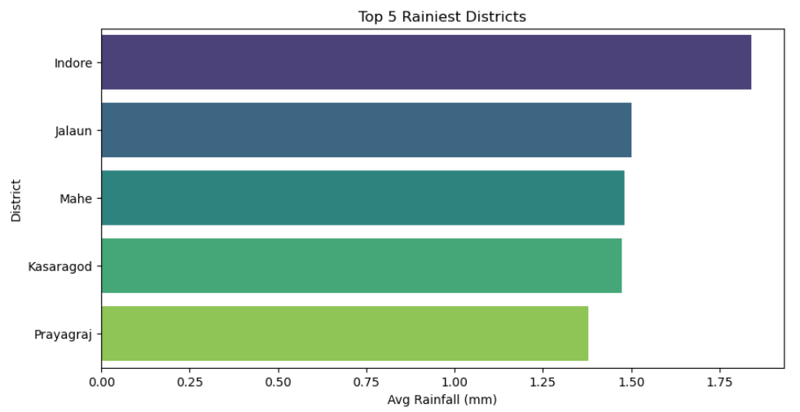
The bar chart presents the top 5 rainiest districts, with Indore experiencing the highest average rainfall, followed by Jalaun, Mahe, Kasaragod, and Prayagraj. The differences in bar lengths indicate variations in rainfall levels, with Indore significantly ahead of the others.

Slide 9
Observations
Key observations from the data:
Rainfall Distribution: The average rainfall is highly concentrated around a specific value, suggesting minimal variation across the dataset. Most locations experience similar rainfall patterns.
Daily Rainfall Trend: The daily rainfall fluctuates slightly, with a minor dip followed by an increase, indicating short-term variations rather than drastic changes.
State-wise Rainfall: Puducherry records the highest average rainfall among states, followed by Andaman & Nicobar and Jharkhand. The distribution suggests significant regional differences in precipitation.
Rainiest Districts: Indore experiences the highest rainfall among districts, followed by Jalaun, Mahe, Kasaragod, and Prayagraj. The variation among these top districts suggests localized climatic influences.

Slide 10
Conclusion
Consistent Rainfall Patterns – The overall rainfall data shows minimal daily fluctuations, indicating stable precipitation trends in most regions.
Regional Variations – Some states (e.g., Puducherry, Andaman & Nicobar) and districts (e.g., Indore) receive significantly higher rainfall, highlighting geographical and climatic influences.
Useful Insights for Planning – The analysis can aid in water resource management, agricultural planning, and disaster preparedness by identifying high-rainfall areas.

