Slide 1
BIG MART
SALES PREDICTION
Machine Learning Project
XGBoost Regressor • Python • Pandas • Scikit-learn
Executed notebook based presentation

Slide 2
Project at a glance
02
Actual notebook scope
DATASET
INPUTS
MODEL
TARGET
8,523 rows
11 features
XGBRegressor
Item_Outlet_Sales
Workflow
Load → Clean → Analyze → Encode → Split → Train → Evaluate
Big Mart Sales Prediction | Actual Notebook

Slide 3
Data collection
03
Actual code and first-row output
# first 5 rows of the dataframe
big_mart_data.head()
Item_Identifier Item_Weight ... Outlet_Type Item_Outlet_Sales
0 FDA15 9.30 ... Supermarket Type1 3735.1380
1 DRC01 5.92 ... Supermarket Type2 443.4228
2 FDN15 17.50 ... Supermarket Type1 2097.2700
3 FDX07 19.20 ... Grocery Store 732.3800
4 NCD19 8.93 ... Supermarket Type1 994.7052
[5 rows x 12 columns]
Big Mart Sales Prediction | Actual Notebook

Slide 4
Dataset structure
04
Actual shape and info
# number of data points & number of features
big_mart_data.shape
# getting some information about thye dataset
big_mart_data.info()
(8523, 12)
<class 'pandas.core.frame.DataFrame'>
RangeIndex: 8523 entries, 0 to 8522
Data columns (total 12 columns):
# Column Non-Null Count Dtype
--- ------ -------------- -----
0 Item_Identifier 8523 non-null object
1 Item_Weight 7060 non-null float64
2 Item_Fat_Content 8523 non-null object
3 Item_Visibility 8523 non-null float64
4 Item_Type 8523 non-null object
5 Item_MRP 8523 non-null float64
6 Outlet_Identifier 8523 non-null object
7 Outlet_Establishment_Year 8523 non-null int64
8 Outlet_Size 6113 non-null object
9 Outlet_Location_Type 8523 non-null object
10 Outlet_Type 8523 non-null object
11 Item_Outlet_Sales 8523 non-null float64
dtypes: float64(4), int64(1), object(7)
memory usage: 799.2+ KB
Big Mart Sales Prediction | Actual Notebook

Slide 5
Data quality check
05
Missing values before preprocessing
# checking for missing values
big_mart_data.isnull().sum()
ITEM_WEIGHT
OUTLET_SIZE
1,463
2,410
Item_Identifier 0
Item_Weight 1463
Item_Fat_Content 0
Item_Visibility 0
Item_Type 0
Item_MRP 0
Outlet_Identifier 0
Outlet_Establishment_Year 0
Outlet_Size 2410
Outlet_Location_Type 0
Outlet_Type 0
Item_Outlet_Sales 0
dtype: int64
These are the two missing-value fields shown by the actual notebook output.
Big Mart Sales Prediction | Actual Notebook

Slide 6
Missing-value treatment
06
Actual notebook approach
# mean value of "Item_Weight" column
big_mart_data['Item_Weight'].mean()
# mode of "Outlet_Size" column
big_mart_data['Outlet_Size'].mode()
MEAN ITEM_WEIGHT
MODE OUTLET_SIZE
12.8576
Medium
Outlet size is filled according to Outlet_Type using the mode.
# checking for missing values
big_mart_data.isnull().sum()
Item_Identifier 0
Item_Weight 0
Item_Fat_Content 0
Item_Visibility 0
Item_Type 0
Item_MRP 0
Outlet_Identifier 0
Outlet_Establishment_Year 0
Outlet_Size 0
Outlet_Location_Type 0
Outlet_Type 0
Item_Outlet_Sales 0
dtype: int64
Big Mart Sales Prediction | Actual Notebook

Slide 7
Categorical cleanup
07
Standardizing Item_Fat_Content
big_mart_data['Item_Fat_Content'].value_counts()
big_mart_data.replace({'Item_Fat_Content': {'low fat':'Low Fat','LF':'Low Fat', 'reg':'Regular'}}, inplace=True)
Item_Fat_Content
Low Fat 5089
Regular 2889
LF 316
reg 117
low fat 112
Name: count, dtype: int64
low fat + LF → Low Fat
reg → Regular
Item_Fat_Content
Low Fat 5517
Regular 3006
Name: count, dtype: int64
Big Mart Sales Prediction | Actual Notebook

Slide 8
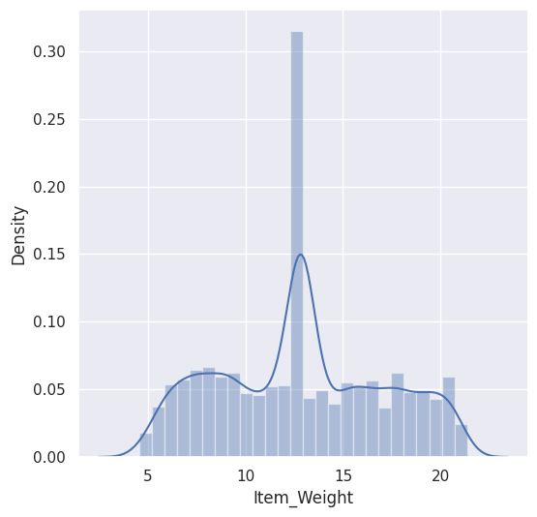
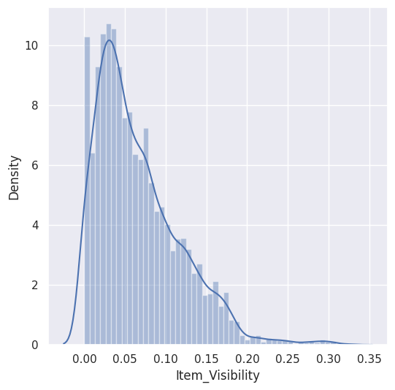
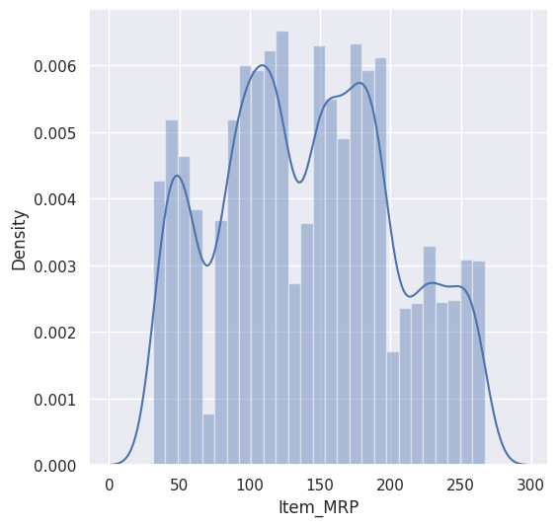
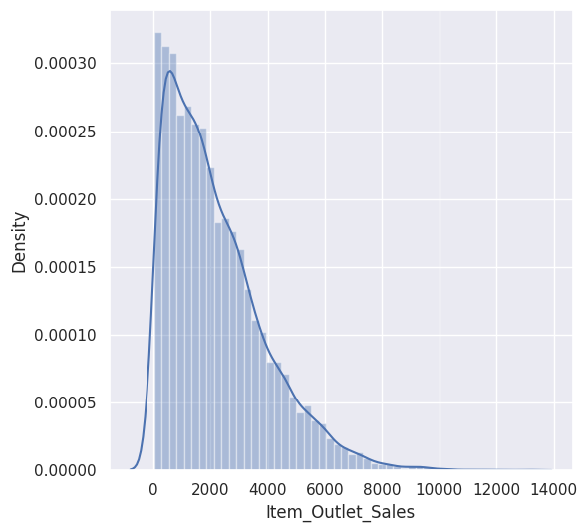
Exploratory data analysis
08
Actual graph outputs from the notebook
Notebook output • cell 24
Notebook output • cell 25
Notebook output • cell 26
Notebook output • cell 27
Big Mart Sales Prediction | Actual Notebook

Slide 9
Feature encoding
09
Actual LabelEncoder implementation
big_mart_data['Item_Identifier'] = encoder.fit_transform(big_mart_data['Item_Identifier'])
big_mart_data['Item_Fat_Content'] = encoder.fit_transform(big_mart_data['Item_Fat_Content'])
big_mart_data['Item_Type'] = encoder.fit_transform(big_mart_data['Item_Type'])
big_mart_data['Outlet_Identifier'] = encoder.fit_transform(big_mart_data['Outlet_Identifier'])
big_mart_data['Outlet_Size'] = encoder.fit_transform(big_mart_data['Outlet_Size'])
big_mart_data['Outlet_Location_Type'] = encoder.fit_transform(big_mart_data['Outlet_Location_Type'])
big_mart_data['Outlet_Type'] = encoder.fit_transform(big_mart_data['Outlet_Type'])
Categorical features converted to numeric values
Item_Identifier • Item_Fat_Content • Item_Type • Outlet_Identifier
Outlet_Size • Outlet_Location_Type • Outlet_Type
Big Mart Sales Prediction | Actual Notebook

Slide 10
Train / test split & model
10
Actual notebook implementation
X_train, X_test, Y_train, Y_test = train_test_split(X, Y, test_size=0.2, random_state=2)
regressor = XGBRegressor()
TRAINING RECORDS
TESTING RECORDS
ALGORITHM
6,818
1,705
XGBRegressor
Big Mart Sales Prediction | Actual Notebook

Slide 11
Model evaluation
11
Actual R² results
# R squared Value
r2_test = metrics.r2_score(Y_test, test_data_prediction)
TRAINING R²
TESTING R²
87.51%
51.56%
Metric: R² (R-squared)
Values shown are the executed notebook results.
Big Mart Sales Prediction | Actual Notebook

Slide 12
Result comparison
12
Training vs testing R²
87.51%
51.56%
Training
Testing
Big Mart Sales Prediction | Actual Notebook

Slide 13
End-to-end implementation
13
Project workflow
01
02
03
04
05
06
07
Load
→
Clean
→
Analyze
→
Encode
→
Split
→
Model
→
Evaluate
Train.csv
Missing values
EDA
LabelEncoder
Train / Test
XGBoost
R²
Big Mart Sales Prediction | Actual Notebook

Slide 14
Conclusion
14
Summary based on the executed notebook
A complete regression workflow was implemented using the provided Big Mart dataset.
Data inspection • Missing-value treatment • Categorical cleanup • Label encoding
Train/test split • XGBoost regression • R² evaluation
TRAINING R²
TESTING R²
87.51%
51.56%
Thank You
Big Mart Sales Prediction | Actual Notebook

