Slide 1
Heart Disease Prediction
By
Dona liza Saji -2348515
Swapnali Singh -2348565
Victor Jose I J-2348570
Department of Computer Science)
Christ (Deemed-to-be-University
Banglore, India

Slide 2
Introduction:
The project focused on analyzing a dataset on prediction of heart disease, incorporating various features such as age, cholesterol levels, chest pain type, and thallium levels. The goal was to apply machine learning techniques to predict the likelihood of heart disease in individuals based on these features.

Slide 3
Project Summary:
The project involved extensive exploratory data analysis (EDA), preprocessing steps, and the application of machine learning algorithms such as Logistic Regression, Decision Trees, and Extreme Gradient Boosting and Neural Network. The analysis delved into age distributions, cholesterol levels, chest pain types, and their relationship with heart disease. Additionally, the study assessed the impact of different features on the accuracy of prediction models.

Slide 4
Purpose of the Project:
The project’s primary purpose was to utilize machine learning techniques to understand and predict heart disease based on various factors.
The project aimed to identify patterns, correlations, and outliers within the data by employing exploratory and statistical analysis.
The subsequent application of machine learning models was geared towards creating predictive tools for diagnosing heart disease, providing valuable insights for healthcare practitioners and researchers.

Slide 5
Modules used :
Pandas
Numpy
matplotlib.pyplot
Seaborn-library
Pandas Profiling
Sweetviz
sklearn
Warnings
Scipy
Xgboost
keras

Slide 6
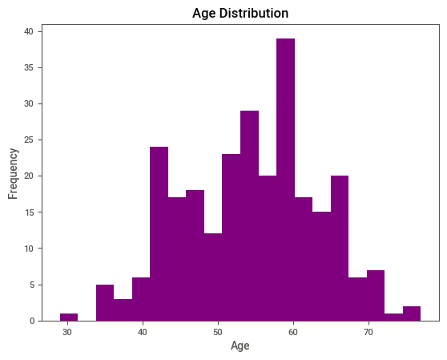
Age distribution:

Slide 7
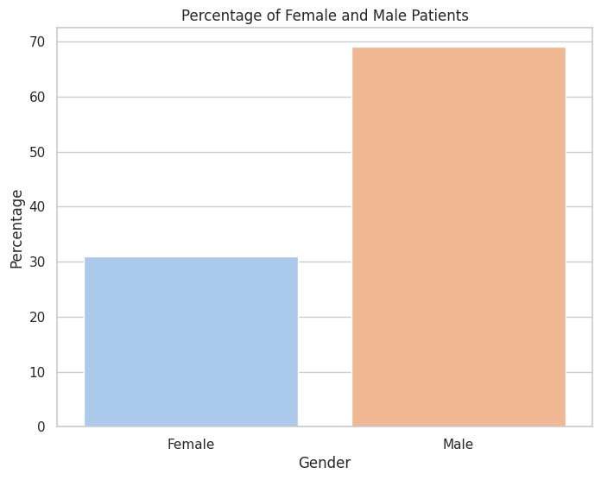
Percentage of Female and Male patients

Slide 8
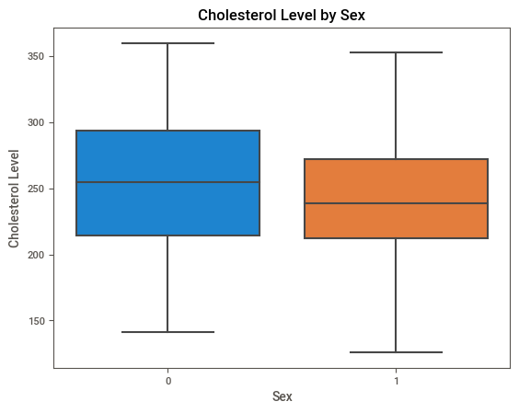
Cholesterol level by sex:

Slide 9
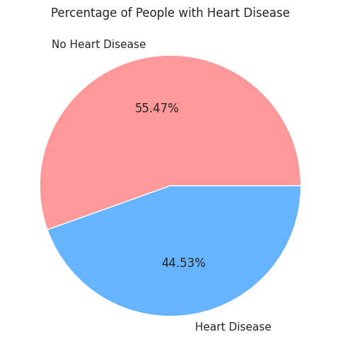
Distribution of people with heart disease and Not

Slide 10
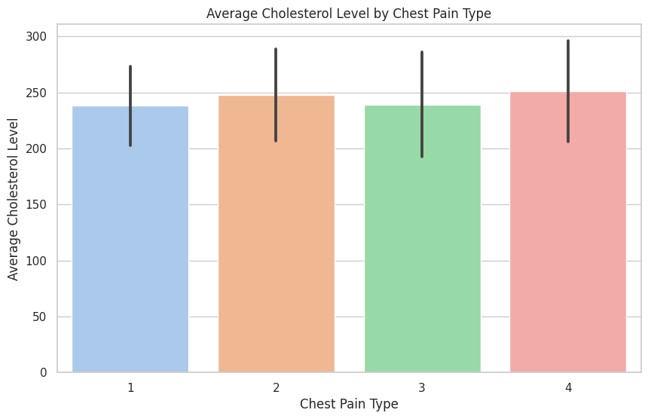
Average cholesterol level by chest pain type:

Slide 11
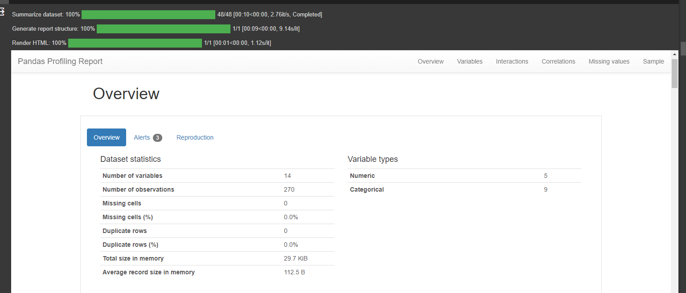
Pandas Profiling:

Slide 12
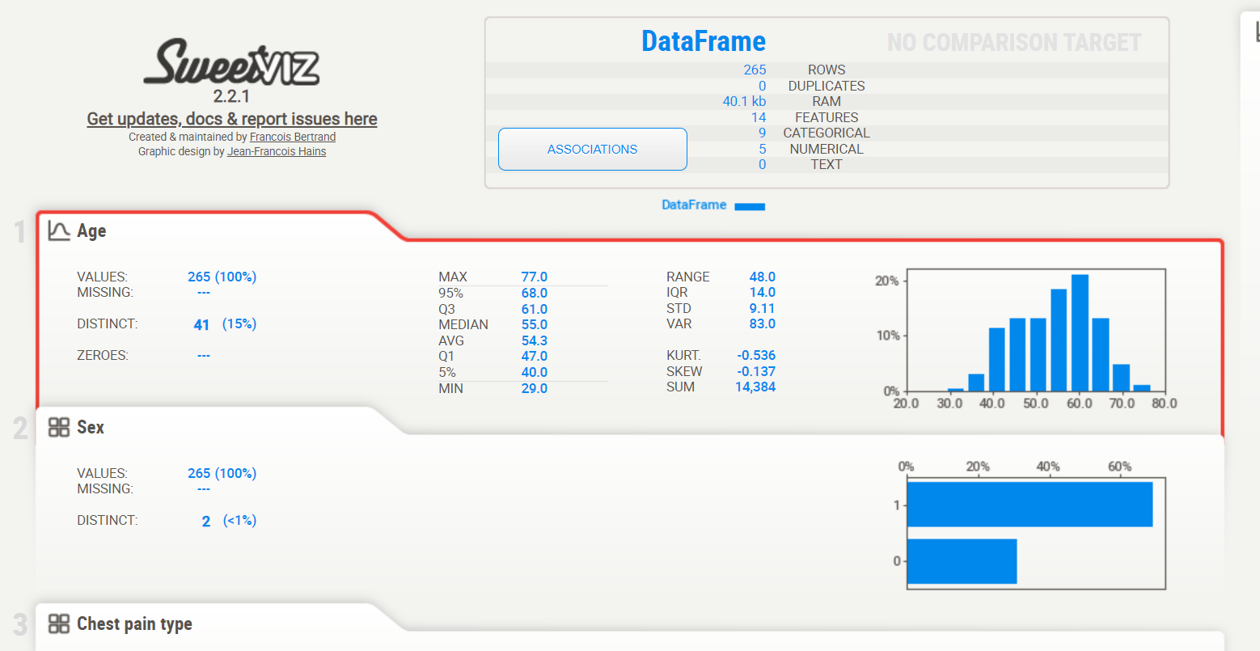
Sweetviz:

Slide 13
MODELS:
Logistic Regression
Decision Tree
Extreme-Gradient Boost
Neural Network

Slide 14
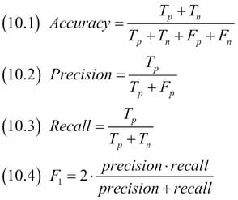
Metrics Used:

Slide 15

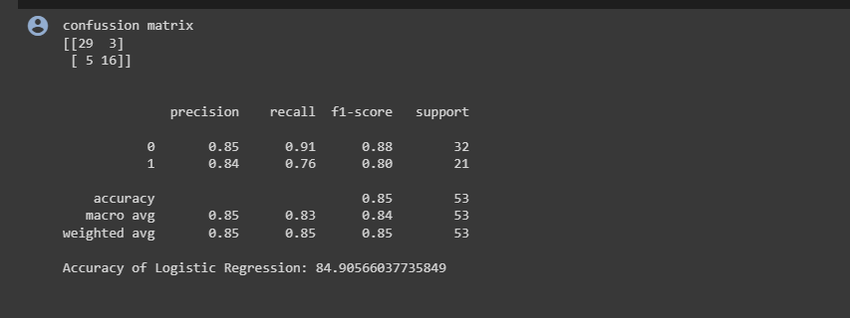
Logistic Regression-
It used for binary classification, estimating the probability of an event occurring based on input features and a logistic function.

Slide 16
Decision Tree:
A supervised machine learning algorithm used for classification and regression tasks, where it makes decisions based on a tree-like structure of conditions
Information Gain= Entropy(S)- [(Weighted Avg) *Entropy(each feature)
Entropy(s)= -P(yes)log2 P(yes)- P(no) log2 P(no)
Where,
S= Total number of samples
P(yes)= probability of yes
P(no)= probability of no
Gini Index= 1- ∑jPj2

Slide 17
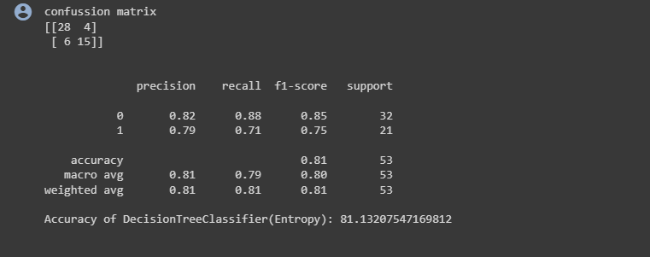
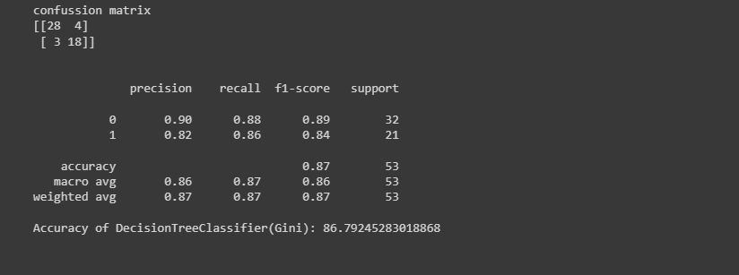

Slide 18
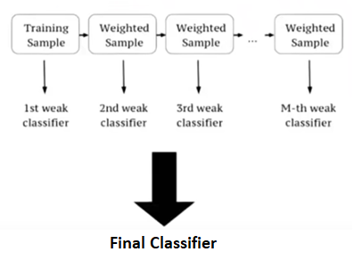
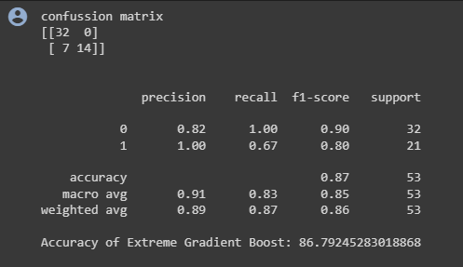
Extreme-Gradient Boost:
It is an ensemble machine learning algorithm that combines the predictions of multiple decision trees to improve accuracy and handle complex tasks.

Slide 19
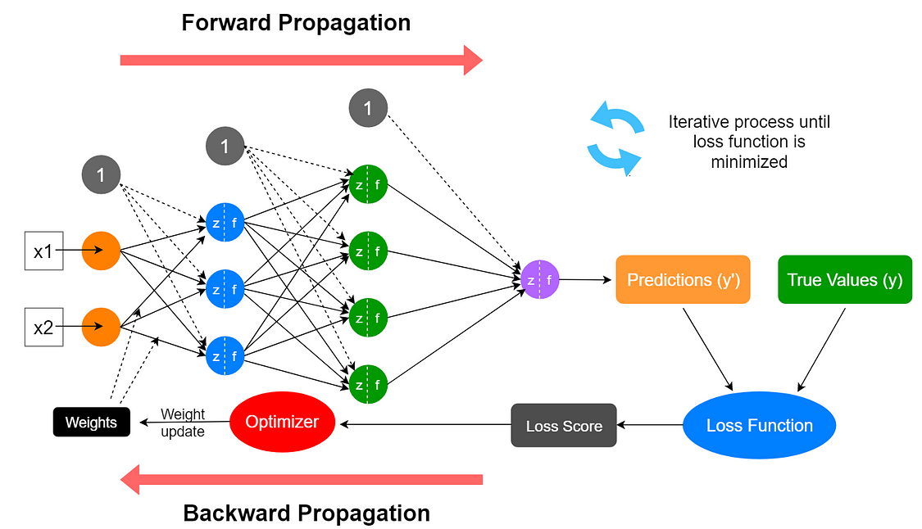
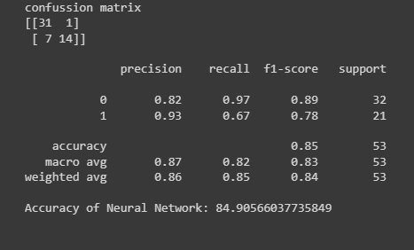
Neural Network:
ML model inspired by the human brain, consisting of interconnected nodes organized into layers, used for various tasks including classification and regression, particularly in deep learning.

Slide 20
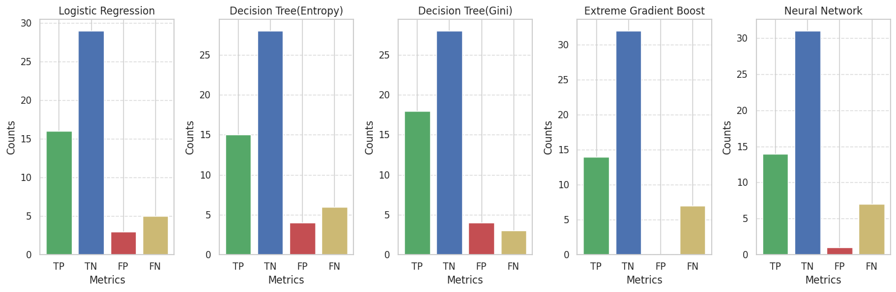
Comparison of the models:

Slide 21
LIMITATIONS:
Limited Dataset
Outliers
Feature Limitations
Model Selection
Evaluation Metrics
Thallium Interpretation

Slide 22
Conclusion:
The model investigated the influence of features like Age, Cholestrol level, fbs over 20 on the prediction of heart disease. We employed various machine learning models, including Decision Tree- Gini and Entropy, Neural Network, Extreme Gradient Boost, and Logistic Regression to analyze and predict heart disease based on the dataset.
Key Findings:
1. Thallium Level Significance- "Thallium Level" feature had a significant influence on the prediction of heart disease.
2. Model Performance- Decision Tree with the Gini criterion delivered the best overall performance
3. Accuracy and False Negatives- Decision Tree (Gini) model not only achieved the highest accuracy but also reduced the false negative rate.

Slide 23
THANKYOU

