Slide 1
Netflix Data analysis
Swapna S. Mohanty

Slide 2
Introduction:
This report provides a comprehensive analysis of the Netflix userbase data. The aim is to derive insights into user preferences, behaviors, and revenue contributions. Through various visualizations and analyses, we seek to understand patterns and trends that can inform business strategies and decision-making.

Slide 3
Objective
The primary objectives of this analysis are:
To understand the distribution of users across different subscription types and the associated revenue contributions.
To analyze device usage patterns and determine preferences based on subscription types.
To identify key countries that contribute significantly to Netflix's revenue.
To explore demographic patterns, such as age and gender, and their impact on subscription choices and device usage.

Slide 4
Hypothesis
Based on the dataset
Users with a 'Premium' subscription type contribute more to the monthly revenue compared to 'Standard' or 'Basic' subscribers.
Users who primarily access Netflix on Smart TVs are more likely to have a 'Premium' subscription compared to those using smartphones or laptops.
Certain countries contribute significantly more to the monthly revenue than others, possibly due to a higher number of subscribers or a preference for higher-tier subscription plans.
Younger users (e.g., age group 18-30) are more likely to access Netflix on smartphones, while older users might prefer Smart TVs or laptops.
Users with longer plan durations (e.g., annual plans) might be more inclined to choose 'Premium' subscriptions.

Slide 5
Analysis & findings

Slide 6
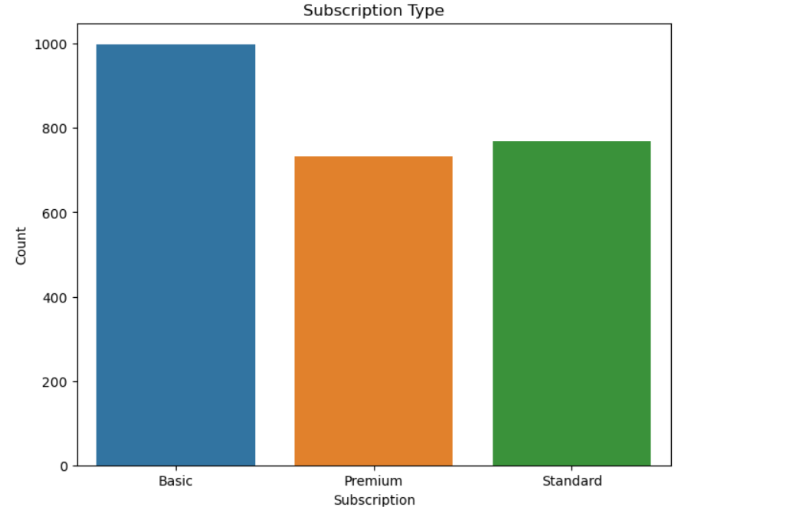
As we can see here the user mostly takes the Basic subscription may be due to its affordability.

Slide 7
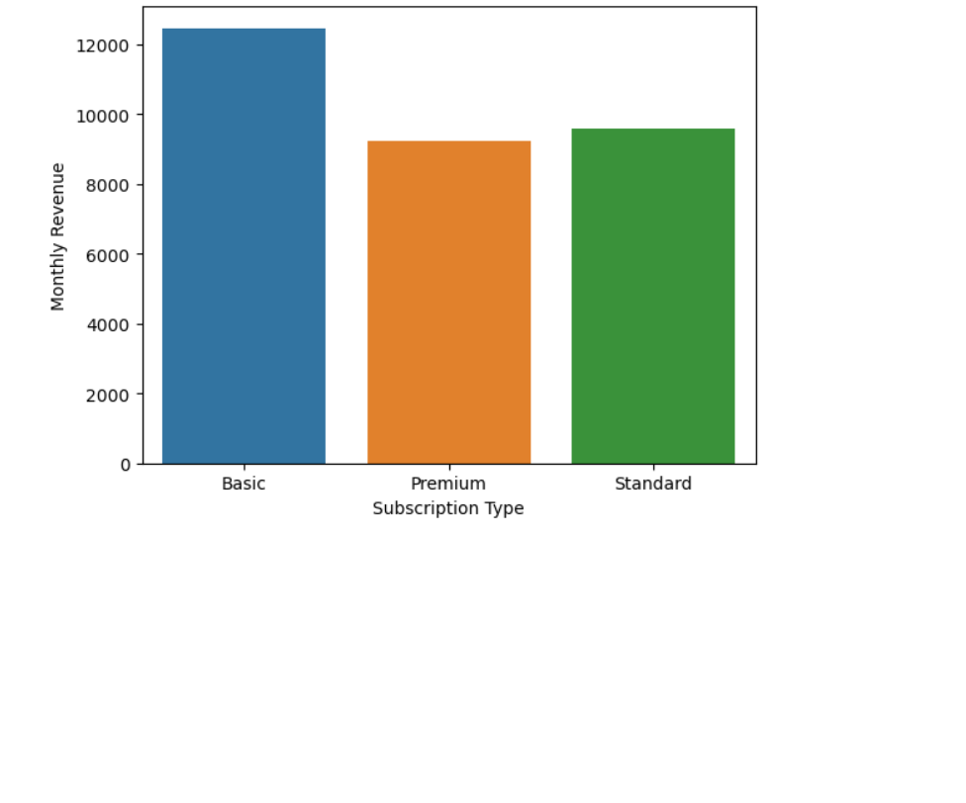
As observed, the 'Basic' subscription type contributes the most to the monthly revenue, followed by 'Standard' and 'Premium'. This not aligns with our hypothesis that users with a 'Premium' subscription contribute more to the monthly revenue compared to other subscription types.
Even if 'Basic' costs less per month than 'Premium', if there are significantly more 'Basic' subscribers than 'Premium', the total revenue from 'Basic' can be higher.

Slide 8
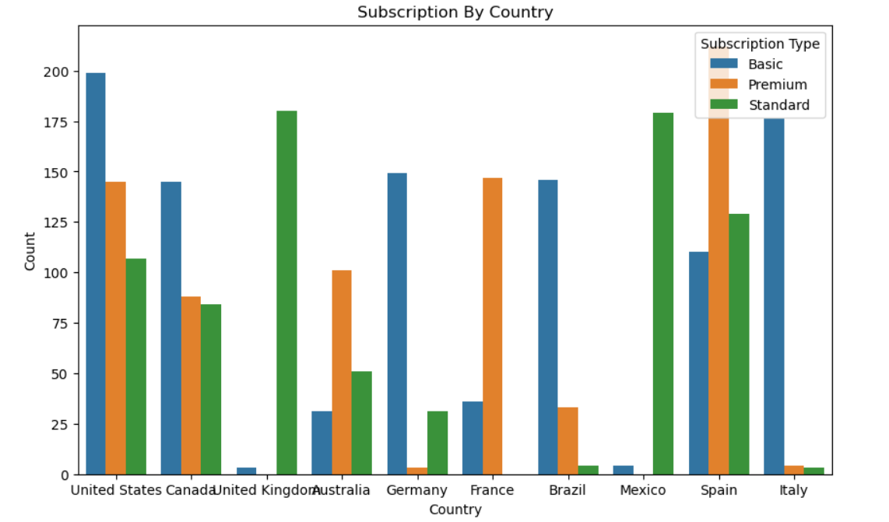
Spain and United state has more customers than others. In Spain more people take the Premium subscription

Slide 9
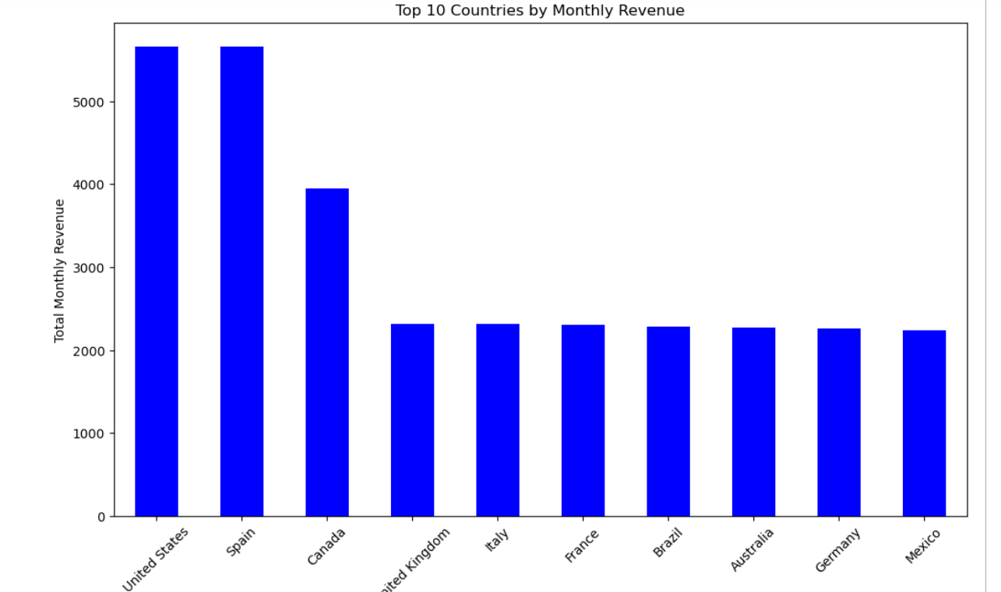
United States and Spain have more monthly Revenue followed by Canada due to higher number of subscriptions. As people of Spain preference for premium subscriptions and that may be the revenue of Spain higher due to premium subscription price is higher.

Slide 10
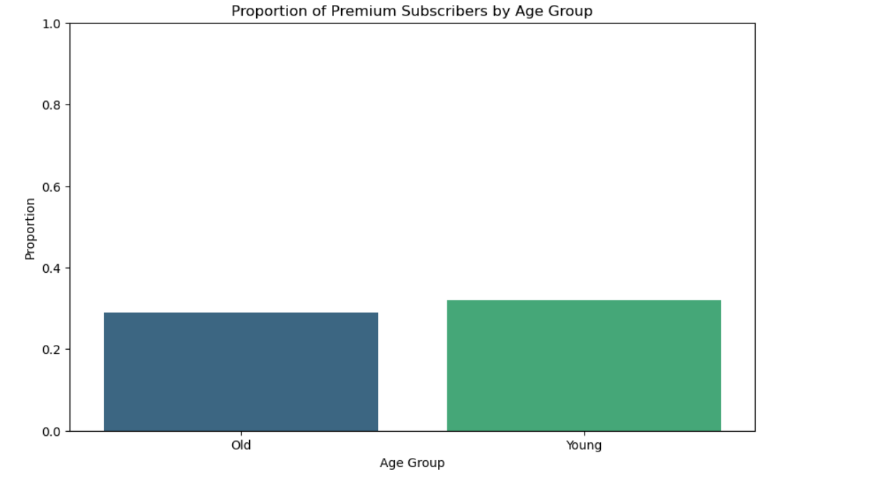
While there is a slightly higher proportion of 'Premium' subscribers in the 'Young' age group compared to the 'Old' age group, the difference is not substantial. Therefore, age might play a role in subscription type preference.

Slide 11
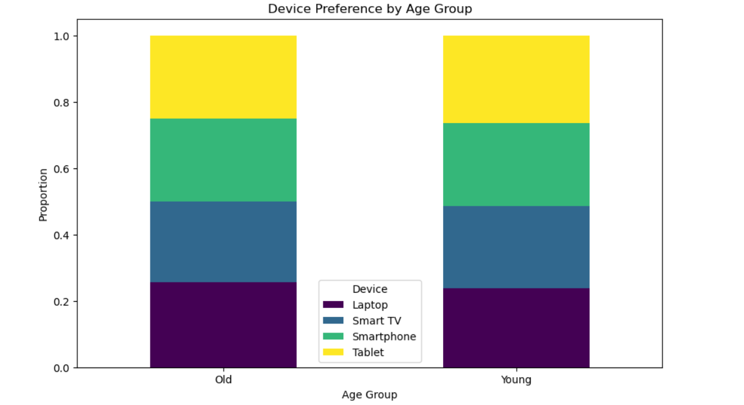
By looking at the segments within each bar, we can conclude all devices are popular among each age groups.

Slide 12
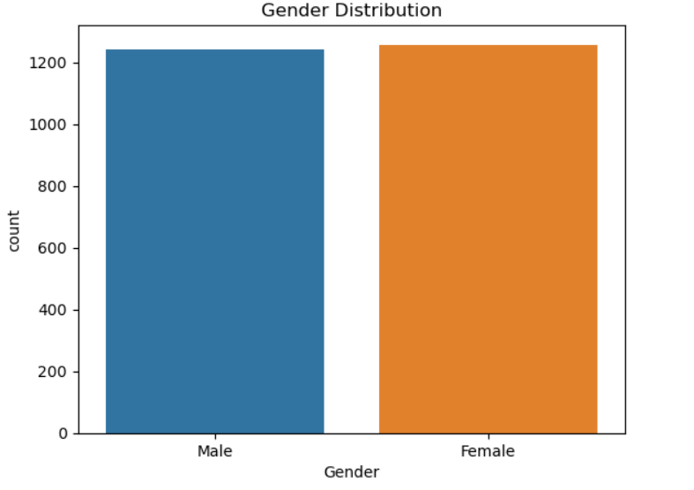
Both male and female user mostly equal.

Slide 13
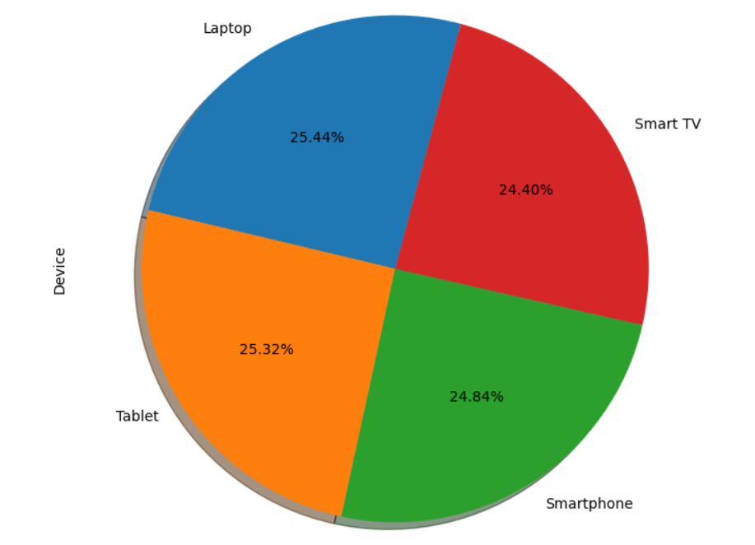
User devices are equally divided.

Slide 14
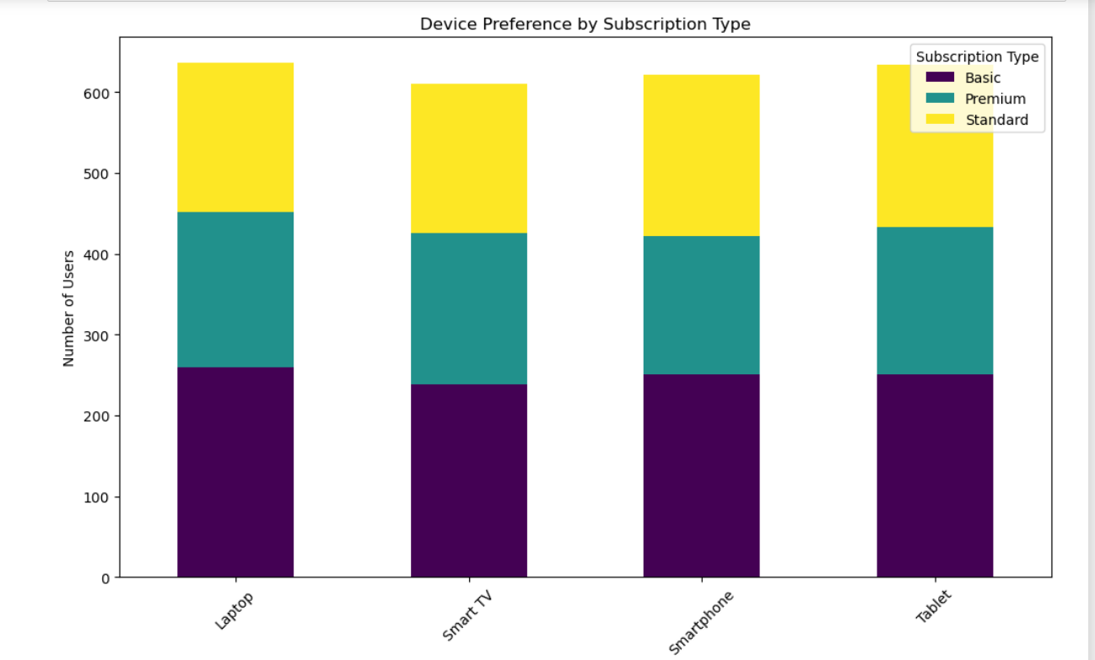
From the above visualization we conclude that laptop is preferred by subscribers.

Slide 15
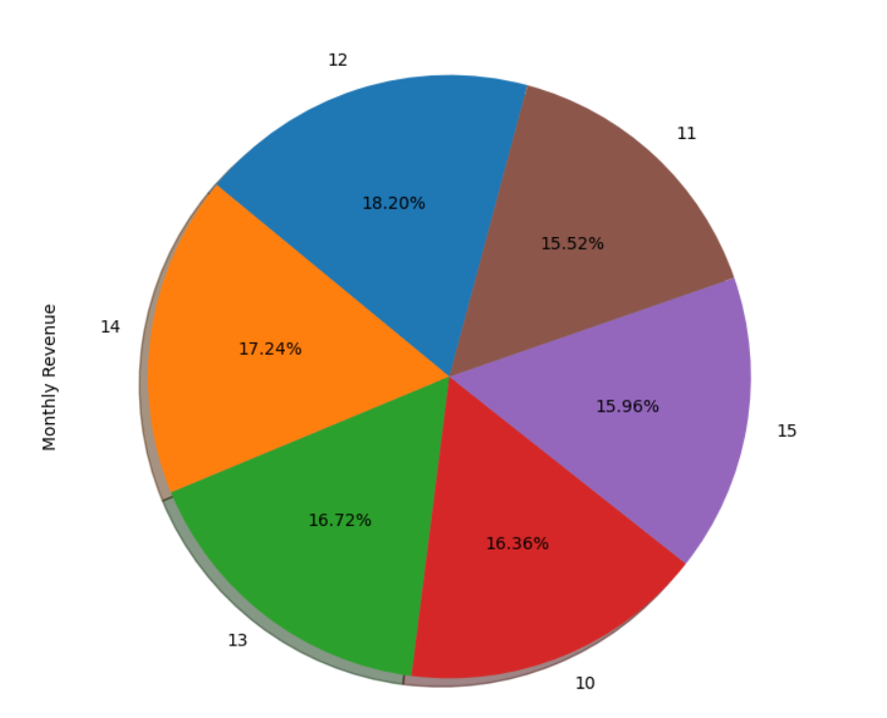
$12 Monthly subscription is most popular. Most of the revenue is coming from this subscription.

Slide 16
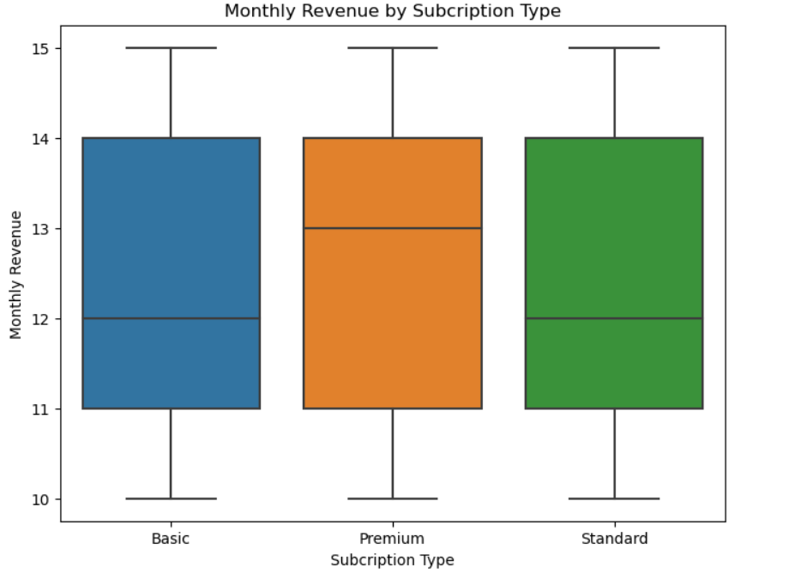
As observed, the 'Premium' subscription type contributes the most to the monthly revenue, followed by 'Standard' and 'Basic'. This aligns with our hypothesis that users with a 'Premium' subscription contribute more to the monthly revenue compared to other subscription types.

Slide 17
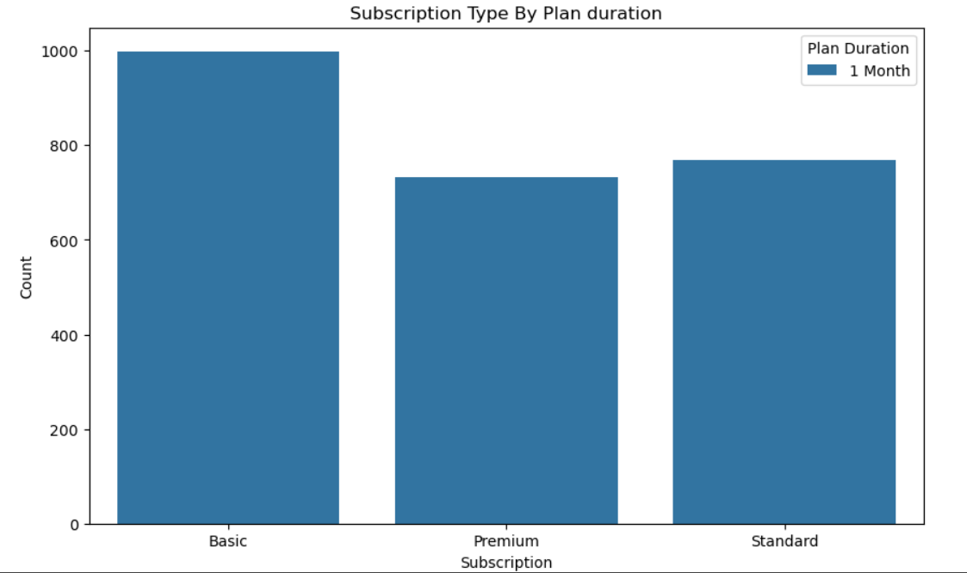
From the graph, it's evident that for longer plan durations, the 'Basic' subscription type has a larger segment compared to 'Standard' and 'Premium'.
Users might find the 'Basic' subscription more cost-effective when committing to longer durations.
It's also possible that certain demographics, such as students or individuals with budget constraints, prefer longer-duration plans to avail discounts and opt for the 'Basic' subscription to further minimize costs.

Slide 18
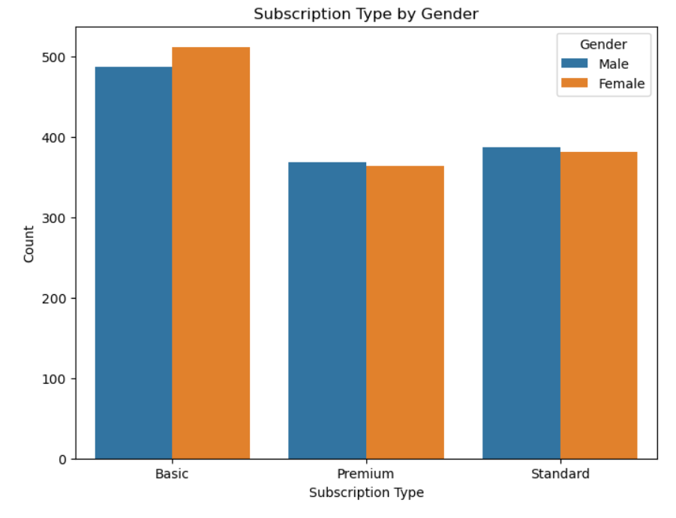
As we know most of the user took the Basic subscription and from the above plot, we conclude that the count of both the male and female users are almost same. The difference is too little.

Slide 19
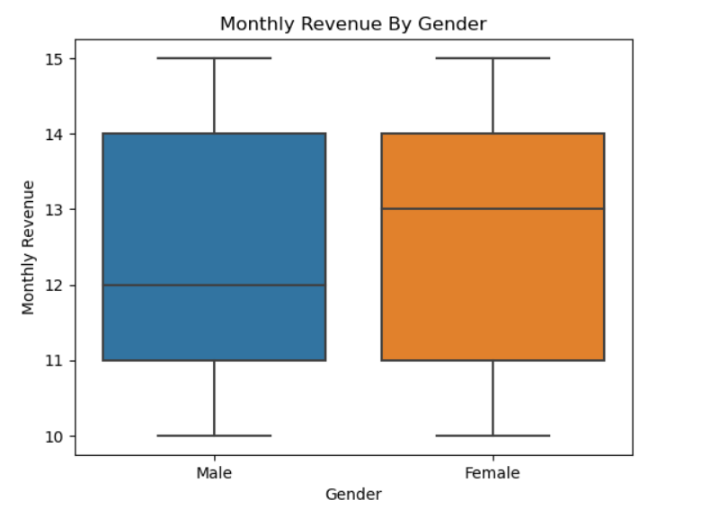
Females contribute slightly more to the monthly revenue than males. This could be due to various factors, such as a higher number of female subscribers, females opting for more expensive subscription plans, or females having longer plan durations.
If females tend to opt for 'Premium' subscriptions more often than males, it could contribute to the higher revenue. Similarly, if females have longer plan durations, it could also lead to higher revenue.

Slide 20
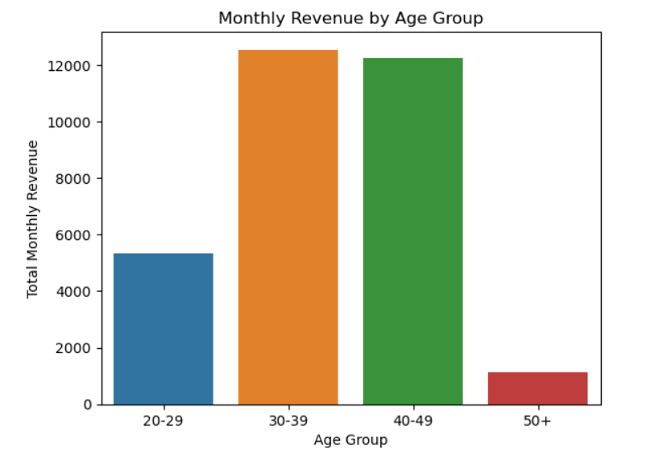
From the above graph we conclude that most of the user purchased subscription are aged 30-49.
The age group '30-49' typically represents individuals in their peak earning years. They might have more disposable income to spend on entertainment, leading to higher subscription rates or preference for premium plans.
The content preferences and viewing habits might differ between genders. Understanding these preferences can help Netflix tailor its content and marketing strategies to better cater to both genders.

Slide 21
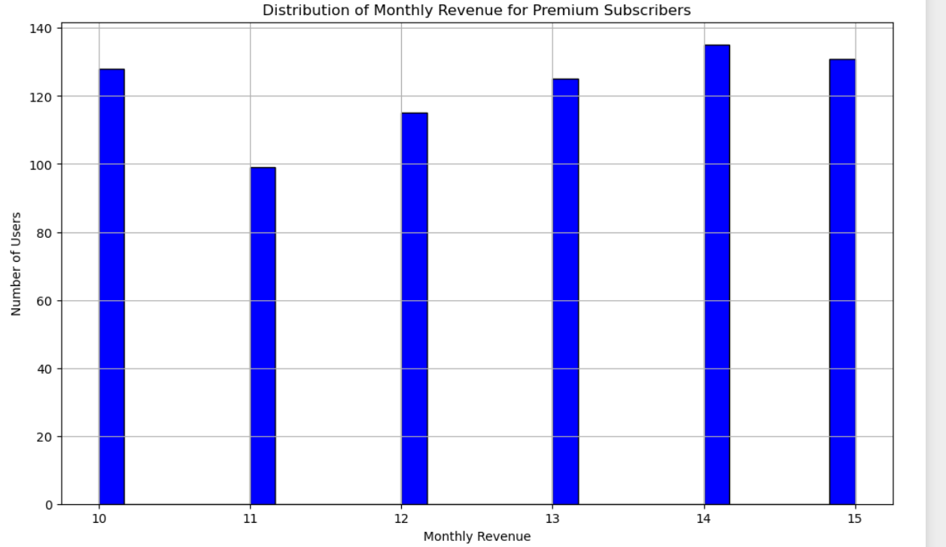
The histogram displays the frequency of users against different monthly revenue values for 'Premium' subscribers.
We can observe a peak around a certain monthly revenue value, which could be the standard monthly cost for 'Premium' subscribers.
There's also a noticeable group of users paying slightly less than the peak value. Based on our assumption, this group might represent users on annual or longer-duration plans who receive a discount on the monthly cost.

Slide 22
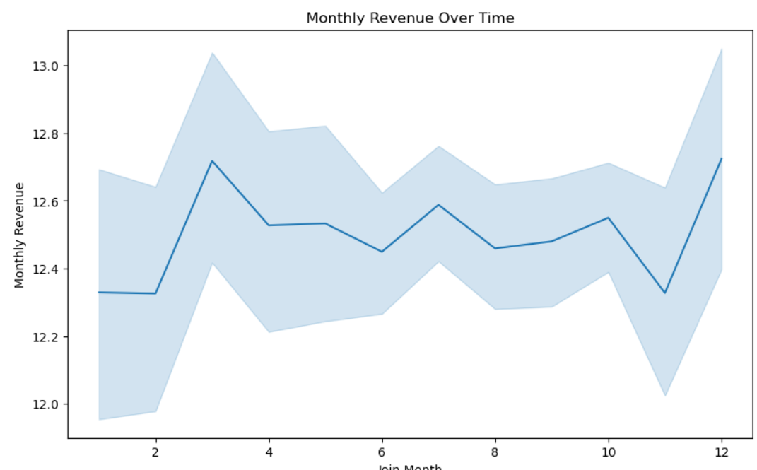
A steady increase in monthly revenue over time, indicating consistent growth for Netflix.
There are some fluctuations, which could be attributed to various factors such as promotional offers, content releases, or seasonal trends.

Slide 23
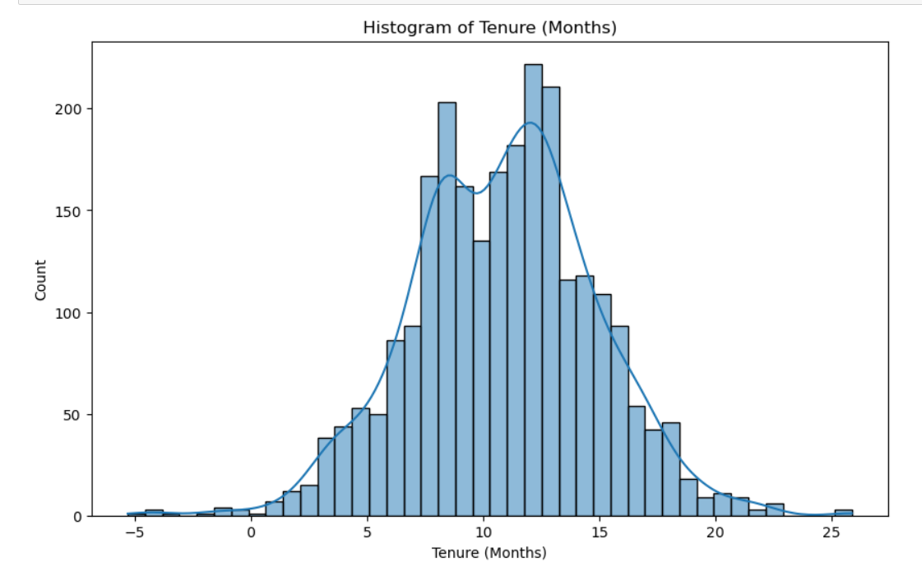
It indicates the most common tenure duration among Netflix users. The peak is around 8-12 months, it suggests that a significant number of users have been subscribed for about a year.

Slide 24
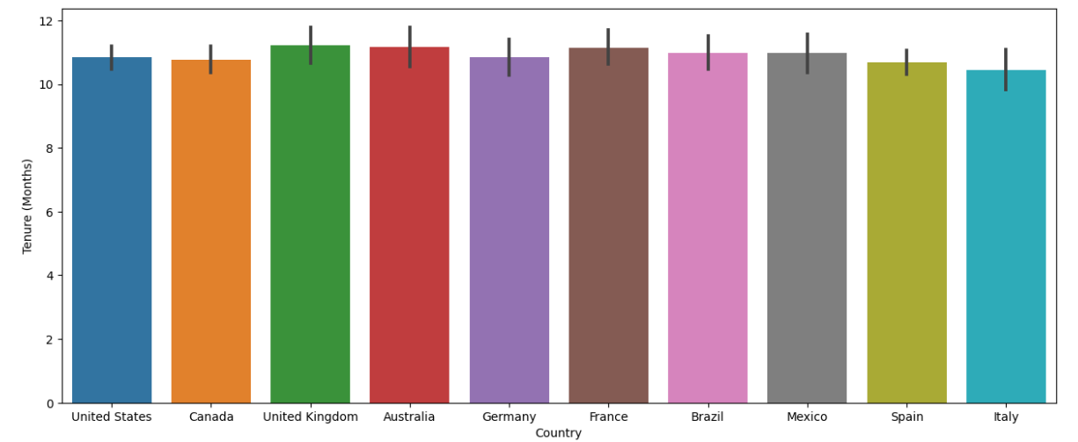
Most countries have subscription duration (Tenure) for 11-12 months around 1 year.

Slide 25
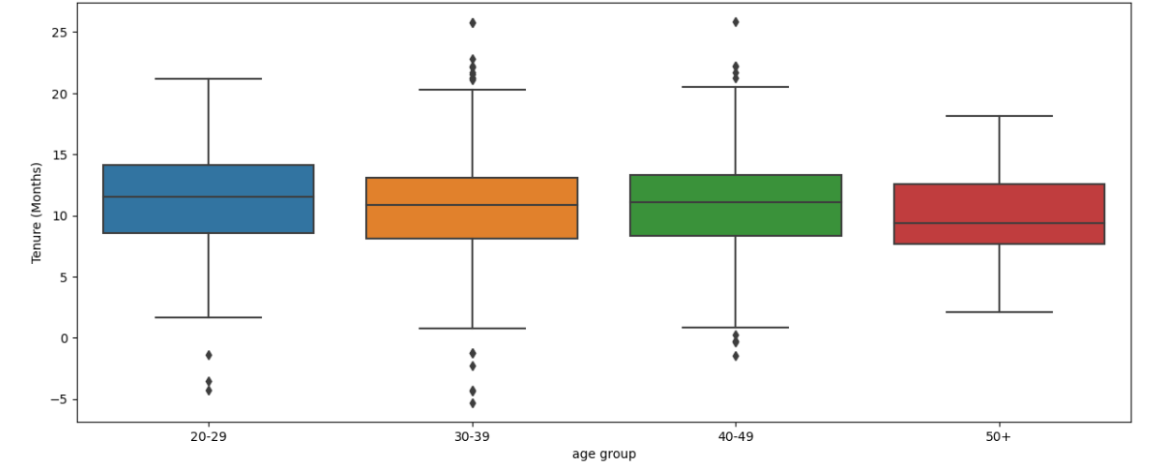
Observed that the 20-29 age group, that means younger age group has little longer Tenure as compared to middle age group. But age group 50+ has shorter Tenure.
This could indicate that younger users are more engaged with the platform, possibly due to a wider range of content that appeals to them.
It may also suggest that they find the platform's features, user interface, or subscription plans more appealing.
This age group might also be more inclined to share accounts, leading to longer tenures.
Older users may not find the content appealing, or they might be less comfortable with the digital platform.
They might also have more established viewing habits and are less likely to explore new content, leading to shorter tenures.
Another possibility is that they are more price-sensitive and less likely to maintain long-term subscriptions.

Slide 26
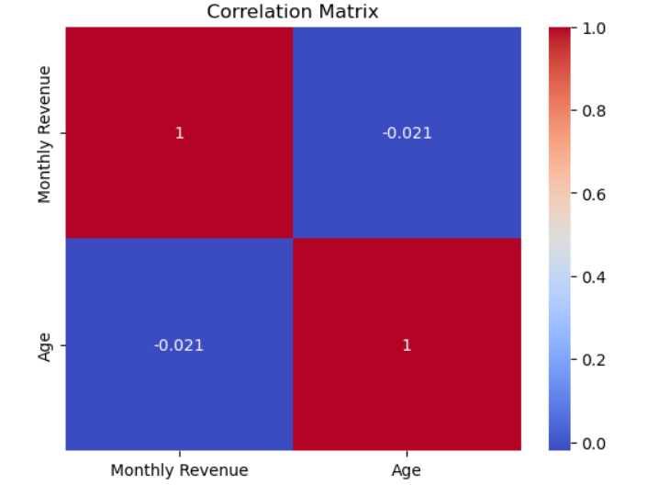
A correlation coefficient of 1 indicates a perfect positive correlation, meaning that as one variable increases, the other variable increases proportionally.
A correlation coefficient of -1 indicates a perfect negative correlation, meaning that as one variable increases, the other variable decreases proportionally. A correlation coefficient of 0 indicates no linear correlation between the variables.
Since the correlation coefficient is close to 0, we can conclude that there is no significant linear relationship between the age of users and their monthly revenue. In other words, knowing one variable (age) does not help predict the other variable (monthly revenue) accurately.

Slide 27
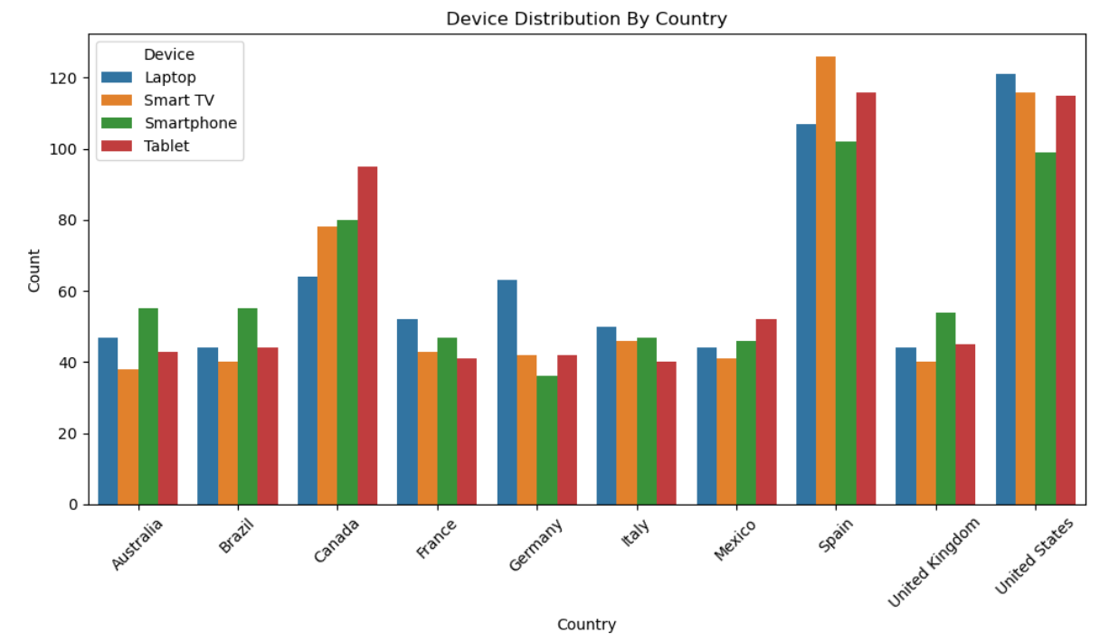
United States and Spain has more Subscribers so we can see here their device distribution also more. In Spain more people are using Smart Tv.

Slide 28
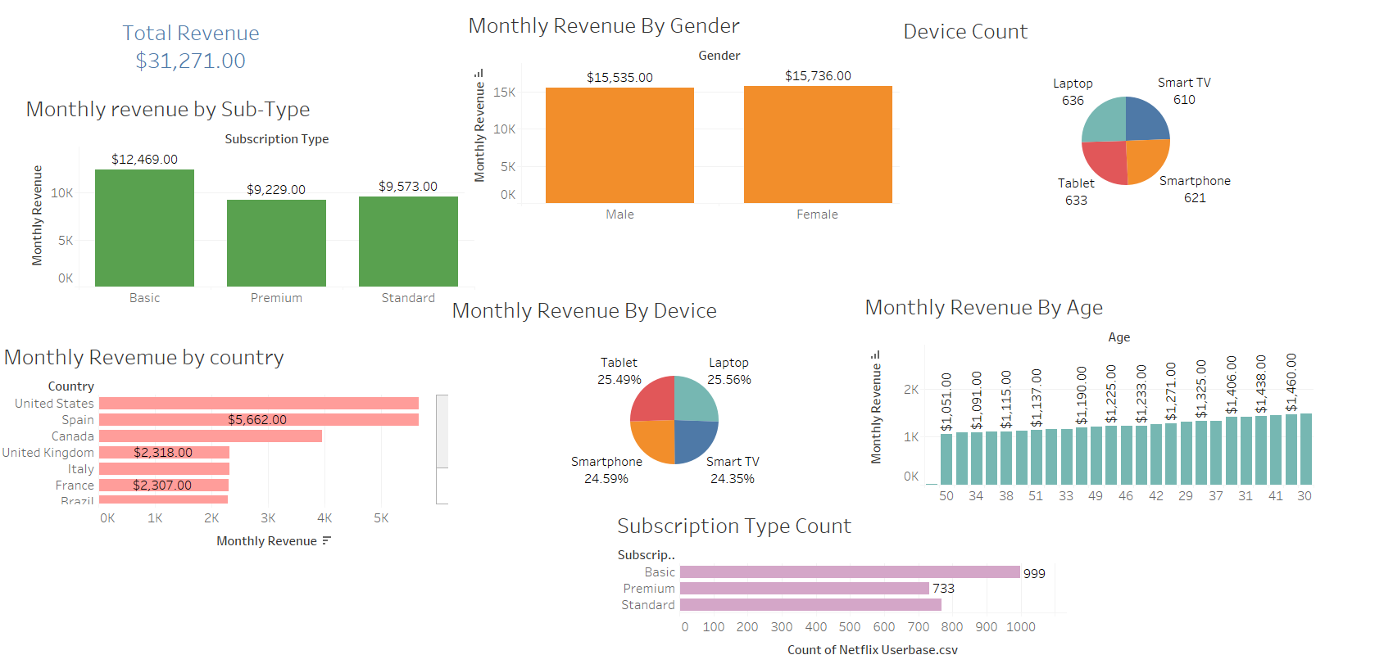
Tableau Presentation

Slide 29
Final Conclusions
Younger Audience Engagement: The '20-29' age group shows longer tenure, indicating a strong customer base.
2. Older Audience Gap: The '50+' age group has shorter tenures, suggesting an area for improvement.
3. Device Preferences: Different age groups prefer different devices for accessing Netflix, with Smart TV users more likely to opt for 'Premium' subscriptions.
4. Revenue Insights: Monthly revenue varies by gender and country, with females contributing slightly more. 30 -49 groups contribute more revenue.
5. Subscription Types: Basic subscriptions are more popular among users and contribute more to monthly revenue.

Slide 30
Recommendations
Content Diversification: Introduce more content that appeals to different age groups, especially the '50+' demographic.
User Experience Enhancement: Simplify the user interface and offer interactive tutorials, focusing on older users.
Targeted Marketing: Leverage the longer tenure of the '20-29' age group with special promotions and loyalty programs.
Use gender and country-specific data to tailor marketing campaigns.

Slide 31
Recommendations
Subscription Incentives:
Offer bundled plans with ISPs to encourage 'Premium' subscriptions.
Introduce family plans and loyalty programs to reward long-term subscriptions.
Revenue: Netflix can consider introducing content that appeals specifically to this 30-49, given their significant contribution to revenue. This could include genres like drama, thrillers, documentaries, or content related to family and work-life balance.
Marketing strategies and promotions targeting this age group can be beneficial. For instance, family packages or discounts on annual plans might be appealing to them.
It's also essential to monitor the viewing habits and feedback from this age group to ensure that their needs and preferences are consistently met.
Data-Driven Strategies:
Implement real-time analytics to monitor KPIs.
Regularly collect customer feedback to adapt and improve.
By focusing on these key areas, Netflix can increase user engagement, extend customer tenure, and maximize revenue. Implementing these recommendations could provide a significant boost to the business.

Slide 32
THANK YOU

