Slide 1
Book1
File created on: 8/26/2023 7:31:43 PM

Slide 2
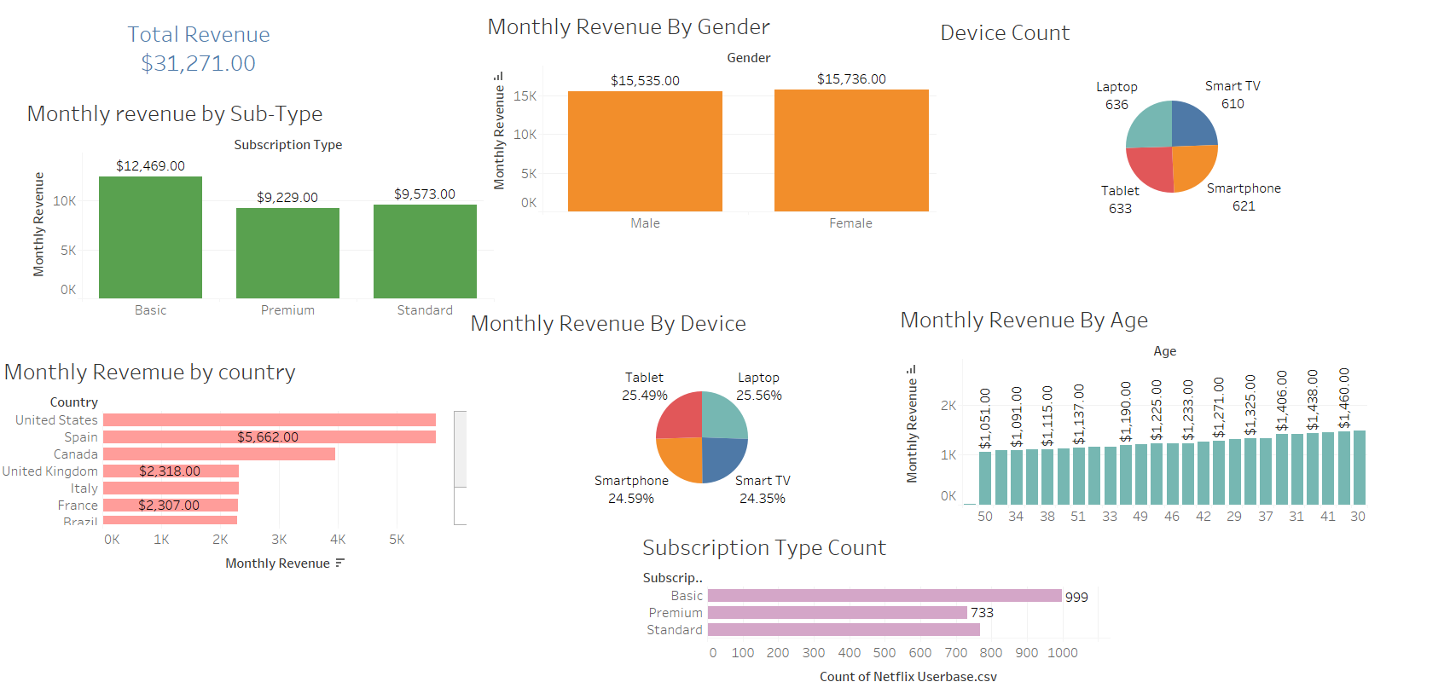
Tableau Presentation

