Slide 1
JIRA
Lesson 01: Introduction to JIRA
Notes:
Add instructor notes here.

Slide 2
Lesson Objectives
In this lesson, you will learn about:
What is JIRA?
Features of JIRA
Basics concepts in JIRA
Issue
Project
Workflow
Components and Versions
JIRA Software
Notes:
Add instructor notes here.

Slide 3
1.1: Introduction to JIRA What is Jira?
Jira is a defect tracking/project management tool
JIRA allows you to track any kind of unit of work (be it an issue, bug, story, project task, etc.) through a predefined workflow
JIRA Software is built for every member of your software team to plan, track, and release great software
Plan : Create user stories and issues, plan sprints, and distribute tasks across your software team.
Track: Prioritize and discuss your team's work in full context with complete visibility.
Release: Ship with confidence and sanity knowing the information you have is always current.
Report: Improve team performance based on real-time, visual data you can use.
Notes:
JIRA is a tool developed by Australian Company Atlassian. It is used for bug tracking, issue tracking, and project management. The name "JIRA" is actually inherited from the Japanese word "Gojira" which means "Godzilla".
The basic use of this tool is to track issues, and bugs related to your software and mobile apps. It is also used for project management. The JIRA dashboard consists of many useful functions and features which make handling of issues easy.
Add instructor notes here.

Slide 4
1.2: JIRA Features Features of Jira
Jira is web based, open source product
JIRA keeps you agile because it is a lightweight, web-based tool for task and issue tracking.
Track issues, teams, iterations and releases
Integrate with your other development tools
Customize to fit your style of Agile development
Notes:
Who uses JIRA?
Software project development teams, help desk systems, leave request systems etc.
Coming to its applicability to QA teams, it is widely used for bug tracking, tracking project level issues- like documentation completion and for tracking environmental issues. A working knowledge of this tool is highly desirable across the industry.
Add instructor notes here.

Slide 5
1.2: JIRA Features Features of Jira
JIRA helps us prioritize, assign, track, report and audit your issues
Example issues: software bugs, help desk tickets, project tasks , change requests, etc.
JIRA reporting allows you to monitor the progress of your issues with detailed graphs and charts.
JIRA helps you map your business process with a custom workflow
JIRA improves productivity by reducing time required to track issues and coordination

Slide 6
1.2: JIRA Features Features of Jira
JIRA can be used for:
Bugs/Change Requests Tracking
Help-desk/ Support/ Customer Service
Project Management
Task Tracking
Requirements Management
Workflow/ Process Management

Slide 7
1.3: JIRA Concepts Jira Basic Concepts
Issue: Every task, bug, enhancement request; basically anything to be created and tracked via JIRA is considered an Issue.
Project: a collection of issues
Workflow: A workflow is simply the series of steps an issue goes through starting from creation to completion.
Components: Components are sub-sections of a project; they are used to group issues within a project into smaller parts.
JIRA
Project
Issue
Workflow
Component
Version
Notes:
Add the notes here.
Add instructor notes here.

Slide 8
1.3: JIRA Concepts Mapping JIRA Concepts - Project and Issues
Example: A Software Development Project
Project
Time Tracking Application
Components
User Interface, Reports, Workflow
Versions
0.1, 0.2..,1.0,1.1…,2.0
Issues
New Features
Bug
Support Ticket
Sub – Tasks
Sub – Tasks
Sub – Tasks

Slide 9
1.3: JIRA Concepts Mapping JIRA Concepts - Workflow
Customizable workflow to meet business needs
Open
In Progress
Respond
Resolved
Closed

Slide 10
1.3: JIRA Concepts JIRA Concepts
JIRA provides real-time, relevant information in a convenient format
JIRA enables clear visibility of situation to the management

Slide 11
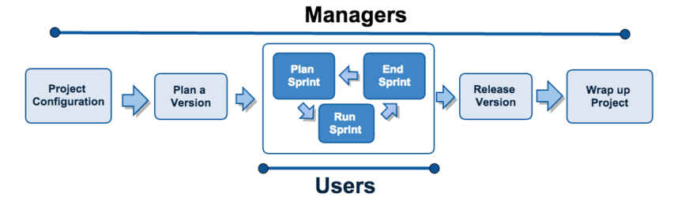
1.4: JIRA Software JIRA Software
Can be used by – Managers and Users
Managers : Will have administrative rights for your instance of JIRA software
Users: who work and resolve issues
JIRA software workflow:

Slide 12
1.4: JIRA Software Manager Role
Manager can perform following tasks:
Create a new software project
Added users
Prepare your backlog
Start and complete a sprint
Evaluate the results

Slide 13
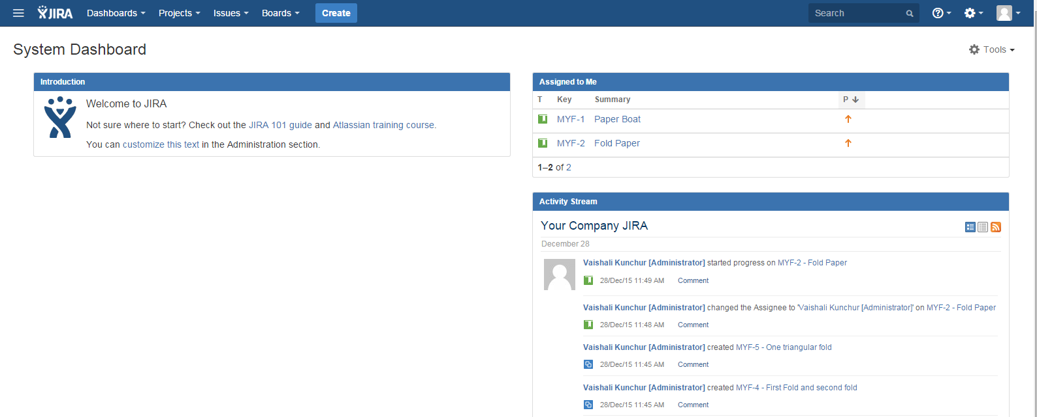
1.4: JIRA Software Login to JIRA
When you login , you get a snapshot about description of your project – dashboard page
Notes:
Once logged in, the dashboard page is displayed (unless otherwise chosen) to the user. The dashboard page gives a snap shot about the description of the project you belong to; issue summary and the activity stream (the issues that are assigned to you, the issues that you created etc).
Add instructor notes here.

Slide 14
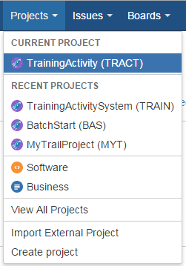
1.4: JIRA Software Project
Project is a collection of issues
Project has following attributes:
Name: given by the administrator
Key: It is an identifier that all the issue names under the project are going to start with. This value is set during the creation of a project and cannot be modified later even by an administrator
Components: subgroups within a project based on common grounds
Vision: For a project different versions can be tracked
Notes:
Project: Every issue belongs to a project. You can choose the same by clicking on the drop down and choosing the project that you want this issue to belong to.

Slide 15
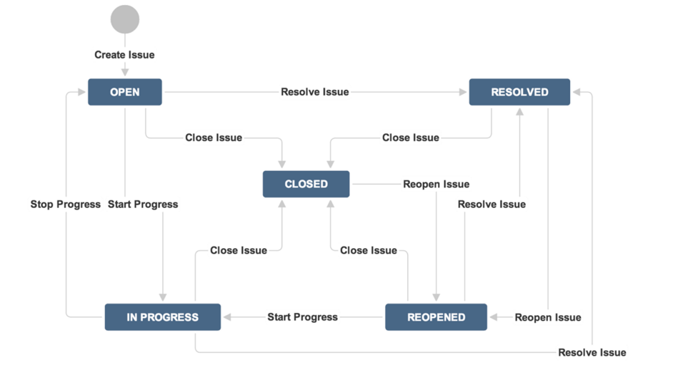
1.4: JIRA Software Workflow
A JIRA workflow is the set of statuses and transitions that an issue goes through during its lifecycle.
The following diagram shows JIRA's built-in workflow:

Slide 16
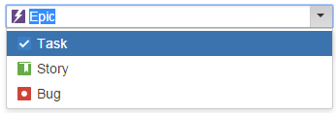
1.5: JIRA Issues Issues
Issue is anything that can be tracked to completion.
Example:
A document to be created
Software bug
Project task
Leave request form
Issue types: (default)
Bug — A problem which impairs or prevents the functions of the product.
Task — A task that needs to be done.
Story — A new feature of the product.
Story – Grouping of issues
Custom Issue — A custom issue type, as defined by your organization if required.
Improvement — An enhancement to an existing feature.
Notes:
Issue type: This field displays all the types of issues that can be created and tracked via JIRA.
The items Bug, new feature, task, improvement are exactly what their names imply. Epic and story are more relevant to agile projects. Story is a requirement in Agile that needs to be tracked from start to finish. Epic is a group of stories.
Choose the issue type as needed

Slide 17
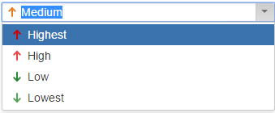
1.5: JIRA Issues Issues
Priority: An issue's priority indicates its relative importance.
Highest — Highest priority. This problem will block progress.
High — Indicates that this issue is causing a problem and requires urgent attention.
Medium — Indicates that this issue has a significant impact.
Low — Indicates that this issue has a relatively minor impact.
Lowest — Lowest priority.
Notes:
Add the notes here.
Add instructor notes here.

Slide 18
1.5: JIRA Issues Projects
Version : versions available for the project.
Release: You can release after creating versions
Assignee: Person to whom this issue should be handed over further. You can also assign an issue to yourself.
Notes:
Component: This list will display the components of the Project.
Affected Version and Fix version: These two fields will display the versions available for the project. It is not necessary that a certain issue that you encountered in a certain version gets fixed in the same one. In cases like that, you can choose the affected version as the current version and fix version as the next one.
Also, these fields can take multiple values. You can choose to set that a certain issue affects both version 1 and version 2 as below:
Assignee: You can type the name of the person to whom this issue should be handed over further. You can also assign an issue to yourself.

Slide 19
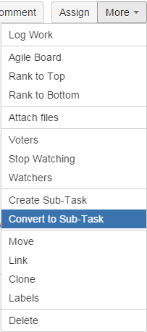
1.5: JIRA Issues Sub tasks
A sub-task is nothing but a division of a parent issue (task) into chunks of work that can be assigned and tracked individually.
Notes:
Example 1: A QA related example could be of the task of Test documentation. Test documentation by itself is an activity that might take a week to finish. Say, it involves the following aspects: Test plan documentation which takes 2 days. Test case documentation – 2 days, Test plan review – ½ day and Test case review – 1 day. Also assume that there are 2 resources.
In this case we can create a JIRA issue of the type task for “Test documentation” and have the following four sub tasks under it:
Test plan documentation – assigned to resource 1
Test case documentation – assigned to resource 2
Test plan review- assigned to resource 2
Test case review- assigned to resource 1
By doing so, it is easier to have a better insight into the progress task wise and resource wise by breaking a sizeable parent task into sub-tasks.
Note: It should not be confused that an issue type of “Task” only contains “sub-tasks”. An issue of any type can have sub-tasks.
Example 2: An example related to bug could be – if a bug is encountered and needs a code change to fix it, the developer can use a sub-task to track this code-fix that needs to take place. Here, the code-fix (of type sub-task) becomes a sub-task under the bug found (of type Bug).
You can create sub-tasks by following one of the two methods:
Create a sub-task to an issue, or
Convert an issue to a sub-task and choose a parent
We will see both the ways below.

Slide 20
Notes:
Agile Board, Rank to Top, Rank to Bottom -> Related to Agile Projects – the details of which are going to be coming up in a later article.
Attach Files, Attach Screenshots -> Lets you attach files to an issue. The screenshot option will auto capture a screenshot. All you need to do is print screen on your machine and you can directly copy it here into JIRA.
Add Vote, Voters, Stop watching, Watchers -> Voting is a process that JIRA users can perform to support the resolution of an issue favorably or unfavorably. The options in this section facilitate the same. You can also choose to watch an issue – when you do so, all the changes to it will be notified to you.
Create Sub-Task, Convert to Sub-task -> These are the options that help create and work with sub-tasks. The details are available intutorial #3 of the JIRA series.
Labels -> This concept is similar to the “Labels” that we find on various blog and web pages. You can categorize issues based on Version and Component formally, but when in need of something more informal, this option can be used. For example, all the issues raised to track peer review comments can be labeled “peer review” to view and track them easily.
5) Log work: This is a way to track the progress on your issue in terms of time. When this option is used, the following dialog opens up. As you can see, the detailed information about how much time is spent on an issue, how much is remaining, etc can be logged here.

Slide 21
1.5: JIRA Issues Managing Issues
Edit: Used to modify issue, change the desired information and update
Comment: Comment will be helpful to communicate issue related information to others
Assign: with this we can give ownership of that issue to a user. On assigning an issue email will be sent
More: With this you can do many tasks like – log work, Move, Link, Clone and Attach Files
To Do
In progress
Done
Notes:
6) Move: JIRA issues can be moved across projects. However, the move from one project to another might mean a different target workflow, a different issue type, a new status etc. It is therefore advisable to analyze thoroughly how the move is going to affect the issue before going ahead with this.
7) Link: This is a very versatile feature of JIRA that allows you can logically link issues with one another and establish relationships/dependencies.
An example situation where this can be used in QA projects is when a certain defect prevents you from working a certain requirement. You can use this option to show the dependency.
8) Clone: As the name implies you can create a duplicate for an issue.

Slide 22
1.4: Introduction to GO Demo
Create issue
Add field to issue
Edit issue
Attach file
Cloning issue
Commenting Issue
Creating Sub Task
Notes:
Add the notes here.
Add instructor notes here.

Slide 23
1.4: Introduction to GO Lab
Issues Lab
Notes:
Add the notes here.
Add instructor notes here.

Slide 24
Summary
JIRA is a Application Lifecycle Management Tool
Jira Components:
Issues
Projects
Components
Versions
Workflow
JIRA Software
Manage JIRA Issues
Notes:
Add the notes here.
Add instructor notes here.

Slide 25
Review Question
Question 1: Which of the following depicts the status and transition of an issue?
Option 1: Version
Option 2: Component
Option 3: Workflow
Question 2: Project will have components and versions
True/False
Question 3: Fill in the Blanks:
Release can be done only after creating ________
Notes:
Add the notes here.
Answers:
Question1. All of the above
Question 2: main()

Slide 26
Match the following
Column 1 | Column2
Issue | Series of steps
Project | Task
Workflow | Sub section of projects
Component | Collection of Issues

