Slide 1
JIRA
Lesson 02: JIRA Configuration
Notes:
Add instructor notes here.

Slide 2
Lesson Objectives
In this lesson, you will learn about:
Configuring Workflow
Agile Projects
JIRA features for Agile
JIRA Versions and Release
Administrative Activities:
Creating and Managing boards
Configuring Project
Creating Users, groups
Creating Workflow
JIRA Reports
Notes:
Add instructor notes here.

Slide 3
2.1: Workflow to JIRA Workflow
JIRA Issues can move through different states of workflow
On creating issue, its status is always “To Do”
It can go through “In Process” and “Done”
Workflow will depend on the project type and the project while creation
Notes:
Add instructor notes here.

Slide 4
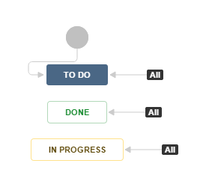
2.1: Workflow to JIRA Workflow
To view the workflow that the certain issue goes through, click on the “View workflow” link that is next to the status field of an issue in the issue details page

Slide 5
2.1: JIRA Versions and Release Versions
We can create JIRA versions
After creating versions we can do project releases

Slide 6
2.2: Agile Project Agile Project
Agile Projects:
Requirements are created and grouped together in Product Backlog
Product Backlog is prioritized according to business importance
Product Backlog items are assigned to Sprints which are 2-4 week duration
JIRA supports all above activities followed by Agile Methodology
Notes:
Add instructor notes here.

Slide 7
2.2: JIRA Features JIRA Features for Agile
Creating boards
User can create and manage boards which will help display issues from a particular project or multiple projects to be monitored
2 type of boards in JIRA agile :
SCRUM board
Kanban board
Plan:
Create Backlog Items (issues)
Create Sprints
Add backlog items to the sprints
Monitor:
You can monitor issues in the sprint
This will show the status of all items in the track mode

Slide 8
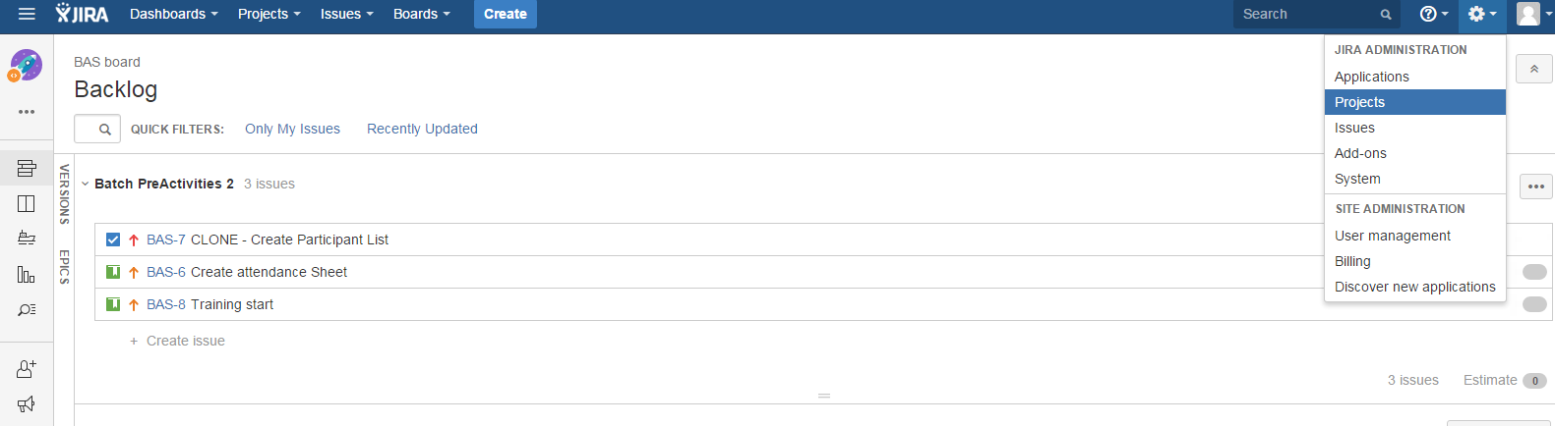
2.3: JIRA Administration Configure Project
Select Project in Administration

Slide 9
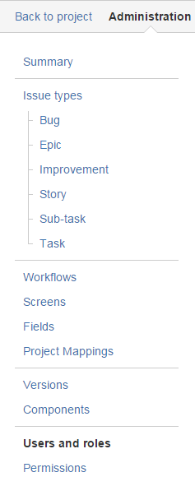
2.3: JIRA Administration Configure Project
Select project from project list
We can Configure following for our project:
Managing Issue Types
Workflow scheme can be defined
Screens can be customized
Components can be created

Slide 10
2.3: JIRA Administration User Management
User Management includes:
Add User
Create User Groups
Modify User

Slide 11
2.3: JIRA Administration Administrative tasks
Administration -> Issues -> Add Issues
Here we can create custom Issues
Administration -> Issues -> Workflow
Here we can create our own workflow
Administration -> Projects -> Components
Here we can create new project components

Slide 12
2.5: JIRA Reports Reports
Agile Reports:
Burndown Chart
Sprint Report
Velocity Chart
Version Report
Epic Report

Slide 13
Demo
Notes:
Add the notes here.
Add instructor notes here.

Slide 14
Lab
Issues Lab
Notes:
Add the notes here.
Add instructor notes here.

Slide 15
Summary
Workflow – to move issues through different status
Create versions of projects and then release them
Administration activities:
Create and configure project
Notes:
Add the notes here.
Add instructor notes here.

Slide 16
Review Question
Question 1 : Which of the following is not an administrative task?
Option 1: Creating Version
Option 2: Creating Component
Option 3: Create Issue type
Question 2: Velocity chart shows the amount of work left to be done.
True/False
Question 3: Fill in the Blanks:
______ show different views for tracking projects
Notes:
Add the notes here.
Answers:
Question1. All of the above
Question 2: main()

