Slide 1

Linux – An Introduction
Subir Panja
Dept. of IT
Academy of Technology

Slide 2
History of Unix
Unix is an Operating System
Unix was the predecessor of Linux
It was developed about 50 years ago i.e., 1969 at AT&T Bell Labs by Ken Thompson and Dennis Ritche
It is a command Line Interpreter
It was developed for Mini-Computer as a time sharing system

Slide 3
What is Linux
The name "Linux" comes from the Linux kernel, started in 1991 by Linus Torvalds
A fully-networked 32/64-bit Unix-like Operating System
Unix Tools Like awk,grep etc.(explained later)
Compilers Like C,C++,Fortran etc.
Network Tools Like telnet, ftp, ping, traceroute
Multi-user, Multitasking, Multiprocessor
Linux is free and open source
Can view and edit the source code of OS
Open Source – source code is available which can be used by any person in the world.
Free – No payment. Direct download and install

Slide 4
Who uses Linux
Predominantly known for its use in servers
supported by corporations such as Dell, Hewlett-Packard, IBM, Novell, Oracle Corporation, Red Hat, and Sun Microsystems
More than 90% super computers use Linux

Slide 5
History of Linux
MINIX, a Unix-like system intended for academic use, was released by Andrew S. Tanenbaum in 1987
In 1991, Linus Torvalds began to work on a non-commercial replacement for MINIX while he was attending the University of Helsinki
This eventually became the Linux kernel
Linux vendors and communities combine and distribute the kernel, GNU components, and non-GNU components, with additional package management software in the form of Linux distributions

Slide 6

Linus Torvalds
Developed the linux kernel in 1991

Slide 7
Commercial and Popular Uptake
Today Linux is used in numerous domains, from embedded systems to supercomputers, and has secured a place in server installations with the popular LAMP application stack
LAMP
(Linux, Apache, MySQL, Perl/PHP/Python)

Slide 8
User Interface
Linux can be controlled by
text-based command line interface (CLI)
graphical user interface (GUI) (usually the default for desktop)
On desktop machines, KDE, GNOME are the most popular graphical user interfaces (GUI)

Slide 9
Advantages
Proponents and analysts attribute the relative success of Linux to its:
security
reliability
low cost
and freedom from vendor lock-in

Slide 10
Disadvantages
Lack of support for certain hardware and application programs designed for Microsoft Windows

Slide 11
Other Facts
A 2001 study of Red Hat Linux 7.1 found that this distribution contained 30 million source lines of code.
Using the Constructive Cost Model, the study estimated that this distribution required about eight thousand man-years of development time.
If all this software had been developed by conventional proprietary means, it would have cost about 1.08 billion dollars (year 2000 U.S. dollars) to develop in the United States.

Slide 12
Desktop applications
Word processing (OpenOffice, Koffice)
Programming (C, C++, Perl, Python, Java, PHP)
Graphics (GIMP)
Web browsers (Mozilla Firefox, Konquerer)
Email (Evolution, Mozilla, KMail)
Audio (amarok)
Games (MAME)

Slide 13
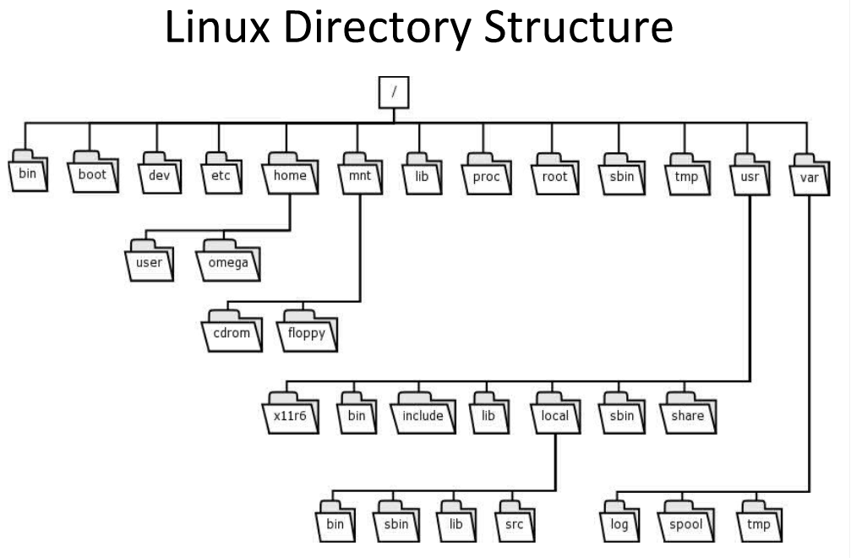

Slide 14
Linux Directory Structure
/
The root directory. The starting point of your directory structure. This is where the Linux system begins. Every other file and directory on your system is under the root directory. Usually the root directory contains only subdirectories, so it's a bad idea to store single files directly under root.
Don't confuse the root directory with the root user account, root password (which obviously is the root user's password) or root user's home directory.

Slide 15
Linux Directory Structure
/boot
As the name suggests, this is the place where Linux keeps information that it needs when booting up. For example, this is where the Linux kernel is kept. If you list the contents of /boot, you'll see a file called vmlinuz - that's the kernel.

Slide 16
Linux Directory Structure
/etc
The configuration files for the Linux system. Most of these files are text files and can be edited by hand. Some interesting stuff in this directory:

Slide 17
Linux Directory Structure
etc/passwd Holds user account info
Included fields are:
Login name
User Id (uid)
Group Id (gid)
General Comment about the user
Home Directory
Shell

Slide 18
Linux Directory Structure
/bin, /usr/bin
These two directories contain a lot of programs (binaries, hence the directory's name) for the system. The /bin directory contains the most important programs that the system needs to operate, such as the shells, ls, grep, and other essential things. /usr/bin in turn contains applications for the system's users. However, in some cases it really doesn't make much difference if you put the program in /bin or /usr/bin.

Slide 19
Linux Directory Structure
/usr
This directory contains user applications and a variety of other things for them, like their source codes, and pictures, docs, or config files they use. /usr is the largest directory on a Linux system, and some people like to have it on a separate partition. Some interesting stuff in /usr:
/usr/doc Documentation for the user apps, in many file formats.

Slide 20
Linux Directory Structure
/lib
The shared libraries for programs that are dynamically linked. The shared libraries are similar to DLL's on Winblows.
/root
The superuser's (root's) home directory. Don't confuse this with the root directory (/) of a Linux system.

Slide 21
Linux Directory Structure
/home
This is where users keep their personal files. Every user has their own directory under /home, and usually it's the only place where normal users are allowed to write files. You can configure a Linux system so that normal users can't even list the contents of other users' home directories. This means that if your family members have their own user accounts on your Linux system, they won't see all the w4r3z you keep in your home directory. ;-)

Slide 22
Linux Directory Structure
/dev
The devices that are available to a Linux system. Remember that in Linux, devices are treated like files and you can read and write devices like they were files. For example, /dev/fd0 is your first floppy drive, /dev/cdrom is your CD drive, /dev/hda is the first IDE hard drive, and so on. All the devices that a Linux kernel can understand are located under /dev, and that's why it contains hundreds of entries.

Slide 23
Linux Directory Structure
/mnt
This directory is used for mount points. The different physical storage devices (like the hard disk drives, floppies, CD-ROM's) must be attached to some directory in the file system tree before they can be accessed. This attaching is called mounting, and the directory where the device is attached is called the mount point.

Slide 24
Linux Directory Structure
The /mnt directory contains mount points for different devices, like /mnt/floppy for the floppy drive, /mnt/cdrom for the CD-ROM, and so on. However, you're not forced to use the /mnt directory for this purpose, you can use whatever directory you wish. Actually in some distros, like Debian and SuSE, the default is to use /floppy and /cdrom as mount points instead of directories under /mnt.

Slide 25
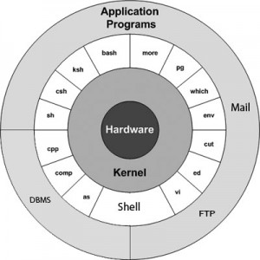
Unix Architecture

Slide 26
Kernel
Kernel is the heart of the operating system
It is the interface between applications and Hardware
Function: Manage memory, I/O devices, allocates the time between user and process, interprocess communication, sets process priority

Slide 27
Shell
The shell which acts as an interface between the user and the kernel.
When a user logs in, the login program checks the username and password, and then starts another program called the shell.
It is a command interpreter and also has programming capability of its own
Types: Bourne Shell(sh) – First shell by Stephen Bourne, C Shell(csh),Korn Shell(ksh), Bourne Again Shell(bash).

Slide 28
Unix Architecture
As an illustration of the way that the shell and the kernel work together, suppose a user types rm myfile (which has the effect of removing the file myfile). The shell searches the filestore for the file containing the program rm, and then requests the kernel, through system calls, to execute the program rm on myfile. When the process rm myfile has finished running, the shell then returns the UNIX prompt % to the user, indicating that it is waiting for further commands.

Slide 29
Basic Linux Commands
File Handling
Text Processing
System Administration
Process Management
Network
File Systems
Advanced Commands

Slide 30
Sources to learn commands??
Primary – man(manual) pages.
man <command> shows all information about the command
<command> - help shows the available options for that command
Secondary – Books and Internet

Slide 31
Commands : Directories
Commands | Meaning
mkdir xyz | make the directory xyz
cd xyz | change directory, down into xyz
cd .. | go up one directory level
cd ~ | go to your home directory
cd ~dannellys2 | go to dannelly's home directory
ls | list the contents of current directory
ls -a | directory listing, including all hidden files
ls -l | directory listing, show permission, edits dates, etc.
ls -al | really long directory listing

Slide 32
Commands : File Manipulation
Commands | Meaning
cp file1 file2 | make a copy of file1 named file2
cat myfile | show contents of myfile
more myfile | show contents of myfile one screen at a time
head myfile | show the top 10 lines of myfile
rm myfile | remove myfile (delete it permanently)
rm * | remove all files in current directory
rm -i * | interactive removal - ask yes/no for each file

Slide 33
Commands : Text Processing
echo [OPTION] [string] echo I love Linux | display a line of text
grep [OPTION] PATTERN [FILE] eg. Grep apple sample.txt | Print lines matching a pattern
wc file1.txt | Print the number of newlines, words, and bytes in files

Slide 34
Commands : Linux File Permissions
3 types of file permissions – read, write, execute
10 bit format from 'ls - l‘ command
1 2 3 4 5 6 7 8 9 10
file type owner group others
eg. drwxrw-r– means owner has all three permissions, group has read and write, others have only read permission
read permission – 4, write – 2, execute 1
eg. rwxrw-r-- = 764
673 = rw-rwx-wx

Slide 35
Commands : System Administration
chmod – change file access permissions
Usage: chmod [OPTION] [MODE] [FILE]
eg. chmod 744 calculate.sh
su – change user ID or become superuser
Usage: su [OPTION] [LOGIN]
eg. su remo, su
passwd – update a user’s authentication tokens(s)
Usage: passwd [OPTION]
eg. passwd

Slide 36
Commands : Process Management
ps – report a snapshot of the current rocesses
Usage: ps [OPTION]
eg. ps, ps -el
kill – to kill a process(using signal mechanism)
Usage: kill [OPTION] pid
eg. kill -9 2275

Slide 37
Commands : Others
Commands | Meaning
who | users logged into this machine
date | today's date
cal | calendar (many options)
man -k calendar | list manual pages related to calendar
man cal | manual page for the "cal" command
exit | logout of system
logout | logout of system
ctrl-d | logout of system
ctrl-c | kill the running program

Slide 38
Creating a new User Account
Add an entry in /etc/passwd and /etc/shadow file (use next uid and suitable gid). You will have to create the user directory and assign a password to the user
Use useradd or adduser command to create a new user (useradd –g <group> -d <home directory> -c <comment> -s <shell> login-name) and groupadd to create a new group (groupadd group-name). You will have to assign a password (passwd login-name)
In GUI: Applications → System Settings → Users and Groups

