Slide 1
Education in new Zealand
Kim Van Nguyen
Swapna
Ancy John
Landy Liu

Slide 2
Content
Reason for choice of topic
Analysis - what we analyzed – sources and data
Wrangling - how we wrangled the data, process
Challenges
Conclusion - what we can conclude after this analysis

Slide 3
1. Reason for choice of topic
Education is essential for everybody
Enhance understanding of the world’s progress in education development (countries invest the most or are improving)
Encourage support in education field for countries that need (from NGOs, angels funds, developed countries, UN)
Contribute to better government’s policy (Ministry of Education)
Notes:
Education is necessary for everyone. Everyone should have access to this. We would like to see if governments are making efforts in providing education to people.
We would like to see which countries invest the highest amount of money on education and which countries spend the least. We can also see if countries spending more or spending less overtime.

Slide 4
2. Analysis
Compare countries in 4 aspects:
Government expenditure
Source: UNESCO Institute for Statistics http://data.uis.unesco.org/
Enrolment
Source: United Nations data.un.org/
Labor rate
Source: Databank of World Bank databank.worldbank.org/source/education-statistics-%5e-all-indicators#
Unemployment rate
Source: Databank of World Bank databank.worldbank.org/source/education-statistics-%5e-all-indicators#
Analyse causes and effects of education in New Zealand
Compare the distribution of schools in each region of New Zealand and also analyze the proportion of students in these regions based on their origin i.e. Maori, Asian, European and International students.
source: https://catalogue.data.govt.nz/
Notes:
Insert a map of your country.

Slide 5
libraries
tidyverse
readxl
visdat
ggplot2
dplyr

Slide 6
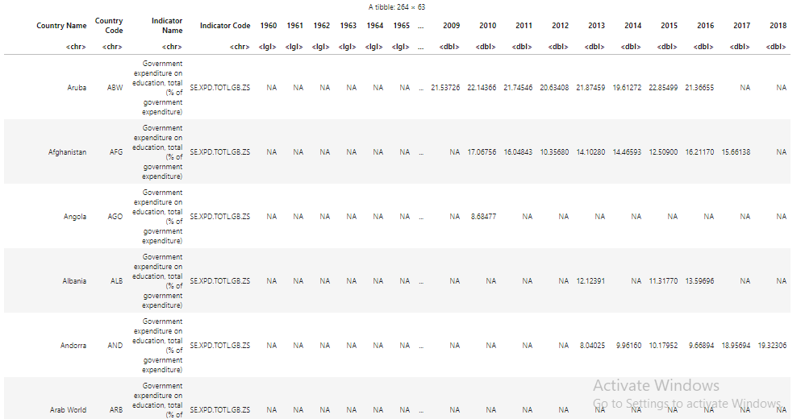
3. Wrangling Government expenditure

Slide 7
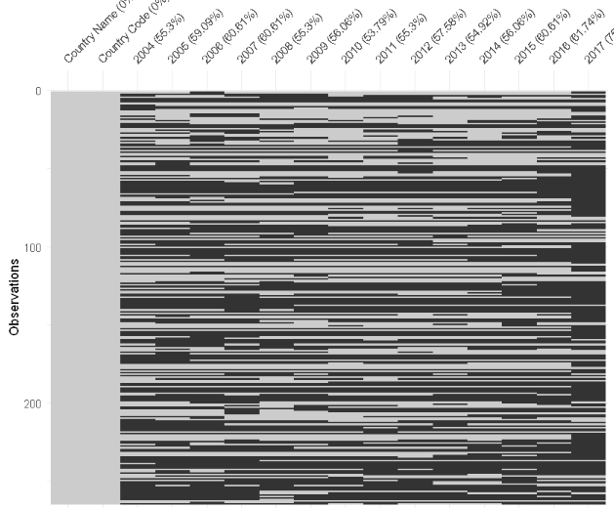
3. Wrangling Government expenditure
Original data
After wrangling

Slide 8
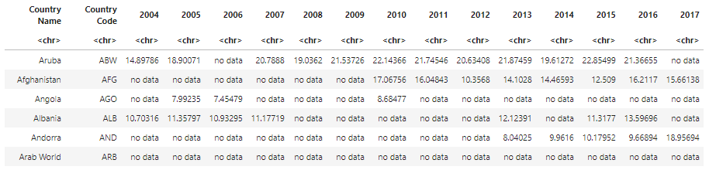
3. Wrangling Government expenditure
AFTER WRANGLING

Slide 9
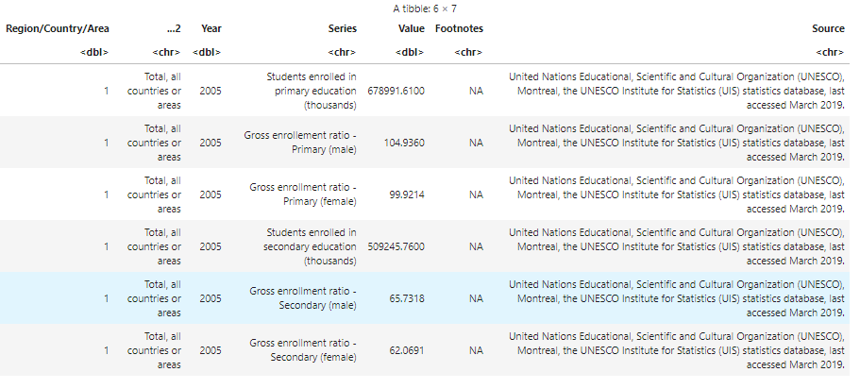
3. Wrangling Enrollment
Original data
Notes:
What, why and how you wrangled

Slide 10
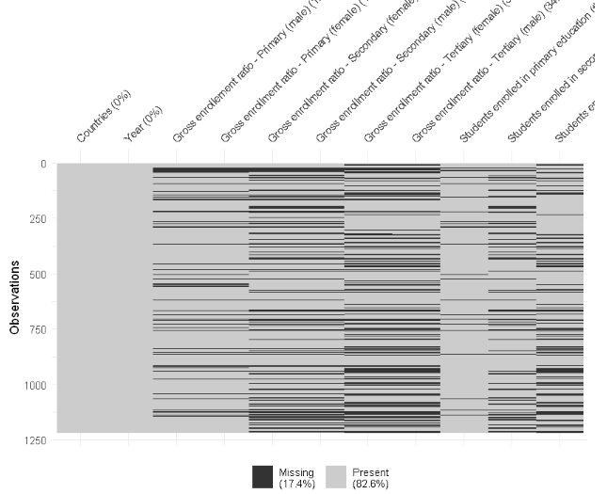

Slide 11
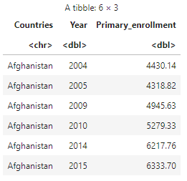
3. Wrangling enrollment
After wrangling
Notes:
What, why and how you wrangled

Slide 12
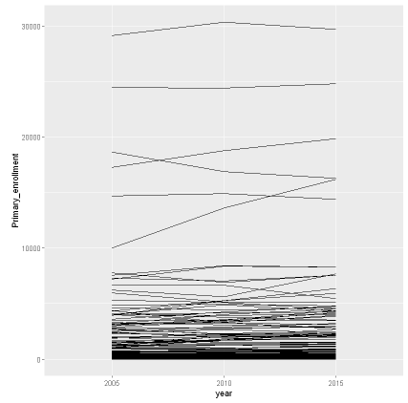
Primary enrollment
5 countries with highest number of enrolment:
India
China
Indonesia
USA
Pakistan
5 countries with lowest number of enrolment:
Niue
Tuvalu
Cook islands
Monaco
Liechtenstein

Slide 13
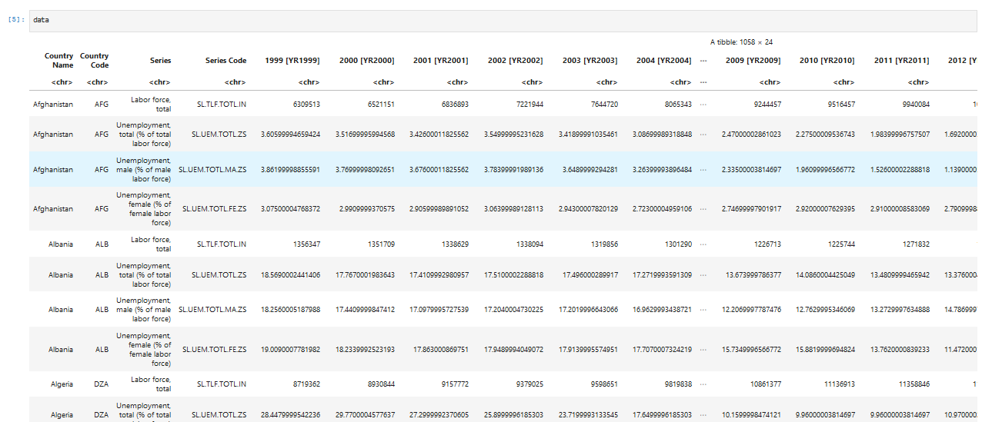
3. Wrangling Labor and unemployment rate

Slide 14
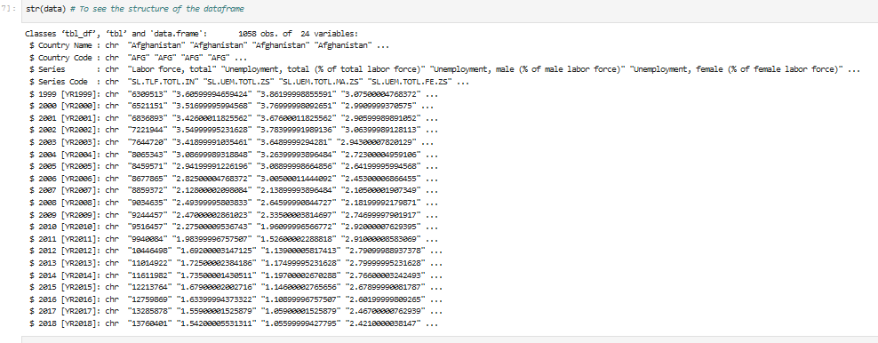
3. Wrangling Original data
Original data

Slide 15
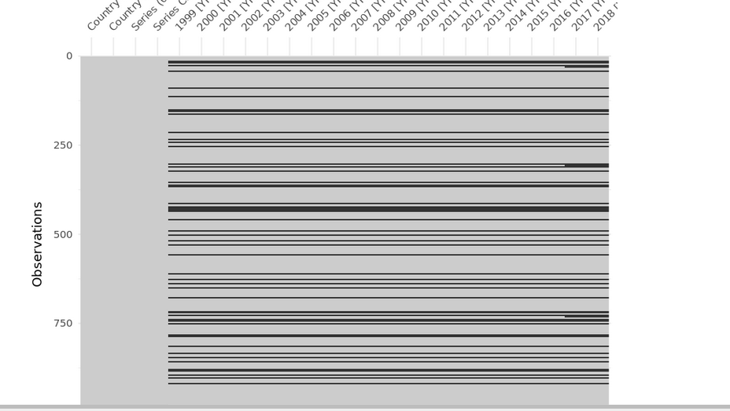
3. Wrangling Missing Values

Slide 16
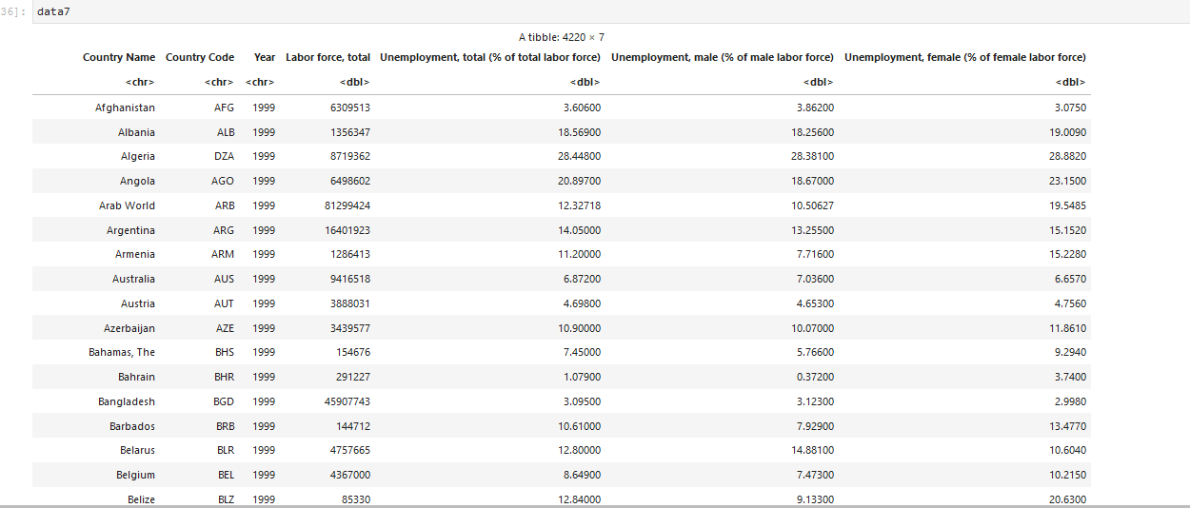
3. Wrangling after wrangling

Slide 17
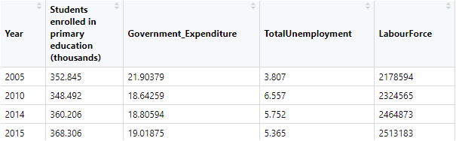
3. Wrangling New Zealand’s education investment and outcome

Slide 18
3. WRANGLING DATASET ON list of schools in New Zealand
Why we wanted to analyse this dataset?
Primary and secondary level education

Slide 19
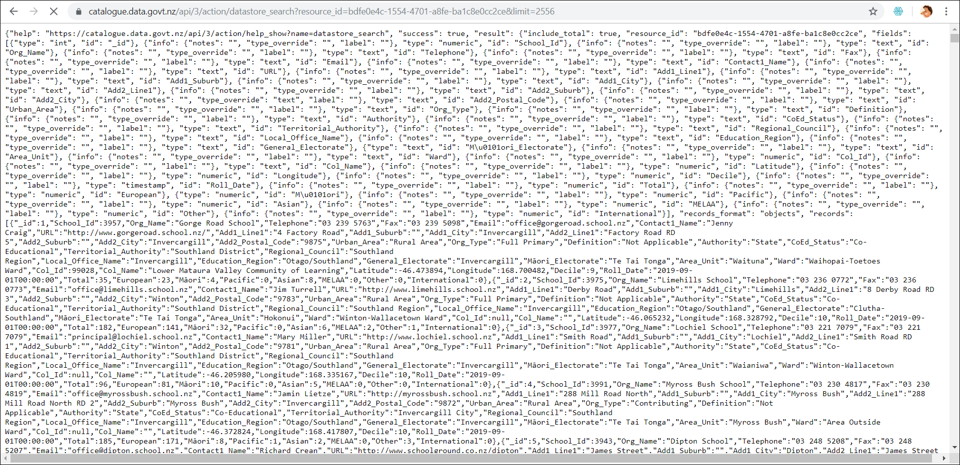
1.Original data
Notes:
We accessed resource data via a web API.
Make a "GET" request to the API to pull raw data containing the list of NZ scools , their information, address, students enrolled.

Slide 20
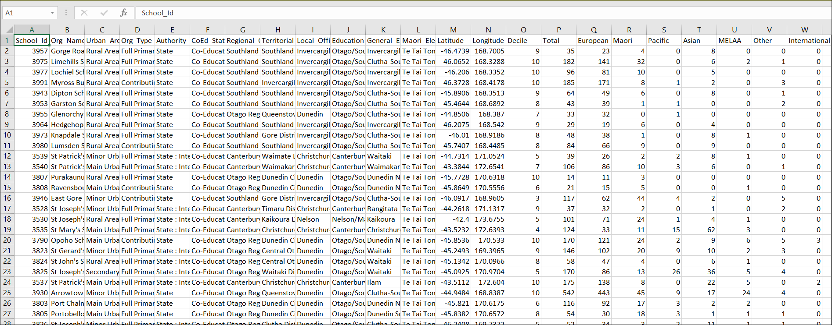
2. After Wrangling.

Slide 21
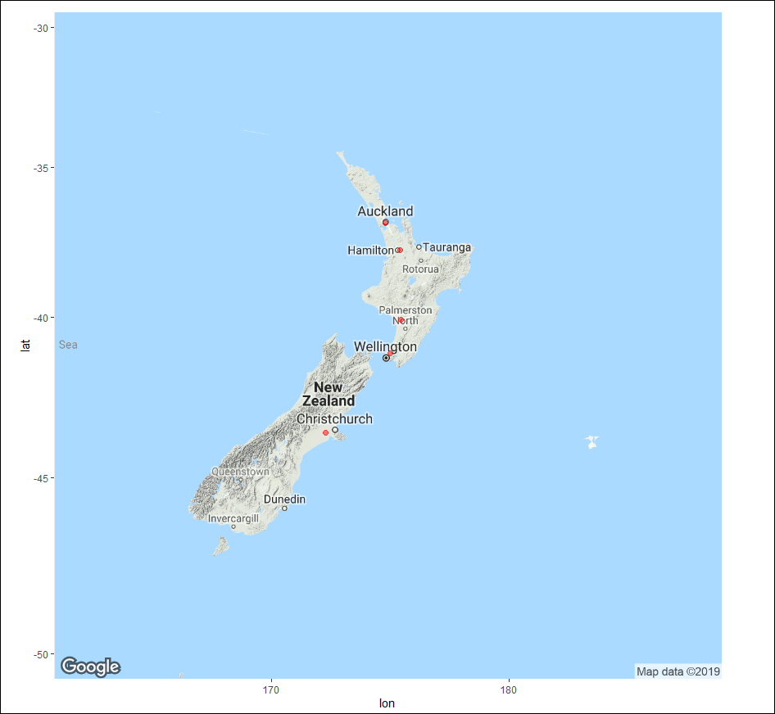
Top Five regions with highest number of schools (Primary: Secondary)
1.Auckland Region 550
2.Waikato Region 309-
3.Canterbury Region 291
4.Wellington Region 247
5.ManawatuWanganui Region197
Notes:
1Auckland Region 550
2Waikato Region 309-
3Canterbury Region 291
4Wellington Region 247
5Manawatu-Wanganui Region197
Ggmap is used for the spatial visualisation along with ggplot from data taken from Google maps to plot the graph of NZ along with these points.

Slide 22
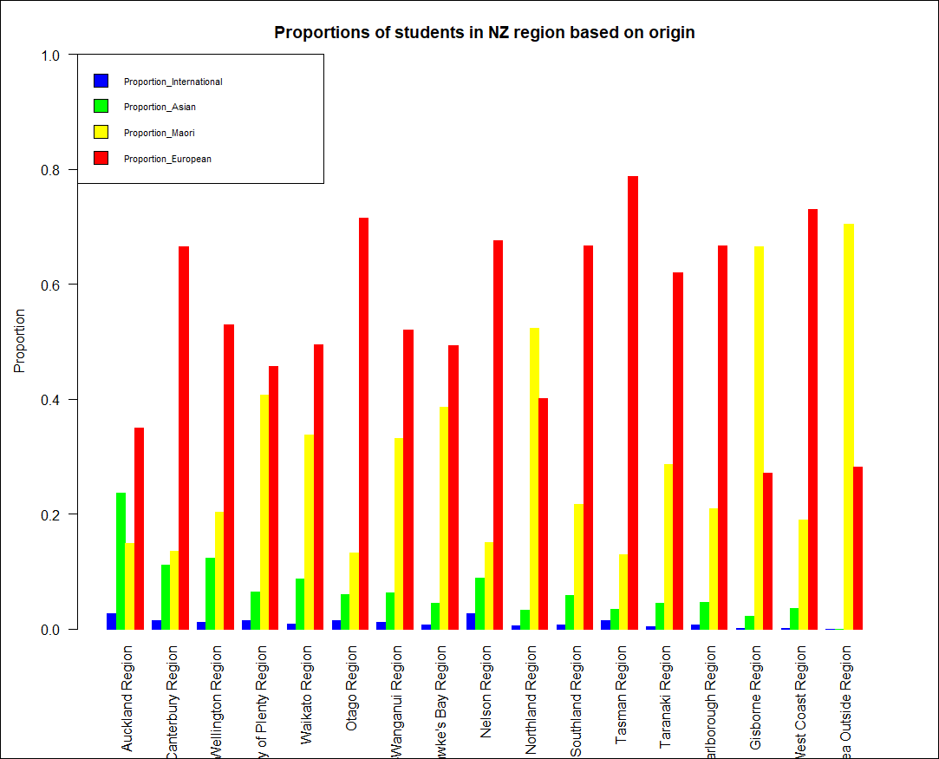
Proportion of students of regions based on their origin
Notes:
Auckland Region
Canterbury Region
Wellington Region
Bay of Plenty Region
Waikato Region
Otago Region Manawatu-Wanganui Region Hawke's Bay Region Nelson Region Northland Region Southland Region Tasman Region Taranaki Region Marlborough Region Gisborne Region West Coast Region Area Outside Region

Slide 23
4. Challenges
Missing data
Every dataset is in different structures
Values were recorded in different formats
Not all years are available
Plotting maps and creating a DF from web data

Slide 24
4. conclusion
Overall image of how the world is progressing in improving education accessibility and quality
The results of investment in education in New Zealand
However!
Only focuses on the basic aspects of education
Limited data. For deep analysis of a specific country, better to use source provided by those countries

Slide 25
Thank you!
QUESTIONS?

