Slide 1
A Chatbot works on 2 major principles:-
NLU : Natural Language Understanding
NLG : Natural Language Generation
NLU : A typical Chatbot classifies the intent of the User based on pre-trained utterances, extracts entities from these utterances and decides on the next course of action
NLG : The output shown to a User by a chatbot can be crudely considered as a case of Natural Language Generation
The elements you may use in a chatbot conversation are:
Greeting: Used to say hello or start a conversation. Formality is dependent on relationship (return versus new users).
Asking: For engaging or seeking information. Helps keep the conversation going.
Informing: Giving information that is either requested or pertinent to the conversation.
Checking: Testing the user’s understanding. Restating details and information for clarity.
Error: When the chatbot doesn’t understand or fails to fulfill a request.
Apologizing: Politely acknowledging the chatbot’s shortcomings. Should be brief and serve as a bridge to alternative solutions.
Suggesting: Presents the user with relevant actions or options.
Conclusion: A clear end to the conversation.

Slide 2
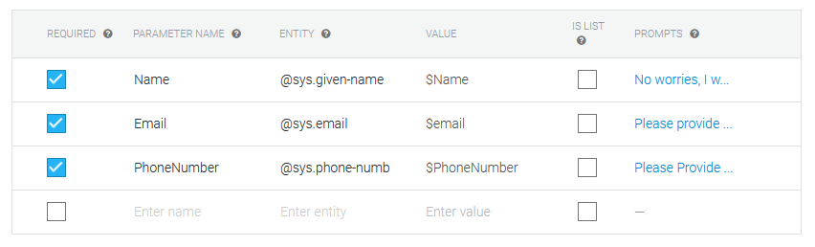
Use Case 1 : Order Enquiry
Greeting Message
Sample Utterances
Check order
See order
Check items ordered
Status of my order
Order Status
Classify Intent based on User utterance, according to knowledge of Order ID
Sample Utterances
User doesn’t remember
User remembers his/her Order ID
Can’t remember
Sorry, I don’t know
3. Forgot
4. can’t recall
5. don’t know
Chatbot asks for User Credentials
Ask for a Confirmation, to see if this is indeed the order id
Fetch Order ID from Database based on inputs provided
Yes, Fetch details from Database
No, Details not present in DB, Ask again
Details fetched, Display
No order ID based on inputs, Ask again

Slide 3
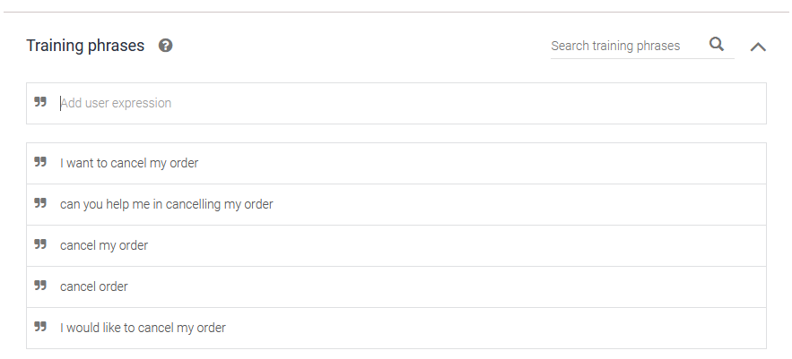
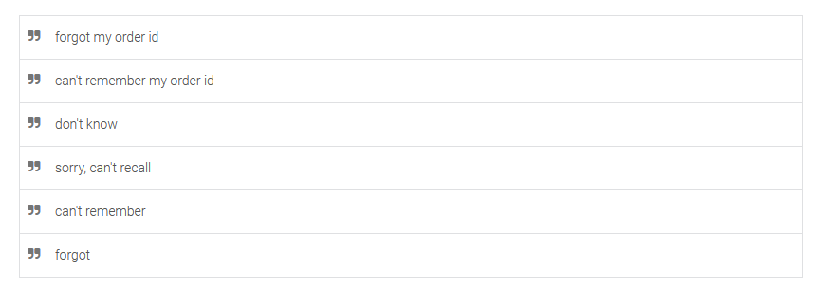
Use Case 2 : Order Cancellation
Greeting Message
Sample Utterances
Classify Intent based on User utterance, according to knowledge of Order ID
User doesn’t remember
User remembers his/her Order ID
Sample Utterances
Chatbot asks for User Credentials
Ask for a Confirmation, to cancel
Fetch Order ID from Database
Ask for a Confirmation, to cancel
Yes, Cancel and Update the status in Database
No, Do Nothing
Yes, Cancel and Update the status in Database
No, Do Nothing

Slide 4
Greeting Message
Sample Utterances
Use Case 3 : Refund Status
Check Refund Status
Refund
Refund Status for my order ID XXXXX
How long will it take to get refund
Not refunded yet
Classify Intent based on User utterance, according to knowledge of Order ID
User doesn’t remember
User remembers his/her Order ID
Sample Utterances
Can’t remember
Sorry, I don’t know
3. Forgot
4. can’t recall
5. don’t know
Chatbot asks for User Credentials
Ask for a Confirmation, to see if this is indeed the order id
Fetch Order ID from Database based on inputs provided
Yes, Fetch details from Database and
Display the Tentative Refund Date
No, Details not present in DB, Ask again
Details fetched, Display the Tentative Refund Date
No order ID based on inputs, Ask again
Tentative Refund Date < Current Date
Tentative Refund Date < Current Date
Raise a Complaint
Raise a Complaint

Slide 5
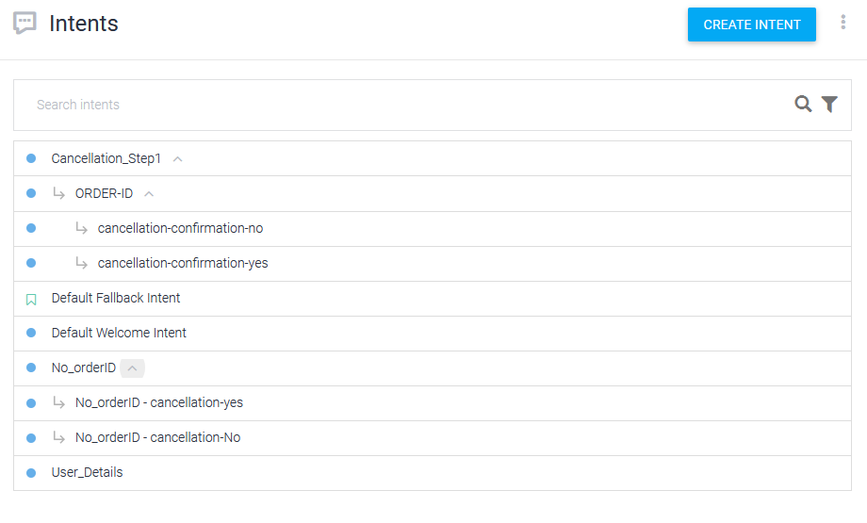
Illustration Using Google DialogFlow-Use Case 2

Slide 6
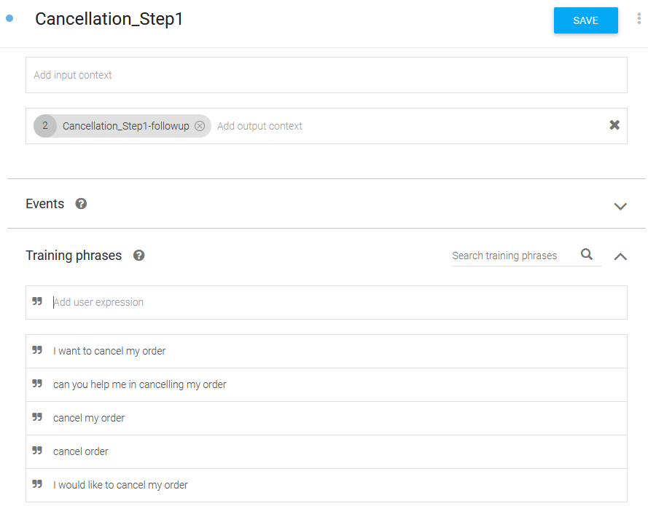
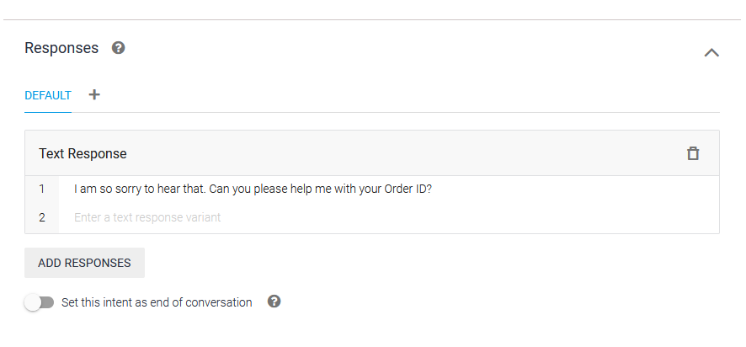
Illustration Using Google DialogFlow-Use Case 2

Slide 7
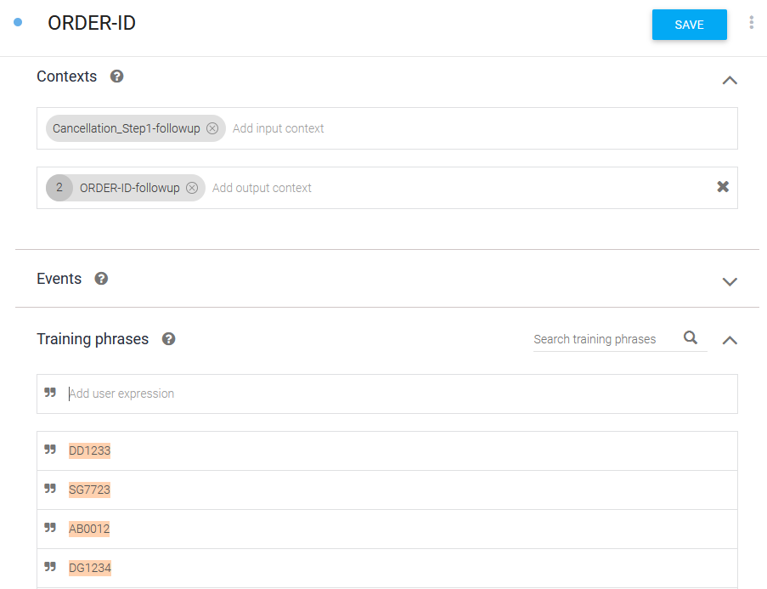
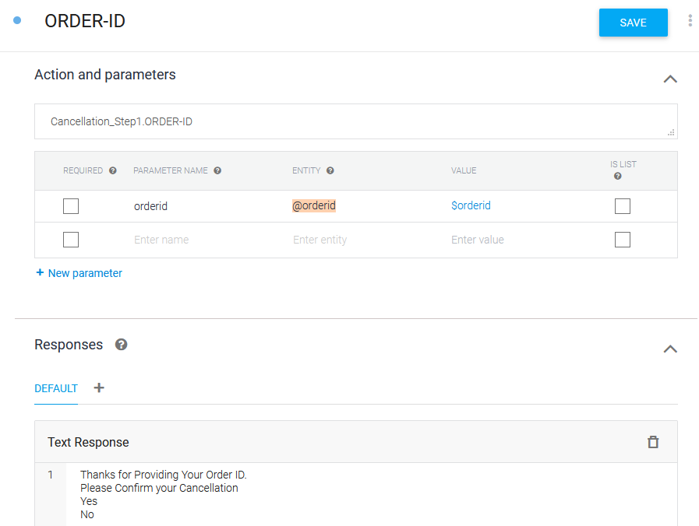
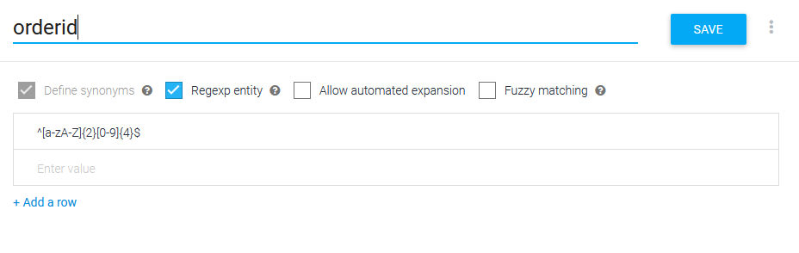
Illustration Using Google DialogFlow-Use Case 2
For illustration purpose, the order id consists of 2 letters followed by 4 numbers. Any order-id that doesn’t follow this convention is invalid

Slide 8
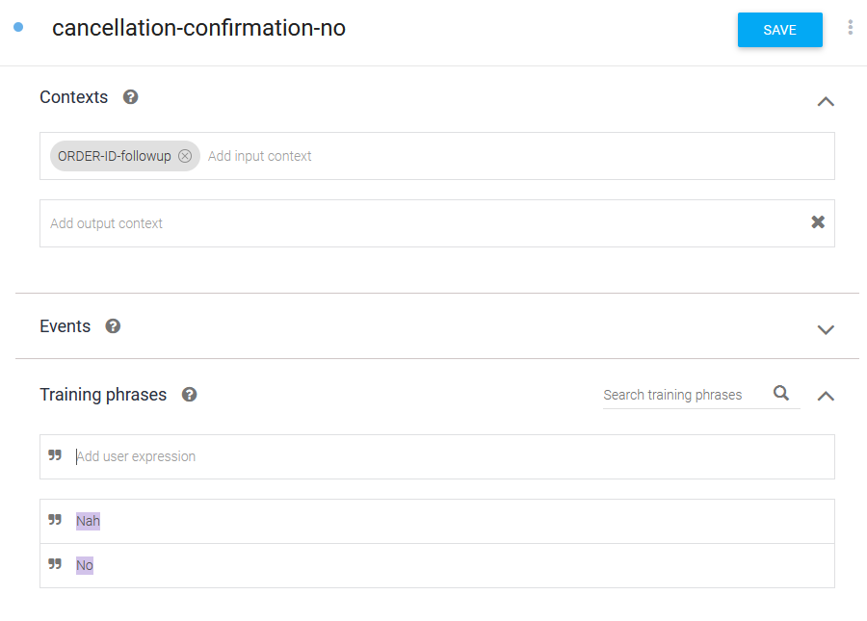
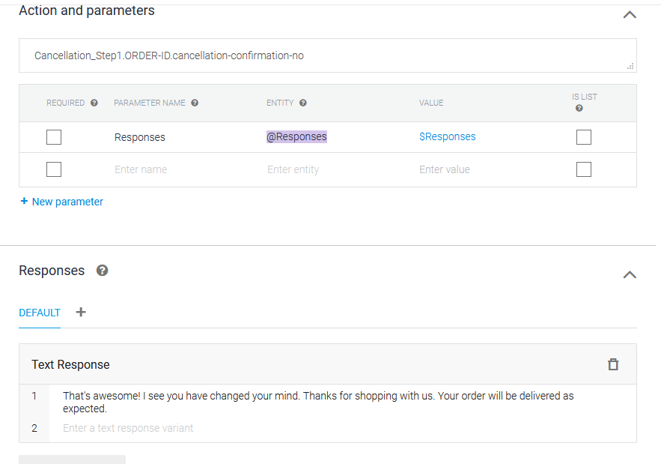
Illustration Using Google DialogFlow-Use Case 2

Slide 9
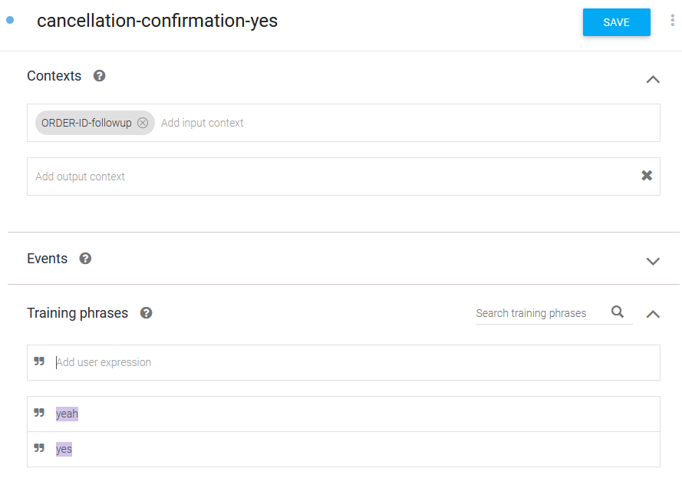
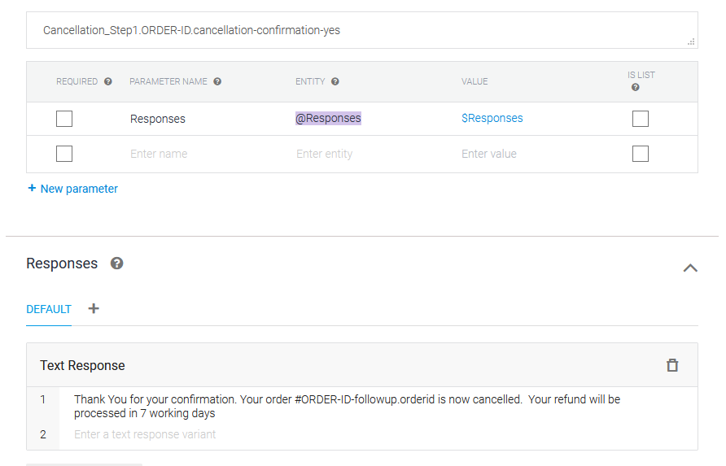
Illustration Using Google DialogFlow-Use Case 2

Slide 10
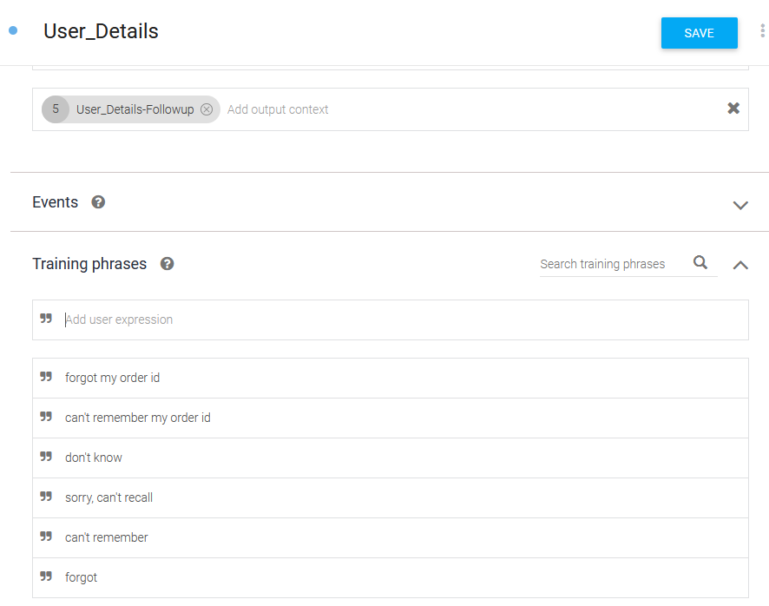
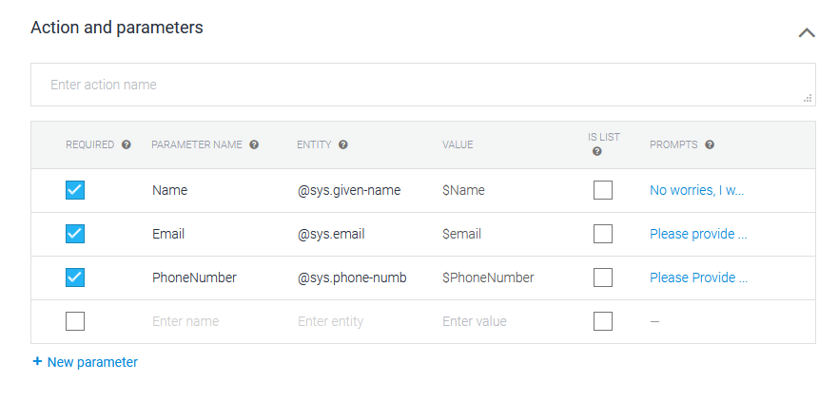
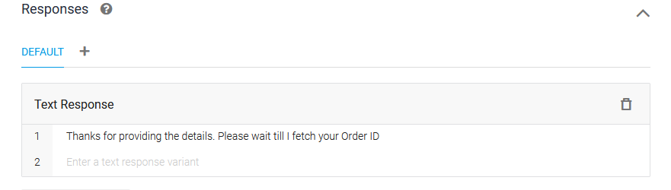
Illustration Using Google DialogFlow-Use Case 2

Slide 11
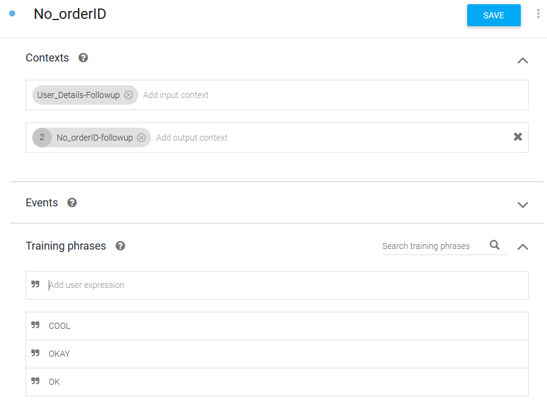
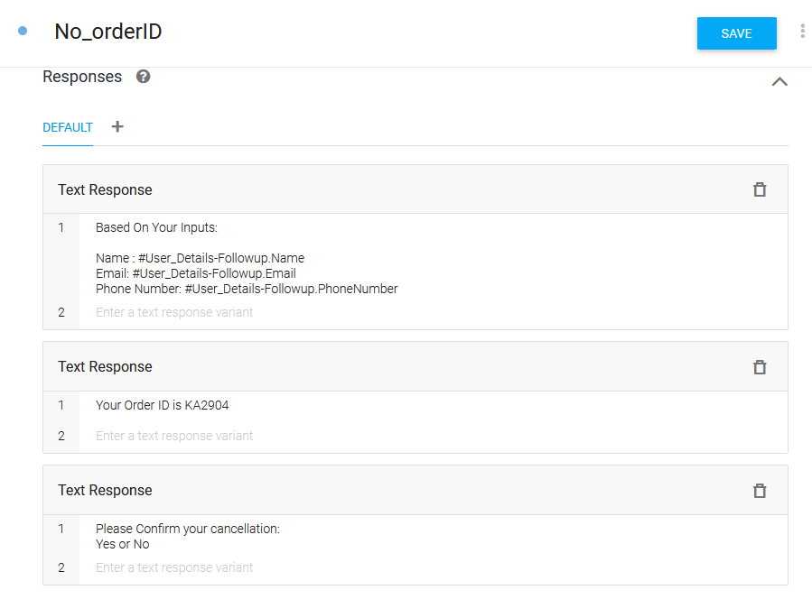
Illustration Using Google DialogFlow-Use Case 2

Slide 12
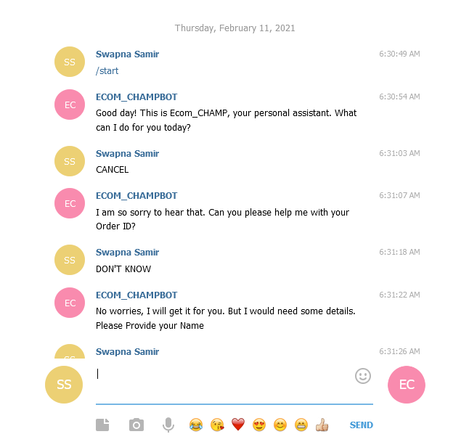
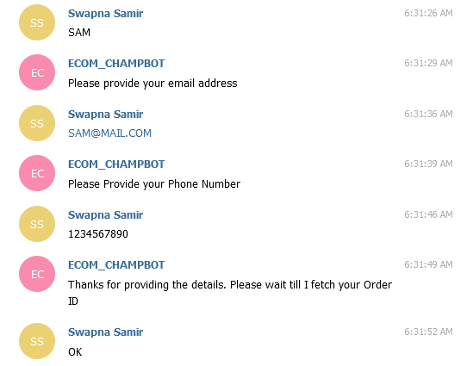
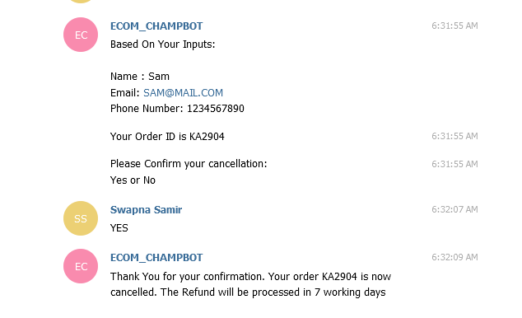
Deployment Using Telegram
Live Demo at
t.me/ECOM_CHAMP_BOT

