Slide 1

Natural Language Processing with Disaster Tweets (Kaggle Competition)

Slide 2
Overview & Objective
Twitter has become an important communication channel in times of emergency. The frequent use of smartphones enables people to announce an emergency they’re observing in real-time. Because of this, more agencies are interested in programatically monitoring Twitter (i.e. disaster relief organizations and news agencies).
Goal is to predict which Tweets are about real disasters and which ones are not

Slide 3
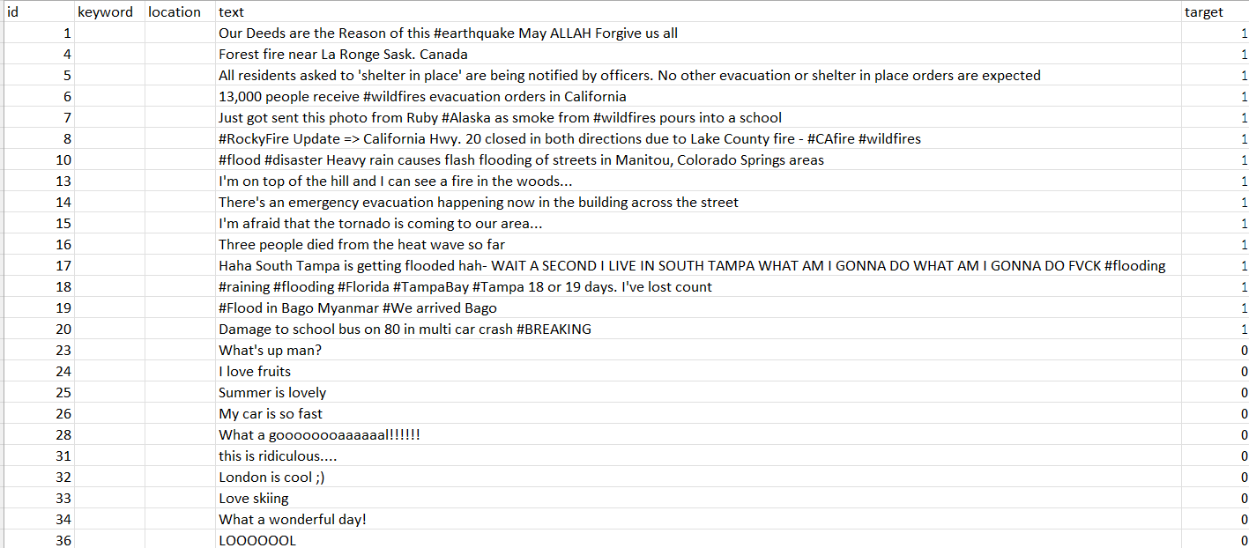
Data Handling
The data has a unique identifier, text of the tweet , location of the tweet , keyword and target which denotes whether a tweet is about a real disaster (1) or not (0).
Have removed html,url,emojis, punctuations , stopwords from the text making it, a usable format.

Slide 4
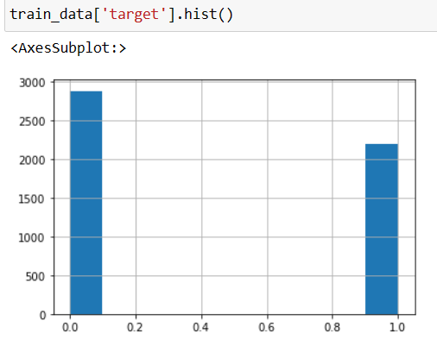
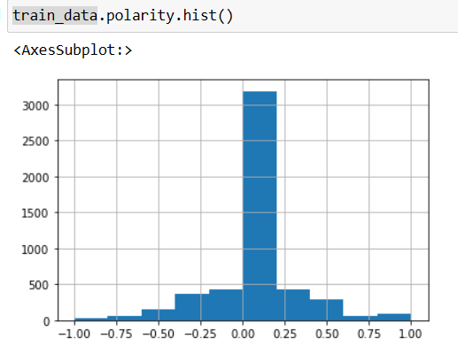
Sentiment Analysis
Based on our 1st plot we can say the tweet is not about a real disaster.
To have a strong evidence on this, have used sentiment analysis to understand how positive the tweet is.

Slide 5
Model Creation and Evaluation

Slide 6
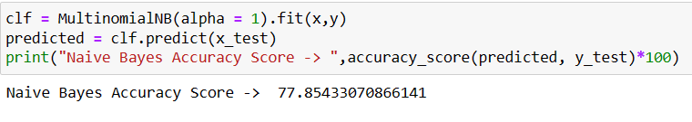
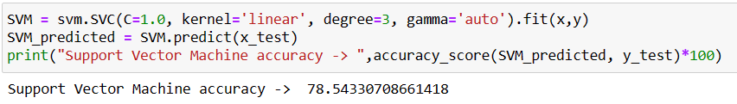
Naïve Bayes And Support Vector Machine
Multinomial Naive Bayes is the most popular supervised learning classifications that is used in NLP
Support Vector Machine is an algorithm that determines the best decision boundary between vectors that belong to a given group (or category) and vectors that do not belong to it.

Slide 7
Model Improvement

Slide 8
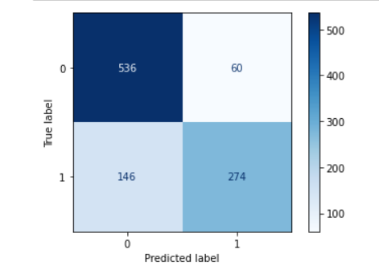

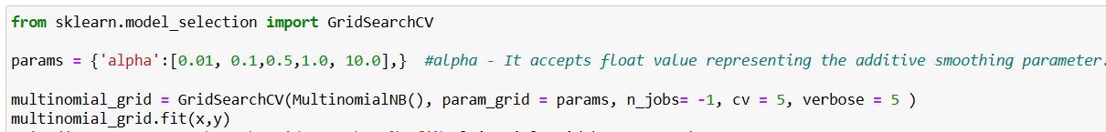
Model Improvement – Naïve Bayes

Slide 9
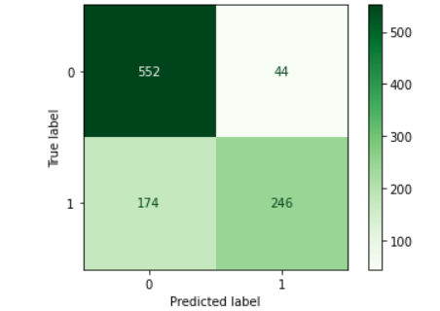
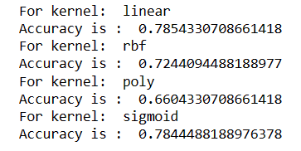

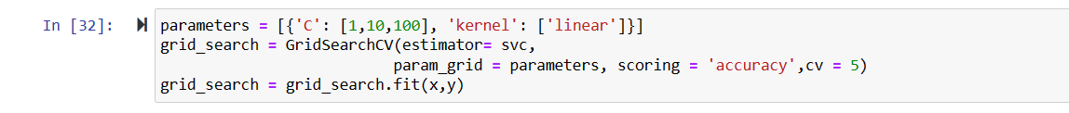
Model Improvement – Support Vector Machine

Slide 10
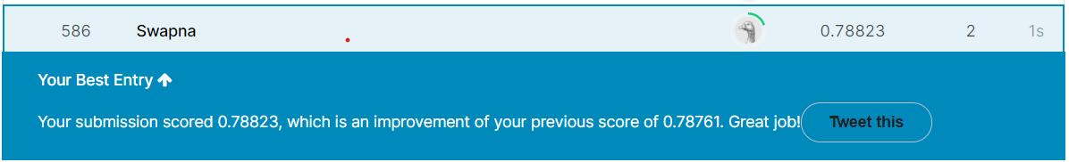
Recommendations
With the help of SVM, I was able to improve a score a bit. However, I think Neural Networks and XG Boost can have some greater impact.

Slide 11

Thank you

