Slide 1
CSE 471: MACHINE LEARNING
Convolutional Neural Network (CNN)

Slide 2
Image classification task
Image data exhibits spatial invariance
  Anything that is detectable in one small, local region of the image look the same if it appeared in another small, local region of the image.

Slide 3
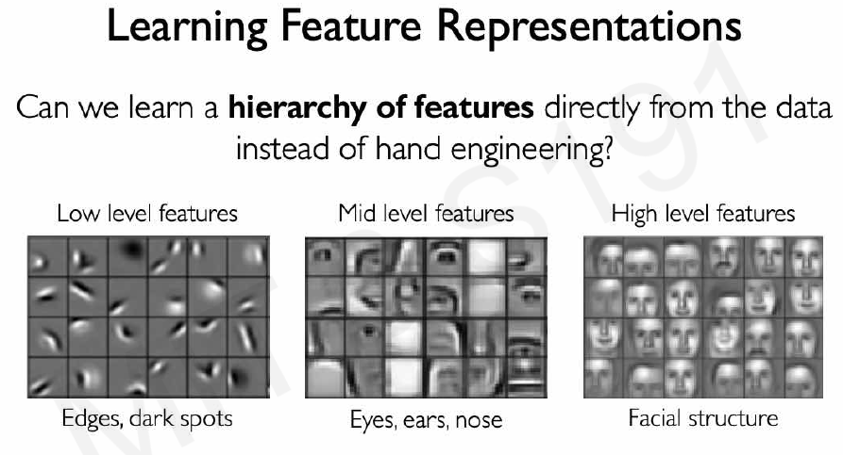
Image classification task
Taken from MIT 6.S191 lecture slides

Slide 4
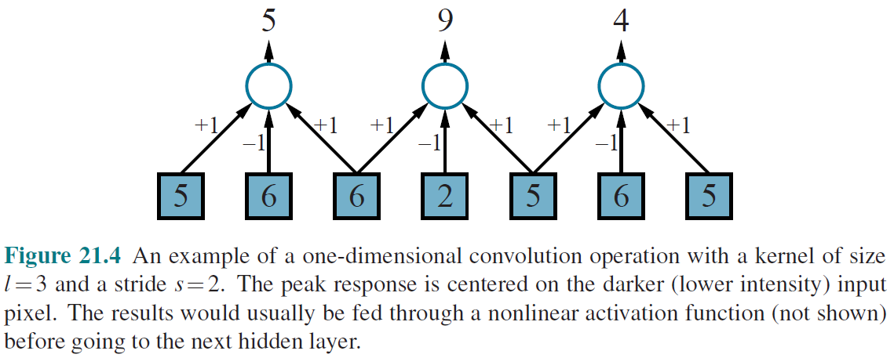
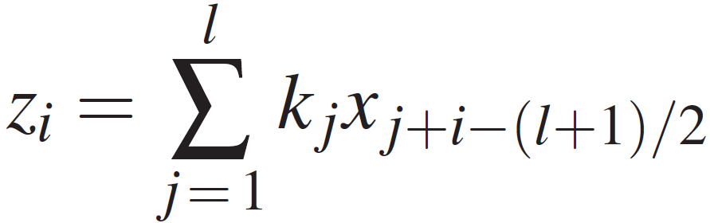
Convolution

Slide 5
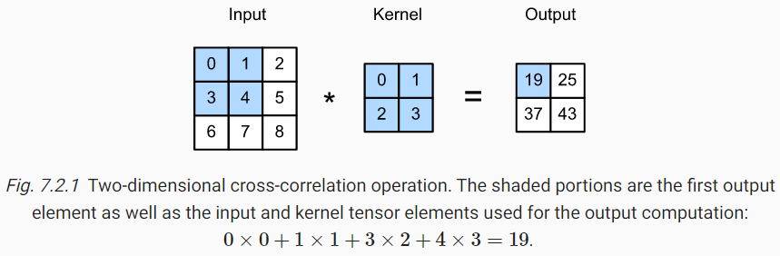
Convolution

Slide 6
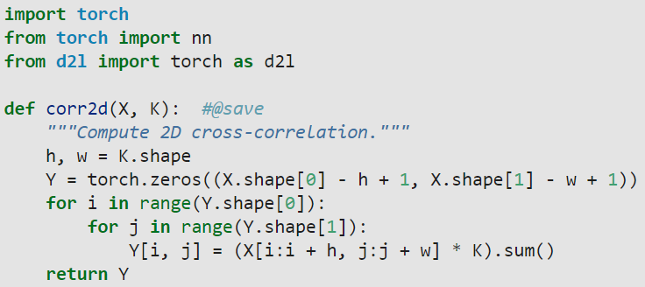
Convolution

Slide 7
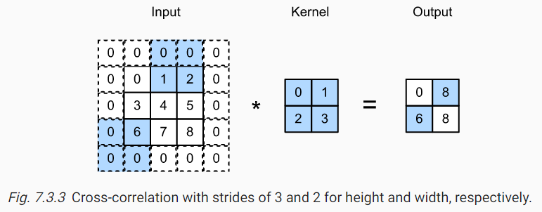
Stride
  Distance between successive pixels on which the kernels are centered.
  Reduces the output size
    Roughly from n to n/s

Slide 8
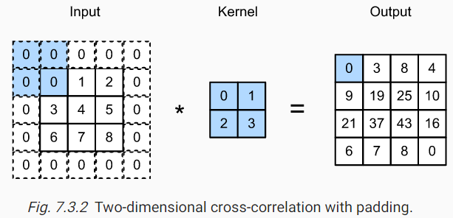
Padding
0s OR
Copies of the outer pixels

Slide 9
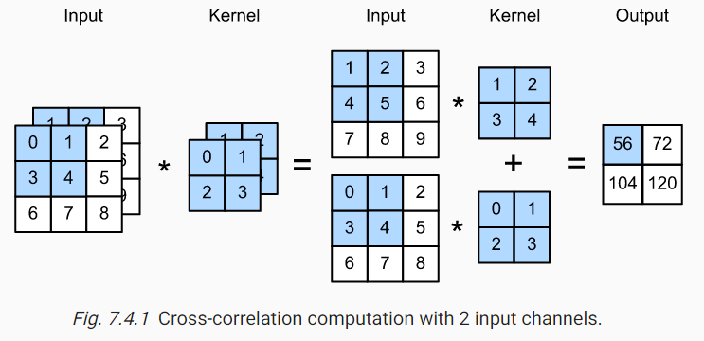
Multiple Input Channels
See the animation from
https://cs231n.github.io/convolutional-networks/

Slide 10
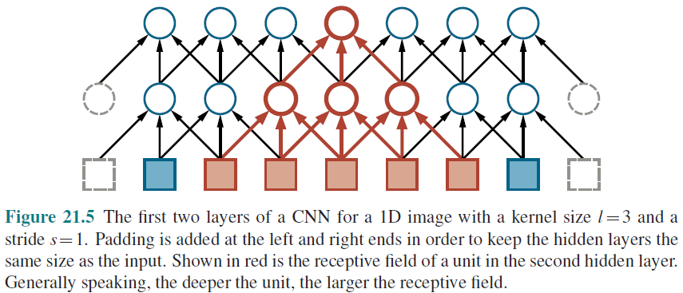
Receptive field
Notes:
When the stride is 1, as in the figure, a node in the m^{th} hidden layer will have a receptive field of size (l −1)m+1
The growth is linear in m
In a 2D image, each dimension of the receptive field grows linearly with m, so the area grows quadratically.)
When stride is larger than 1, receptor field grows as O(ls^{m})

Slide 11
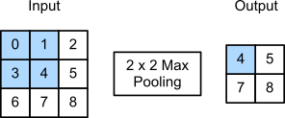
Pooling
Average pooling
  Average value of l inputs
  l=s → Down sampling an image
Max pooling
  Maximum value of l inputs
  Feature detector
Notes:
Average-pooling
Facilitates multi-scale recognition.
It also reduces the number of weights required in subsequent layers, leading to lower computational cost and possibly faster learning.

Slide 12
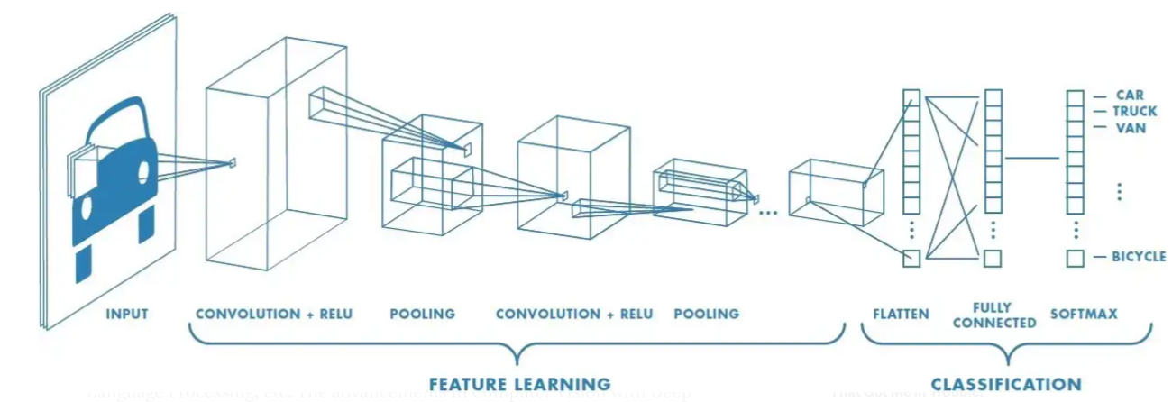
Putting it all together

Slide 13
Tensors
Minibatch size = 64
256 x 256 RGB image
  A tensor of dimension: 256×256×3×64
5 x 5 x 3 kernel, 96 of them. When applied with stride 2 in both x and y, we get
  A tensor of 128 x 128 x 96 x 64
  Called a Feature Map
  Each channel carries information from one feature

Slide 14
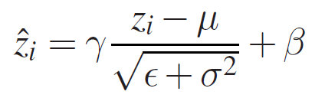
Batch Normalization
z_{i} are values of z for each instance of the minibatch
µ - mean
σ – standard deviation
ε – small constant
ϒ and β are learned parameters

Slide 15
Gradient of cross entropy with softmax
https://fanzengau.com/myblog/content/machine_learning/gradient_of_categorical_cross_entropy/gradient_of_categorical_cross_entropy.html
Notes:
Reference:
https://fanzengaau.com/myblog/content/machine_learning/gradient_of_categorical_cross_entropy/gradient_of_categorical_cross_entropy.html

Slide 16
CNN Back propagation
See hand written notes

