Slide 1
Data Cleaning & Feature Engineering
Kowshic Roy

Slide 2
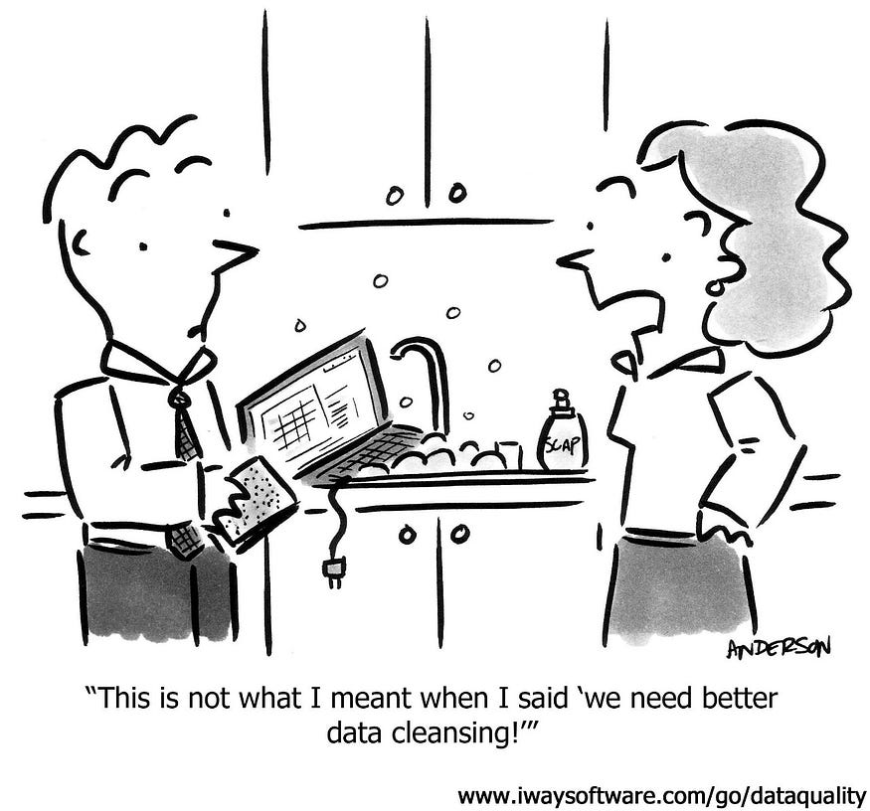

Slide 3
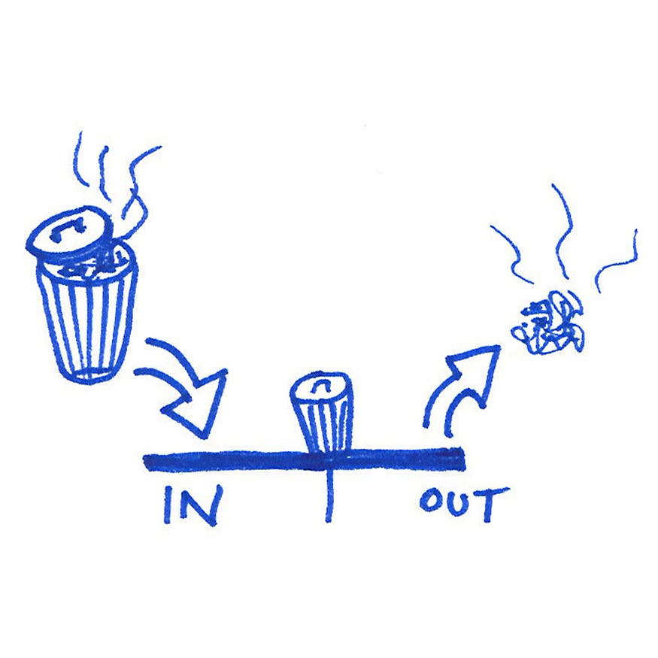

Slide 4

Temperature of BD.
https://live8.bmd.gov.bd/file/2016/08/17/pdf/58.pdf

Slide 5
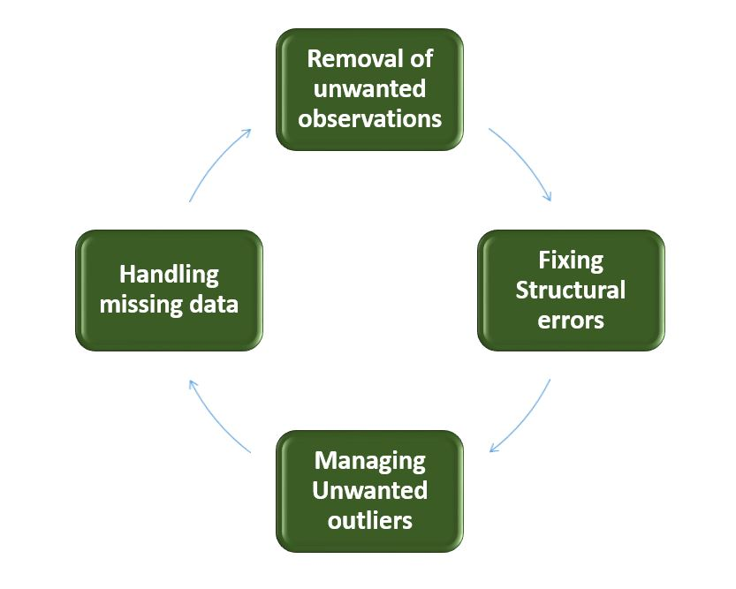

Slide 6
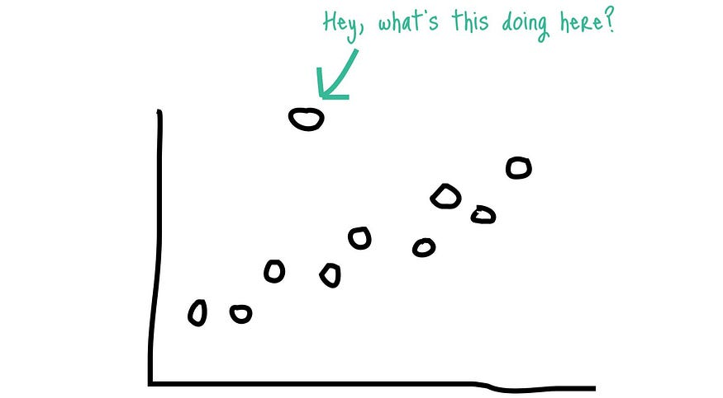
Outliers

Slide 7
References
https://medium.com/analytics-vidhya/the-imperative-of-data-cleansing-b97aa7557f76
https://www.geeksforgeeks.org/data-cleansing-introduction/?ref=next_article

