Slide 1
Machine Learning
Kowshic Roy

Slide 2
Class 06
Decision Tree & Random Forest

Slide 3
Task Type
1. Classification
2. Regression

Slide 4
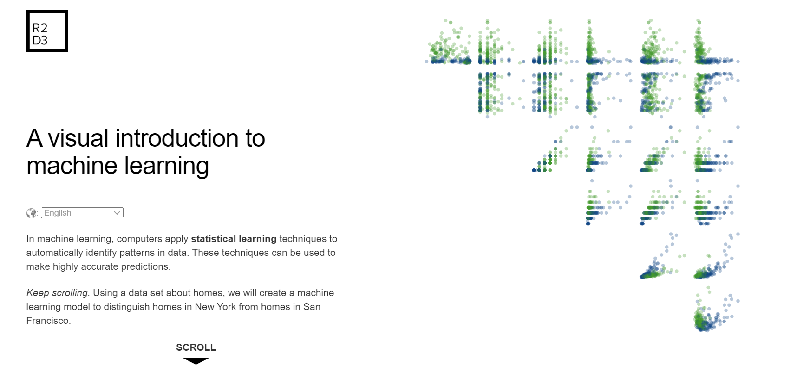
A visual introduction to machine learning

