Slide 1

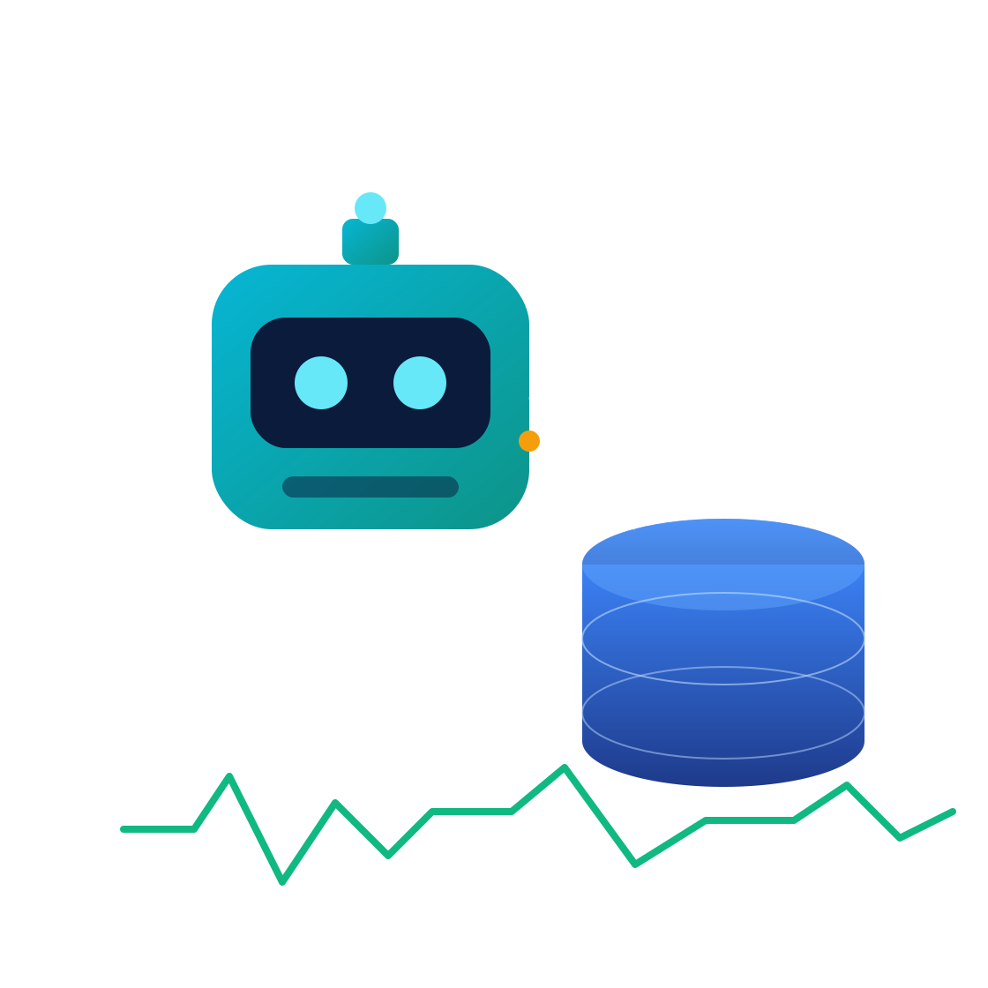
AUTONOMOUS SYSTEMS · DATABASE OPERATIONS
AI-Powered Autonomous
Database Administrator
Real-time monitoring, LLM-driven optimization, and safe self-healing for PostgreSQL & MySQL — with human-in-the-loop approval.
Presented by Swapneel Kulkarni
Notes:
Hi, I'm Swapneel. This project is an AI-powered autonomous Database Administrator — an agent that continuously watches PostgreSQL and MySQL, finds performance problems, proposes fixes, and can safely apply them with a human in the loop. Goal for today: show the architecture, a live demo, and the engineering decisions behind it.

Slide 2






THE PROBLEM
Database performance doesn't scale with human DBAs
Production databases drift toward trouble faster than teams can react — and every manual fix risks downtime.
Slow queries
Missing / redundant indexes
Table bloat
Seq scans & N+1 patterns degrade latency
Wrong indexes hurt reads and writes
Dead tuples inflate storage & scans
Lock contention
Connection exhaustion
Replication lag
Hot rows stall concurrent transactions
Pools saturate under load spikes
Replicas fall behind, risking staleness
Must hold to: 100M+ rows · 1000+ queries/min · < 2% monitoring overhead · PostgreSQL 14+ & MySQL 8.0+
Autonomous DBA Agent
02
Notes:
Databases drift toward trouble faster than teams can react. Six recurring failure modes: slow queries, bad indexes, table bloat, lock contention, connection exhaustion, replication lag. Traditional DBA work is manual, reactive, and risky. And it has to hold at scale — 100M+ rows, 1000+ queries/min, under 2% monitoring overhead, on both Postgres 14+ and MySQL 8. That overhead budget is what forces an efficient async design.

Slide 3
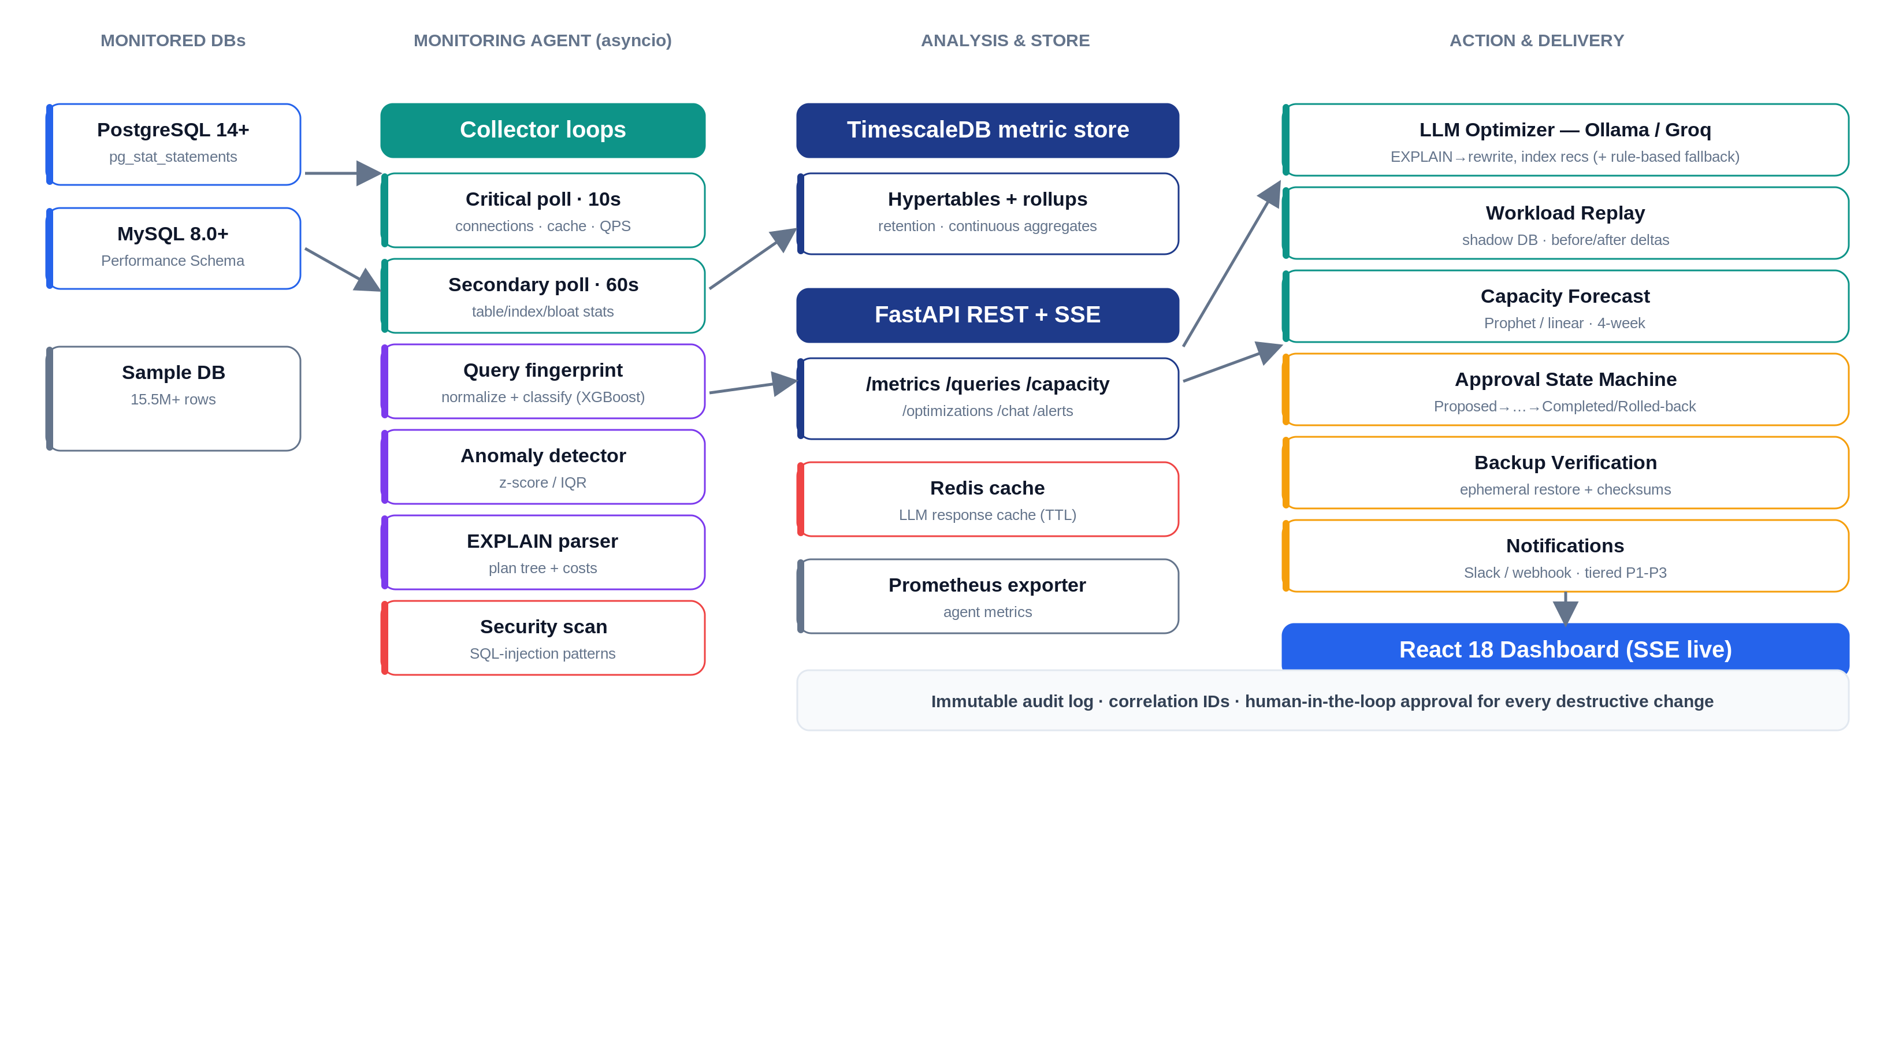
APPROACH · CORE ARCHITECTURE
A closed-loop optimization pipeline
Autonomous DBA Agent
03
Notes:
Read it left to right. Monitored databases feed an async monitoring agent that polls metrics and pg_stat_statements. Queries get fingerprinted and classified; an anomaly detector uses z-score and IQR; an EXPLAIN parser structures the plan. Everything lands in TimescaleDB, served by FastAPI with an SSE stream. On the right are the actions: the LLM optimizer (Ollama/Groq with a rule-based fallback), workload replay on a shadow DB, capacity forecasting, the approval state machine, backup verification, and security scanning. Every destructive change is gated by approval and written to an immutable audit log.

Slide 4
TECH STACK
Production-grade and fully containerized
Backend
Frontend
Data & Infra
Observability
Python 3.11 · asyncio
React 18
PostgreSQL / MySQL
structlog (JSON)
FastAPI
TypeScript
TimescaleDB
Prometheus
asyncpg / aiomysql
Vite
Redis
Grafana
XGBoost classifier
Recharts
Docker Compose
OpenTelemetry
Prophet forecasting
Tailwind CSS
Ollama / Groq LLM
Tiered alerting
transitions state machine
Server-Sent Events
MinIO cold storage
Immutable audit log
Autonomous DBA Agent
04
Notes:
Backend is Python asyncio so polling never blocks — key to the 2% overhead budget. FastAPI for the API and SSE. TimescaleDB because it's Postgres-native with hypertables, rollups, and retention. Redis caches LLM responses. The LLM layer is Ollama locally with a Groq fallback, and crucially a rule-based fallback so the pipeline works with no model at all. Frontend is React 18 + TypeScript with Recharts, streaming over SSE. Everything is containerized with docker-compose.

Slide 5







OVERVIEW · WHAT IT DOES
Nine capabilities, one autonomous agent
Real-time monitoring
Slow-query detection
SQL optimization
10s critical / 60s secondary polling
Fingerprinting + z-score / IQR anomalies
LLM rewrites + rule-based fallback
Workload replay
Capacity forecasting
Approval workflow
Validate changes on a shadow DB
Prophet / linear · 4-week lookahead
Human-in-the-loop state machine
Backup verification
Security detection
Natural-language chat
Ephemeral restore + checksums
SQL-injection & exfiltration alerts
Ask the DB questions in English
Autonomous DBA Agent
05
Notes:
These nine capabilities map directly to the project's expected outputs. Monitoring, slow-query detection, optimization, replay, forecasting, approval, backup verification, security detection, and a natural-language chat. The chat is notable: common questions like 'top 5 slowest queries' are answered deterministically straight from the data, so it works even without an LLM.

Slide 6
DEEP DIVE · THE OPTIMIZATION LOOP
From anomaly to safe deployment
1
Monitor
2
Fingerprint
3
Detect
4
Analyze
Poll metrics + pg_stat_statements
Normalize & classify queries
z-score / IQR anomaly flags
EXPLAIN + LLM / heuristics
5
Propose
6
Replay
7
Approve
8
Deploy
Index, rewrite, config change
Test on shadow DB, measure delta
Human reviews & signs off
Apply + watch, auto-rollback
Safety rails: every destructive change needs approval · full immutable audit trail · automatic rollback if p99 regresses
Autonomous DBA Agent
06
Notes:
This is the heart of the system — the safe optimization loop. We monitor, fingerprint, detect an anomaly, analyze with EXPLAIN plus the LLM or heuristics, propose a concrete change, then — and this is the hardest and most important part — replay it against a shadow database to measure the real before/after delta. Only then does a human approve, and on deploy we keep watching and auto-rollback if p99 latency regresses. Safety rails: approval, audit trail, rollback.

Slide 7
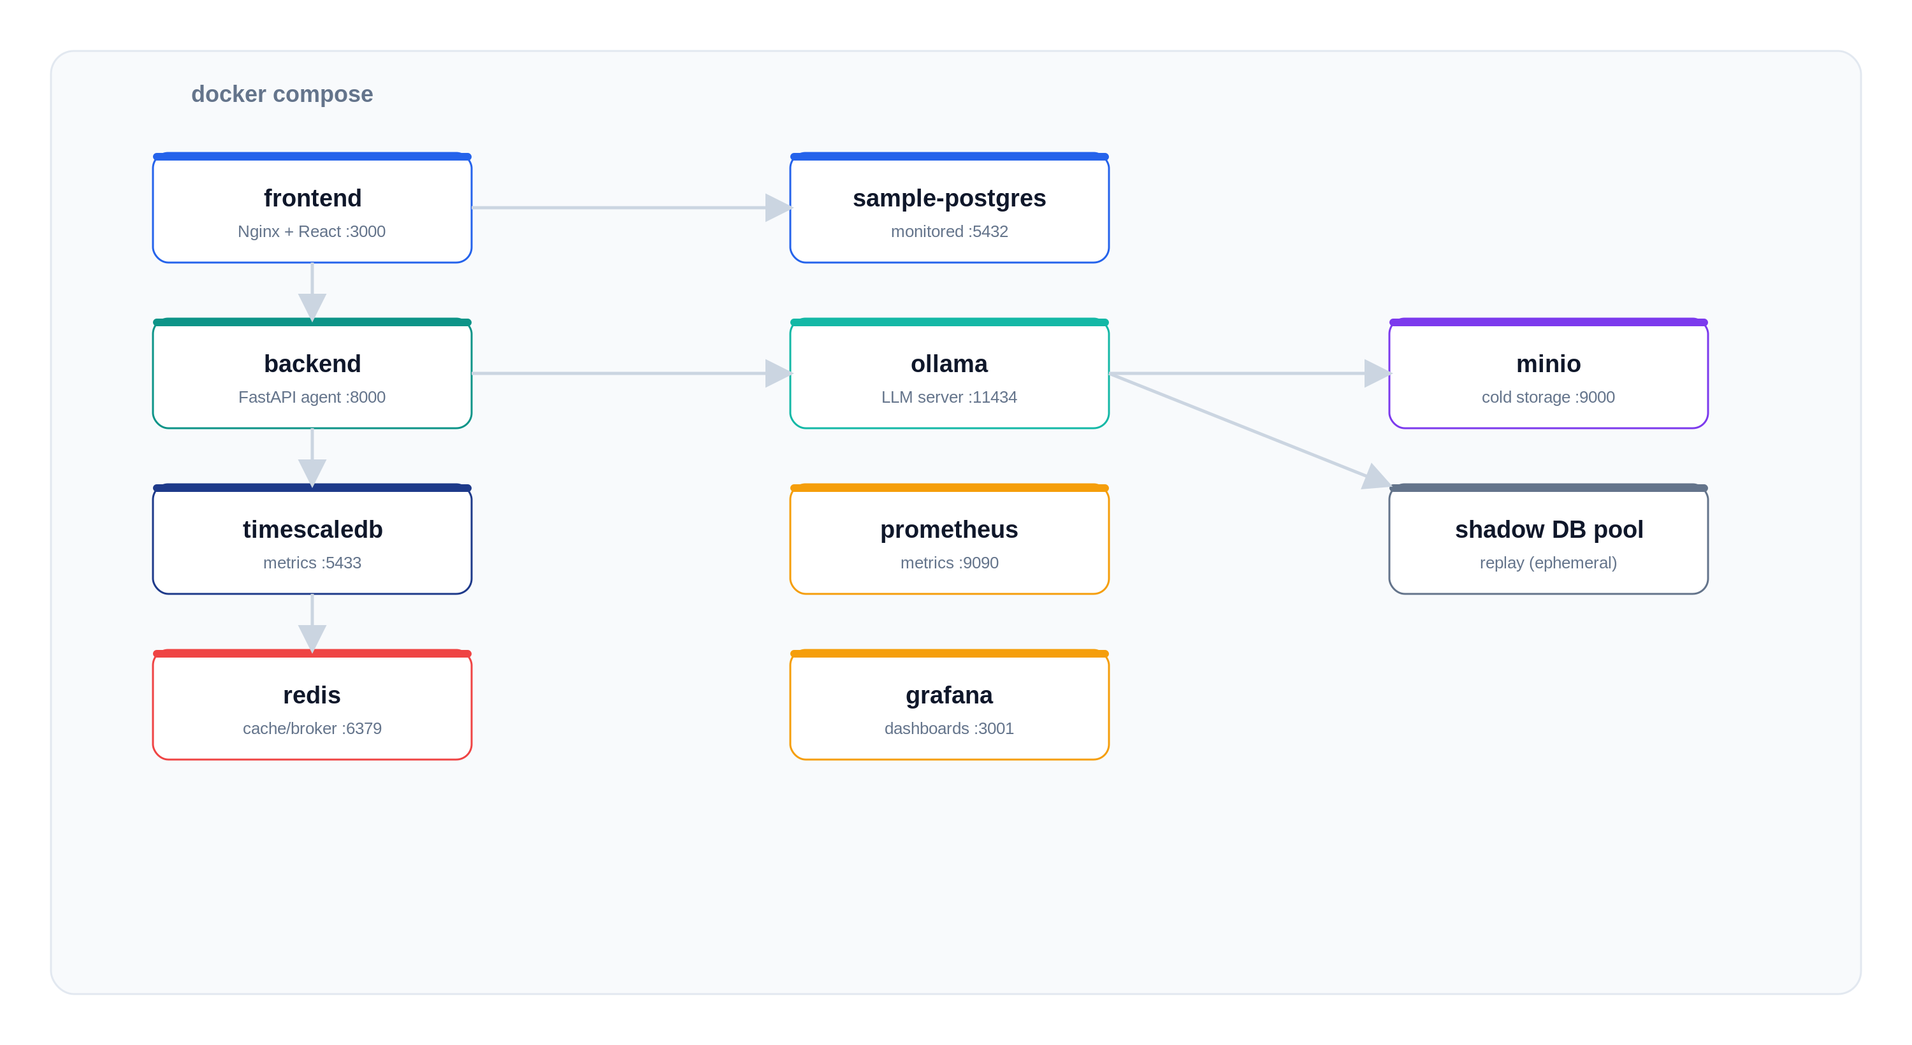


INFRASTRUCTURE
One command brings up the whole stack
docker compose up --build
9 services, one network
Degraded-mode startup
Boots even if a dependency is down
Fast frontend
Nginx gzip + immutable asset caching
Configurable dataset
SEED_* env · 15.5M → 100M+ rows
Autonomous DBA Agent
07
Notes:
The whole stack is one 'docker compose up'. Nine services on one network. I designed startup to be degraded-mode tolerant — the API boots and serves even if TimescaleDB, Redis, or Ollama aren't up yet, and reconnects later. The frontend is served by Nginx with gzip and immutable asset caching for fast reloads. The sample dataset size is configurable via env vars, from about 15 million rows up to the 100M+ scale from the brief.

Slide 8
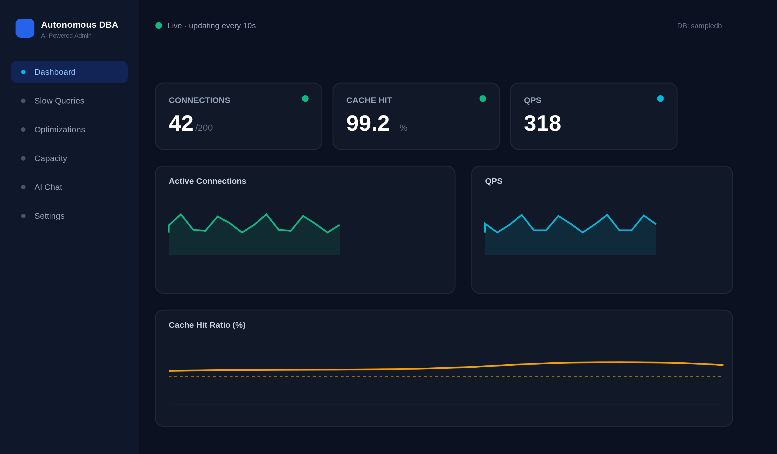

FRONTEND · DASHBOARD & UI
Live operational visibility
Dashboard
Live KPIs & charts via SSE
Slow Queries
Top-N with one-click Optimize
Optimizations
Side-by-side review & approve
Capacity
Forecasts with confidence bands
AI Chat
Data-backed natural-language answers
Alerts & Settings
Security events & thresholds
Autonomous DBA Agent
08
Notes:
The dashboard streams live over Server-Sent Events — KPI cards and charts update every ten seconds. Six tabs: live Dashboard, Slow Queries with a one-click Optimize, an Optimization review screen with approve/reject, Capacity forecasts with confidence bands, the AI Chat, and Alerts/Settings for security events and thresholds. This mockup mirrors the real running UI.

Slide 9

DEMO · RUN IT LOCALLY
Up and running in three steps
bash
Dashboard
# 1 — clone & configure
git clone <repo> && cd autonomous-dba
cp .env.example .env
# 2 — launch the full stack
cd infra/docker
docker compose up --build
# 3 — (optional) enable live LLM
docker exec -it dba-ollama \
ollama pull llama3.2:1b
localhost:3000
API docs (OpenAPI)
localhost:8000/docs
Grafana
localhost:3001
Prometheus
localhost:9090
Autonomous DBA Agent
09
Notes:
Running it locally is three steps: clone and copy the env file, then 'docker compose up --build' from infra/docker. Optionally pull a small model into Ollama for live LLM answers. In the live demo I'll open the dashboard on :3000, show the OpenAPI docs on :8000/docs, trigger an optimization on a slow query, and ask the chat for the slowest queries.

Slide 10
CHALLENGES & SOLUTIONS
Hard problems, pragmatic fixes
CHALLENGE ROOT CAUSE SOLUTION
Settings crashed at import
pydantic-settings tried to JSON-parse the comma-separated DB list
Raw string field + cached property to parse it
Dashboard showed no live data
The agent wrote metrics but never fed the SSE stream
Snapshot publish callback → per-DB SSE queues
pg_stat_statements was dormant
CREATE EXTENSION isn't enough without preloading
Preload via compose command + seed a workload
LLM not always available
Ollama/Groq may be offline in a demo
Graceful degradation + rule-based fallback
Needed production-scale data
Tiny seed didn't exercise slow scans
Configurable seed: 15.5M → 100M+ rows
Autonomous DBA Agent
10
Notes:
A few I'd highlight. The app crashed at import because pydantic-settings tried to JSON-parse the comma-separated database list — fixed with a raw string plus a parsed property. The dashboard showed nothing because the agent wrote metrics but never pushed them to the SSE stream — I added a publish callback. And pg_stat_statements quietly did nothing until I preloaded the library via the compose command and seeded a workload. The through-line: most issues were integration and contract problems, not algorithms.

Slide 11
RESULTS & LESSONS LEARNED
What shipped, and what I learned
13
9 / 10
15.5M+
< 2%
REST + SSE endpoints
expected-output features
rows monitored live
target DB overhead
Lessons learned
Graceful degradation beats hard failure — the system must still boot and serve when a dependency is missing.
Treat the frontend↔backend contract as first-class — most bugs were route/field mismatches, not logic.
Build observability in from day one — structured logs and correlation IDs made every issue traceable.
Scope to the 20% that demonstrates the 80% — a focused, working slice beats a broad, broken one.
Autonomous DBA Agent
11
Notes:
Where it landed: 13 endpoints, nine of ten expected-output features working, monitoring 15M+ rows live, designed to stay under the 2% overhead budget. Biggest lessons: graceful degradation beats hard failure; treat the frontend-backend contract as first-class; build observability in from day one; and scope to the slice that actually demonstrates the system.

Slide 12
Q & A
Happy to dig into any part of the system
How do you keep changes safe?
How would this scale to many DBs?
Why both rule-based & LLM?
What would you build next?
Autonomous DBA Agent
12
Notes:
Anticipated questions: safety (approval + replay + rollback + audit), scaling (Celery workers, connection pooling, data tiering — scaffolded), why both rule-based and LLM (reliability and cost vs. flexibility), and what's next (Alerts UI, automatic p99 rollback trigger, Kubernetes).

Slide 13

Thank You
AI-Powered Autonomous Database Administrator
Swapneel Kulkarni
swapneel2121@gmail.com
Notes:
Thank you — happy to take questions or walk through any part of the code or the live system.

