Slide 1
SQL
By Swapnika Nadimpalli

Slide 2
Database:
It is an organized structure collection of data, which is used to store in an electronic device.
Types:
SQL
No SQL
SQL:
It is used to manipulate and retrieve the data of the relationship database management system (RDMS) or Database Programming Language.
Eg: MySQL, Oracle.
No SQL:
There are no tables, they can be stored in any kind of system. (no imIt ages or videos can be recorded, only the pathway is mentioned)

Slide 3
Database
Click on Schema.
Type in the command, “ Create database databasename eg: create database sqlclass
Click on Thunder I (above the text command area)
How to delete ?
Drop database databasename;
Manual Procedure
Under the schemas, right click the database
Select drop schema from the dialogue box that has appeared.
How to create a table?
Before creating a table you select the respective database you want to insert the table in.
Eq: command- use sqlclass

Slide 4
Procedure:
Creating
Write the command,”create table tablename” eg: create table sys
Write down the table column name you wish to flow.
Eg: 1. (
2. Id int,
3. Name varchar (60),
4. Age int
5. )
Here, the number must have the “int” command and letters like name must have Varchar command along with (60) /(120) - stating the letter number capacity of the table.

Slide 5
B. Flowing
To check if the table is flowing or not one must write the command “ describe tablename” eq: describe sys
C. Inserting values
Eg: 1. Insert into sys
2.Values
3. (
4. 1,
5. “Naina”,
6. 25
7. )
Note: If once wants the id number to flow according the normal chronological numbers order, they need to type auto increment in the command
Eg: create table sys (id int auto_increment………)
D. Data flowing in the table
- Write the command, “select * from sys”
Eg: select * from sys

Slide 6
Queries
How to add extra column?
alter table tablename add column name varchar(60)/int
How to Drop the table
alter table table name drop column name
How to Rename
Alter table tablename change cloumnname(that you want to change) name of the chaging column varchar(60)
How to update?
Update tablename setname(that you want to change) where id= (where you want to change)
Delete single lines
Delete from table name where id=

Slide 7
Aggregative functions
How does one know the number of entries?
Select count(*( as numberofrecords from tablename
How to know the average of all the data?
Select avg(marks) as numberofmarks from tablename
How to find maximum number?
Select max(marks) as numberofmaxmarks from tablename

Slide 8
Searching for specific data
How to arrange order where same numbers will not be appeared?
Select distincto(marks) as numberofdistinctmarks from table name
How to know specific data?
Select * from tablename where age=(give age you need to find)
How to search a particular name of names starting with particular alphabet
Select * from tablename where name like “%A”
Here, if we type “a%” it shows the results with “a”as an ending alphabet

Slide 9
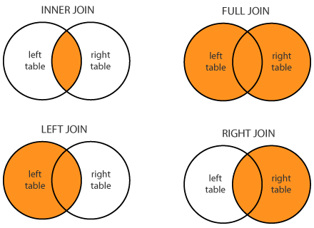
Join Tables
How to interjoin tables (interjunction)
select*from table1name as t1 inner join table2name as t2 on t1.id=t2.id
(t1 and t2 are refer indications)
How to join right table ( according to the 2nd table)
Select * from table1name as t1 right join table2name as t2 on t1.id=t2.id
How to join left table (according to 1st table)
Select * from table1name as t1 left join table2name as t2 t1.id=t2.id

Slide 10
Arrangement and categorisation number
How to enable data to flow in ascending or descending order
Select * from tablename order by id asc
(or)
Select * from tablename order by id desc
How to know the number of people in each category?
Select stream, count(name) numberofs from tablename group by stream

Slide 11
Ranking
How to give marks in descending order according to the age?
Select name,marks,rank() over (order by marks desc, age desc)
From table name
Select name,marks,rank() over(order by mark desc) as studentmarksrank from table name

Slide 12
Highest number
How to find the highest salary
Select salary as nth salary from tablename as t1 where -0 +(select count(*) from table name as t2 where t1.salary<t2.salary)
(If you want to find second highest replace 0 with 1)
How to find the lowest
Select salary as nth salary from tablename as t1 where -0 +(select count(*) from table name as t2 where t1.salary>t2.salary)

Slide 13
View and Store
View - Safety security
Create view viewer as select name,age from table name
Select * table name viewer
Store - faster retrieval of data
Delimited
Create procedure pro()
Begin
Select id, name from table name;
End
Call pro

Slide 14
Indexing - If we want to find out one column
Create index ind on tablename(column name)
ind= reference word
(If we want to find multiple columns after this change ind and put another word eg: indi and use the same query)

