Slide 1



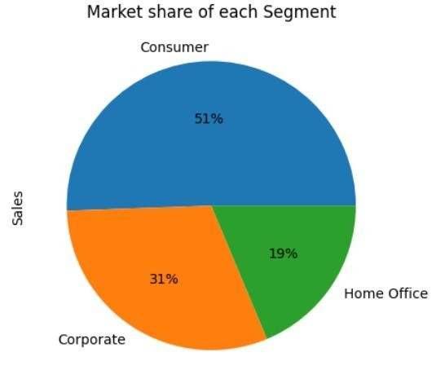
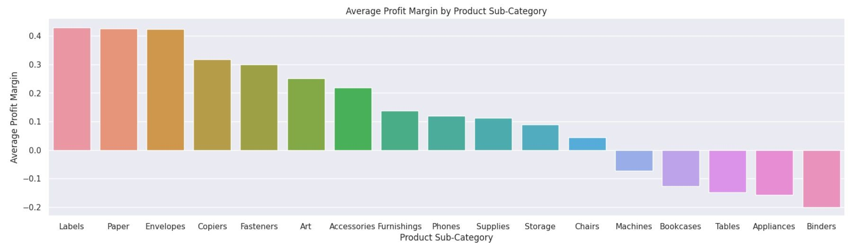
ANALYSIS OF SUPERSTORE DATASET
Program Feedback
Project Short Summary
Analysis of superstore dataset project is to conduct a comprehensive analysis of the Sample Superstore dataset to gain valuable insights into Sales trends and Profitability of the store.
I had an amazing experience to IBM Cloud Skills Builds platform. Study content and comprehensive document are very helpful to understand the basics of new technology.
SWAPNIL PAL
swapnilpaljnp@gmail.com
Veer Bahadur Singh Purvanchal University
#skillsbuild

