Slide 1


Integration of Coordinate Descent and Machine Learning for Black-Box optimization
Swapnil Agrawal
Guided By
Prof. Nicholas V. Sahinidis

Slide 2
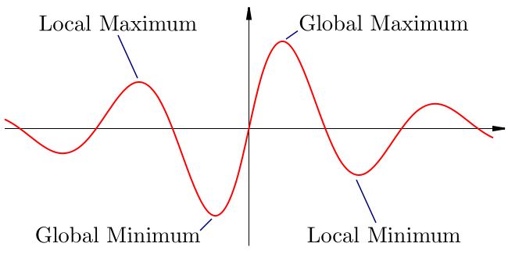
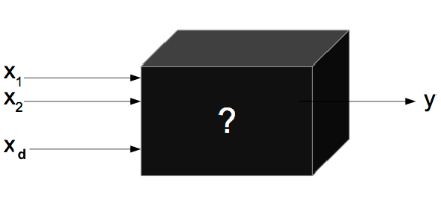

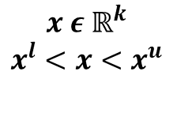
Objective
Optimize a black-box Function within limited number of function calls and time, given the number of variables, variable bounds and a black-box function to find input-output (x, y) pairs
$$x ε ℝ^{k}$$
$$x^{l}<x<x^{u}$$
$$y ∈ ℝ$$
Independent Variables
Dependent Variables
Notes:
Problem statement

Slide 3
Motivation
Systems becoming more complex – difficult to understand than experiment
In some cases, the function is not at all available in the algebraic form though we have access to function output on providing it some input (Example – Aspen process simulation)
Evaluating the function can be expensive in terms of money or time
Wide Application
Notes:
Introduction and Motivation

Slide 4
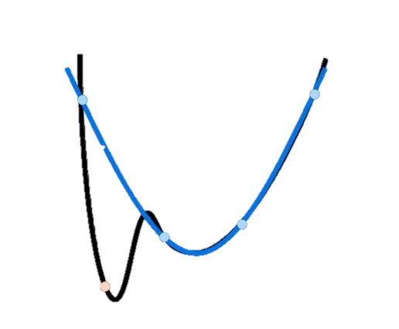
Approach
Chose Sampling
Method
Sample Points
Build Surrogate Model
Update Optimum point (if improvement)
Optimize
Surrogate
Model
Function evaluation limit reached?
No
Black-Box
Function
Yes
Report the best calculated optimum value

Slide 5
Problem Set
Non-Convex Smooth black-box problems are selected for analysis of the algorithm. These problems are further divided in four categories based on the number of input variables in the problem.
Category | Number of Variables | Total Problems
1 | 1-2 | 86
2 | 3-9 | 97
3 | 10-30 | 27
4 | >30 | 35
Base Case Black Box Function
camel6 is a two-dimensional test problem, which exhibits six local minima, two of which are global minima. The detailed discussion of this problem is mentioned in Rios, Sahinidis paper ^{[1]}
Table1 – Categories based on number of variables
[1] Rios, L.M. & Sahinidis, N.V. J Glob Optim (2013) 56: 1247. https://doi.org/10.1007/s10898-012-9951-y

Slide 6
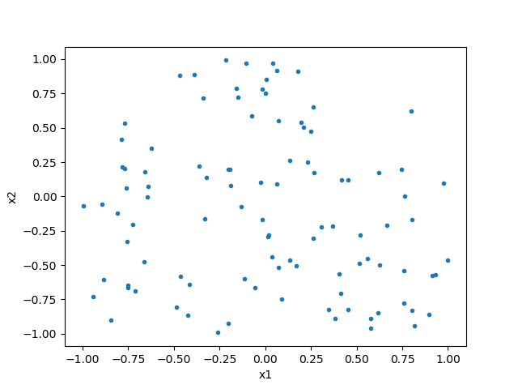
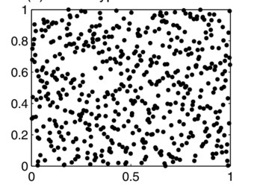
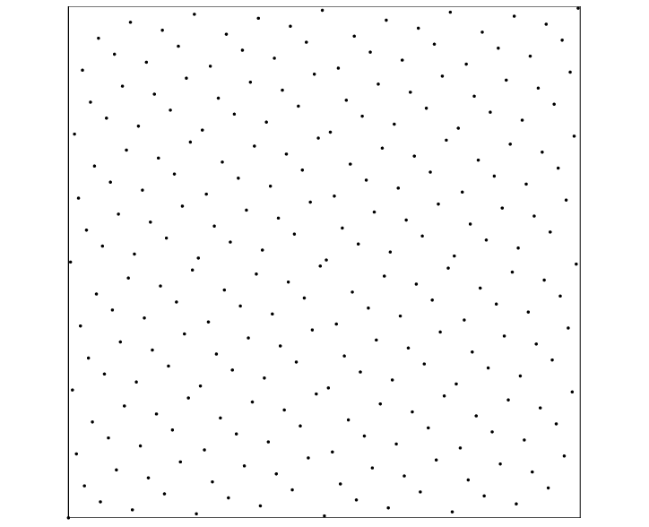
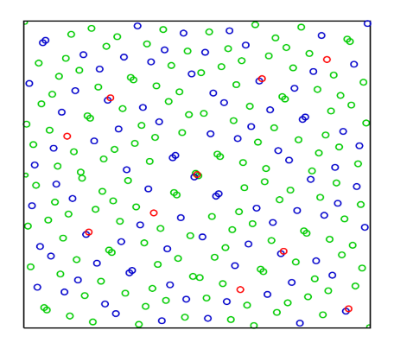
Sampling Methods
Solving camel6 blackbox problem with different sampling methods shows the best progress with sobol sampling method
Random Sampling
Latin – Hypercube Sampling
Hammersley Sampling
Sobol-Sequence Sampling
Notes:
Solved for camel6
Try solving for some other problem also to check repeatability of results
Check for higher dimension problems too

Slide 7
Sampling Points
Chose Sampling
Method
Sample Points
Build Surrogate Model
Update Optimum point (if improvement)
Optimize
Surrogate
Model
Function evaluation limit reached?
No
Black-Box
Function
Yes
Report the best calculated optimum value

Slide 8
Selecting 20 points for one iteration shows the best progress and took the least amount of time
Sampling Points
Notes:
Solved for camel6
Try solving for some other problem also to check repeatability of results
Check for higher dimension problems too

Slide 9
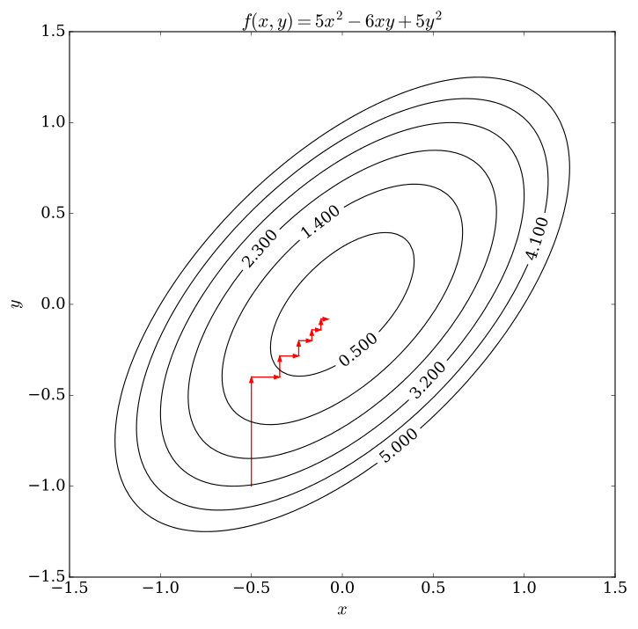
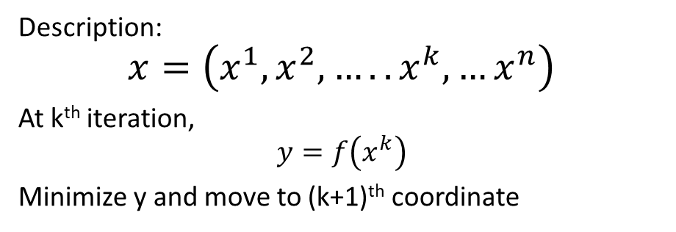
Coordinate Descent Method
It is an optimization algorithm that successively minimizes along coordinate directions to find the minimum of a function.
At each iteration, the algorithm determines a coordinate or coordinate block, then minimizes over the corresponding coordinate hyperplane while fixing all other coordinates or coordinate blocks.
Description:
$$x=\left(x^{1},x^{2},…..x^{k}, …x^{n}\right)$$
At k^{th} iteration,
$$y=f\left(x^{k}\right)$$
Minimize y and move to (k+1)^{th} coordinate

Slide 10
Search Space
Chose Sampling
Method
Sample Points
If local search :
Shrink search space
Build Surrogate Model
Update Optimum point (if improvement)
Yes
If local search : Increase search space
Optimize
Improvement?
No
Function evaluation limit reached?
No
Yes
Report the best calculated optimum value

Slide 11
Search Space – Global vs Local
Observation - Global search is fast in the beginning but does not improve after a point while local search is slow and takes more function evaluations to converge
Proposed Solution - Start with global search (using complete range) and then start localizing it by reducing the bounds

Slide 12
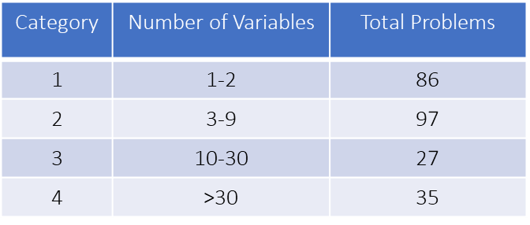
Results and Discussion
A total of 245 black-box function are solved with 2500 function evaluation limit by using both global and local search method.
The comparison of fractions of problems solved with both the methods for different categories is shown in the figure.

Slide 13
Function Evaluations
For both the search methods, after around 2500 function evaluations, the fraction of problems solved for each category saturates.

Slide 14
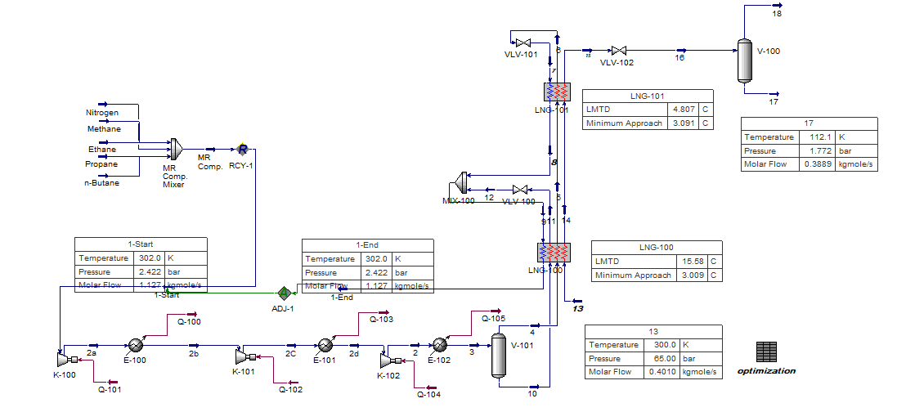
Pilot Test – Aspen Black-Box Function
Problem Statement – Optimize the energy of Single mixed refrigerant (SMR) process which is modeled by Aspen HYSYS
Number of variables – 8
Results – With 10,000 function evaluations, the optimum value of 13.74523 KW/(ton/day) is obtained whereas the known optimum value for the problem is 10.99 KW/(ton/day) by Na J. [2].
[2] Na, J., Lim, Y., & Han, C. (2017). A modified DIRECT algorithm for hidden constraints in an LNG process optimization. Energy, 126, 488-500.

Slide 15
Conclusions
Comparing the two algorithms, Global Search and local Search, it can be concluded that global search is good for low dimensional problems and when we have lower limit on number of function evaluations as there are more chances of finding optimum in less function evaluations with global search.
When limit on function evaluations is more, using local search provides better results.
For problems more than 30 dimensions cyclic coordinate search is not a good algorithm to perform optimization.

Slide 16
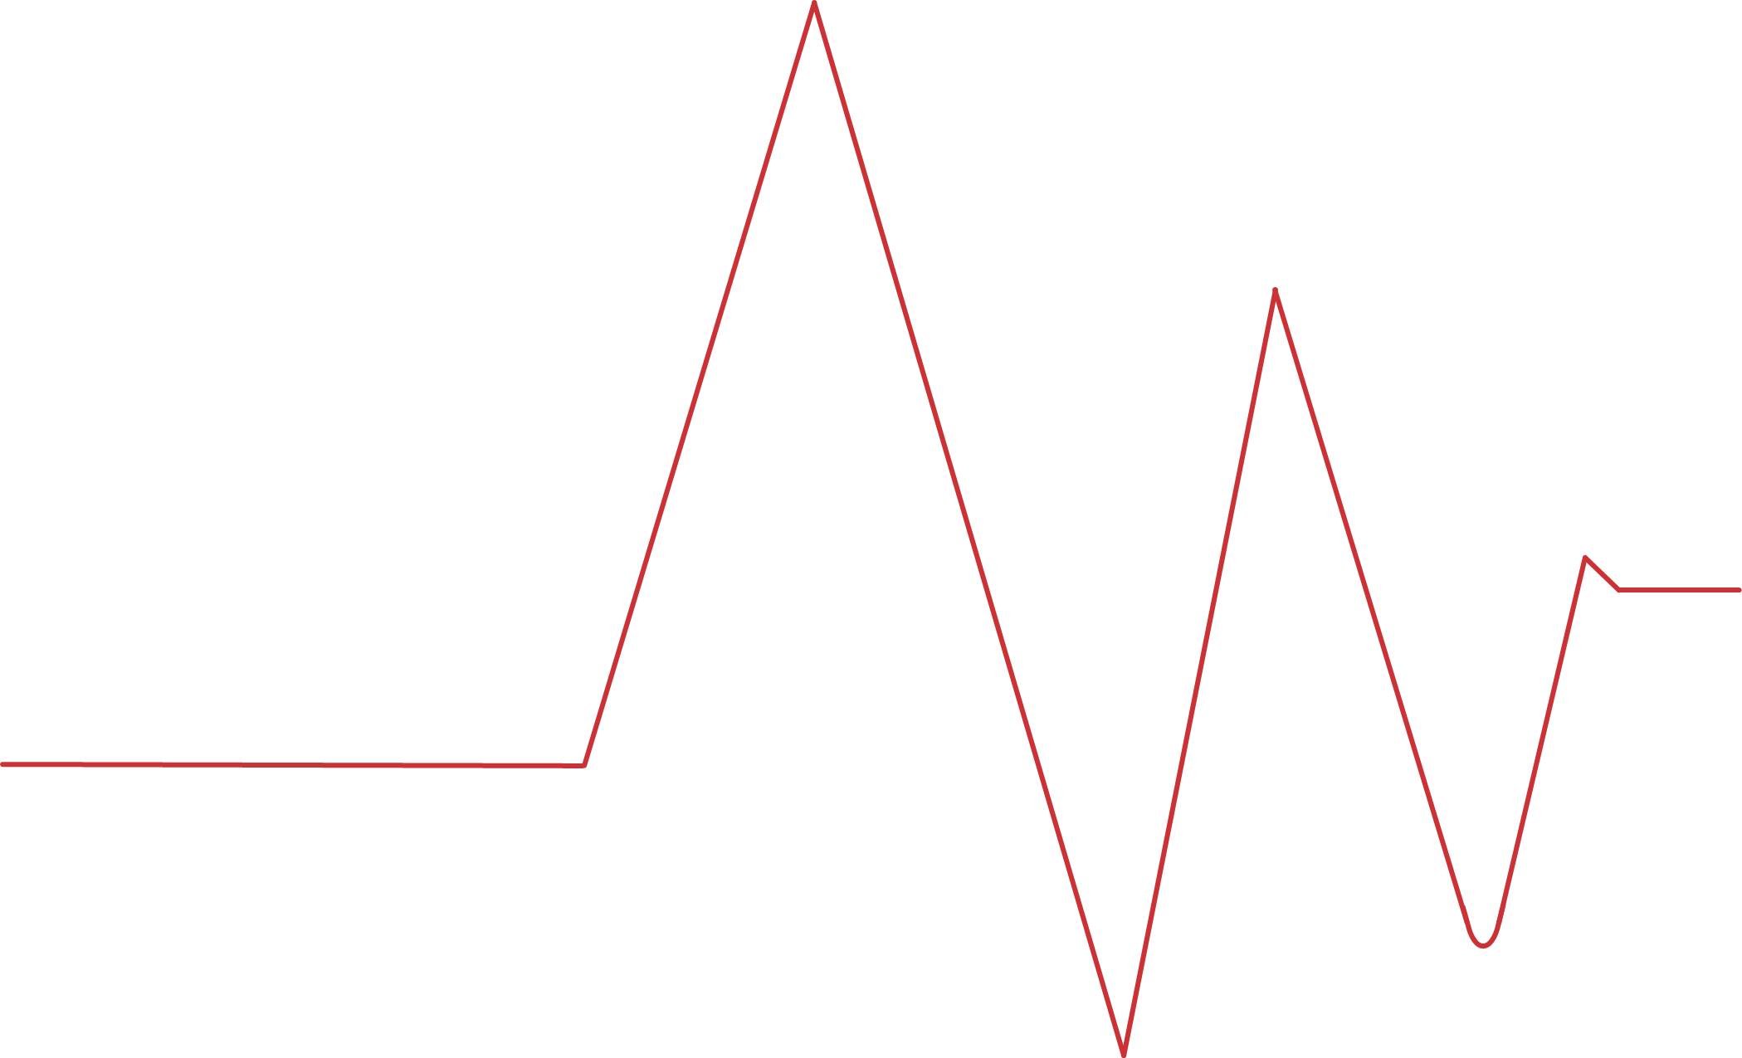
Thank You

