Slide 1
EXPLORATORY DATA ANALYSIS / NETFLIX CATALOGUE
8,807
ADMIT ONE
6,131
movies
2,676
TV shows
titles, taken apart.
122 countries
42 genres
What is actually on Netflix, where it comes from,
and how the library changed as the service grew.
Python · pandas · matplotlib | Data snapshot: January 2008 - September 2021
Notes:
Opening: this is an EDA of the public Netflix titles dataset - 6,131 movies and 2,676 TV shows listed up to September 2021.

Slide 2
THE BRIEF
REEL 02 / 15
One table, twelve columns, five questions
8,807
12
1925-2021
2008-2021
rows, one per title
columns: type, cast, country, rating, duration...
release years covered
window in which titles were added
WHAT WE SET OUT TO ANSWER
Q1
How big is each side of the catalogue: movies or shows?
Q2
How fast did it grow, and is the library new or old?
Q3
Which countries and genres does it come from?
Q4
Who is the content for, and how long is it?
Q5
Which people and which months stand out?
Source: netflix_data.csv (8,807 titles, added to Sept 2021)
Notes:
Structure of the talk follows these five questions. The dataset description and the project guidelines came with the zip.

Slide 3
BEFORE WE COUNT ANYTHING
REEL 03 / 15
A few small problems, fixed before the charts
FOUND
WHAT IT LOOKED LIKE
WHAT WE DID
3 rows
duration typed into the rating column (Louis C.K. specials)
moved to duration, rating set to Unknown
30% / 9% / 9%
director / cast / country are blank
labelled Unknown so gaps stay visible
10 rows
no date_added
kept, but left out of time-based charts
text dates
'September 25, 2021' and '90 min' / '2 Seasons'
parsed to real dates, minutes and seasons
multi-value cells
'Drama, Comedy' in one cell; co-productions
split and exploded so each item is counted
14 rating codes
TV-MA, PG-13, TV-Y7-FV ...
grouped into 4 audience bands
No duplicate rows or duplicate IDs were found. The cleaned file is saved as data/netflix_clean.csv.
Notes:
The only genuine data error is the three shifted rows. Everything else is missing data that we label rather than guess.

Slide 4
01 / THE SPLIT
REEL 04 / 15
Seven movies for every three shows
70%
30%
MOVIES · 6,131
TV · 2,676
Count is not watch-time
Still a movie library
The balance moves
A series takes far longer to watch than a film, so TV matters more than 30% suggests. This dataset has no viewing data to measure it.
By number of titles, the catalogue is closer to a film archive than a box-set shelf.
TV's share was smaller in the early years and grew later (see reel 05).
Source: netflix_data.csv (8,807 titles, added to Sept 2021)
Notes:
6,131 movies, 2,676 TV shows. Be careful to say this is title count, not hours watched.

Slide 5
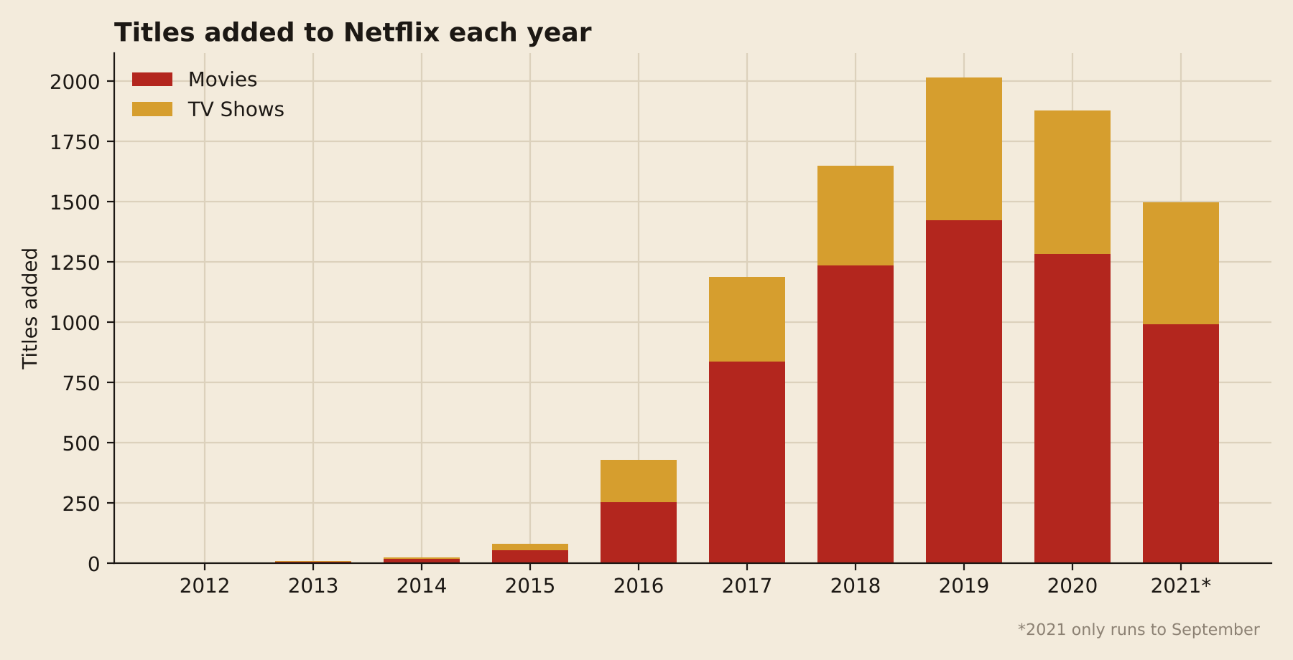
02 / GROWTH
REEL 05 / 15
From 82 titles a year to over 2,000 in four years
2,016
titles added in 2019, the peak year
25x
growth from 2015 (82 titles) to 2019
-7%
dip in 2020; 2021 already had 1,498 by September
Source: netflix_data.csv (8,807 titles, added to Sept 2021)
Notes:
Additions before 2015 are tiny. The jump from 2016 to 2017 alone is 429 to 1,188. The 2020 dip may relate to the pandemic but the data cannot prove that. 2021 is a partial year.

Slide 6
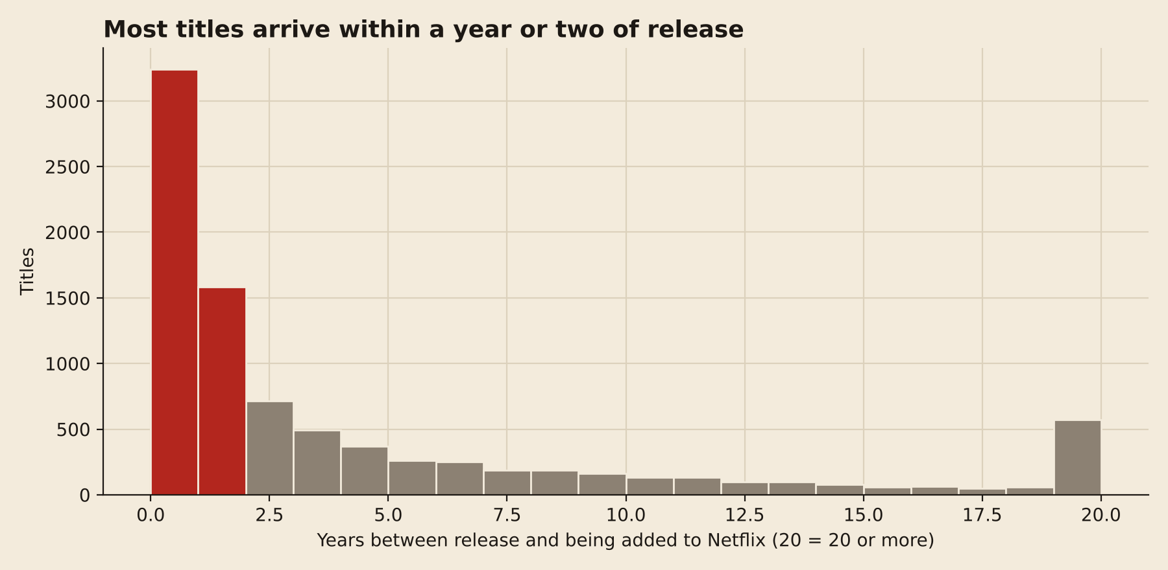
03 / HOW NEW IS IT?
REEL 06 / 15
A young library: the median title lands one year after release
1 year
median gap between release and arriving on Netflix
63%
arrive within two years of release
71%
of titles were released in 2015 or later
Source: netflix_data.csv (8,807 titles, added to Sept 2021)
Notes:
Red bars are titles added within a year of release. The long grey tail on the right is older back-catalogue. The last bar groups everything 20+ years old.

Slide 7
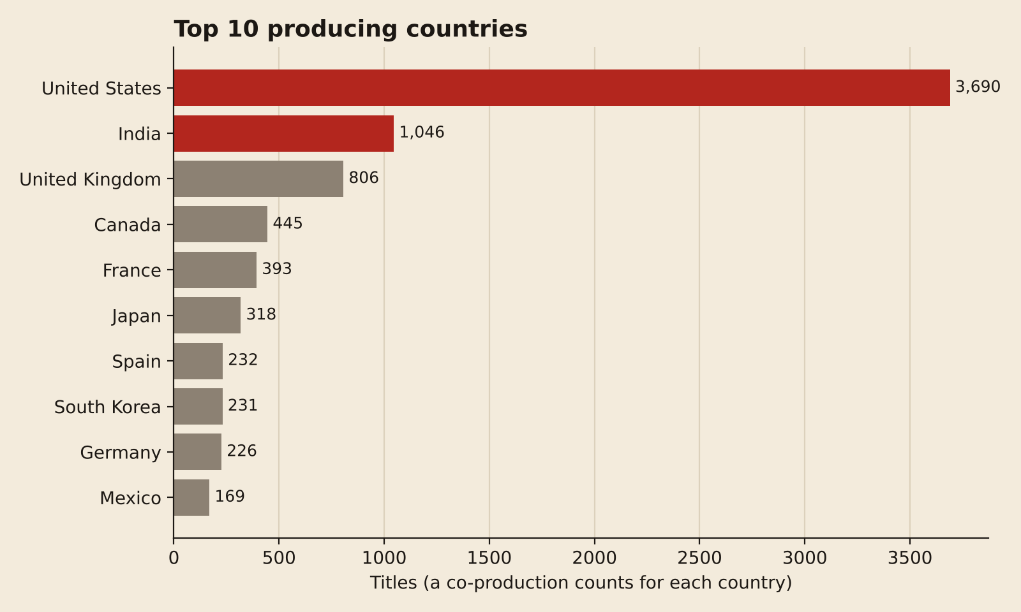
04 / GEOGRAPHY
REEL 07 / 15
America leads, and India is the surprise runner-up
46%
of titles with a known country involve the United States
1,046
titles involve India, more than the UK or Canada
122
countries appear in the catalogue
Source: netflix_data.csv (8,807 titles, added to Sept 2021)
Notes:
Co-productions are counted once per country, so these bars add up to more than the number of titles. Country is blank for about 9% of titles.

Slide 8
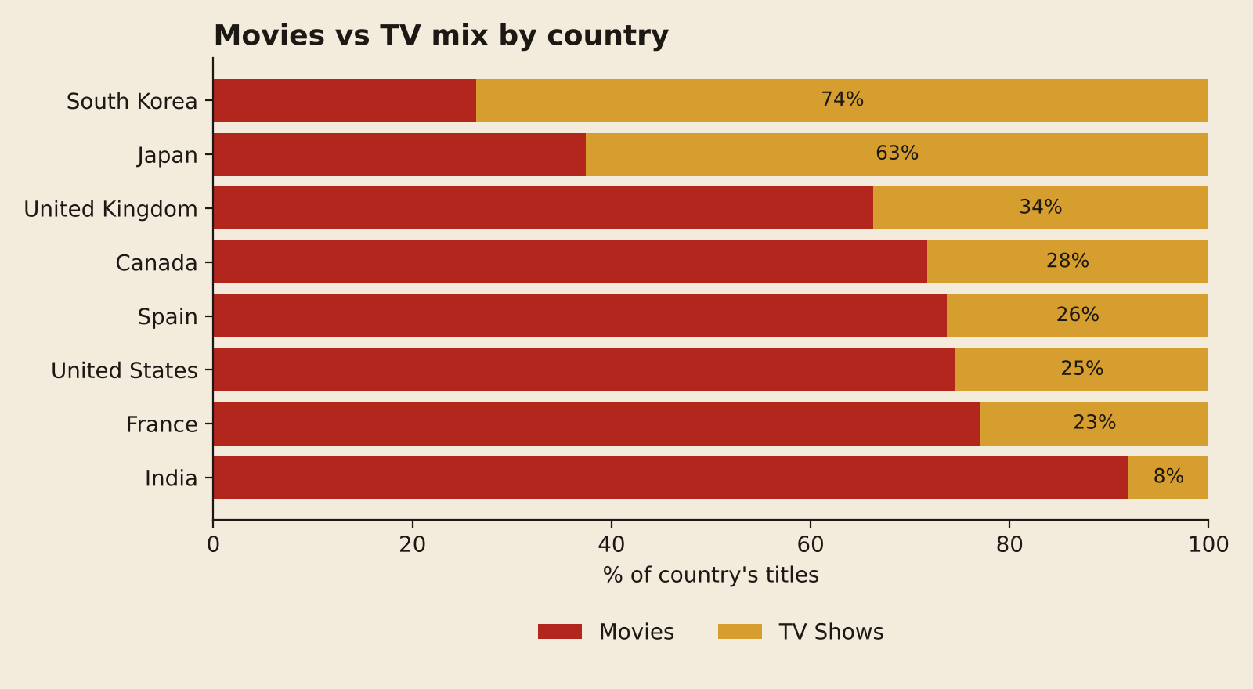
04 / GEOGRAPHY, CONTINUED
REEL 08 / 15
India is a movie country, South Korea is a TV country
92%
of India's titles are movies
74%
of South Korea's titles are TV shows
63%
of Japan's are TV (anime and drama)
Source: netflix_data.csv (8,807 titles, added to Sept 2021)
Notes:
Mix by country among the top eight. The US sits near the overall 70/30 average.

Slide 9
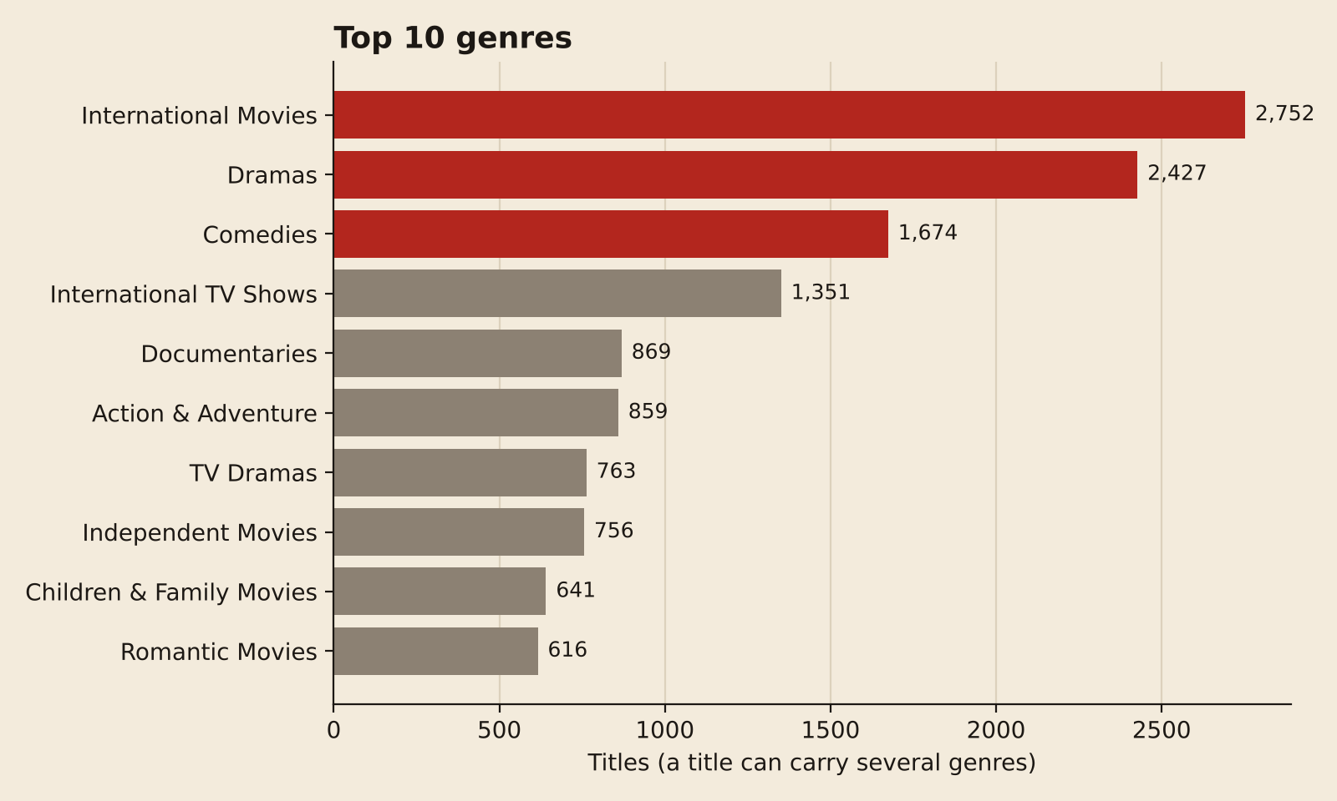
05 / GENRES
REEL 09 / 15
International stories, told as drama and comedy
2,752
International Movies, the biggest single label
2,427
Dramas, then 1,674 Comedies
42
distinct genre tags in total
Source: netflix_data.csv (8,807 titles, added to Sept 2021)
Notes:
A title can carry several genres, so bars overlap. Among TV, Crime TV Shows (470) and Kids' TV (451) are the next biggest after International, Dramas and Comedies.

Slide 10
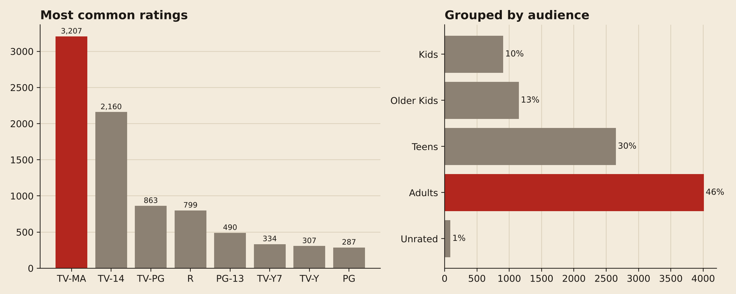
06 / AUDIENCE
REEL 10 / 15
Three out of four titles are aimed at teens and adults
36%
76%
10%
of the catalogue is TV-MA, the single biggest rating
is rated for teens or adults (TV-14, PG-13, TV-MA, R...)
is for the youngest viewers (TV-Y, TV-Y7, TV-G, G)
Source: netflix_data.csv (8,807 titles, added to Sept 2021)
Notes:
Audience bands: Kids = TV-Y/Y7/G/G; Older Kids = TV-PG/PG; Teens = TV-14/PG-13; Adults = TV-MA/R/NC-17. The adult share has been steady around 45% since 2017.

Slide 11
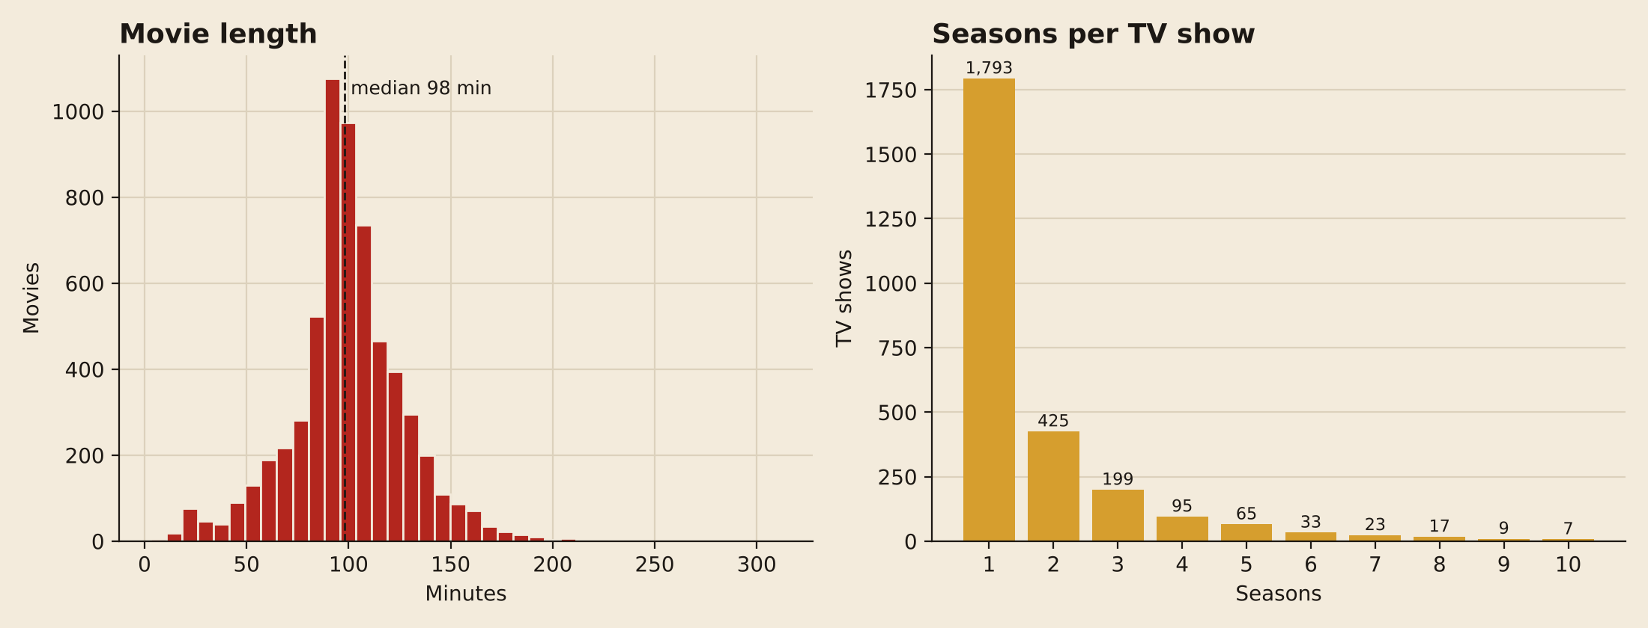
07 / LENGTH
REEL 11 / 15
Films run about 98 minutes, and most shows stop after one season
98 min
64%
67%
median movie length
of movies run between 80 and 120 minutes
of TV shows have a single season
Source: netflix_data.csv (8,807 titles, added to Sept 2021)
Notes:
Wide rather than deep: lots of short-run shows, few long-running series. Seasons chart is cut at 10; a handful of shows run longer (max 17).

Slide 12
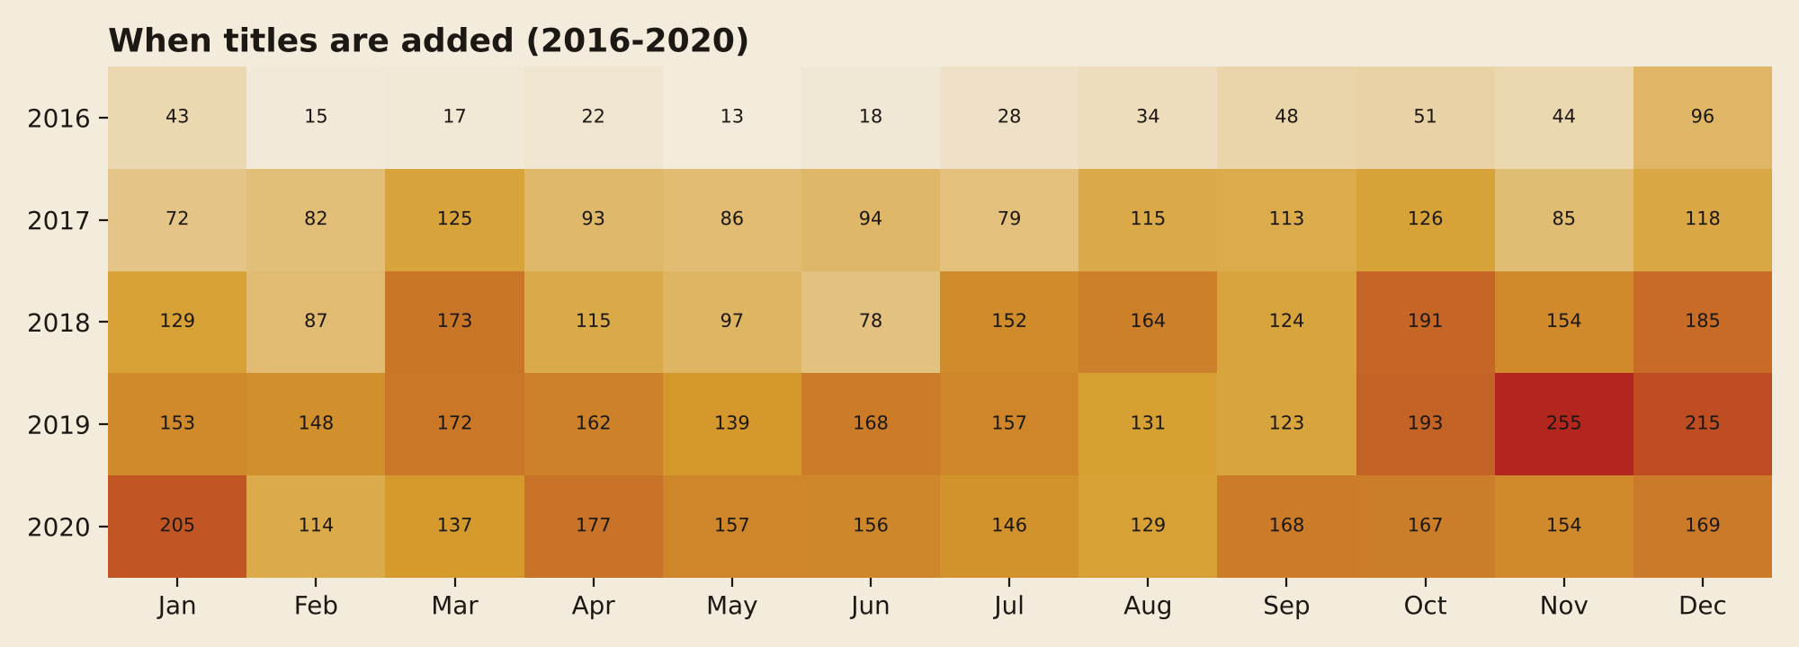
08 / TIMING
REEL 12 / 15
No release season: titles arrive all year round
255
titles added in November 2019, the busiest month in the data
Jul, Dec
the busiest calendar months overall
Feb
Darker cells mean more titles added. 2016 to 2020 shown, 2021 is incomplete. Apart from the 2019 autumn spike, months look broadly alike, which fits a steady always-on release pipeline.
the quietest, with 563 titles across all years
Source: netflix_data.csv (8,807 titles, added to Sept 2021)
Notes:
Heatmap rows = year added, columns = month. January 2020 (205) and December 2019 (215) are also high.

Slide 13
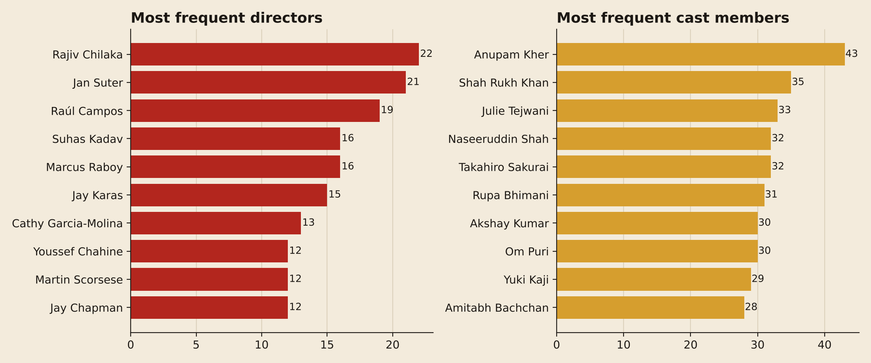
09 / NAMES
REEL 13 / 15
The people who keep coming back
43
credits for Anupam Kher, the most frequent cast member
22
titles for director Rajiv Chilaka (kids' animation)
30%
of titles have no director listed, so treat the ranking as a floor
Source: netflix_data.csv (8,807 titles, added to Sept 2021)
Notes:
Cast list is dominated by Indian film actors plus voice actors for dubbed anime and kids' shows. Top directors include stand-up special directors (Jan Suter, Raul Campos).

Slide 14
THE SHORT VERSION
REEL 14 / 15
What the catalogue says
1
Movie-heavy
5
Grown-up
70% movies, 30% shows.
76% teens and adults; TV-MA is #1.
2
Fast build-up
6
Wide, not deep
82 titles in 2015, 2,016 in 2019.
98-minute films; 67% of shows have one season.
3
Young
7
Always on
Median title arrives one year after release.
Releases spread across the year.
4
Global
US first, India second, Korea and Japan lean TV.
Notes:
Seven findings, one line each.

Slide 15
HONEST LIMITS
REEL 15 / 15
Caveats, and where to go next
WHAT THIS DATA CANNOT SAY
NEXT STEPS
It lists titles, not viewing, so 'most' means 'most listed', never 'most watched'.
1
Join viewing hours or IMDb scores to separate listed from loved.
Director, cast and country have gaps, so people and country rankings are lower bounds.
2
Mine the description text to cluster themes.
Co-productions count once per country, so country totals exceed the title count.
3
Forecast yearly additions, allowing for the 2020 shock.
The snapshot ends in September 2021; the 2021 bar is a partial year.
Code: netflix_eda.ipynb · Data: netflix_data.csv

