Slide 1
EXPLORATORY DATA ANALYSIS
Employee Wellness Analysis
Understanding Mental Health & Treatment-Seeking Patterns at XYZ Technical Solutions
Dataset: 1,048 employee survey responses • 28 attributes
Prepared for: EDA Project Submission

Slide 2
What We'll Cover
1
Dataset Overview
What the data captures and why it matters to XYZ
Why this matters
Data Cleaning
XYZ Technical Solutions lost a valued employee to a health crisis. This analysis turns a public workplace mental-health survey into concrete, data-backed ideas for protecting the rest of the team.
2
Fixing corrupted values, messy categories & missing data
3
Exploratory Analysis
8 visualizations uncovering who needs support, and why
8
visualizations across demographics, workplace policy, and treatment outcomes
4
Key Insights
The strongest patterns behind treatment-seeking
5
Recommendations
Practical next steps for XYZ's wellness programs
Employee Wellness Analysis | 2

Slide 3
Why This Analysis Matters
After losing an important employee to a health crisis, XYZ Technical Solutions wants to proactively identify employees who are in need of, or may need, mental health support — and design workplace programs that genuinely help.
1,048
48.9%
57.8%
employees surveyed
already sought treatment
treatment rate with family history
(vs. 20.3% without)
Employee Wellness Analysis | 3

Slide 4
1
Dataset Overview
A workplace mental-health survey capturing demographics, workplace stressors, employer support programs, and whether the respondent has sought treatment.
At a Glance
1,048 respondents • 28 original attributes
Age range (cleaned): 18–65 yrs (median 31)
0 duplicate rows found
Top country: United States (61% of responses)
Target variable: treatment (Yes / No)
Demographics:
Age, Gender, Country, State
Workplace Factors:
Company size, remote work, tech company, self-employed
Employer Support:
Benefits, care options, wellness programs, anonymity, leave
Attitudes & Outcomes:
Willingness to disclose, treatment, work interference
Employee Wellness Analysis | 4

Slide 5
2
Data Preprocessing
Raw survey data is never analysis-ready. Before any chart could be trusted, we walked through five deliberate cleaning steps — each is detailed on its own slide with the code that performed it.
Initial Inspection
Shape, dtypes, missing values, duplicates
1
Age Outliers
Impossible values (-1726, 99999999999) removed
2
Gender Cleanup
30+ free-text spellings → 3 clean categories
3
Corrupted Labels
Excel auto-dates restored to employee-count ranges
4
Missing Values
Imputation, 'Not Applicable' tagging, column pruning
5
Employee Wellness Analysis | 5

Slide 6
1
Step 1: Initial Data Inspection
Before touching a single value, we profiled the raw file to see exactly what needed fixing — shape, data types, missing values, and duplicate rows.
1,048 × 28
412 / 236 / 916
0
raw rows and columns
missing in state / work_interfere / comments
exact duplicate rows found
Employee Wellness Analysis | 6

Slide 7
1
Code: Initial Data Inspection
df = pd.read_csv('employee_wellness_dataset.csv')
print(df.shape)
df.info()
# Missing values per column, worst first
df.isna().sum().sort_values(ascending=False).head(10)
print('Duplicate rows:', df.duplicated().sum())
Full notebook: Employee_Wellness_EDA.ipynb
Employee Wellness Analysis | 7

Slide 8
2
Step 2: Fixing Age Outliers
The Age column contained impossible entries — negative ages and typos like 99999999999. We keep only realistic working ages (18-75) and treat the rest as missing rather than guessing a value.
-1726 to 1e11
6
18 - 65
raw min/max before cleaning
rows flagged as invalid and set to NaN
clean range (median 31)
Employee Wellness Analysis | 8

Slide 9
2
Code: Fixing Age Outliers
print(sorted(df['Age'].unique())[:5],
sorted(df['Age'].unique())[-5:])
df['Age_clean'] = df['Age'].apply(
lambda x: x if 18 <= x <= 75 else np.nan)
n_bad = df['Age'].apply(
lambda x: not (18 <= x <= 75)).sum()
print('Outliers removed:', n_bad)
print(df['Age_clean'].describe())
Full notebook: Employee_Wellness_EDA.ipynb
Employee Wellness Analysis | 9

Slide 10
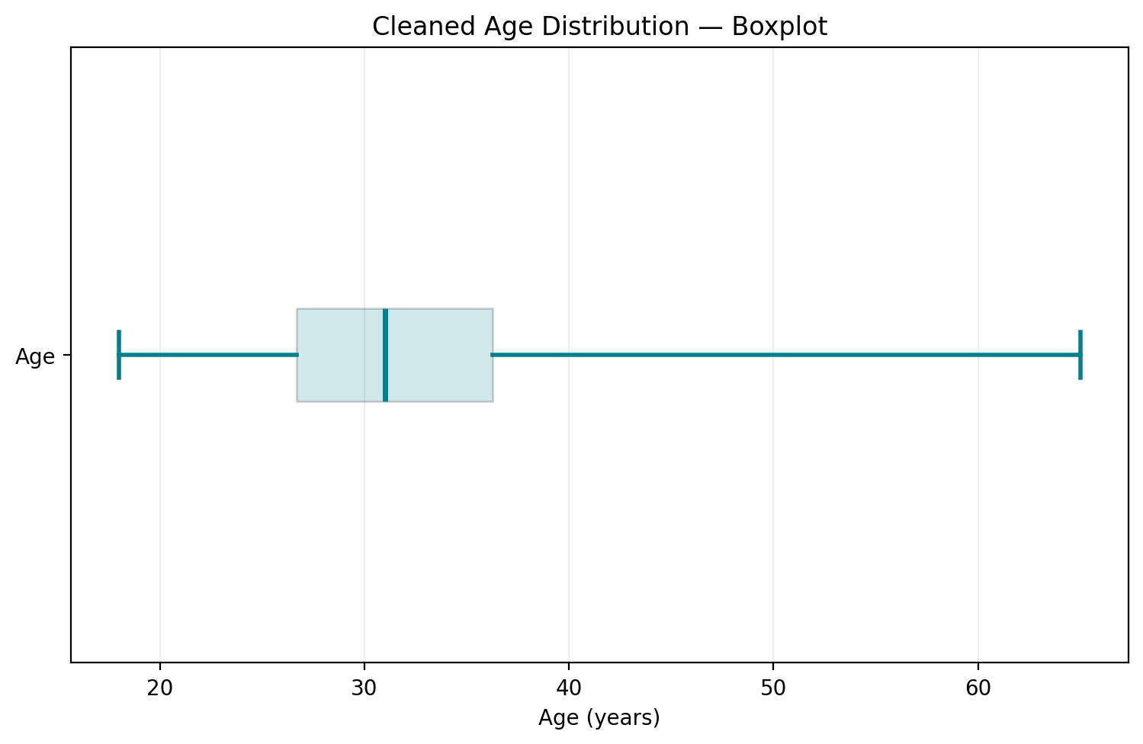
2
Age Outliers: Boxplot
INSIGHT
Invalid ages were removed
The raw Age column contained impossible values. After cleaning, the reported age range is 18–65 years with a median of 31.
The boxplot summarizes the cleaned distribution; its quartiles are estimated from the age-group counts shown in this presentation.
Employee Wellness Analysis | 11

Slide 11
3
Step 3: Standardizing Gender
Free-text entry produced 37 distinct spellings for gender ('Male-ish', 'Cis Female', 'malr'...). A lookup-based function collapses these into three consistent, analyzable categories.
37 → 3
829 / 206 / 13
0
raw spellings collapsed into clean categories
Male / Female / Other after cleaning
unmapped or dropped responses
Employee Wellness Analysis | 10

Slide 12
3
Code: Standardizing Gender
def clean_gender(g):
g = str(g).strip().lower()
male_set = {'male','m','male-ish','maile',
'cis male','mal','make','man', ...}
female_set = {'female','f','cis female','woman',
'femake','trans woman', ...}
if g in male_set: return 'Male'
if g in female_set: return 'Female'
return 'Other/Non-binary'
df['Gender_clean'] = df['Gender'].apply(clean_gender)
df['Gender_clean'].value_counts()
Full notebook: Employee_Wellness_EDA.ipynb
Employee Wellness Analysis | 11

Slide 13
4
Step 4: Repairing Corrupted Category Labels
Two 'no_employees' categories were silently mangled by Excel's auto-date conversion: '6-25' became '25-Jun' and '1-5' became '5-Jan'. We restore the original labels and set a proper, ordered category so charts sort correctly.
2 / 6
'25-Jun' → '6-25'
Ordered
categories corrupted by Excel auto-dates
'5-Jan' → '1-5'
categorical dtype applied for correct sorting
Employee Wellness Analysis | 12

Slide 14
4
Code: Repairing Corrupted Category Labels
print(df['no_employees'].unique())
map_fix = {'25-Jun': '6-25', '5-Jan': '1-5'}
df['no_employees_clean'] = \
df['no_employees'].replace(map_fix)
order_size = ['1-5','6-25','26-100','100-500',
'500-1000','More than 1000']
df['no_employees_clean'] = pd.Categorical(
df['no_employees_clean'],
categories=order_size, ordered=True)
Full notebook: Employee_Wellness_EDA.ipynb
Employee Wellness Analysis | 13

Slide 15
5
Step 5: Missing Values & Column Pruning
Remaining gaps needed different treatment depending on what they meant: self_employed was mode-imputed, a blank work_interfere means the condition doesn't apply (not truly missing), and comments was too sparse to use.
self_employed
work_interfere
comments
18 missing → filled with mode ('No')
236 missing → labeled 'Not Applicable'
87% missing → column dropped entirely
Employee Wellness Analysis | 14

Slide 16
5
Code: Missing Values & Column Pruning
df['self_employed'] = df['self_employed'] \
.replace('NA', np.nan).fillna('No')
df['work_interfere_clean'] = \
df['work_interfere'].fillna('Not Applicable')
df = df.drop(columns=['comments'])
print('Duplicate rows:', df.duplicated().sum())
df.shape
Full notebook: Employee_Wellness_EDA.ipynb
Employee Wellness Analysis | 15

Slide 17
1
Age Distribution
INSIGHT
A young workforce
Roughly 60% of respondents are between 25 and 34 years old — a career stage often marked by rising workload and career-establishment stress, making early wellness intervention especially valuable.
Employee Wellness Analysis | 16

Slide 18
1
Code: Age Distribution
bins = [17,24,29,34,39,44,49,75]
labels = ['18-24','25-29','30-34','35-39',
'40-44','45-49','50+']
df['age_bin'] = pd.cut(df['Age_clean'], bins=bins,
labels=labels)
ax = df['age_bin'].value_counts() \
.reindex(labels).plot(kind='bar',
color='#028090')
ax.set_title('Age Distribution of Respondents')
ax.set_xlabel('Age Group'); ax.set_ylabel('Count')
plt.tight_layout(); plt.show()
Full notebook: Employee_Wellness_EDA.ipynb
Employee Wellness Analysis | 17

Slide 19
2
Gender Distribution
INSIGHT
A male-dominated sample
Nearly 4 in 5 respondents identify as male. Any gender-based comparisons in this dataset should be read with this imbalance in mind — findings may not generalize evenly across XYZ's own workforce.
Employee Wellness Analysis | 18

Slide 20
2
Code: Gender Distribution
def clean_gender(g):
g = str(g).strip().lower()
if g in male_set: return 'Male'
if g in female_set: return 'Female'
return 'Other/Non-binary'
df['Gender_clean'] = df['Gender'].apply(clean_gender)
ax = df['Gender_clean'].value_counts().plot(
kind='bar', color='#00A896')
ax.set_title('Gender Distribution')
ax.set_xlabel(''); ax.set_ylabel('Count')
plt.tight_layout(); plt.show()
Full notebook: Employee_Wellness_EDA.ipynb
Employee Wellness Analysis | 19

Slide 21
3
Treatment-Seeking Overall
INSIGHT
Nearly an even split
48.9% of respondents (512 of 1,048) have already sought treatment for a mental health condition. This is not a fringe issue — it affects close to half the workforce sampled, reinforcing the need for organization-wide, not opt-in-only, support.
Employee Wellness Analysis | 20

Slide 22
3
Code: Treatment-Seeking Overall
ax = df['treatment'].value_counts().plot(
kind='pie', autopct='%1.1f%%',
colors=['#A9D6D2','#028090'], ylabel='')
ax.set_title(
'Has the Employee Sought Mental Health Treatment?')
plt.tight_layout(); plt.show()
print(df['treatment'].value_counts(normalize=True))
Full notebook: Employee_Wellness_EDA.ipynb
Employee Wellness Analysis | 21

Slide 23
4
Family History vs. Treatment
INSIGHT
The strongest predictor
Employees with a family history of mental illness seek treatment at 57.8%, nearly 3x the rate of those without a family history (20.3%). Of all factors studied, this shows the clearest link.
Employee Wellness Analysis | 22

Slide 24
4
Code: Family History vs. Treatment
ct = pd.crosstab(df['family_history'], df['treatment'],
normalize='index') * 100
ax = ct.plot(kind='bar', color=['#F2A65A','#028090'])
ax.set_title(
'Treatment Rate by Family History of Mental Illness')
ax.set_ylabel('% of group'); ax.set_xlabel('Family History')
plt.tight_layout(); plt.show()
print(ct.round(1))
Full notebook: Employee_Wellness_EDA.ipynb
Employee Wellness Analysis | 23

Slide 25
5
Work Interference vs. Treatment
INSIGHT
A practical warning sign
Respondents who say their condition interferes with work 'Sometimes' or 'Often' overwhelmingly report seeking treatment. Self-reported interference is a strong, easy-to-ask signal managers can act on.
Employee Wellness Analysis | 24

Slide 26
5
Code: Work Interference vs. Treatment
order_wi = ['Never','Rarely','Sometimes','Often',
'Not Applicable']
ct = pd.crosstab(df['work_interfere_clean'],
df['treatment']).reindex(order_wi)
ax = ct.plot(kind='bar', color=['#F2A65A','#028090'])
ax.set_title('Treatment by Reported Work Interference')
ax.set_ylabel('Count'); ax.set_xlabel('')
plt.tight_layout(); plt.show()
Full notebook: Employee_Wellness_EDA.ipynb
Employee Wellness Analysis | 25

Slide 27
6
Company Size vs. Treatment
INSIGHT
A mild, structural effect
Treatment-seeking is fairly stable across company sizes, with a slightly higher share at very small companies (1-5 employees) — possibly reflecting less formal HR support infrastructure to fall back on.
Employee Wellness Analysis | 26

Slide 28
6
Code: Company Size vs. Treatment
map_fix = {'25-Jun':'6-25', '5-Jan':'1-5'}
df['no_employees_clean'] = \
df['no_employees'].replace(map_fix)
order_size = ['1-5','6-25','26-100','100-500',
'500-1000','More than 1000']
ct = pd.crosstab(df['no_employees_clean'],
df['treatment']).reindex(order_size)
ax = ct.plot(kind='bar', color=['#F2A65A','#028090'])
ax.set_title('Treatment by Company Size')
ax.set_ylabel('Count'); ax.set_xlabel('')
plt.tight_layout(); plt.show()
Full notebook: Employee_Wellness_EDA.ipynb
Employee Wellness Analysis | 27

Slide 29
7
Benefits Awareness vs. Treatment
INSIGHT
Awareness drives action
Employees who KNOW their employer offers mental-health benefits seek treatment at 62%, vs. just 36% among those who say 'Don't know'. Communicating what already exists may matter as much as adding new benefits.
Employee Wellness Analysis | 28

Slide 30
7
Code: Benefits Awareness vs. Treatment
ct = pd.crosstab(df['benefits'], df['treatment'])
ax = ct.plot(kind='bar', color=['#F2A65A','#028090'])
ax.set_title(
'Treatment by Awareness of Mental Health Benefits')
ax.set_ylabel('Count'); ax.set_xlabel('')
plt.tight_layout(); plt.show()
print((ct['Yes'] / ct.sum(axis=1) * 100).round(1))
Full notebook: Employee_Wellness_EDA.ipynb
Employee Wellness Analysis | 29

Slide 31
8
Respondent Geography
INSIGHT
A US/UK-heavy sample
61% of respondents are from the United States and 15% from the United Kingdom. Healthcare-access and cultural differences across these regions may be confounding some of the patterns shown — validate against XYZ's own locations.
Employee Wellness Analysis | 30

Slide 32
8
Code: Respondent Geography
top_countries = df['Country'].value_counts().head(8)
ax = top_countries.plot(kind='barh', color='#028090')
ax.set_title('Top 8 Countries by Respondent Count')
ax.invert_yaxis()
plt.tight_layout(); plt.show()
Full notebook: Employee_Wellness_EDA.ipynb
Employee Wellness Analysis | 31

Slide 33
Key Insights
1
Family history is the strongest predictor — 57.8% treatment rate vs. 20.3% without it.
4
Nearly half of all respondents (48.9%) have already sought treatment — this is mainstream, not a fringe issue.
2
Self-reported work interference tracks closely with treatment-seeking, making it a practical check-in cue.
5
Company size and remote-work status show only mild effects — culture matters more than structure.
3
Awareness of benefits drives usage more than existence of benefits alone (62% vs. 36%).
6
The sample skews young, male, and US/UK-based — validate findings against XYZ's actual workforce.
Employee Wellness Analysis | 32

Slide 34
!
Recommendations for XYZ
Communicate benefits clearly
Awareness alone raised treatment-seeking by up to 26 points — make existing programs visible.
1
Train managers on warning signs
Self-reported work interference is a strong, actionable cue for a supportive check-in.
2
Build in proactive check-ins
With ~49% already needing support, don't rely on opt-in programs alone.
3
Protect anonymity
Willingness to disclose to supervisors/coworkers varies widely — offer confidential channels.
4
Validate on XYZ's own data
Re-run this analysis on XYZ's employee survey before finalizing any program.
5
Employee Wellness Analysis | 33

Slide 35
Thank You
Questions & Discussion

