Slide 1
Vehicle Damage Detection Under the Guidance of Mr. Saurabh Panwar. Group Members’ names and PRN Gaurav Kumar Singh (240340128009) Mitali Giri (240340128016) Satyasish Patranabish (240340128029) Snehal Awadan (240340128033) Swapnil Burud (240340128034)

Slide 2
INTRODUCTION
Objective: Develop an AI-based system to automatically detect and assess car damage from images.
Importance: Enhances efficiency and accuracy in vehicle inspection, crucial for insurance claims, rentals, and resale evaluations.
Technology: Introduce YOLOv8, the latest version of the "You Only Look Once" (YOLO) algorithm, known for its speed and accuracy in object detection.

Slide 3
PROBLEM STATEMENT
Manual vehicle damage assessment is a time-consuming, labor-intensive, and often subjective process, leading to inconsistencies, delays, and increased costs in industries such as insurance, fleet management, and vehicle inspections.
There is a critical need for an automated, accurate, and efficient solution to detect and classify vehicle damages from images, reducing the dependency on manual evaluations and enhancing operational efficiency.

Slide 4
Dataset Description
Well-structured and labelled collection of images specifically focused on various types of vehicle damage.
This dataset was chosen due to its high-quality annotations, diverse range of damage types and coverage of different vehicle models and environments.
An excellent fit for training our YOLO model.

Slide 5
Work-Flow:
Data Collection:
Use online databases, web scraping tools, or manual collection.
Data Annotation:
Annotate the images to mark damaged areas.
Data Preparation:
Structure the dataset into training, validation, and test sets and ensure they are compatible with YOLOv8.
Model Training:
Configure Training: Set up the training configuration, including hyperparameters and data paths.
Train Model: Run the training process to train YOLOv8 on the annotated dataset.
Model Evaluation
Evaluate the model on the validation set to check performance metrics like precision, recall, and mAP.
Fine-tune the model based on evaluation results.

Slide 6
Continued:
Testing
Test the trained model on the test set to ensure it generalizes well to new data.
Analyze metrics to confirm the model’s effectiveness.
Deployment
Deploy the model using frameworks like FastAPI or Flask.
Create a user interface using Streamlit for users to upload images and view results.
Connect the front end and back end to enable seamless interaction.
Usage
Users upload car images through the interface.
The model processes the images and detects damaged areas.
Display the results, highlighting detected damages on the car images.
Maintenance
Continuously monitor the model’s performance and update it with new data as needed.
Implement improvements based on user feedback and new research.

Slide 7
Importance of Image Preprocessing
Preprocessing is a crucial part of model building.
Preprocessing model’s ability to learn by reducing noise and enhancing important features.
Essential for handling variations in lighting, angles, and image quality

Slide 8
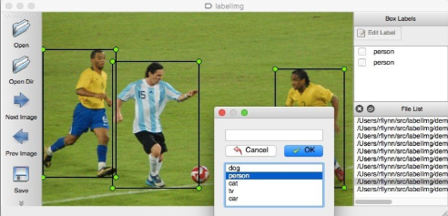
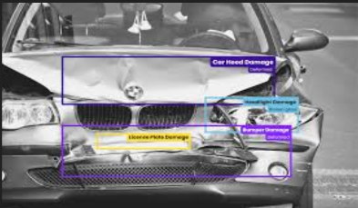
Image Annotation
Sources of images (e.g., damaged car datasets, manual collection).
Tools for image annotation (e.g., LabelImg, VGG Image Annotator).
Example of annotated images with bounding boxes around damages.

Slide 9
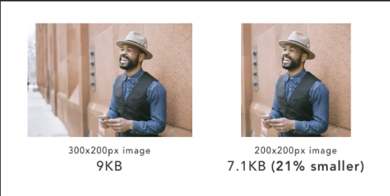
Image Resizing
Standardizing image dimensions (e.g., 640x640 pixels) to match model input size.
Tools for resizing images (e.g., OpenCV, PIL).

Slide 10
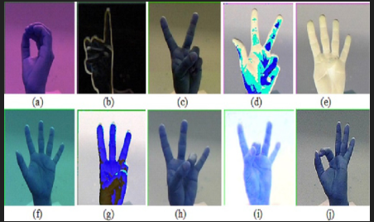
Image Augmentation
Techniques: Rotation, flipping, scaling, color adjustments, and cropping.
Purpose: Increase dataset size and diversity, and improve model robustness.

Slide 11
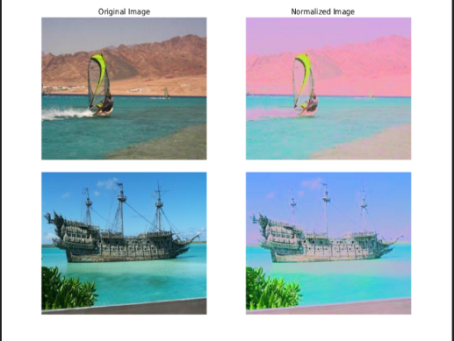
Image Normalization
Scaling pixel values to a range (e.g., 0-1 or -1 to 1).
Helps the model converge faster and improves performance.

Slide 12
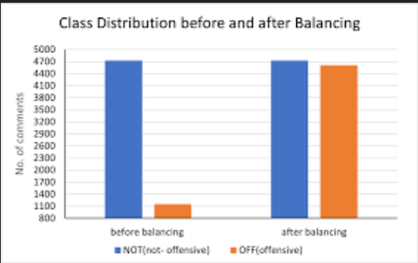
Handling Class Imbalance
Importance of having a balanced dataset for each damage type.
Techniques: Oversampling, under sampling, synthetic data generation (e.g., SMOTE).

Slide 13
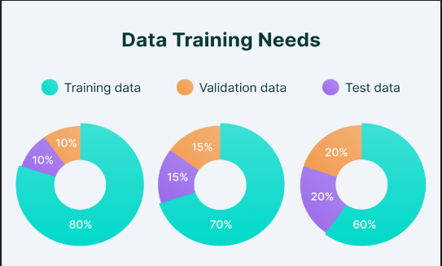
Splitting the Dataset
Train/Validation/Test split (e.g.,
70%/20%/10%).
The importance of having a separate
The validation set to monitor the model
performance.

Slide 14
Why YOlOv8?
High Accuracy:
YOLOv8 consistently outperforms previous versions and other models in terms of accuracy on benchmarks like COCO and Roboflow 100.
Speed:
As a single-stage detector, YOLOv8 processes images in a single pass, making it ideal for real-time applications.
Ease of Use:
YOLOv8 offers a user-friendly interface, including an easy-to-use CLI and a well-structured Python package.
Advanced Features:
Incorporates spatial attention, feature fusion, and context aggregation modules for improved performance.

Slide 15
Working of YOLOV8
Single Neural Network: YOLO uses a single CNN to predict multiple bounding boxes and class probabilities for those boxes.
Grid System: The image is divided into a grid. Each grid cell is responsible for detecting objects that fall within it.
Bounding Boxes and Confidence: For each grid cell, YOLO predicts a fixed number of bounding boxes, confidence scores for these boxes, and class probabilities.
Real-Time Processing: The entire detection process happens in a single forward pass of the network, making it extremely fast and suitable for real-time applications

Slide 16
Comparing with other Models
Faster R-CNN:
Strengths: Higher accuracy, particularly for detecting small objects and achieving higher precision.
Weaknesses: Slower inference speed compared to YOLO, making it less suitable for real-time applications.
SSD (Single Shot MultiBox Detector):
Strengths: Similar to YOLO in terms of speed, with good accuracy. It also performs well for real-time applications.
Weaknesses: Typically less accurate than YOLO on smaller objects.

Slide 17
Streamlit Framework
Streamlit: A Python-based web app framework.
Chosen for simplicity and rapid development.
Ideal for creating data-driven web applications.
Provides an intuitive interface for developers.
Supports real-time updates and dynamic content.

Slide 18
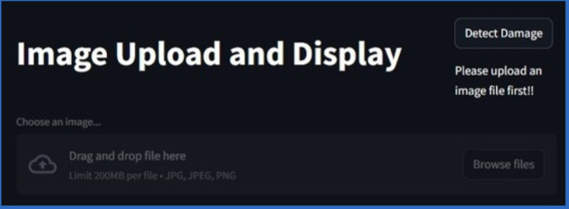
Detection Interface

Slide 19
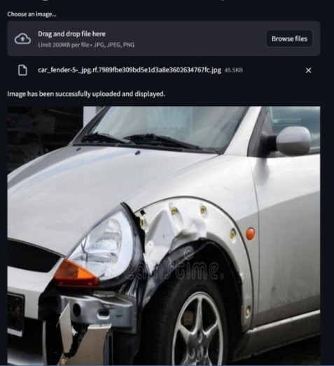
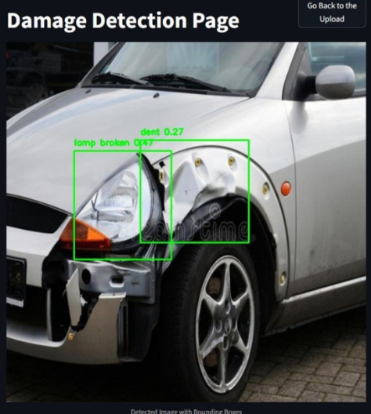

Slide 20
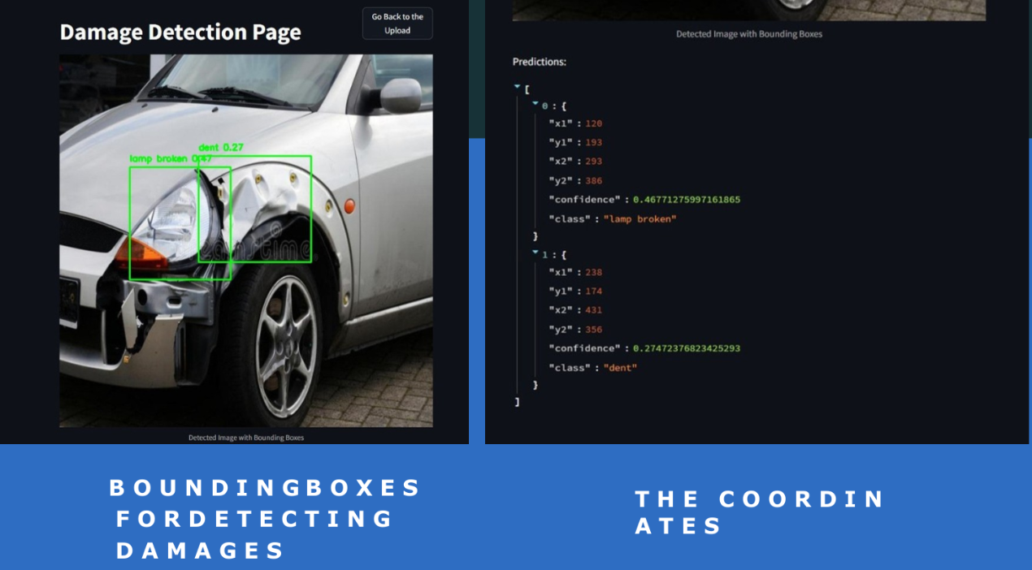

Slide 21
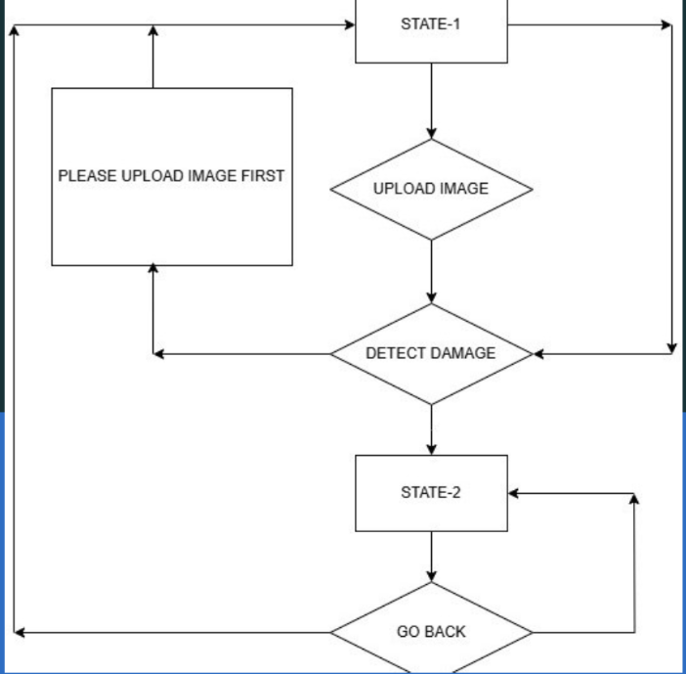
Flow-chart

Slide 22
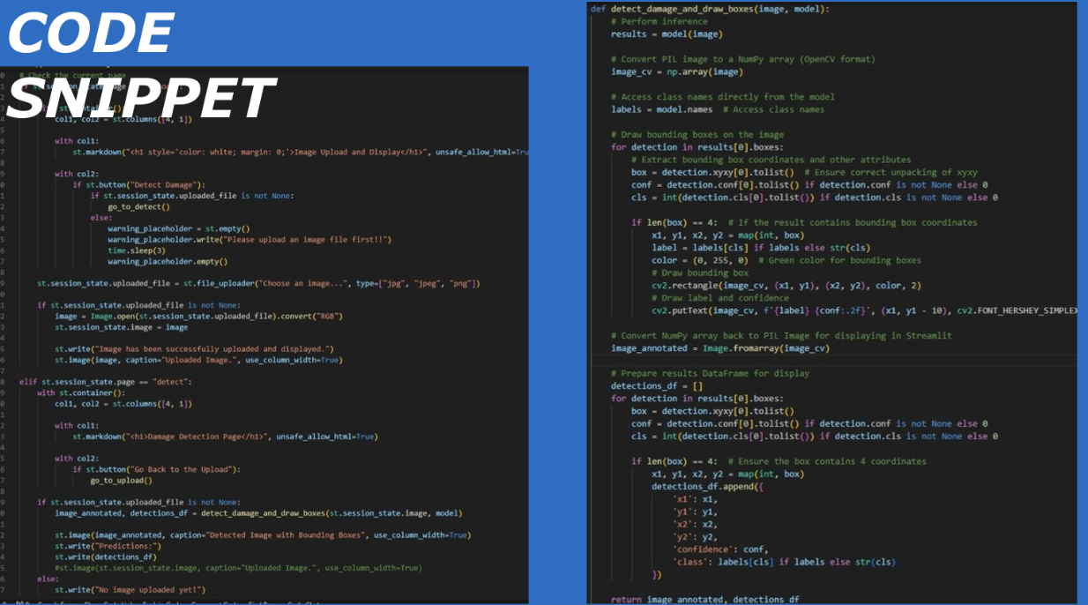

Slide 23
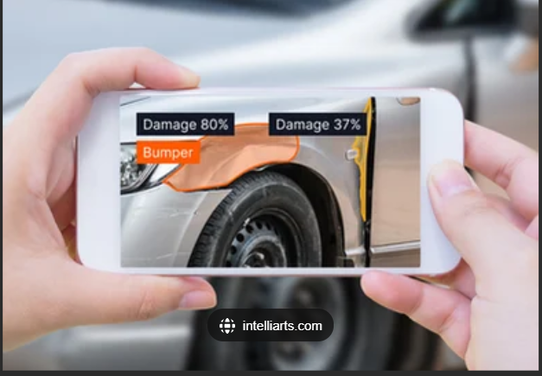
Future Scope
1) Development of a Mobile Application:
User-friendly interface for end-users to easily assess car damage.

Slide 24
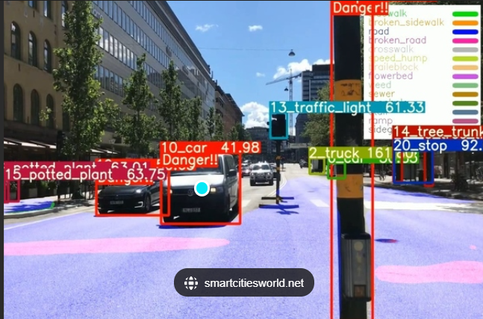
Future Scope
2) Real-Time Damage Detection in Autonomous Cars
Implementing the damage detection system into autonomous cars could allow for real-time monitoring and assessment of car conditions.

Slide 25
Conclusion
The car damage detection project utilizing YOLOv8 represents a significant advancement in automated inspection technologies.
By leveraging YOLOv8's powerful object detection capabilities, the project successfully identifies and analyzes vehicle damages with remarkable speed and accuracy.
This not only enhances efficiency in scenarios like insurance assessments and vehicle inspections but also sets the stage for future enhancements.
The project demonstrates the potential of deep learning models in revolutionizing traditional inspection processes, offering a robust solution that is both scalable and adaptable to industry needs.

Slide 26
THANK YOU !

