Slide 1


COLLEGE OF ENGINEERING
Karvenagar, Pune
Permanently Affiliated to SPPU | Accredited with ‘A’ grade by NAAC | Recipient of ‘Best College’ award by SPPU,
Accredited by NBA ( Electrical Engg and Mechanical Engg) | Recognized under 2(f) and 12(B) of UGC Act 1956 |ISO 9001:2015 certified
Department of Computer Engineering
Group ID: P34
Name of Guide: Dr. Smita Chaudhari
Title of BE-Project: Lung Cancer Detection Using Deep Learning
Domain of Project: Deep Learning
Names of Group Members: 1. Swapnil Bandal
2. Shreyas Padmawar
3. Akash Deshmukh

Slide 2
COLLEGE OF ENGINEERING
Karvenagar, Pune
Permanently Affiliated to SPPU | Accredited with ‘A’ grade by NAAC | Recipient of ‘Best College’ award by SPPU,
Accredited by NBA ( Electrical Engg and Mechanical Engg) | Recognized under 2(f) and 12(B) of UGC Act 1956 |ISO 9001:2015 certified
Department of Computer Engineering
Research Gap Identified: 1) Accuracy.
2) Existing model didn’t detect the stage of lung cancer.
Motivation of the Project:
1) The mortality rate is even higher than breast cancer and prostate cancer combination.
2) Lung cancer is one of the key causes of death amongst humans globally, with a mortality rate of approximately five million cases annually.
3) However, early detection and diagnosis can improve the survival rate.
Objective of the Project:
1) The main purpose of the lung cancer detection by using CNN algorithm is to detect the lung cancer at the earlier stage.
2) Give the premedical treatment to that patient for early recovery from lung cancer.
3) We are using the CNN algorithm to improve the accuracy rate for lung cancer detection.
Does the project contribute to our society by any means? Yes.

Slide 3
COLLEGE OF ENGINEERING
Karvenagar, Pune
Permanently Affiliated to SPPU | Accredited with ‘A’ grade by NAAC | Recipient of ‘Best College’ award by SPPU,
Accredited by NBA ( Electrical Engg and Mechanical Engg) | Recognized under 2(f) and 12(B) of UGC Act 1956 |ISO 9001:2015 certified
Department of Computer Engineering
No. | Title of paper | Year | Authors | Findings | Limitations
1. | A lung cancer detection method using image retrieval and data mining techniques. | 2021 | Muthazhagan B, Ravi T, Rajini-girinath D | proposed an Lung Cancer Detection Method Using Content-Based Image Retrieval and Data Mining Techniques methodology used is SVM algorithm. | Limitations are The malignancy is classified as ‘Normal’ and ‘Abnormal’, not as Stages 1-4.
2. | A machine learning approach to diagnosing lung and colon cancer using a deep learning-based classification framework. | 2021 | Masud M, Sikder N, et al. | proposed research paper on A Machine Learning Approach to Diagnosing Lung cancer Using a Deep Learning Based Classification Framework | The limitations are Dataset uses microscopic cells images rather than CT/MRI scans.
3. | A comparative analysis of segmentation techniques for lung cancer detection. Pattern Recognition and Image Analysis. | 2019 | Tripathi P, Tyagi S, Nath M | This paper proposed research paper on Comparative Analysis of Segmentation Techniques for Lung Cancer Detection | The limitations are marker-controlled watershed segmentation provides less accurate results.
4. | Use of Deep residual learning to detect lung cancer | 2019 | Siddharth Bhatia | They provide a set of pre-processing algorithms for obtaining cancer-vulnerable lung characteristics from images using UNet and ResNet models. | Accuracy is low.(around 84%)

Slide 4
COLLEGE OF ENGINEERING
Karvenagar, Pune
Permanently Affiliated to SPPU | Accredited with ‘A’ grade by NAAC | Recipient of ‘Best College’ award by SPPU,
Accredited by NBA ( Electrical Engg and Mechanical Engg) | Recognized under 2(f) and 12(B) of UGC Act 1956 |ISO 9001:2015 certified
Department of Computer Engineering
Software and Hardware Requirements:
Software Requirement:
IDE: Visual-studio-code
Language: Python 3.8
Framework: Django
Hardware Requirements:
Hard Disk: Greater than 5 GB
RAM: Greater than 4 GB
Processor: I3 and Above

Slide 5
COLLEGE OF ENGINEERING
Karvenagar, Pune
Permanently Affiliated to SPPU | Accredited with ‘A’ grade by NAAC | Recipient of ‘Best College’ award by SPPU,
Accredited by NBA ( Electrical Engg and Mechanical Engg) | Recognized under 2(f) and 12(B) of UGC Act 1956 |ISO 9001:2015 certified
Department of Computer Engineering
Technical Risks or Technical Feasibility :
Image might be unclear or distorted.
Neural network might over fit the data.
Neural network might under fit the data.
Back up plan to Avoid:
Image processing.
Use of regularizers.
Get more amount of data.

Slide 6
COLLEGE OF ENGINEERING
Karvenagar, Pune
Permanently Affiliated to SPPU | Accredited with ‘A’ grade by NAAC | Recipient of ‘Best College’ award by SPPU,
Accredited by NBA ( Electrical Engg and Mechanical Engg) | Recognized under 2(f) and 12(B) of UGC Act 1956 |ISO 9001:2015 certified
Department of Computer Engineering
Cost Risks or Cost Feasibility:
We are using all open source technologies for our project development like python, CNN algorithm and Django framework for better interface. So there is no cost risk.

Slide 7
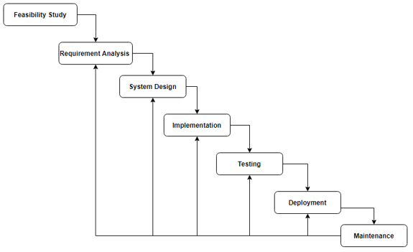
COLLEGE OF ENGINEERING
Karvenagar, Pune
Permanently Affiliated to SPPU | Accredited with ‘A’ grade by NAAC | Recipient of ‘Best College’ award by SPPU,
Accredited by NBA ( Electrical Engg and Mechanical Engg) | Recognized under 2(f) and 12(B) of UGC Act 1956 |ISO 9001:2015 certified
Department of Computer Engineering
Software Development Process:

Slide 8
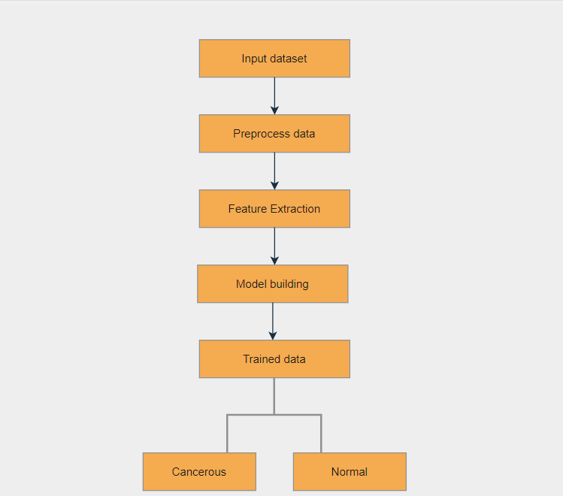
COLLEGE OF ENGINEERING
Karvenagar, Pune
Permanently Affiliated to SPPU | Accredited with ‘A’ grade by NAAC | Recipient of ‘Best College’ award by SPPU,
Accredited by NBA ( Electrical Engg and Mechanical Engg) | Recognized under 2(f) and 12(B) of UGC Act 1956 |ISO 9001:2015 certified
Department of Computer Engineering
Architecture Diagram :

Slide 9
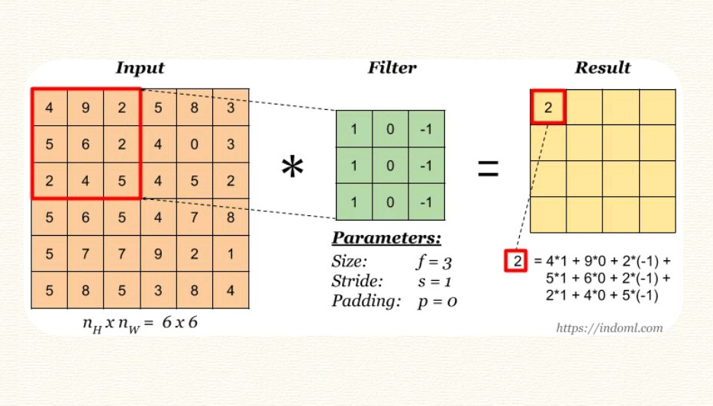
COLLEGE OF ENGINEERING
Karvenagar, Pune
Permanently Affiliated to SPPU | Accredited with ‘A’ grade by NAAC | Recipient of ‘Best College’ award by SPPU,
Accredited by NBA ( Electrical Engg and Mechanical Engg) | Recognized under 2(f) and 12(B) of UGC Act 1956 |ISO 9001:2015 certified
Department of Computer Engineering
Feature Extraction:

Slide 10
COLLEGE OF ENGINEERING
Karvenagar, Pune
Permanently Affiliated to SPPU | Accredited with ‘A’ grade by NAAC | Recipient of ‘Best College’ award by SPPU,
Accredited by NBA ( Electrical Engg and Mechanical Engg) | Recognized under 2(f) and 12(B) of UGC Act 1956 |ISO 9001:2015 certified
Department of Computer Engineering
Analysis of Algorithms which are used in the project:
Convolutional Neural Network:
CNN image classification takes an input image and process it, and then classify it into different categories. For example, let’s say that we need to build a Cat and Dog classifier that inputs an image, assign importance to various aspects in the image and then predict the probability of both classes. We choose the appropriate class based on the output probability. The pre-processing in CNN is much lesser as compared to other algorithms.

Slide 11
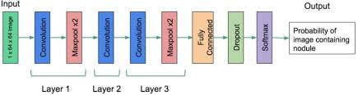
COLLEGE OF ENGINEERING
Karvenagar, Pune
Permanently Affiliated to SPPU | Accredited with ‘A’ grade by NAAC | Recipient of ‘Best College’ award by SPPU,
Accredited by NBA ( Electrical Engg and Mechanical Engg) | Recognized under 2(f) and 12(B) of UGC Act 1956 |ISO 9001:2015 certified
Department of Computer Engineering
Convolutional Neural Network:

Slide 12
COLLEGE OF ENGINEERING
Karvenagar, Pune
Permanently Affiliated to SPPU | Accredited with ‘A’ grade by NAAC | Recipient of ‘Best College’ award by SPPU,
Accredited by NBA ( Electrical Engg and Mechanical Engg) | Recognized under 2(f) and 12(B) of UGC Act 1956 |ISO 9001:2015 certified
Department of Computer Engineering
Why CNN is best?
The main advantage of CNN is that it automatically detects the important features without any human supervision. This is why CNN would be an ideal solution to computer vision and image classification problems.
In KNN, output completely relies on nearest neighbors, which may or may not be good choice. Also it is sensitive to distance metrics.
CNN has very high accuracy in image recognition problems.
CNN is considered to be more powerful than ANN.

Slide 13
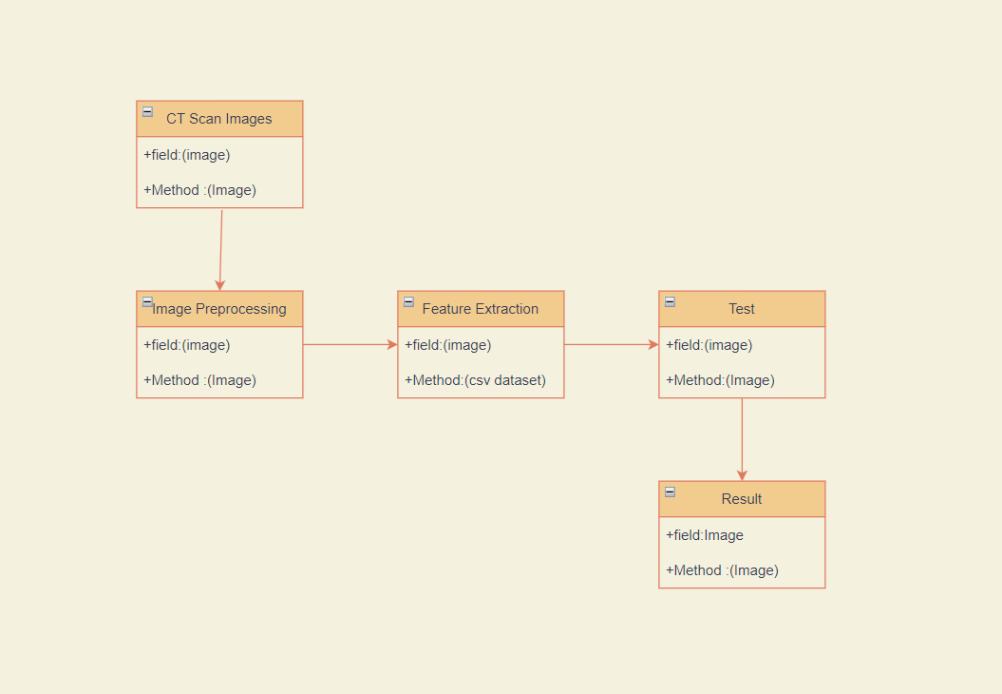
COLLEGE OF ENGINEERING
Karvenagar, Pune
Permanently Affiliated to SPPU | Accredited with ‘A’ grade by NAAC | Recipient of ‘Best College’ award by SPPU,
Accredited by NBA ( Electrical Engg and Mechanical Engg) | Recognized under 2(f) and 12(B) of UGC Act 1956 |ISO 9001:2015 certified
Department of Computer Engineering
Class Diagram:

Slide 14
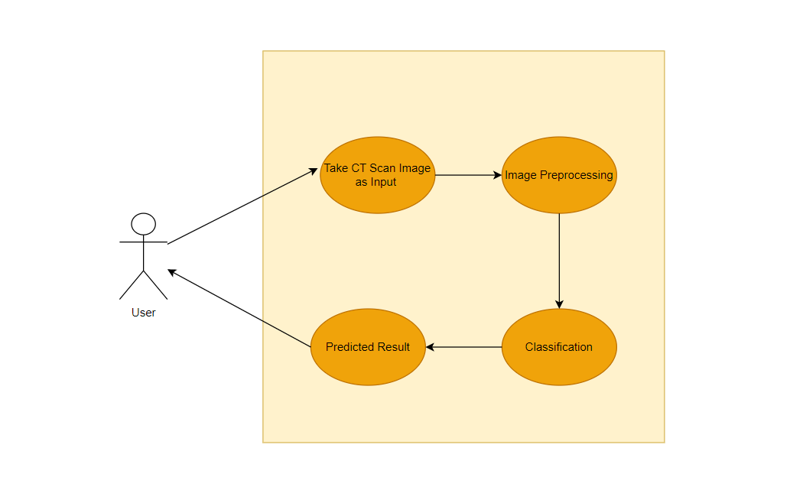
COLLEGE OF ENGINEERING
Karvenagar, Pune
Permanently Affiliated to SPPU | Accredited with ‘A’ grade by NAAC | Recipient of ‘Best College’ award by SPPU,
Accredited by NBA ( Electrical Engg and Mechanical Engg) | Recognized under 2(f) and 12(B) of UGC Act 1956 |ISO 9001:2015 certified
Department of Computer Engineering
Use Case Diagram:

Slide 15
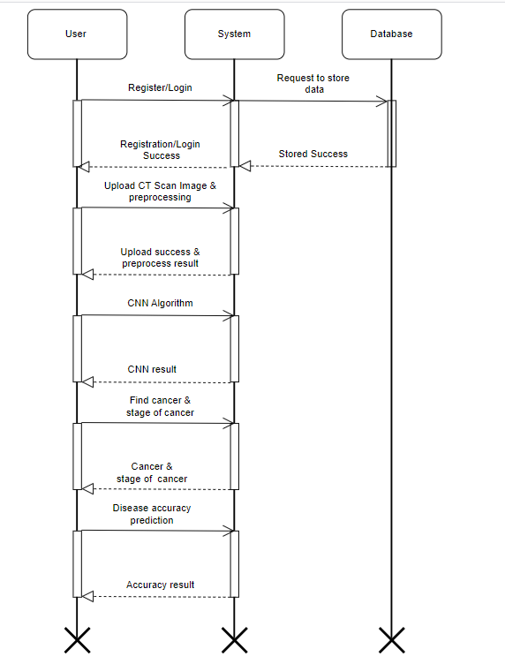
COLLEGE OF ENGINEERING
Karvenagar, Pune
Permanently Affiliated to SPPU | Accredited with ‘A’ grade by NAAC | Recipient of ‘Best College’ award by SPPU,
Accredited by NBA ( Electrical Engg and Mechanical Engg) | Recognized under 2(f) and 12(B) of UGC Act 1956 |ISO 9001:2015 certified
Department of Computer Engineering
Sequence Diagram

Slide 16
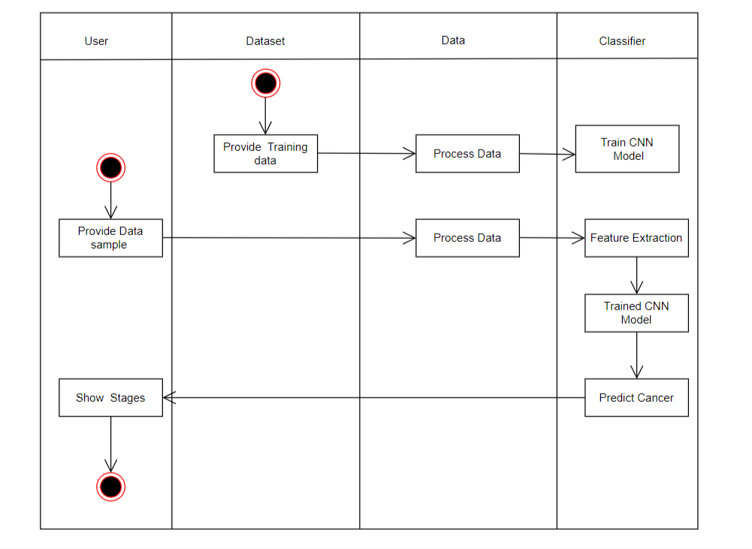
COLLEGE OF ENGINEERING
Karvenagar, Pune
Permanently Affiliated to SPPU | Accredited with ‘A’ grade by NAAC | Recipient of ‘Best College’ award by SPPU,
Accredited by NBA ( Electrical Engg and Mechanical Engg) | Recognized under 2(f) and 12(B) of UGC Act 1956 |ISO 9001:2015 certified
Department of Computer Engineering
Activity Diagram:

Slide 17
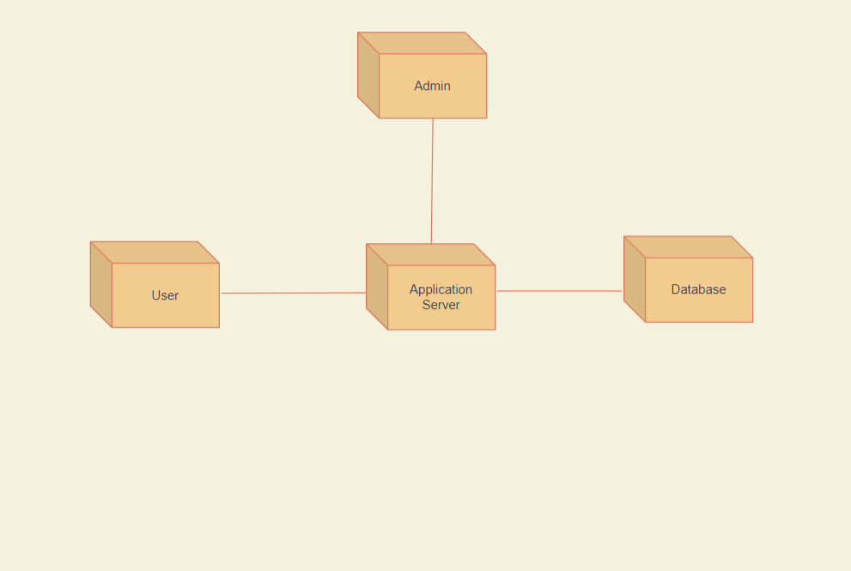
COLLEGE OF ENGINEERING
Karvenagar, Pune
Permanently Affiliated to SPPU | Accredited with ‘A’ grade by NAAC | Recipient of ‘Best College’ award by SPPU,
Accredited by NBA ( Electrical Engg and Mechanical Engg) | Recognized under 2(f) and 12(B) of UGC Act 1956 |ISO 9001:2015 certified
Department of Computer Engineering
Deployment Diagram:

Slide 18
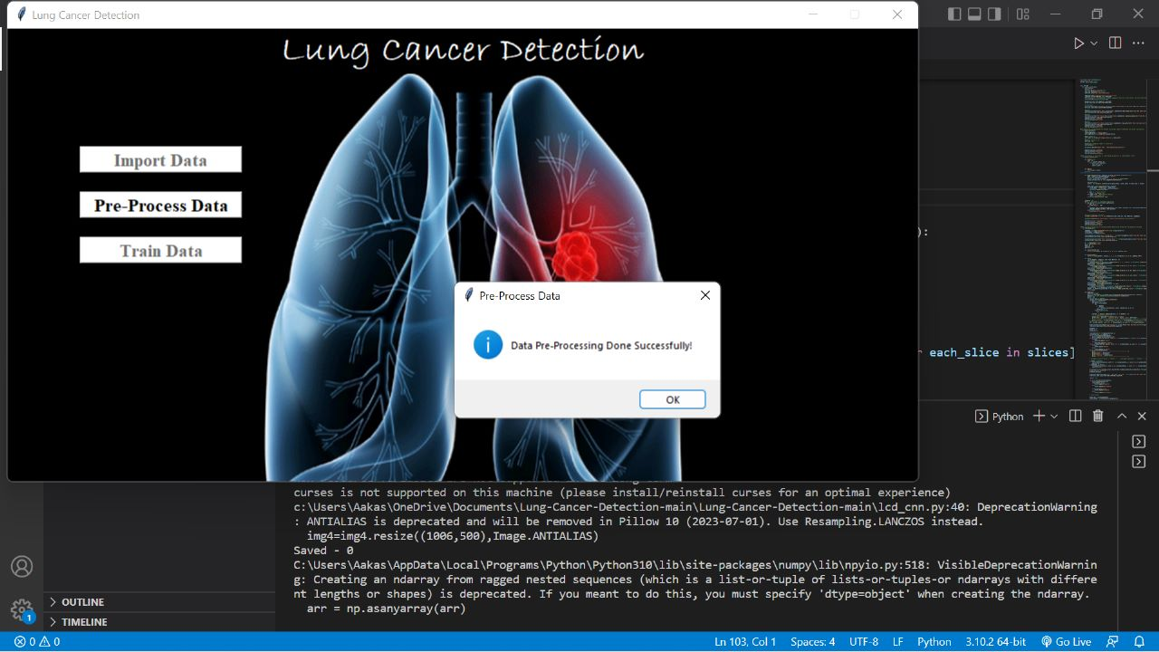
COLLEGE OF ENGINEERING
Karvenagar, Pune
Permanently Affiliated to SPPU | Accredited with ‘A’ grade by NAAC | Recipient of ‘Best College’ award by SPPU,
Accredited by NBA ( Electrical Engg and Mechanical Engg) | Recognized under 2(f) and 12(B) of UGC Act 1956 |ISO 9001:2015 certified
Department of Computer Engineering
Output:

Slide 19
COLLEGE OF ENGINEERING
Karvenagar, Pune
Permanently Affiliated to SPPU | Accredited with ‘A’ grade by NAAC | Recipient of ‘Best College’ award by SPPU,
Accredited by NBA ( Electrical Engg and Mechanical Engg) | Recognized under 2(f) and 12(B) of UGC Act 1956 |ISO 9001:2015 certified
Department of Computer Engineering
Plan of Paper Publication in International Journals/Conferences:
Title: Lung Cancer Detection using Deep Learning
Journal: International Journal of Advanced Research in Science, Communication and
Technology (IJARSCT)(UGC Approved).
Year: 2022
Status: Going to Publish.

Slide 20
COLLEGE OF ENGINEERING
Karvenagar, Pune
Permanently Affiliated to SPPU | Accredited with ‘A’ grade by NAAC | Recipient of ‘Best College’ award by SPPU,
Accredited by NBA ( Electrical Engg and Mechanical Engg) | Recognized under 2(f) and 12(B) of UGC Act 1956 |ISO 9001:2015 certified
Department of Computer Engineering
References Used:
Muthazhagan B, Ravi T, Rajinigirinath D. An enhanced computer-assisted lung cancer detection method using content-based image retrieval and data mining techniques. Journal of Ambient Intelligence and Humanized Computing. 2020 Jun 2:1-9.
Sajja T, Devarapalli R, Kalluri H. Lung Cancer Detection Based on CT Scan Images by Using Deep Transfer Learning. Traitement du Signal. 2019 Oct;36(4):339-44.
Masud M, Sikder N, Nahid AA, Bairagi AK, AlZain MA. A machine learning approach to diagnosing lung and colon cancer using a deep learning-based classification framework. Sensors. 2021 Jan;21(3):748.
Tripathi P, Tyagi S, Nath M. A comparative analysis of segmentation techniques for lung cancer detection. Pattern Recognition and Image Analysis. 2019 Jan;29(1):167-73.
P. Monkam, S. Qi, H. Ma, W. Gao, Y.YaoandW .Qian,” Detection and Classification of Pulmonary Nodules Using Convolutional Neural Networks: A Survey,” in IEEE Access, vol. 7, pp. 78075-78091, 2019,doi:10.1109/ACCESS.2019.2920980.
H. Guo , U. Kruger, G. Wang, M. K. Karla and P. Yan, ”Knowledge-Based Analysis for Mortality Prediction From CT Images,” in IEEE Journal of Biomedical and Health Informatics, vol. 24, no. 2, pp. 457- 464,Feb.2020,doi:10.1109/JBHI.2019.2946066.
D. Kumar et al., ”Automatic Detection of White Blood Cancer From Bone Marrow Microscopic Images Using Convolutional Neural Net-works,”inIEEEAccess,vol.8,pp.142521-142531,2020,doi:10.1109/ACCESS.2020.3012292.
Eng.OnLine,vol.17,p.113,Aug.2018 R. Yamashita, M. Nishio , R. K. G. Do, and K. Togashi, “Convolutional neural networks: An overview and application in radiology,” InsightsImag.vol.9,pp.611–629,Aug.2018.

Slide 21
COLLEGE OF ENGINEERING
Karvenagar, Pune
Permanently Affiliated to SPPU | Accredited with ‘A’ grade by NAAC | Recipient of ‘Best College’ award by SPPU,
Accredited by NBA ( Electrical Engg and Mechanical Engg) | Recognized under 2(f) and 12(B) of UGC Act 1956 |ISO 9001:2015 certified
Department of Computer Engineering
THANK YOU!!!

