Slide 1


COLLEGE OF ENGINEERING
Karvenagar, Pune
Permanently Affiliated to SPPU | Accredited with ‘A’ grade by NAAC | Recipient of ‘Best College’ award by SPPU,
Accredited by NBA ( Electrical Engg and Mechanical Engg) | Recognized under 2(f) and 12(B) of UGC Act 1956 |ISO 9001:2015 certified
Department of Computer Engineering
Group ID: P34
Name of Guide: Dr. Smita Chaudhari
Title of BE-Project: Lung Cancer Detection Using Deep Learning
Domain of Project: Deep Learning
Names of Group Members: 1. Swapnil Bandal
2. Shreyas Padmawar
3. Akash Deshmukh

Slide 2
COLLEGE OF ENGINEERING
Karvenagar, Pune
Permanently Affiliated to SPPU | Accredited with ‘A’ grade by NAAC | Recipient of ‘Best College’ award by SPPU,
Accredited by NBA ( Electrical Engg and Mechanical Engg) | Recognized under 2(f) and 12(B) of UGC Act 1956 |ISO 9001:2015 certified
Department of Computer Engineering
Research Gap Identified: 1) Accuracy.
2) Existing model didn’t detect the stage of lung cancer.
Motivation of the Project:
1) The mortality rate is even higher than breast cancer and prostate cancer combination.
2) Lung cancer is one of the key causes of death amongst humans globally, with a mortality rate of approximately five million cases annually.
3) However, early detection and diagnosis can improve the survival rate.
Objective of the Project:
1) The main purpose of the lung cancer detection by using CNN algorithm is to detect the lung cancer at the earlier stage.
2) Give the premedical treatment to that patient for early recovery from lung cancer.
3) We are using the CNN algorithm to improve the accuracy rate for lung cancer detection.
Does the project contribute to our society by any means? Yes.

Slide 3
COLLEGE OF ENGINEERING
Karvenagar, Pune
Permanently Affiliated to SPPU | Accredited with ‘A’ grade by NAAC | Recipient of ‘Best College’ award by SPPU,
Accredited by NBA ( Electrical Engg and Mechanical Engg) | Recognized under 2(f) and 12(B) of UGC Act 1956 |ISO 9001:2015 certified
Department of Computer Engineering
Software and Hardware Requirements:
Software Requirement:
IDE: Visual-studio-code
Language: Python 3.8
Framework: Django
Hardware Requirements:
Hard Disk: Greater than 5 GB
RAM: Greater than 4 GB
Processor: I3 and Above

Slide 4
COLLEGE OF ENGINEERING
Karvenagar, Pune
Permanently Affiliated to SPPU | Accredited with ‘A’ grade by NAAC | Recipient of ‘Best College’ award by SPPU,
Accredited by NBA ( Electrical Engg and Mechanical Engg) | Recognized under 2(f) and 12(B) of UGC Act 1956 |ISO 9001:2015 certified
Department of Computer Engineering
Technical Risks or Technical Feasibility :
Image might be unclear or distorted.
Neural network might over fit the data.
Neural network might under fit the data.
Back up plan to Avoid:
Image processing.
Use of regularizers.
Get more amount of data.

Slide 5
COLLEGE OF ENGINEERING
Karvenagar, Pune
Permanently Affiliated to SPPU | Accredited with ‘A’ grade by NAAC | Recipient of ‘Best College’ award by SPPU,
Accredited by NBA ( Electrical Engg and Mechanical Engg) | Recognized under 2(f) and 12(B) of UGC Act 1956 |ISO 9001:2015 certified
Department of Computer Engineering
Cost Risks or Cost Feasibility:
We are using all open source technologies for our project development like python, CNN algorithm and Django framework for better interface. So there is no cost risk.

Slide 6
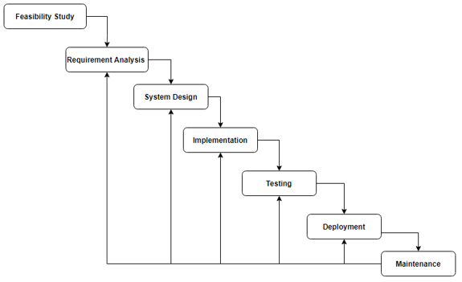
COLLEGE OF ENGINEERING
Karvenagar, Pune
Permanently Affiliated to SPPU | Accredited with ‘A’ grade by NAAC | Recipient of ‘Best College’ award by SPPU,
Accredited by NBA ( Electrical Engg and Mechanical Engg) | Recognized under 2(f) and 12(B) of UGC Act 1956 |ISO 9001:2015 certified
Department of Computer Engineering
Software Development Process:

Slide 7
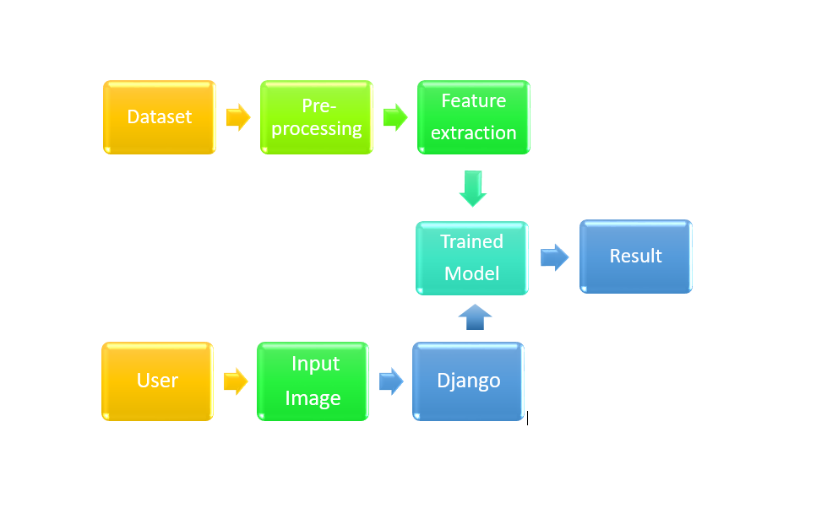
COLLEGE OF ENGINEERING
Karvenagar, Pune
Permanently Affiliated to SPPU | Accredited with ‘A’ grade by NAAC | Recipient of ‘Best College’ award by SPPU,
Accredited by NBA ( Electrical Engg and Mechanical Engg) | Recognized under 2(f) and 12(B) of UGC Act 1956 |ISO 9001:2015 certified
Department of Computer Engineering
Architecture Diagram :

Slide 8
COLLEGE OF ENGINEERING
Karvenagar, Pune
Permanently Affiliated to SPPU | Accredited with ‘A’ grade by NAAC | Recipient of ‘Best College’ award by SPPU,
Accredited by NBA ( Electrical Engg and Mechanical Engg) | Recognized under 2(f) and 12(B) of UGC Act 1956 |ISO 9001:2015 certified
Department of Computer Engineering
Analysis of Algorithms which are used in the project:
Convolutional Neural Network:
CNN image classification takes an input image and process it, and then classify it into different categories. For example, let’s say that we need to build a Cat and Dog classifier that inputs an image, assign importance to various aspects in the image and then predict the probability of both classes. We choose the appropriate class based on the output probability. The pre-processing in CNN is much lesser as compared to other algorithms.

Slide 9
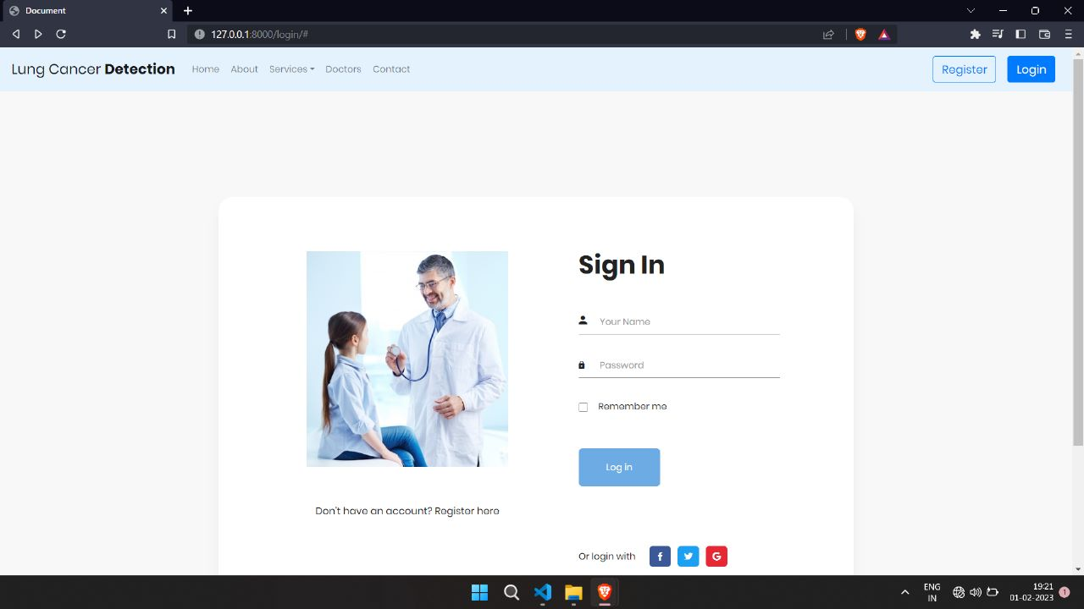

Slide 10
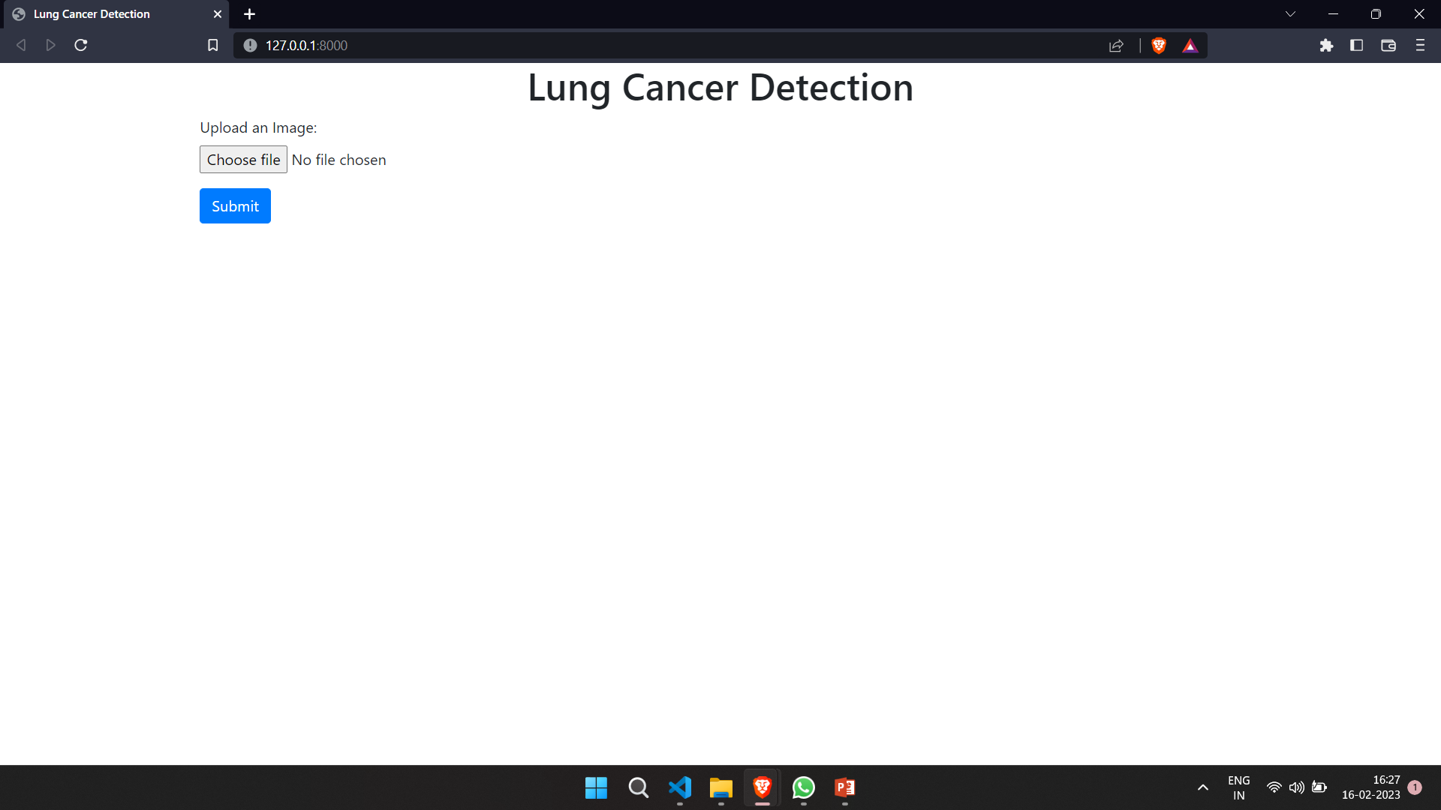
COLLEGE OF ENGINEERING
Karvenagar, Pune
Permanently Affiliated to SPPU | Accredited with ‘A’ grade by NAAC | Recipient of ‘Best College’ award by SPPU,
Accredited by NBA ( Electrical Engg and Mechanical Engg) | Recognized under 2(f) and 12(B) of UGC Act 1956 |ISO 9001:2015 certified
Department of Computer Engineering
Input Page:

Slide 11
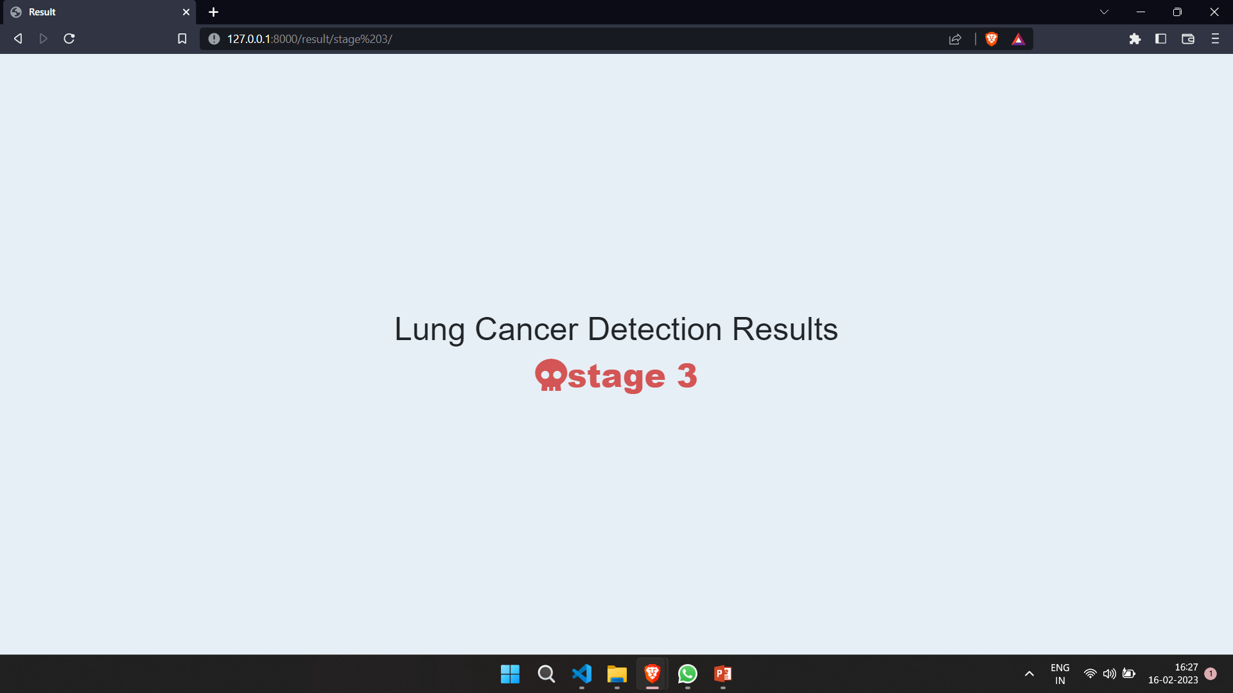
COLLEGE OF ENGINEERING
Karvenagar, Pune
Permanently Affiliated to SPPU | Accredited with ‘A’ grade by NAAC | Recipient of ‘Best College’ award by SPPU,
Accredited by NBA ( Electrical Engg and Mechanical Engg) | Recognized under 2(f) and 12(B) of UGC Act 1956 |ISO 9001:2015 certified
Department of Computer Engineering
Result Page:

Slide 12
COLLEGE OF ENGINEERING
Karvenagar, Pune
Permanently Affiliated to SPPU | Accredited with ‘A’ grade by NAAC | Recipient of ‘Best College’ award by SPPU,
Accredited by NBA ( Electrical Engg and Mechanical Engg) | Recognized under 2(f) and 12(B) of UGC Act 1956 |ISO 9001:2015 certified
Department of Computer Engineering
Problem Faced:
Data Overfitting
Plan to avoid
Obtain more data.
Decrease the number of features.
Increase regularization.
Use dropouts activation function in fully connected layer.

Slide 13
COLLEGE OF ENGINEERING
Karvenagar, Pune
Permanently Affiliated to SPPU | Accredited with ‘A’ grade by NAAC | Recipient of ‘Best College’ award by SPPU,
Accredited by NBA ( Electrical Engg and Mechanical Engg) | Recognized under 2(f) and 12(B) of UGC Act 1956 |ISO 9001:2015 certified
Department of Computer Engineering
Plan of Paper Publication in International Journals/Conferences:
Title: Lung Cancer Detection using Deep Learning
Journal: International Journal of Advanced Research in Science, Communication and
Technology (IEEE).
Year: 2022
Status: Submitted at IEEE waiting for approval.

Slide 14
COLLEGE OF ENGINEERING
Karvenagar, Pune
Permanently Affiliated to SPPU | Accredited with ‘A’ grade by NAAC | Recipient of ‘Best College’ award by SPPU,
Accredited by NBA ( Electrical Engg and Mechanical Engg) | Recognized under 2(f) and 12(B) of UGC Act 1956 |ISO 9001:2015 certified
Department of Computer Engineering
References Used:
Muthazhagan B, Ravi T, Rajinigirinath D. An enhanced computer-assisted lung cancer detection method using content-based image retrieval and data mining techniques. Journal of Ambient Intelligence and Humanized Computing. 2020 Jun 2:1-9.
Sajja T, Devarapalli R, Kalluri H. Lung Cancer Detection Based on CT Scan Images by Using Deep Transfer Learning. Traitement du Signal. 2019 Oct;36(4):339-44.
Masud M, Sikder N, Nahid AA, Bairagi AK, AlZain MA. A machine learning approach to diagnosing lung and colon cancer using a deep learning-based classification framework. Sensors. 2021 Jan;21(3):748.
Tripathi P, Tyagi S, Nath M. A comparative analysis of segmentation techniques for lung cancer detection. Pattern Recognition and Image Analysis. 2019 Jan;29(1):167-73.

Slide 15
COLLEGE OF ENGINEERING
Karvenagar, Pune
Permanently Affiliated to SPPU | Accredited with ‘A’ grade by NAAC | Recipient of ‘Best College’ award by SPPU,
Accredited by NBA ( Electrical Engg and Mechanical Engg) | Recognized under 2(f) and 12(B) of UGC Act 1956 |ISO 9001:2015 certified
Department of Computer Engineering
THANK YOU!!!

