Slide 1
sql-business-insights-project
Presenter: Swapnil chavan

Slide 2
Our Company
Atliq Hardware is one of the leading computer hardware producers in India as well as 26 other countries across the globe
Manufactures products under 3 major divisions i.e., Peripherals & Accessories, PC, Networking & Storage
We have a total of 74 Customers like Neptune, Sage, Leader, Vijay Sales etc. across all markets/countries

Slide 3
Objective
Assist the management team to gain more insights about the business
Take data-driven decisions to scale business

Slide 4
About data
We have 4 fact tables i.e., sales monthly, manufacturing cost, pre invoice deductions, gross price which have measurable metrics and 2-dimension table i.e., customer details and product details.
Fiscal year for Atliq Hardware starts from 1st September and ends on 31st August each year
Sales data is available for fiscal year 2020-2021

Slide 5
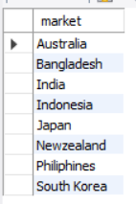
Request 1: Provide the list of markets in which customer "Atliq Exclusive" operates its business in the APAC region
Query:
SELECT distinct market FROM dim_customer WHERE customer = "Atliq Exclusive" AND region = "APAC" ORDER BY market;

Slide 6
Request 2: What is the percentage of unique product increase in 2021 vs. 2020?
The final output contains these fields,
unique_products_2020
unique_products_2021
percentage_chg
unq_product_2020 | unq_product_2021 | pct_chg
245 | 334 | 36.33%
Query:
with
cte20 as
(select count(distinct product_code) as unq_product_2020
from fact_sales_monthly
where fiscal_year = 2020),
cte21 as
(select count(distinct product_code) as unq_product_2021
from fact_sales_monthly
where fiscal_year = 2021)
select *,
round((unq_product_2021 - unq_product_2020)/unq_product_2020*100,1) as pct_chg
from cte20
cross join cte21;

Slide 7
Request 3: Provide a report with all the unique product counts for each segment and sort them in descending order of product counts.
The final output contains 2 fields,
segment
product_count
Query:
segment | unq_product_count
Accessories | 20
Peripherals | 20
Notebook | 17
Storage | 9
Desktop | 4
Networking | 3
SELECT
segment,
count(distinct product) as unq_product_count
FROM dim_product
group by segment
order by unq_product_count desc

Slide 8
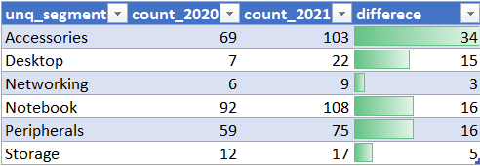
Request 4: Follow-up: Which segment had the most increase in unique products in 2021 vs 2020? The final output contains these fields:
segment, product_count_2020, product_count_2021, difference
Query:
WITH CTE1 AS (select p.segment as unq_segment, count(distinct(s.product_code)) as count_2020 from fact_sales_monthly s join dim_product p on p.product_code = s.product_code where s.fiscal_year= 2020 group by p.segment), CTE2 AS (select p.segment as unq_segment, count(distinct(s.product_code)) as count_2021 from fact_sales_monthly s join dim_product p on p.product_code = s.product_code where s.fiscal_year= 2021 group by p.segment) SELECT A.unq_segment, A.count_2020, B.count_2021, (B.count_2021-A.count_2020) AS differece FROM CTE1 A JOIN CTE2 B ON A.unq_segment = B.unq_segment

Slide 9

Request 5 Get the products that have the highest and lowest manufacturing costs. The final output should contain these fields,
product_code
product manufacturing_cost
Query:
SELECT p.product_code, p.product, m.manufacturing_cost
from dim_product p join fact_manufacturing_cost m on p.product_code = m.product_code where manufacturing_cost in ( SELECT max(manufacturing_cost) from fact_manufacturing_cost union SELECT min(manufacturing_cost) from fact_manufacturing_cost ) order by manufacturing_cost desc;

Slide 10


Insights
Highest manufacturing cost
Lowest manufacturing cost
AQ HOME Allin1 Gen 2 (Plus 3)
Category: Personal Desktop
AQ Master wired x1 Ms (Standard 1)
Category: Mouse
$240.54
$0.89

Slide 11
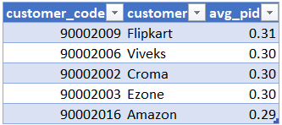
Request 6 Generate a report which contains the top 5 customers who received an average high pre_invoice_discount_pct for the fiscal year 2021 and in the Indian market. The final output contains these fields,
customer_code
customer
average_discount_percentage
Query:
select
c.customer_code, c.customer,
round(avg(pid.pre_invoice_discount_pct),2) as avg_pid
from dim_customer c
join fact_pre_invoice_deductions pid
on c.customer_code = pid.customer_code
where fiscal_year = 2021 and market = "India"
group by c.customer_code, c.customer
order by avg_pid desc
limit 5;

Slide 12
Request 7 Get the complete report of the Gross sales amount for the customer “Atliq Exclusive” for each month . This analysis helps to get an idea of low and high-performing months and take strategic decisions. The final report contains these columns:
Month
Year
Gross sales Amount
Query:
select
concat(monthname(s.date),'(',year(s.date),')') as month,
s.fiscal_year,
sum(s.sold_quantity*g.gross_price) as gross_sale_amt
from fact_sales_monthly s
join dim_customer c on s.customer_code = c.customer_code
join fact_gross_price g on s.product_code = g.product_code
where c.customer = "Atliq Exclusive"
group by month, s.fiscal_year
order by s.fiscal_year

Slide 13
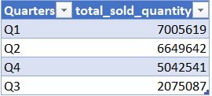
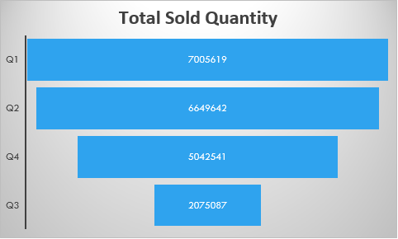
Request 8 In which quarter of 2020, got the maximum total_sold_quantity? The final output contains these fields sorted by the
total_sold_quantity
Quarter
total_sold_quantity
Query:
SELECT
CASE
WHEN MONTH(date) IN (9,10,11) THEN 'Q1'
WHEN MONTH(date) IN (12,1,2) THEN 'Q2'
WHEN MONTH(date) IN (3,4,5) THEN 'Q3'
WHEN MONTH(date) IN (6,7,8) THEN 'Q4'
END AS Quarters,
SUM(sold_quantity) AS total_sold_quantity
FROM fact_sales_monthly
WHERE fiscal_year = 2020
GROUP BY Quarters
ORDER BY total_sold_quantity DESC;

Slide 14

Request 9 Which channel helped to bring more gross sales in the fiscal year 2021 and the percentage of contribution? The final output contains these fields,
channel
gross_sales_mln (gross_price * sold_quantity)
Percentage
Query:
WITH CTE1 AS (
SELECT
c.channel,
SUM(s.sold_quantity * g.gross_price) / 1000000 AS gross_sales_mln
FROM fact_sales_monthly s
JOIN fact_gross_price g
ON s.product_code = g.product_code
JOIN dim_customer c
ON s.customer_code = c.customer_code
WHERE s.fiscal_year = 2021
GROUP BY c.channel
)
SELECT
channel,
ROUND(gross_sales_mln, 1) AS gross_sales_mln,
ROUND(gross_sales_mln * 100 / SUM(gross_sales_mln) OVER (), 2) AS percentage
FROM CTE1
ORDER BY percentage DESC;

Slide 15
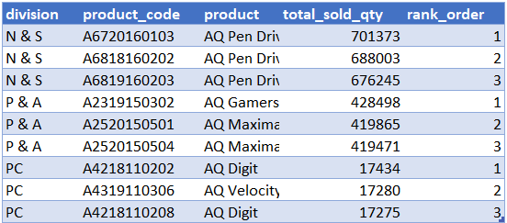
Request 10 Get the Top 3 products in each division that have a high total_sold_quantity in the fiscal_year 2021?
The final output contains these fields,
division
product_code
Product
total_sold_quantity
rank_order
Query:
WITH
sales_data AS (
SELECT
p.division,
fs.product_code,
p.product,
SUM(fs.sold_quantity) AS total_sold_qty
FROM fact_sales_monthly fs
JOIN dim_product p
ON p.product_code = fs.product_code
WHERE fs.fiscal_year = 2021
GROUP BY p.division, fs.product_code, p.product
),
ranked_data AS (
SELECT *,
RANK() OVER (
PARTITION BY division
ORDER BY total_sold_qty DESC
) AS rank_order
FROM sales_data
)
SELECT *
FROM ranked_data
WHERE rank_order <= 3;

Slide 16
Thank You

