Slide 1
Efficient Online Detection of Dynamic Control Dependence
Paper by :-
Bin Xin
Xiangyu Zhang
Presentation By :-
Debjeet Majumdar(15111014)
Swapnil Mhamane(15111044)

Slide 2
Introduction

Slide 3
Control Dependence
Predicate P : Decision making statement
Statement s control depends on a predicate statement p
If(a<5)
a= a+5
Print(a)
Notes:
Game is focused on set of predicates statements Captures the effects of predicate statement on path selection
Predicate defines whether stamtent s will be there in execution path or not

Slide 4
Static and Dynamic Control Dependence
Statement and Statement instance
Static Control Dependence (SCD)
Control dependence relation between program statement.
Dynamic Control Dependence (DCD)
Control Dependence relation between executing instance of program statement
May include statically self dependent statements but different instance dynamically

Slide 5
Applications
Program slicing
Information flow analysis
Data lineage
Fault Localization
Notes:
Slicing : set of statements that might affect values of variable occurrences.
Information flow analysis : prevent zero day attacks and information leak
Data lineage : reverse flow - set of input elements based on output

Slide 6
Strategies for DCD
Offline approach
Online approach

Slide 7
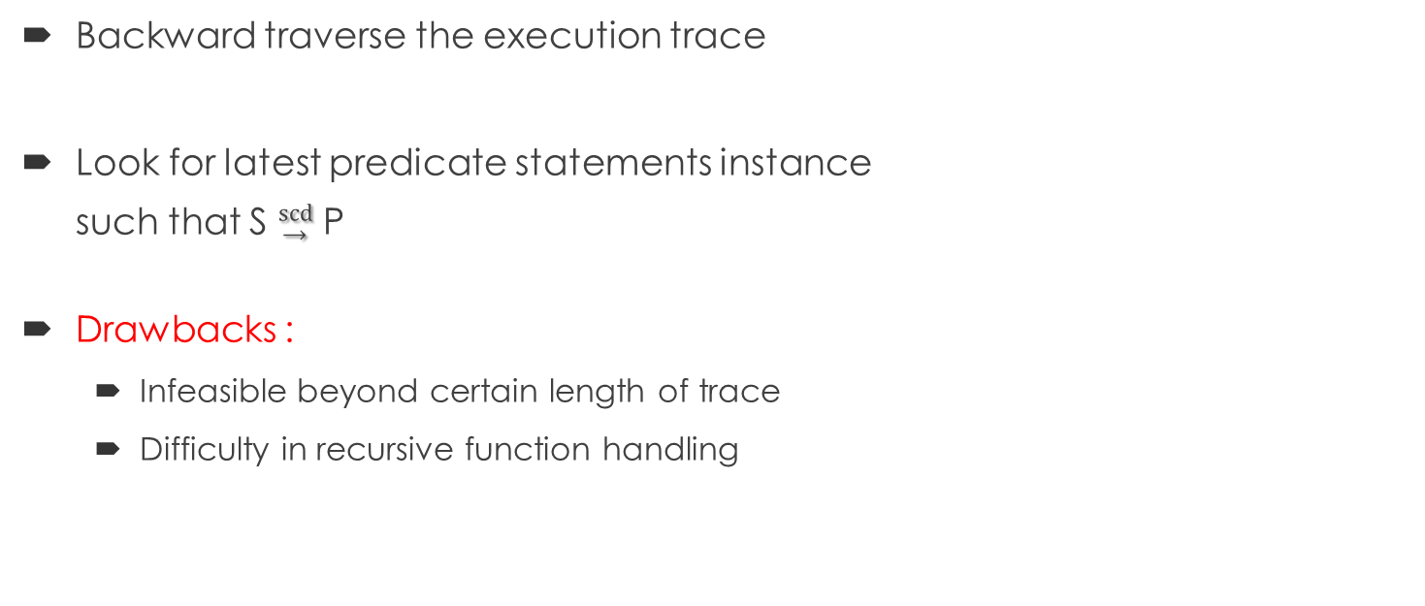
Offline Algorithm
Backward traverse the execution trace
Look for latest predicate statements instance such that S $\underset{→}{\text{scd}}$P
Drawbacks :
Infeasible beyond certain length of trace
Difficulty in recursive function handling

Slide 8
Earlier Online Algorithm
Couples control dependence with call stack maintenance
Solves problem with recursive function
Drawbacks :
Problems with library functions compiled on different source.
Inefficient in handling interprocedural DCD

Slide 9
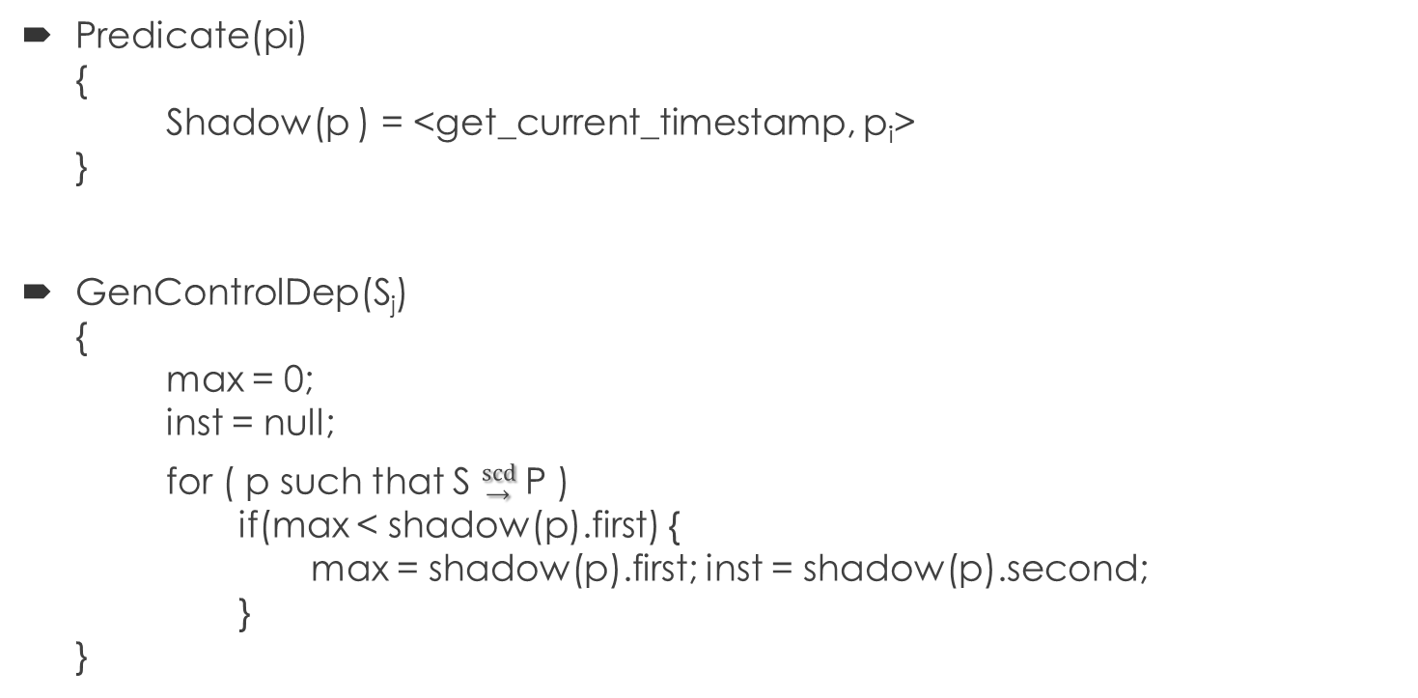
Earlier Online Detection
Predicate(pi) { Shadow(p ) = <get_current_timestamp, p_{i}> }
GenControlDep(S_{j}) { max = 0; inst = null; for ( p such that S $\underset{→}{\text{scd}}$ P ) if(max < shadow(p).first) { max = shadow(p).first; inst = shadow(p).second; } }

Slide 10
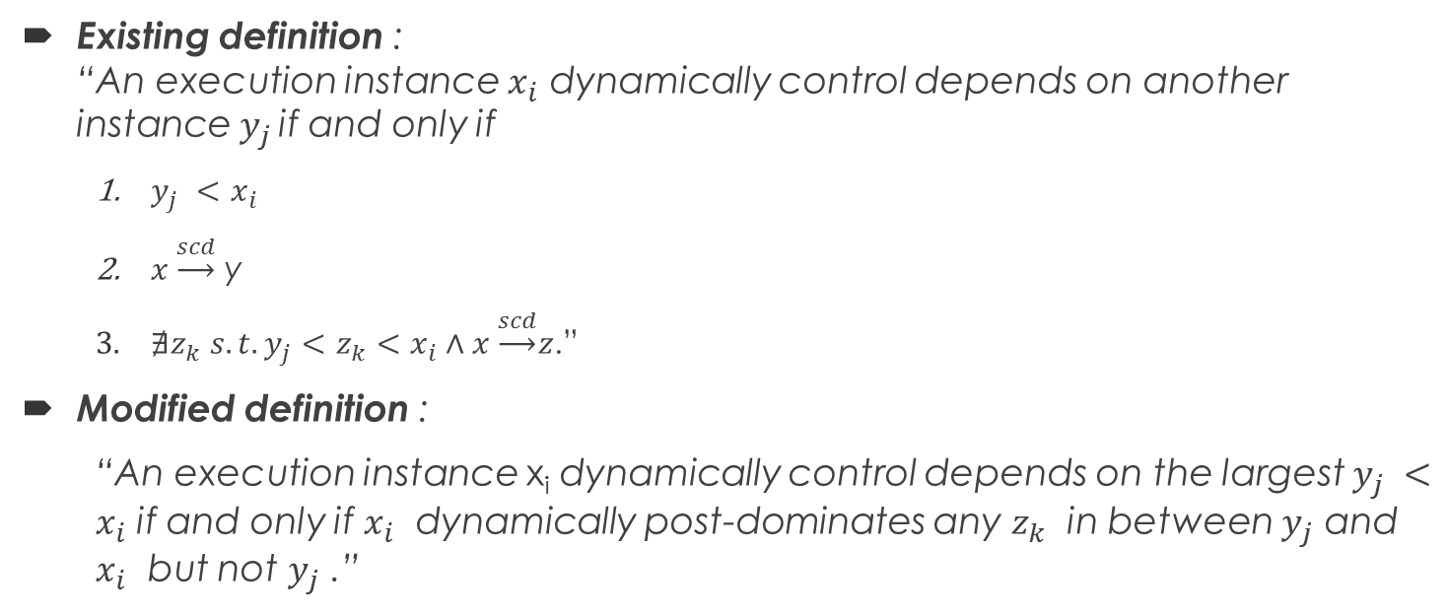
Defining DCD
Existing definition : “An execution instance $x_{i}$ dynamically control depends on another instance $y_{j}$ if and only if
$y_{j} <x_{i}$
$x \underset{→}{scd}$ y
$∄z_{k} s.t. y_{j}<z_{k}<x_{i}∧x \underset{→}{scd}z$.”
Modified definition :
“An execution instance x_{i} dynamically control depends on the largest $y_{j} <x_{i}$ if and only if $x_{i}$ dynamically post-dominates any $z_{k}$ in between $y_{j}$ and $x_{i}$ but not $y_{j}$ .”

Slide 11

Important constructs
Branching Point(BP $\hat{s}i$)
More than one successors
Immediate Post Dominance: IPD($\hat{s}i$)_{m}
Region
$R\left(\hat{s}i\right)=\left\{Xj \right| \hat{s}i<Xj<IPD\left(\hat{s}i\right)m \}$

Slide 12

Intraprocedural algorithm
Branching($\hat{s}i$ , $IPD\left(\hat{s}i\right)$) { if (CDS.top().second ≡ $IPD\left(\hat{s}i\right)$ { //optimized top entry CDS.top().first= $\hat{s}i$; } else { CDS.push(< $\hat{s}i$ , $IPD\left(\hat{s}i\right)$ >); } }
Merging (t_{j} ) { if (CDS.top().second ≡ t) CDS.pop(); }

Slide 13
Example

Slide 14
Cases in Interprocedural dependence
Function in-lining
How would you go about recursive call ?
Loss of semantics
Solution : Use context sensitive analysis
Calling context
An ordered set of call sites
Types of interprocedural control flow
Regular
Irregular

Slide 15
Example

Slide 16

Inter-procedural algorithm
Branching($\hat{s}i$ , $IPD\left(\hat{s}i\right)$, bp) { if (CDS.top().second ≡ $IPD\left(\hat{s}i\right)bp$ { CDS.top().first= $\hat{s}i$; } else { CDS.push(< $\hat{s}i$ , $IPD\left(\hat{s}i\right)bp$>); } }
Merging (t_{j} , bp) { if (CDS.top().second ≡ t $bp$) CDS.pop(); }

Slide 17
Irregular interprocedural DCD
Caused by long Jumps , exception handlings etc.
Solution :
Use of dummy nodes and edges
Pseudo predicates.

Slide 18
Example

Slide 19
Modified CFG

Slide 20
Implementation

Slide 21
DCD Evaluation Setup
Instrumentation
Input
Runnable Class
JRE Execute
Runnable
Soot API
AspectJ

Slide 22
Implementation
Dynamic analysis
Instrumentation
Soot
Find post dominator
Statement based instrumentation of function call
AspectJ
Implement algorithm on function call

Slide 23
AspectJ
Aspect Oriented Programming
Separation of cross-cutting concerns
E.g. security, logging
Joinpoints
PointCuts
Joinpoint collection
Advice
Instrument behaviour on collected joinpoints

Slide 24
Conclusion
Dynamic control dependence plays a crucial role in several applications
Detection of Dynamic control dependence efficiently is essential
The paper brings up a new novel definition for dynamic control dependence, which provides a more efficient detection algorithm
The project outlines the detection algorithm as a crosscutting application using aspectJ

Slide 25
References
“Efficient online detection of dynamic control dependence” by Bin Xin, Xiangyu Zhang published in ISSTA’07
X. Zhang, H. He, N. Gupta, and R. Gupta. Experimental evaluation of using dynamic slices for fault location. In AADEBUG, 2005.
“Dynamic Program Slicing” by Hiralal Agrawal, Joseph R.horgan published in conference Programming language design and implementation ’90
https://eclipse.org/aspectj/
The Compiler Desing Handbook : Optimization and Machine Code Generation by Y.N. Shrikant, Priti Shankar

Slide 26

THANK YOU …!

