Slide 1
Efficient Execution Plans for Distributed Skyline Query Processing
Paper by
Joao B. Rocha Junior, Akrivi Vlachou
Christos Dolkeridis, Kjetil Norvag
Presentation by
Ritika (15111036)
Swapnil Mhamane(15111044)
Published in EDBT/ICDT ‘11

Slide 2
System Overview
Each server stores autonomously a fraction of the data.
Horizontal partition of data.
All servers need to process the skyline query.
Each server S_{i} can directly connect to any other server S_{i}.
Notes:
Cluster
No coordinator
No specific initiator
Naïve approach

Slide 3
Naïve Approach
A skyline query can be initiated by any server (S_{org}).
Skyline query is processed by sending the query to all servers S_{i}.
Each server Si reports its local skyline set SKY_{i} to originator.
S_{org} gathers local skyline set and computes global skyline set
Use of transitivity property
Single hop execution
Notes:
Cluster
No coordinator
No specific initiator
Naïve approach

Slide 4
Motivation
Execution plan defines the order in which the individual skyline queries are processed on different servers
Servers need not be contacted can be pruned
Discarding some data points locally based on skyline points from preceding server
Negative point : Local skyline queries on consecutive server is a blocking operation
Observation :
There exist dependency between two servers
Optimizations by exploiting these dependencies.

Slide 5
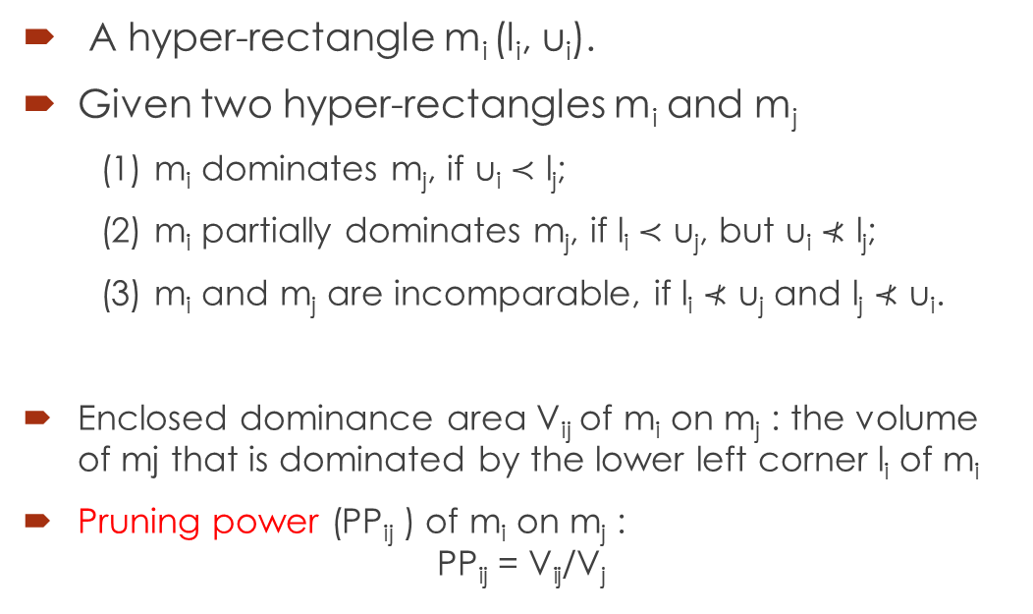
Relation among MBR
A hyper-rectangle m_{i} (l_{i}, u_{i}).
Given two hyper-rectangles m_{i} and m_{j}
(1) m_{i} dominates m_{j}, if u_{i} ≺ l_{j};
(2) m_{i} partially dominates m_{j}, if l_{i} ≺ u_{j}, but u_{i} ⊀ l_{j};
(3) m_{i} and m_{j} are incomparable, if l_{i} ⊀ u_{j} and l_{j} ⊀ u_{i}.
Enclosed dominance area V_{ij} of m_{i} on m_{j} : the volume of mj that is dominated by the lower left corner l_{i} of m_{i}
Pruning power (PP_{ij} ) of m_{i} on m_{j} :
$$\text{PP}\text{ij}\text{ = }\text{Vij}\text{/}\text{Vj}$$

Slide 6
Main phases of SkyPlan
Collect the MBRs of all servers.
Builds a weighted directed graph
The graph is transformed into an execution plan
Execute plan recursively

Slide 7
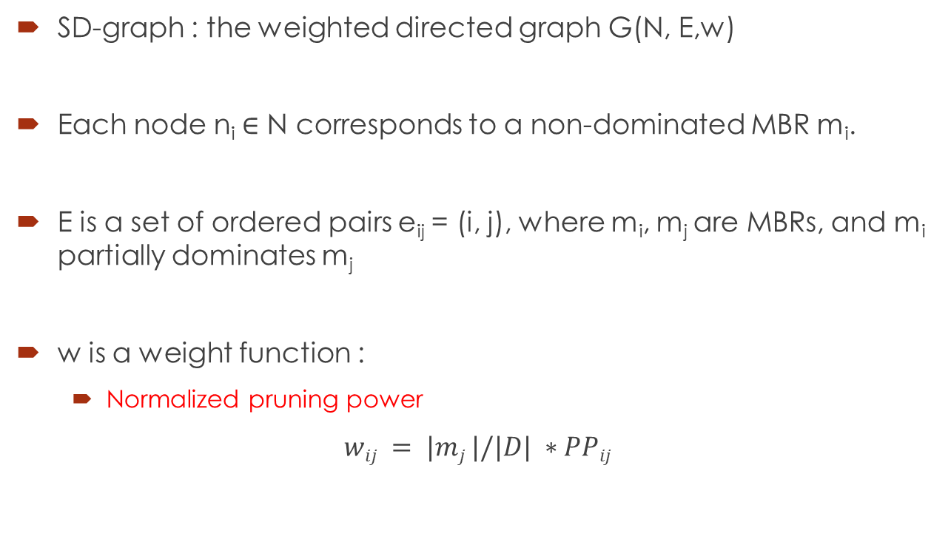
Skyline dependency graph
SD-graph : the weighted directed graph G(N, E,w)
Each node n_{i} ∈ N corresponds to a non-dominated MBR m_{i}.
E is a set of ordered pairs e_{ij} = (i, j), where m_{i}, m_{j} are MBRs, and m_{i} partially dominates m_{j}
w is a weight function :
Normalized pruning power
$wij = |mj |/|D| ∗PPij$

Slide 8
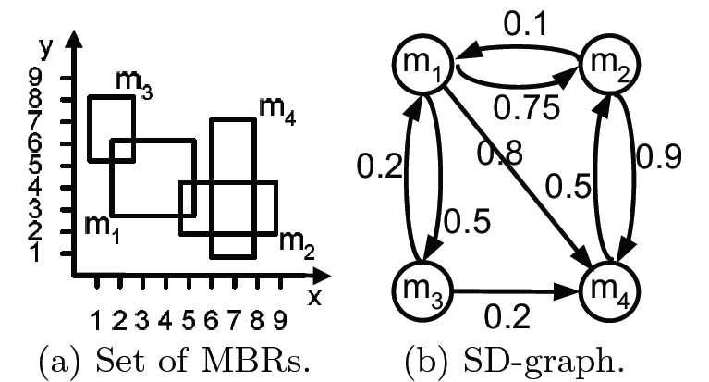
SD-graph example

Slide 9
Finding Maximum Spanning Tree

Slide 10
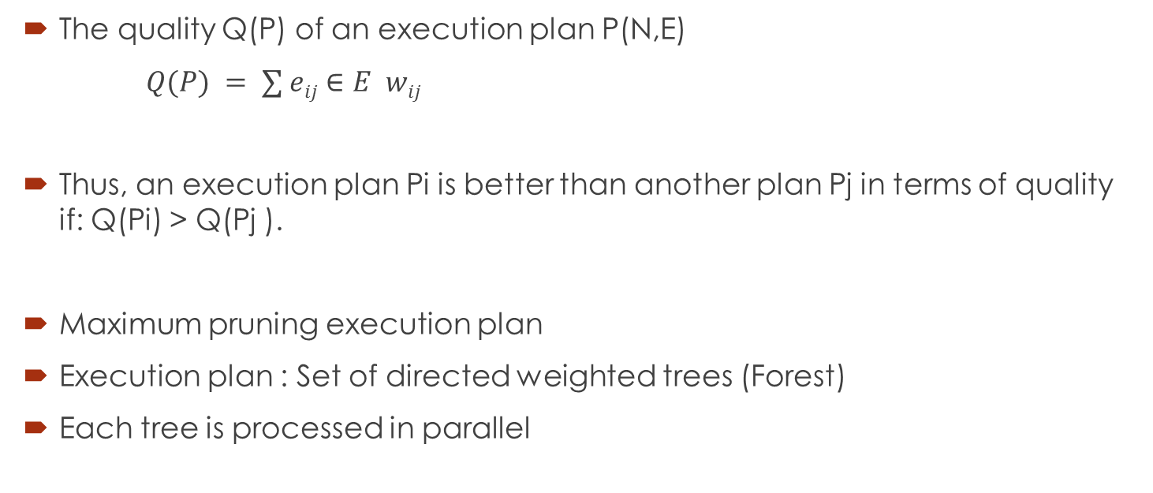
Execution Plan
The quality Q(P) of an execution plan P(N,E)
$Q(P) = ∑ eij∈E wij$
Thus, an execution plan Pi is better than another plan Pj in terms of quality if: Q(Pi) > Q(Pj ).
Maximum pruning execution plan
Execution plan : Set of directed weighted trees (Forest)
Each tree is processed in parallel

Slide 11
Algorithm: QueryProcessing(Si,F,P)
INPUT: Filter points F = {f1, . . . , fk},Execution plan P.
OUTPUT: Local skyline
m ← P.getRootMBR()
sky ← computeSkyline(m)
P’ ← refinePlan(P, sky)
F’ ← refineFilters(F, sky)
S’ ← P’.getNextServers()
for (∀S_{j} ∈ S’) do sky_{j} ← QueryProcessing(S_{j} , F’,P_{j}‘)
sky ← mergeSkyline(sky, sky_{j} )
return sky

Slide 12
Example

Slide 13
Multi-objective execution plan
K-hop execution plan
Another objective is to restrict the number of hops in query processing
Bounding latency in consecutive execution
K-hop execution plan : Execution plan with height at most k
Hop constrained maximum spanning tree problem
Capacity constrained execution Plan
Load balancing is another important aspect
Each tree can have at most no. of nodes bounded by capacity

Slide 14
Summary
Paper targets the problem of deriving efficient execution plan for distributed skyline computation
It proposes the novel framework called SkyPlan, that maps the dependencies between the queries into graph and generates cost aware execution plan.
Aim was to maximize pruning power in consecutive queries while keep increment in parallelism
It proposes distributed query execution mechanism that allows continuous refinement of plan during in-network query processing.

Slide 15
References
João B. Rocha-Junior∗ , Akrivi Vlachou, Christos Doulkeridis, and Kjetil Nørvåg “Efficient execution plans for distributed skyline query processing”

Slide 16

Thank you …!

Slide 17
core

Slide 18
ant

Slide 19
INd

