Slide 2
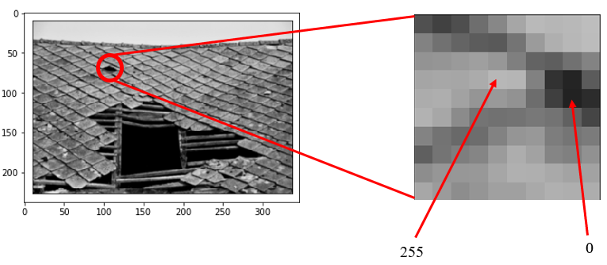
Convolutional Neural Networks
How computers interpret images?
Grayscale image

Slide 3
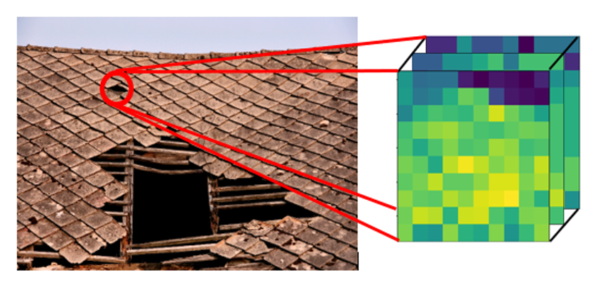
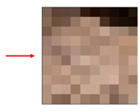
Convolutional Neural Networks
How computers interpret images?
Blue channel
Green channel
Red channel
Colour image

Slide 4
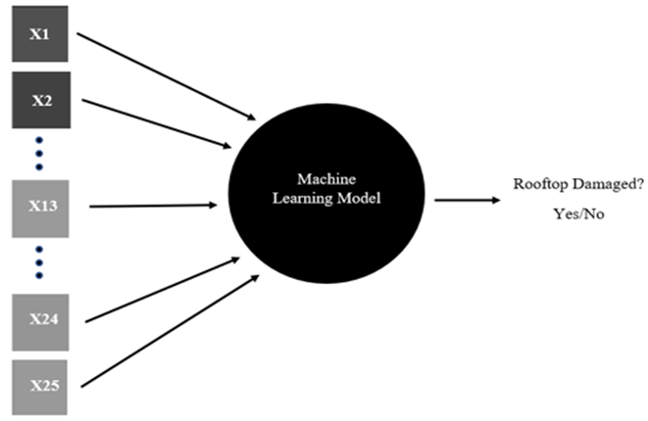
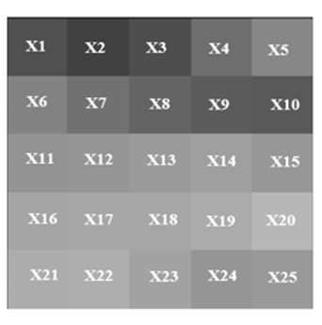
Convolutional Neural Networks
How computers interpret images?

Slide 5

Convolutional Neural Networks
Why CNN?
5 pixels
.
.
.
.
.
.
5 pixels
20 nodes
20 nodes
2 nodes
1st hidden layer
2nd hidden layer
output layer
25 nodes
No of Parameters = 25*20 + 20 = 570
No of Parameters = 20*2 + 2 = 42
No of Parameters = 20*20 + 20 = 420
Total number of trainable parameters = 570 + 420 + 42 = 1032 parameters only in 5x5 image with 2 hidden layers

Slide 6
Convolutional Neural Networks
Why CNN?
Large number of trainable parameters in ANN which increases computational complexity
ANN treats all image pixels as independent to each others
ANN does not take into account the spatial relationship between the pixels, so it fails to identify the patterns in the image pixels
Whereas, CNNs use sparsely connected layers which reduces total number of trainable parameters
CNNs accepts matrices as input, so we can explore spatial relationship between the pixels in the image

Slide 7
Convolutional Neural Networks
Why CNN?
1st row
spatial information between
pixels is distorted
4 pixels
2nd row
4 pixels
Output
layer
3rd row
4th row
Fully connected
layer

Slide 8
Convolutional Neural Networks
Why CNN?
1st row
4 pixels
2nd row
4 pixels
Output
layer
Now, every hidden node is connected to a local
region of pixels and can find out the local patterns
in the image
3rd row
Then output layers combines the findings of each
hidden nodes and predicts the final output
4th row

Slide 9
Convolutional Neural Networks
Why CNN?
We can rearrange each of these vectors (input and hidden layers in previous layer) as matrices
4 pixels
Output layer
Convolutional layer
4 pixels
We can add more localized hidden nodes to find more patterns
In the image
Convolutional layer

Slide 10
Convolutional Neural Networks
How Convolutional layers are generated?
We introduce kernels or filters with random weights which convolves over the whole image to create localized
convolutional layer
0
1
1
1
0
0
0
1
-1
-1
4 pixels
-1
1
0
0
1
0
convolution operator
0
1
0
0
filter/kernel
4 pixels

Slide 11
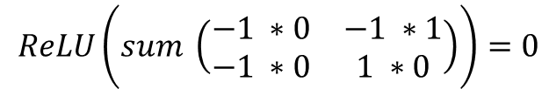
Convolutional Neural Networks
How Convolutional layers are generated?
We introduce kernels or filters with random weights which convolves over the whole image to create localized
convolutional layer
0
1
1
1
started learning
patterns of the
digit 7 (seven)
-1
-1
0
0
1
0
0
0
1
-1
1
0
1
0
0
0
1
0
filter/kernel
1
0
0
0
1
0
0
convolutional layer
input layer
$$ReLU\left(sum \left(\begin{matrix}−1 ∗0 & −1 ∗1 \\ −1 ∗0 & 1 ∗0\end{matrix}\right)\right)=0$$

Slide 12
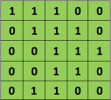


Convolutional Neural Networks
How Convolutional layers are generated?
$$=$$
filter
input layer

Slide 13
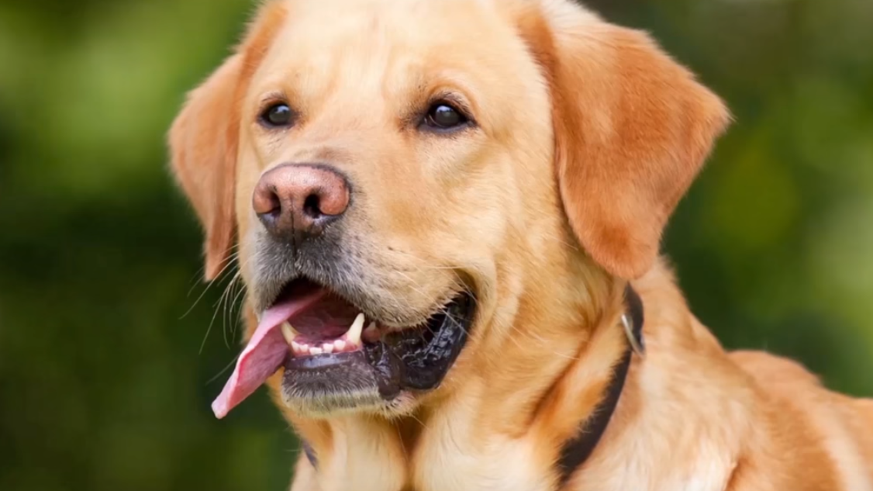
Convolutional Neural Networks
How many filters do we need?
We may like to detect:
Teeth
Tongue
Whiskers
So for every features in the image
we will convolve different filters
with respect to the image to detect
those features. For instance, one
filter for teeth, one for tongue and
another for whiskers and then we
stack up those convolutional layers
as one final layer

Slide 14
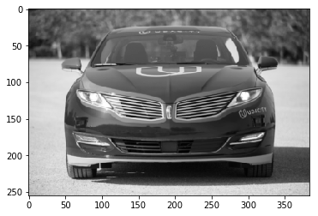
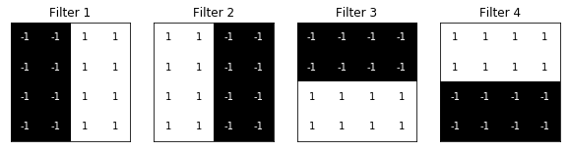
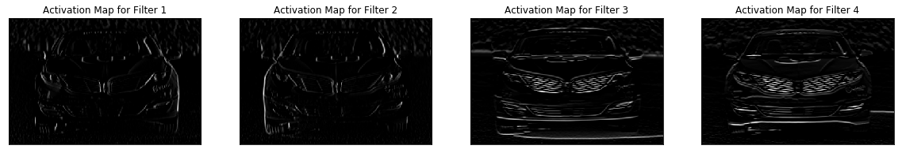
Convolutional Neural Networks
How many filters do we need?
input layer
four filters to detect four different
patterns in the image

Slide 15
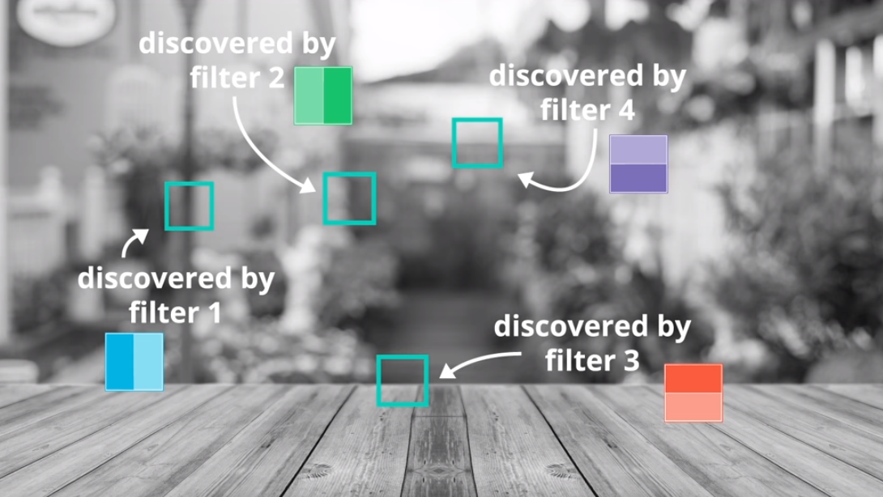
Convolutional Neural Networks
How many filters do we need?

Slide 16
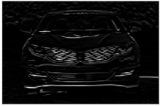
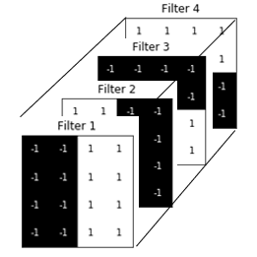
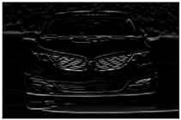
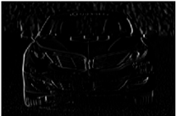
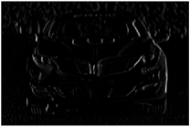
Convolutional Neural Networks
How many filters do we need?
input layer
filters
convolutional layer

Slide 17
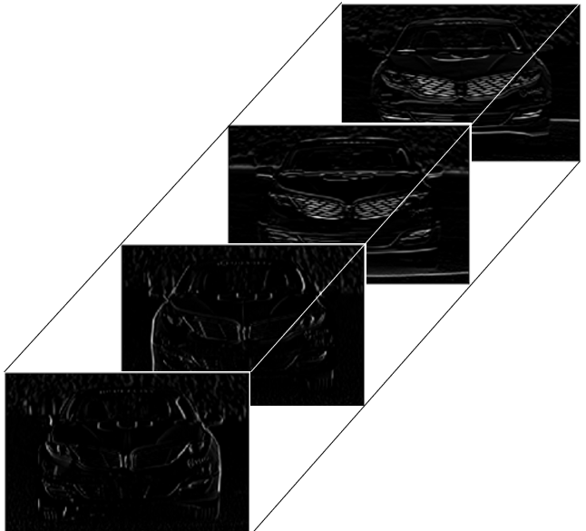


Convolutional Neural Networks
How many filters do we need?
$$\left[CONV LAYER\right]$$
$$\left[CONV LAYER\right]$$
Output
convolutional layer is passed through multiple
other convolutional layers to find out patterns
within the patterns (complex patterns)
convolutional layer

Slide 18
Convolutional Neural Networks
Tuning parameters in CNN
Number of filters
Size of filters
Stride of filters
Padding

Slide 19
Convolutional Neural Networks
Tuning parameters in CNN: Stride and Padding
0
1
1
1
1
0
1
?
1
-1
-1
0
0
0
1
0
1
0
?
-1
1
0
0
1
0
0
?
?
?
filter/kernel
0
1
0
0
0
1
0
0
0
0
1

Slide 20
Convolutional Neural Networks
Tuning parameters in CNN: Stride and Padding
0
1
1
1
1
0
0
1
?
0
1
0
1
-1
-1
0
0
0
1
0
0
1
0
?
1
0
0
-1
1
0
0
1
0
0
0
?
?
?
0
0
0
filter/kernel
0
1
0
0
0
0
1
0
0
0
0
0
1
Padding
0
0
0
0
0
0

Slide 21
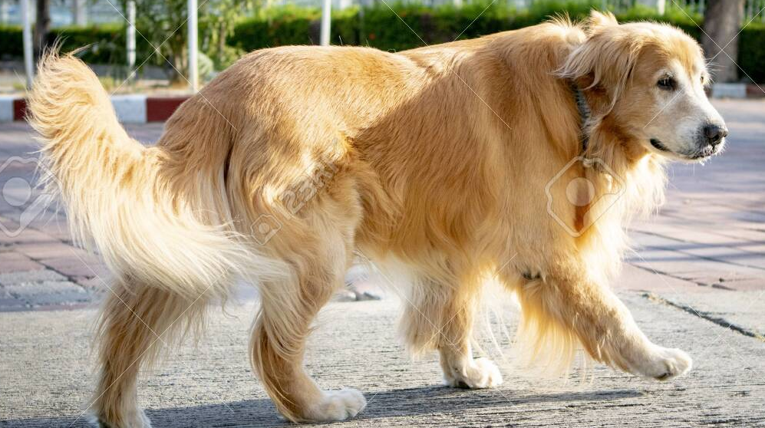
Recurrent Neural Networks
Temporal dependencies – it means dependency of input/independent variables over time
Is this dog walking or running?
"He turned out the light and went into Jem's room. He would be there all night, and he would be there when Jem waked up in the morning."
To Kill a Mockingbird, Harper Lee
Who is ‘He’ here?

Slide 22








Recurrent Neural Networks
time step 1
Arko
$$x_{1}$$
5
8
next hidden layer/ output layer
time step 2
is
$$x_{2}$$
1
1
next hidden layer/ output layer
Should they have
Same weights?
time step 3
cool,
$$x_{3}$$
-2
-3
next hidden layer/ output layer
-3
time step 4
be
$$x_{4}$$
0
next hidden layer/ output layer
Should they have
Same weights?
4
time step 5
cool,
$$x_{5}$$
4
next hidden layer/ output layer
2
time step 6
be
$$x_{6}$$
7
next hidden layer/ output layer
Who is ‘him’ here?
-6
time step 7
like
$$x_{7}$$
-1
next hidden layer/ output layer
7
time step 8
him
$$x_{8}$$
9
next hidden layer/ output layer

Slide 23








Recurrent Neural Networks
time step 1
Arko
$$x_{1}$$
5
8
Activation/
Information/
Memory
time step 2
is
$$x_{2}$$
1
1
time step 3
cool,
$$x_{3}$$
-2
-3
-3
time step 4
be
$$x_{4}$$
0
4
time step 5
cool,
$$x_{5}$$
4
2
time step 6
be
$$x_{6}$$
7
4
time step 5
like
$$x_{5}$$
4
2
time step 6
him
$$x_{6}$$
7

