Slide 1

TEERTHANKER MAHAVEER UNIVERSITY
COLLEGE OF COMPUTING SCIENCES & INFORMATION TECHNOLOGY
PROJECT ON
D-SMATM
INTERNAL GUIDE
Mr. Shobit Kumar
SUBMITTED BY:
Swapnil Jain TCA1409072

Slide 2
D-SMATM

Slide 3

CONTENTS
INTRODUCTION
PROBLEM STATEMENT
OBJECTIVE
NEED OF THE PROJECT
REQUIREMENTS
MODULES
PROJECT FLOW DESCRIPTION
DATA BASE
SCREEN SHOTS

Slide 4
INTRODUCTION D-SMATM is a project by which we can introduce a machine in which we deposit a money as well as we also withdraw the cash at one place.

Slide 5
PROBLEM STATEMENT
IN THIS WORLD OF HUSSEL, EVERY ONE WANTS TO SAVE THEIR TIME & EFFORTS.
AWARE ABOUT ATM FUNCTION AS PER THE CURRENT SCENARIO OF DEMONITISATION IN INDIA

Slide 6
OBJECTIVE 1.The main objective of this project is to provide a platform to the end user to attain the accessibility to all facilities that a ATM mahine can provide. 2.To aware the people who don’t even know how to operate the ATM machines in today world.So we can say that this project van also be use a Learn Up Kit (LUK) / ATM Awareness Kit(AAK).

Slide 7
NEED OF THE PROJECT
To aware the people about ATM.
For the security reasons.
To provide deposit and withdrawal facility at one place.
User friendly system so that every single fellow can access it with having any problem.

Slide 8
FUTURISTIC
Use the biometric system for enetering credentials by which we can achive:
Security
Transcation in your figure tip

Slide 9
REQUIREMENTS
OPERATING SYSTEM : WINDOW XP/7 OR ABOVE
PLATFORM : NEATBEANS 8.1
TOOLS : My SQL Workbench 6.3 CE
DATABASE : MYSQL 5.3

Slide 10

MODULES
HOME
MENU PAGE
DEPOSIT
BALANCE ENQUIRY
CASH WITHDRAW
FUND TRANSFER
PIN CHANGE
FAST CASH

Slide 11
DATA FLOW DESCRIPTION
DEPOSIT
Home Page
BALANCE ENQUIRY
WITHDRAWAL
FUND TRANSFER
FAST CASH
PIN CHANGE
Database

Slide 12
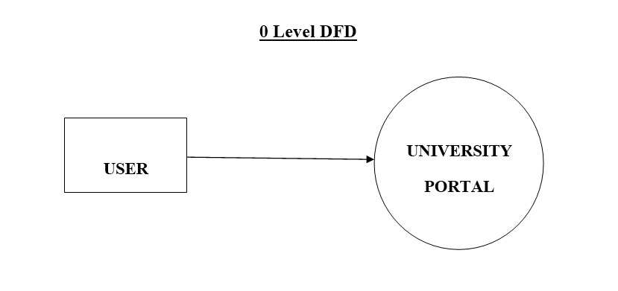
DATA FLOW DIAGRAM
USER
D-SMATM

Slide 13

DATABASE
Balance Table

Slide 14
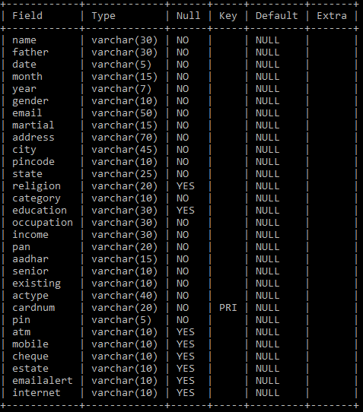
DATABASE
Signup Table

Slide 15
SCREEN SHOTS & DETAILS

Slide 16
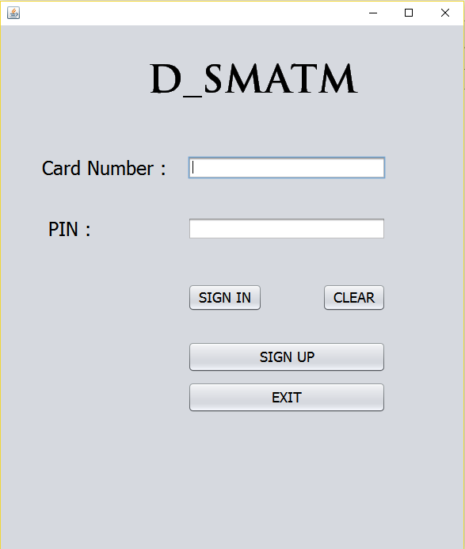

Slide 17
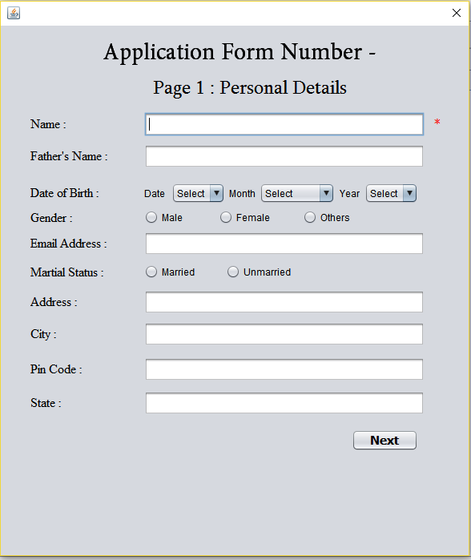

Slide 18
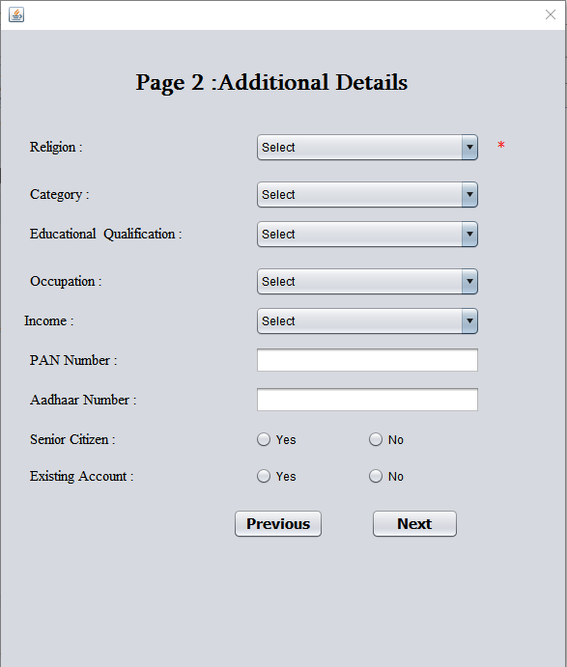

Slide 19
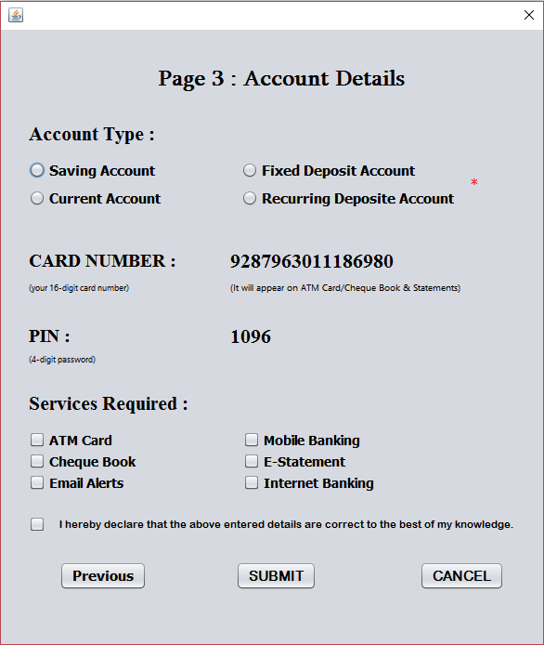

Slide 20
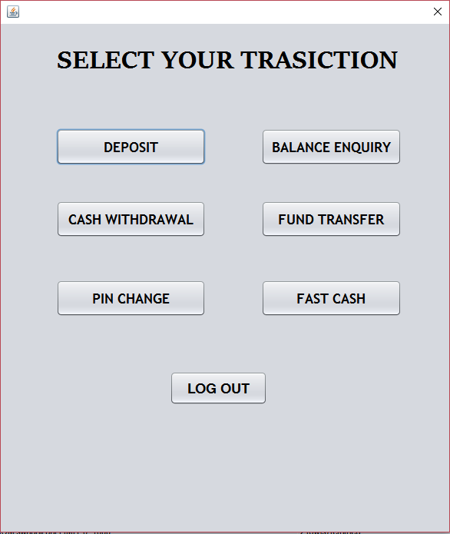

Slide 21
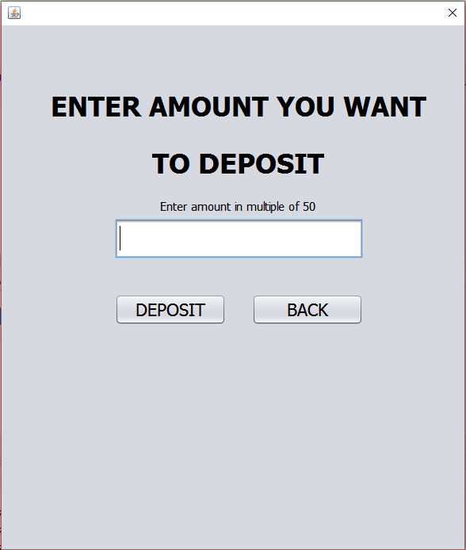

Slide 22
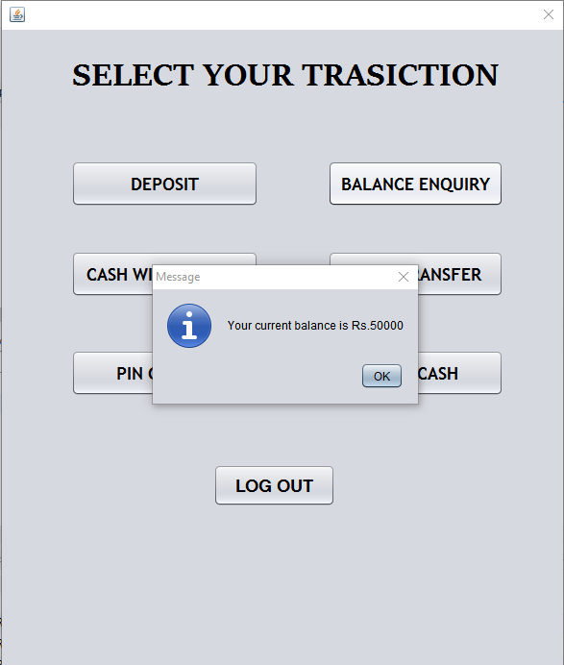

Slide 23
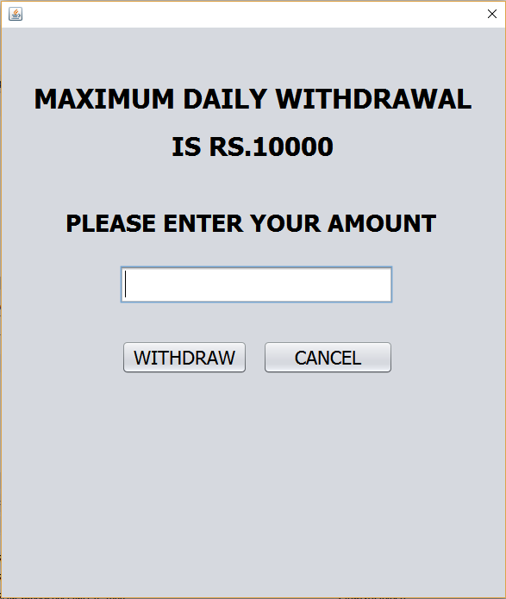

Slide 24
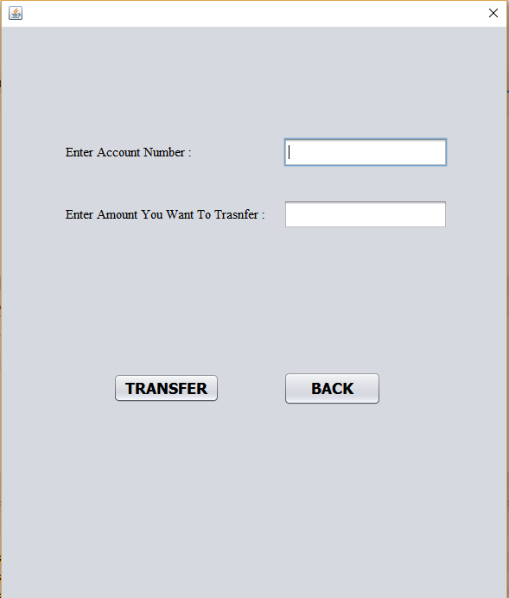

Slide 25
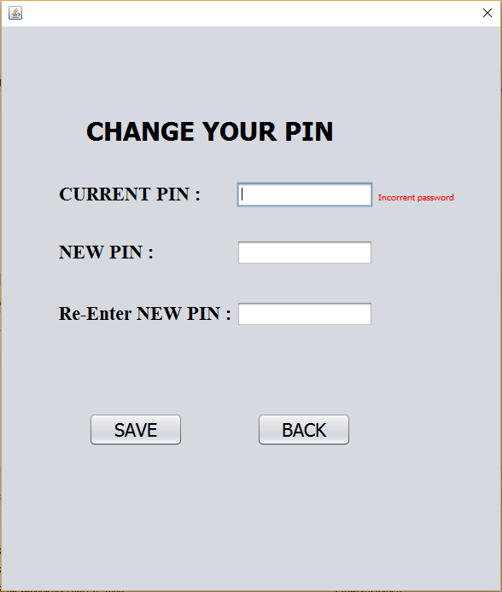

Slide 26
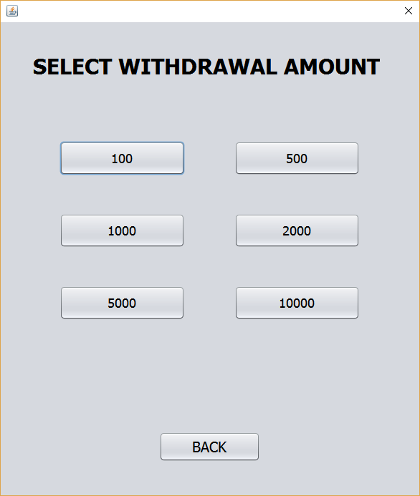

Slide 27
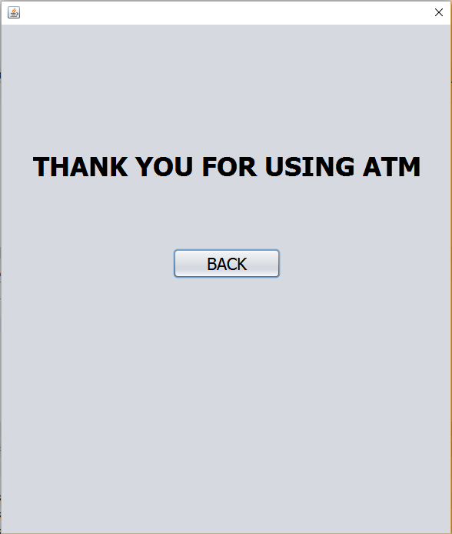

Slide 28
THANK YOU

