Slide 1

Maven
June 2016

Slide 2
Overview
What is Maven?
Maven is a project management and comprehension tool. Maven provides developers a complete build lifecycle framework. Development team can automate the project's build infrastructure in almost no time as Maven uses a standard directory layout and a default build lifecycle.
In case of multiple development teams environment, Maven can set-up the way to work as per standards in a very short time. As most of the project setups are simple and reusable, Maven makes life of developer easy while creating reports, checks, build and testing automation setups.
Notes:
This course covers integration basics that are important to understand for all developers working on integration projects.

Slide 3
Overview
Maven provides developers ways to manage following:
Builds
Documentation
Reporting
Dependencies
SCMs
Releases
Distribution
mailing list
To summarize, Maven simplifies and standardizes the project build process. It handles compilation, distribution, documentation, team collaboration and other tasks seamlessly. Maven increases reusability and takes care of most of build related tasks.
Notes:
This course covers integration basics that are important to understand for all developers working on integration projects.

Slide 4
Objective
Maven primary goal is to provide developer
A comprehensive model for projects which is reusable, maintainable, and easier to comprehend.
plugins or tools that interact with this declarative model.
Maven project structure and contents are declared in an xml file, pom.xml referred as Project Object Model (POM), which is the fundamental unit of the entire Maven system. Refer to Maven POM section for more detail.
Notes:
This course covers integration basics that are important to understand for all developers working on integration projects.

Slide 5
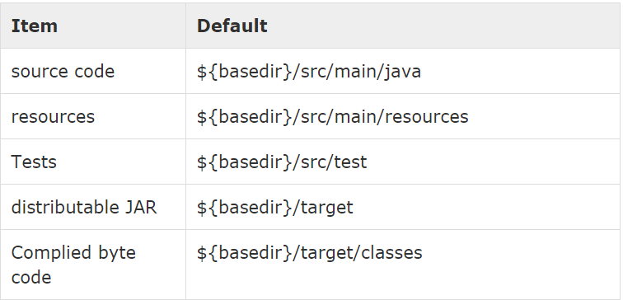
Convention over Configuration
Maven uses Convention over Configuration which means developers are not required to create build process themselves.
Developers do not have to mention each and every configuration detail. Maven provides sensible default behavior for projects. When a Maven project is created, Maven creates default project structure. Developer is only required to place files accordingly and he/she need not to define any configuration in pom.xml.
As an example, following table shows the default values for project source code files, resource files and other configurations. Assuming, ${basedir} denotes the project location:
Notes:
This course covers integration basics that are important to understand for all developers working on integration projects.

Slide 6
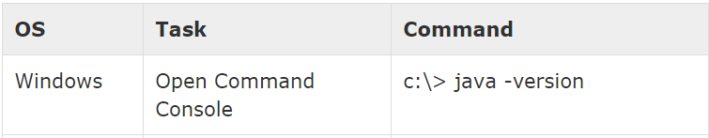
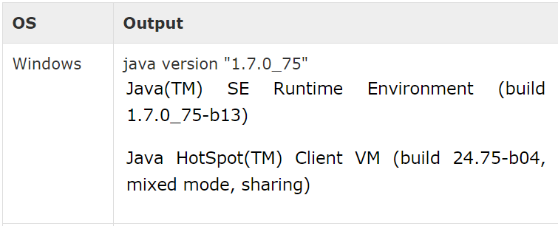
Environment Setup
Maven is Java based tool, so the very first requirement is to have JDK installed on your machine.
Step 1 - verify Java installation on your machine
Now open console and execute the following java command.
Let's verify the output for all the operating systems:
Notes:
This course covers integration basics that are important to understand for all developers working on integration projects.

Slide 7
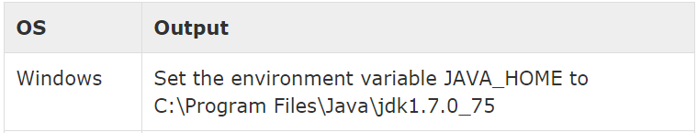
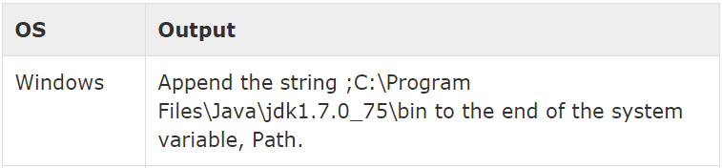
Environment Setup
Step 2: Set JAVA environment
Set the JAVA_HOME environment variable to point to the base directory location where Java is installed on your machine. For example
Append Java compiler location to System Path. Verify Java Installation using java -version command explained above.
Notes:
This course covers integration basics that are important to understand for all developers working on integration projects.

Slide 8
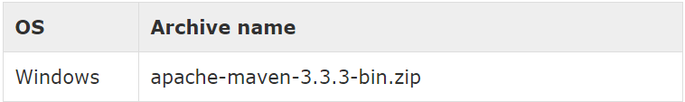
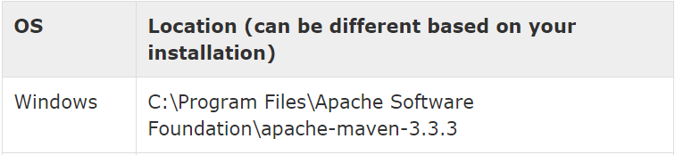
Environment Setup
Step 3: Download Maven archive
Download Maven 3.3.3 fromhttp://maven.apache.org/download.cgi
Step 4: Extract the Maven archive
Extract the archive, to the directory you wish to install Maven 3.3.3. The subdirectory apache-maven-3.3.3 will be created from the archive.
Notes:
This course covers integration basics that are important to understand for all developers working on integration projects.

Slide 9
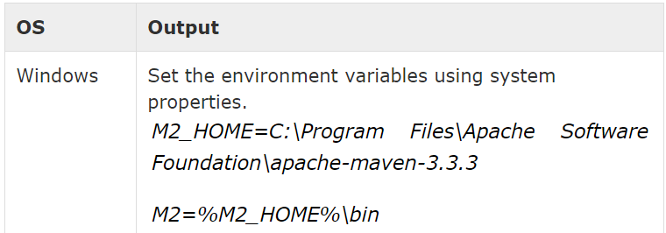
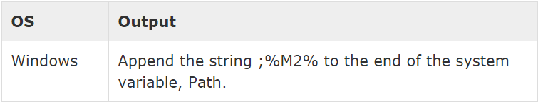
Environment Setup
Step 5: Set Maven environment variables
Add M2_HOME, M2, MAVEN_OPTS to environment variables.
Step 6: Add Maven bin directory location to system path
Now append M2 variable to System Path
Notes:
This course covers integration basics that are important to understand for all developers working on integration projects.

Slide 10
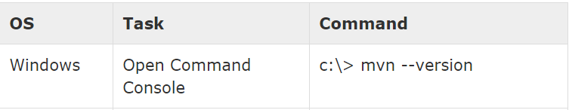
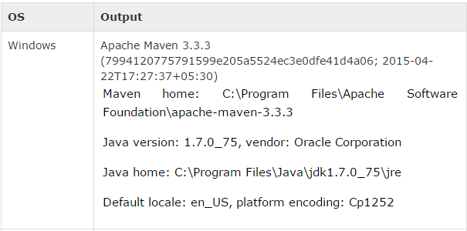
Environment Setup
Step 7: Verify Maven installation
Now open console, execute the following mvn command.
Finally, verify the output of the above commands, which should be something as follows:
Notes:
This course covers integration basics that are important to understand for all developers working on integration projects.

Slide 11
Maven POM
POM stands for Project Object Model. It is fundamental Unit of Work in Maven. It is an XML file. It always resides in the base directory of the project as pom.xml.
The POM contains information about the project and various configuration detail used by Maven to build the project(s).POM also contains the goals and plugins. While executing a task or goal, Maven looks for the POM in the current directory. It reads the POM, gets the needed configuration information, then executes the goal. Some of the configuration that can be specified in the POM are following:
project dependencies
plugins
goals
build profiles
project version
developers
mailing list
Notes:
This course covers integration basics that are important to understand for all developers working on integration projects.

Slide 12
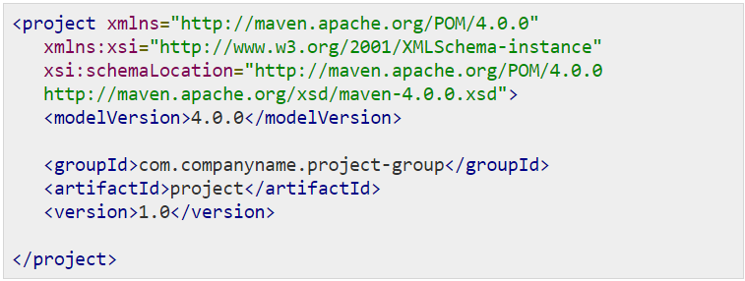
Example POM
It should be noted that there should be a single POM file for each project.
All POM files require the project element and three mandatory fields: groupId, artifactId, version.
Projects notation in repository is groupId:artifactId:version.
Notes:
This course covers integration basics that are important to understand for all developers working on integration projects.

Slide 13
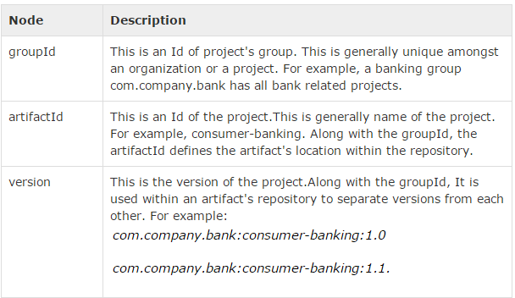
Example POM
Root element of POM.xml is project and it has three major sub-nodes :
Notes:
This course covers integration basics that are important to understand for all developers working on integration projects.

Slide 14
Maven Plugins
Maven is actually a plugin execution framework where every task is actually done by plugins. Maven Plugins are generally used to :
create jar file
create war file
compile code files
unit testing of code
create project documentation
create project reports
A plugin generally provides a set of goals and which can be executed using following syntax:
mvn [plugin-name]:[goal-name]
For example, a Java project can be compiled with the maven-compiler-plugin's compile-goal by running following command
mvn compiler:compile
Notes:
This course covers integration basics that are important to understand for all developers working on integration projects.

Slide 15
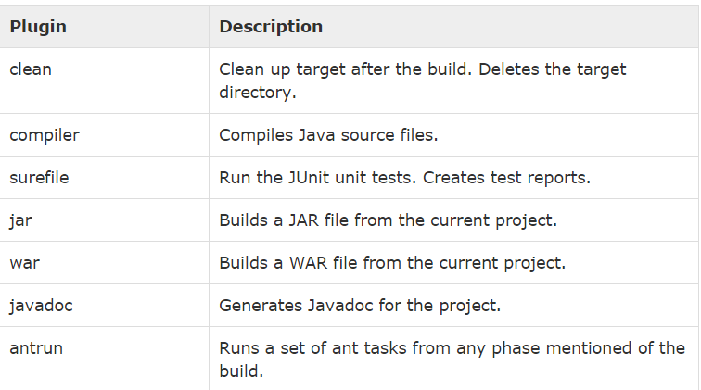
Maven Plugins
Following is the list of few common plugins:
Notes:
This course covers integration basics that are important to understand for all developers working on integration projects.

Slide 16
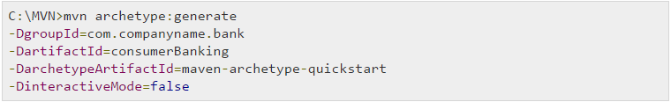
Creating Java Project using Maven
Maven uses archetype plugins to create projects. To create a simple java application, we'll use maven-archetype-quickstart plugin. In example below, We'll create a maven based java application project in C:\MVN folder.
Let's open command console, go the C:\MVN directory and execute the following mvn command.
C:\MVN>mvn archetype:generate -DgroupId=com.companyname.bank -DartifactId=consumerBanking -DarchetypeArtifactId=maven-archetype-quickstart -DinteractiveMode=false
Maven will start processing and will create the complete java application project structure.
Notes:
This course covers integration basics that are important to understand for all developers working on integration projects.

Slide 17
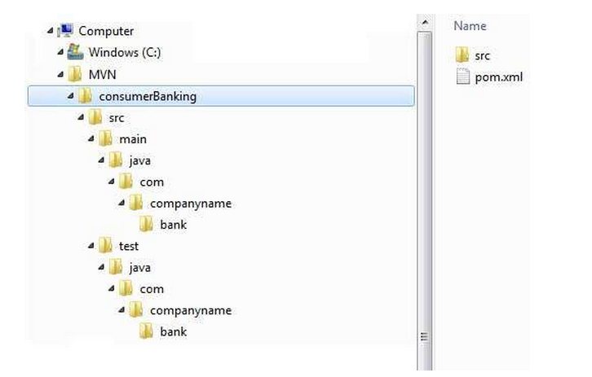
Creating Java Project using Maven
Now go to C:/MVN directory. You'll see a java application project created named consumerBanking (as specified in artifactId). Maven uses a standard directory layout as shown below:
Notes:
This course covers integration basics that are important to understand for all developers working on integration projects.

Slide 18
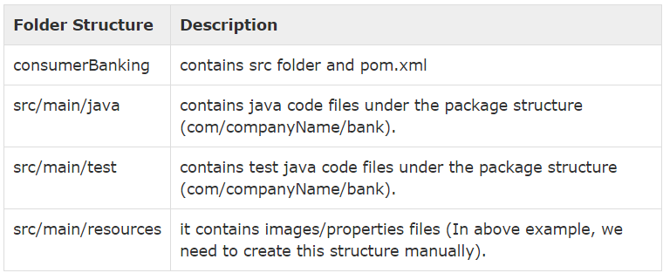
Creating Java Project using Maven
Using above example, we can understand following key concepts
Notes:
This course covers integration basics that are important to understand for all developers working on integration projects.

Slide 19
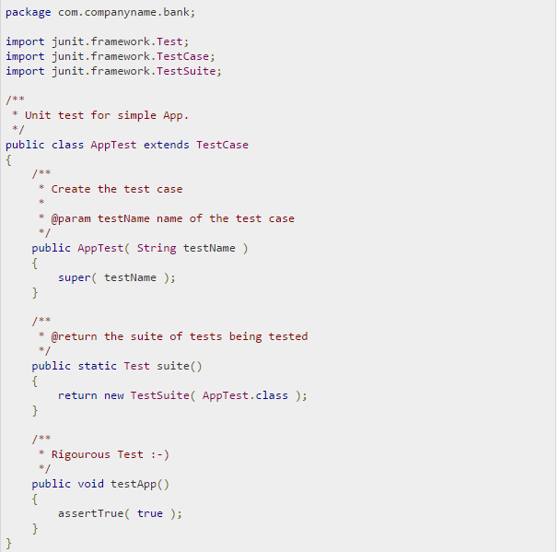
Creating Java Project using Maven
Open C:\MVN\consumerBanking\src\test\java\com\companyname\bank folder, you will see AppTest.java.
Notes:
This course covers integration basics that are important to understand for all developers working on integration projects.

Slide 20
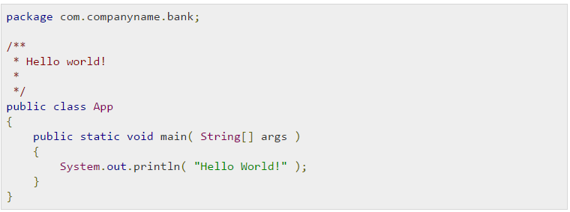
Creating Java Project using Maven
If you see, Maven also created a sample Java Source file and Java Test file. Open C:\MVN\consumerBanking\src\main\java\com\companyname\bank folder, you will see App.java.
Notes:
This course covers integration basics that are important to understand for all developers working on integration projects.

Slide 21
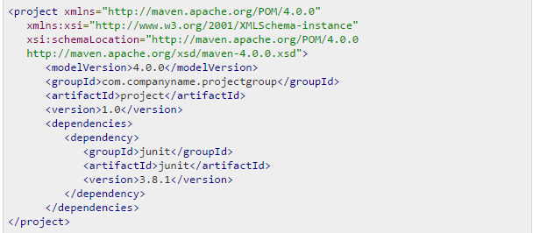
Build & Test Java Project using Maven
What we learnt in Project Creation chapter is how to create a Java application using Maven. Now we'll see how to build and test the application.
Go to C:/MVN directory where you've created your java application. OpenconsumerBanking folder.You will see the POM.xml file with following contents.
Here you can see, Maven already added Junit as test framework. By default Maven adds a source file App.java and a test file AppTest.java in its default directory structure discussed in previous chapter.
Notes:
This course covers integration basics that are important to understand for all developers working on integration projects.

Slide 22
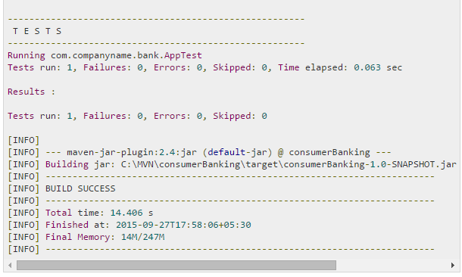
Build & Test Java Project using Maven
Let's open command console, go the C:\MVN\consumerBanking directory and execute the following mvn command.
C:\MVN\consumerBanking>mvn clean package
Maven will start building the project.
Notes:
This course covers integration basics that are important to understand for all developers working on integration projects.

Slide 23
Build & Test Java Project using Maven
You've built your project and created final jar file, following are the key learning concepts
We give maven two goals, first to clean the target directory (clean) and then package the project build output as jar(package).
Packaged jar is available in consumerBanking\target folder as consumerBanking-1.0-SNAPSHOT.jar.
Test reports are available in consumerBanking\target\surefire-reports folder.
Maven compiled source code file(s) and then test source code file(s).
Then Maven run the test cases.
Finally Maven created the package.
Now open command console, go the C:\MVN\consumerBanking\target\classes directory and execute the following java command.
C:\MVN\consumerBanking\target\classes>java com.companyname.bank.App
You will see the result
Notes:
This course covers integration basics that are important to understand for all developers working on integration projects.

Slide 24
References
http://www.tutorialspoint.com/maven/maven_quick_guide.htm

