Slide 1
Why HTML ? Browser History.
1990 (World Wide Web) web browser
Invented By British Computer science
1994 (Netscape) web browser
Invented by Mosaic Communications Corporation
1995 (Internet Explorer) web browser
By Microsoft

Slide 2
Version Control System
Git vs. GitHub
Open For All
SVN vs. Subversion
Need to setup in organization

Slide 3
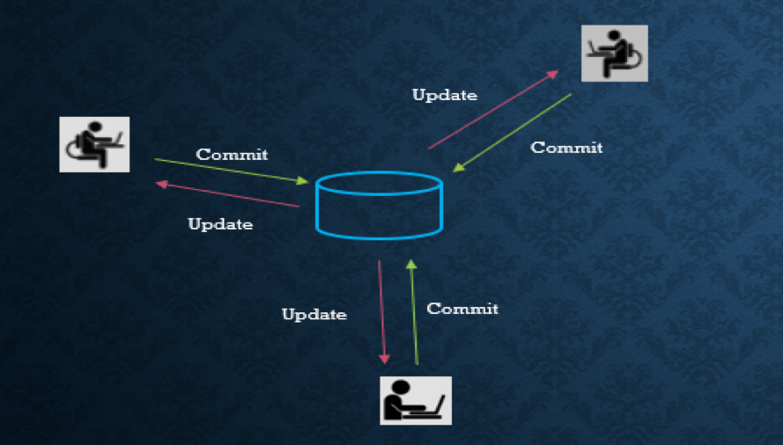

Slide 4
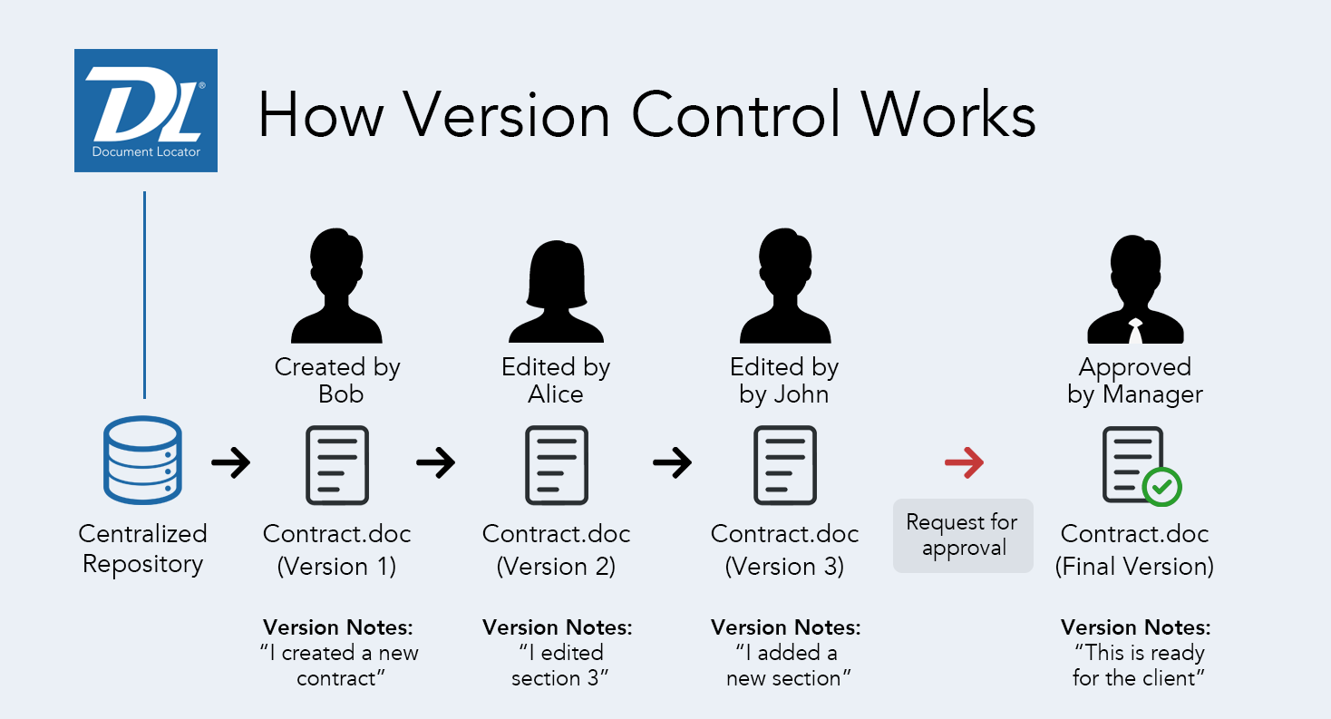

Slide 5
What is HTML
HTML stands for Hyper Text Markup Language
HTML is the standard markup language for creating Static Web pages
HTML describes the structure of a Web page
HTML consists of a series of elements
HTML elements tell the browser how to display the content
HTML elements label pieces of content such as "this is a heading", "this is a paragraph", "this is a link", etc.
Ways of creating static websites.
Create Static Web Pages By Coding
Create Static Web Pages By Predefined Views/Components.

Slide 6
Static Web Page | Dynamic Web Page
In static web pages, Pages will remain same until someone changes it manually. | In dynamic web pages, Content of pages are different for different visitors.
Static Web Pages are simple in terms of complexity. | Dynamic web pages are complicated.
Static Web Page takes less time for loading than dynamic web page. | Dynamic web page takes more time for loading.
In Static Web Pages, database is not used. | In dynamic web pages, database is used.
Static web pages are written in languages such as: HTML, JavaScript, CSS, etc. | Dynamic web pages are written in languages such as: AJAX, ASP, ASP.NET, JSP etc.

Slide 7
HTML Tags
<head> : Contains metadata/information for the document like Form Information
We can add <script> and <title> tag inside <head>
<title> : This tag will be inside the <head> tag to give page title
<body> : Designing part
<td> and <th> : To create table heading and Cells
<img> : Defines Image
<form> : Takes user information
<input> : Text Area
<H1> to <H6> : Heading Tags

Slide 8
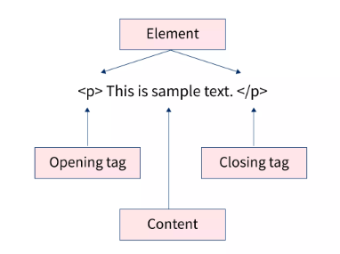
HTML Elements

Slide 9
HTML Attributes
href Attribute:
<a href="https://www.google.com">Visit W3Schools</a>
src Attribute :
<img src="img_girl.jpg">
The width and height Attributes:
<img src="img_girl.jpg" width="500" height="600">
alt Attribute :
<img src="img_girl.jpg" alt="Girl with a jacket">
style Attribute
<p style="color:red;">This is a red paragraph.</p>

Slide 10
HTML Formatting
<b> - Bold text
<strong> - Important text
<i> - Italic text
<mark> - Marked text
<small> - Smaller text
<del> - Deleted text
<ins> - Inserted text
<sub> - Subscript text
<sup> - Superscript text

Slide 11
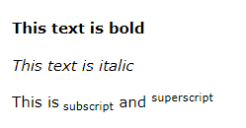
<p><b>This text is bold</b></p>
<p>This is<sub> subscript</sub> and <sup>superscript</sup></p>

Slide 12
HTML Paragraphs
The HTML <p> element defines a paragraph.
A paragraph always starts on a new line, and browsers automatically add some white space (a margin) before and after a paragraph.
Syntax :
<p>This is a paragraph.</p> <p>This is another paragraph.</p>

Slide 13
Anchor
The <a> tag defines a hyperlink, which is used to link from one page to another.
The most important attribute of the <a> element is the href attribute, which indicates the link's destination.

Slide 14
Phrase Tag
Abbreviation tag : <abbr>
Marked tag: <mark>
Strong tag: <strong>
Emphasized tag : <em>
Definition tag: <dfn>
Quoting tag: <blockquote>
Short quote tag : <q>
Code tag: <code>
Keyboard tag: <kbd>
Address tag: <address>

Slide 15
Phrase Tag
Text Abbreviation tag :
This tag give’s information if we place pointer on the text.
<p>An <abbr title = "Hypertext Markup language">HTML </abbr>language is used to create web pages. </p>

Slide 16
Phrase Tag
Strong text:
This tag is used to display the important text of the content. The text written between <strong> and </strong> will be displayed as important text.
<p>In HTML it is recommended to use <strong>lower-case</strong>, while writing a code. </p>

Slide 17
Phrase Tag
Marked tag:
The content written between <mark> and </mark> tag will show as yellow mark on browser. This tag is used to highlight a particular text.
<p>This tag will <mark>highlight</mark> the text.</p>

Slide 18
Phrase Tag
Emphasized text
This tag is used to emphasize the text, and displayed the text in italic form. The text written between <em> and </em> tag will italicized the text.
<p>HTML is an <em>easy </em>to learn language.</p>

