Slide 1



SAPTHAGIRI COLLEGE OF ENGINEERING (Affiliated to Visvesvaraya Technological University, Belagavi & Approved by AICTE, New Dehli) Department of Computer Science & Engineering
Presentation on :- Presented By:-
Fake Job Prediction Swapnil 1SG18CS119
Using Machine Learning Pranav Parth 1SG18CS072
Rishu Raj 1SG18CS085
Ritik Saini 1SG18CS086
Under the Guidance of:
Prof. Latha A
Assistant Professor,
Dept. Of CSE, SCE
2021-22

Slide 2
Contents
Absract
1
2
Introduction
Problem Statement
3
4
Software Requirements
5
Architecture
6
Proposed System
NLP
7
8
Naïve Bayes
9
SGD

Slide 3
ABSTRACT
To design a qualified training program so that the competence of job seekers can be in line with the industrial needs, Training Need Analysis (TNA) should be conducted before establish a training program.
Unfortunately, there have been many fraudulent job ads by individuals on behalf of the company. In order to overcome the problem, an employment scam detection is required.
Different classifiers are used for checking fraudulent post in the web and the results of those classifiers are compared for identifying the best employment scam detection model.

Slide 4
INTRODUCTION
Employment scams are on the rise. According to CNBC, the number of employment scams doubled in 2018 as compared to 2017.
Economic stress and the impact of the coronavirus have significantly reduced job availability and the loss of jobs for many individuals.
Many people are falling prey to these scammers using the desperation that is caused by an unprecedented incident. Most scammer do this to get personal information from the person they are scamming.
The scammers provide users with a very lucrative job opportunity and later ask for money in return. Or they require investment from the job seeker with the promise of a job.

Slide 5
LITERATURE SURVEY
Sl.No. | Title | Author | Publisher | Description | Disadvantages | Advantages
1. | Detecting Online Recruitment Fraud Using Machine Learning | Hridita Tabassum; Gitanjali Ghosh; | IEEE(2021) | In this paper, publisher proposed a solution on how to detect ORF. They presented results based on the previous model and the methodologies, to create the ORF detection model where they used own dataset. | Not Working for both text and numeric data. | Accuracy of different prediction models, where LightGBM (95.17%) and Gradient Boosting (95.17%) give the highest accuracy.

Slide 6
LITERATURE SURVEY
Sl.No. | Title | Author | Publisher | Description | Disadvantages | Advantages
2. | Online Recruitment Fraud Detection using ANN | Ibrahim M. Nasser; Amjad H. Alzaanin; | IEEE(2020) | In this paper, publisher proposed a solution on how to detect ORF. In this paper, an Artificial Neural Network based model is proposed to detect fraud job posts. The public Employment Scam Aegean Dataset (EMSCAD) is used. | The EMSCAD dataset contains very less amount of data and diversity of information is also limited. | ANN model has precision, recall, and f-measure of 91.84%, 96.02%, and 93.88% respectively.

Slide 7
LITERATURE SURVEY
Sl.No. | Title | Author | Publisher | Description | Disadvantages | Advantages
3. | Fake Job Recruitment Detection Using Machine Learning Approach | Shawni Dutta and Prof.Samir Kumar Bandyopadhyay | IEEE(2020) | Employment scam detection will guide job-seekers to get only legitimate offers from companies. For tackling employment scam detection, several machine learning algorithms are proposed as countermeasures in this paper. Supervised mechanism is used to exemplify the use of several classifiers for employment scam detection. | Accuracy with hyper parameter is not up to mark. | Accuracy of different prediction models, where KNN has 90% accuracy, Decision tree has 93% accuracy and random forest has 95%accuracy.

Slide 8
LITERATURE SURVEY
Sl.No. | Title | Author | Publisher | Description | Disadvanatges | Advantages
4. | Fake Job Detection and Analysis Using Machine Learning and Deep Learning Algorithms | C.S. Anita ; P. Nagarajan ; | IEEE(2020) | In this paper, we have applied machine learning and deep learning algorithms to classify and detect fake jobs from real jobs in a large dataset of job posts. Machine learning algorithms such as logistic regression, KNN classifier and random forest algorithm are used for classification purpose. Deep learning algorithm, Bi-Directional LSTM is used to train the neurons for classification. | Hyper tuning parameter link count vectorizer has not been implemented. | Accuracy of different prediction models, where Logistic Regression has 93% accuracy and random forest has 95%accuracy.

Slide 9
PROBLEM STATEMENT
This project aims to create classifier that will have the capability to identify fake and real jobs.
OBJECTIVE & SCOPE
The final result will be evaluated based on two different models. Since the data provided has both numeric and text features one model will be used on the text data and other on numeric data.
The final output will be a combination of the two. The final model will take in any relevant job posting and produce a final result determining whether the job is real or not

Slide 10
REQUIREMENTS
2 GB RAM
Microsoft Windows: 7/8/10
Dual Core Processor
Python: 3.6+
Hard Disk: 128 GB
Modem(Wi-Fi/Ethernet)
Jupyter Notebook
I/O Devices
Hardware Requirements
Software
Requirements

Slide 11
METHODOLOGY
Problem Definition
Evaluation
Data Collection
Modelling
Data Exploration & Visualisation
Data Pre-Processing/ Mining

Slide 12
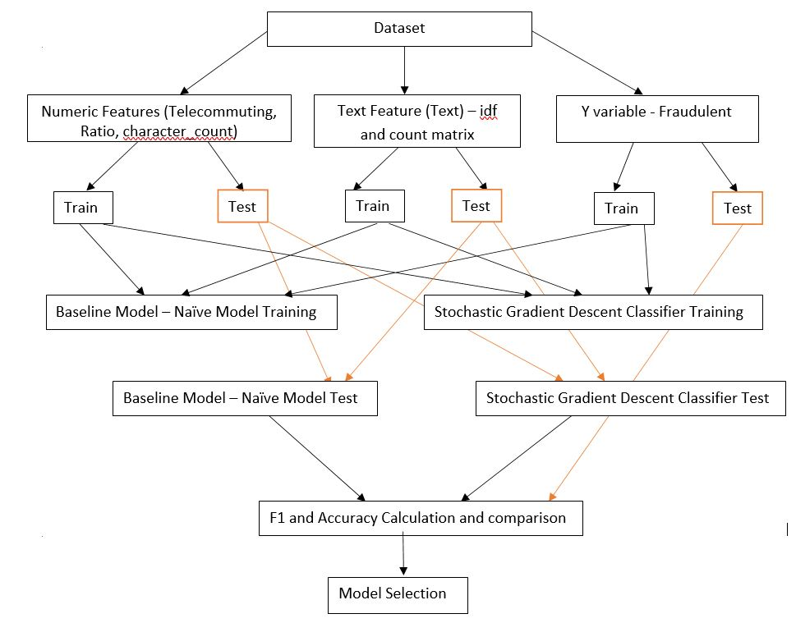
SYSTEM ARCHITECTURE

Slide 13
Natural Language Processing
The essence of NLP lies in making computer understand the natural language.
Computers can understand the structured form of data like spreadsheets and the tables , but human languages, texts, and it gets difficult for the computer to understand it, and there arises the need for NLP.
Computers can’t truly understand the human language. If we feed enough data and train a model properly, it can distinguish and try categorizing various parts of speech based on previously fed data and experiences.

Slide 14
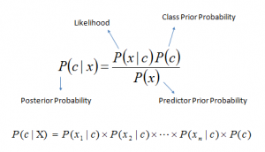
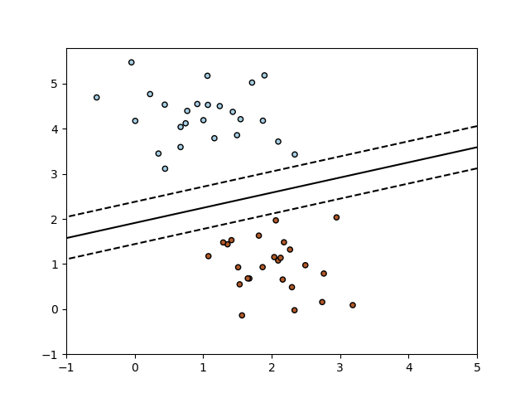
Naïve Bayes
Naïve Bayes is used because it can compute the conditional probabilities of occurrence of two events based on the probabilities of occurrence of each individual event, encoding those probabilities is extremely useful.
Stochastic Gradient Descent
The SGD Classifier is used since it implements a plain stochastic gradient descent learning routine which supports different loss functions and penalties for classification.

Slide 15
TESTING
Unit Testing
Here we test separate modules of the project which is the feature extraction of a given job.
Unit | Expected Outcome | Actual Outcome
Tokenization | This should split data into smaller units. | Data is split into words.
To Lower | Data converted to lowercase. | The split words are converted to lowercase.
Stopword Removal | Stopword are words that do not add much meaning to sentences. | Ex: the, a, an, he etc. These words are removed.
Lemmaziation | Grouping of splitted data. | Grouping together the words to form data so it can be analyzed as single item.
Location_ratio | Returns ratio of Fake to Real jobs specific to location. | Retuned ratio of Fake to Real jobs specific to location.

Slide 16
TESTING
Integration Testing
On integrating the modules, we test whether the project as a whole works as expected
(interactions between the modules work in right manner).
Module | Expected Outcome | Actual Outcome
Feature Extraction | Each of the feature set must show correct analyzed value. | Job dataset features are analyzed / evaluated.
Classifier | Should Classify Fake job as Fake and Real Jobs as Real. | Classified Fake jobs as Fake and Real jobs as Real using Hyper parameter tuning.

Slide 17
TESTING
System Testing
This is the final testing of the project, wherein the observed output is compared
to the excepted output (whether they match).
System | Expected Outcome | Actual Outcome
Classify Fake job | Display if job is Fake. | Displayed the job is Fake.
Classify Real Job | Display if job is Fake. | Displayed the job is Fake.

Slide 18

RESULTS
The final model used for this analysis is SGD. This is based on the results of the metrics as compared to baseline model.
Based on this metrics, SGD has slightly better performance than baseline model.

Slide 19
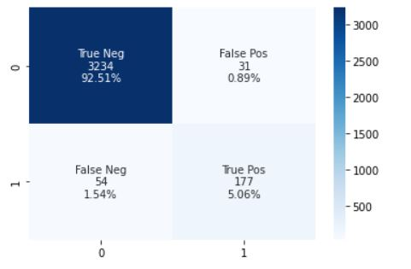
CONCLUSION
Only 2% of times has the model not identified the class correctly as evident from confusion matrix.

Slide 20
REFERENCES
[1] Bandar Alghamdi and Fahad Alharby, ―An Advance Model for Online Recruitment Fraud Detection, Journal of Information Security > Vol.10 No.3, July 2019
[2] Irina Rish, ―An Empirical Study of the Naïve Bayes Classifier An empirical study of the naive Bayes classifier, research gate, January 2001.
[3] D. E. Walters ―Bayes’s Theorem and the Analysis of Binomial Random Variables, Wiley Online Library, 1988
[4] Fionn Murtagh ―Multilayer perceptrons for classification and regression,Neurocomputing, Volume 2, Issues 5–6, July 1991, Pages 183-197
[5] P. Cunningham and S. J. Delany ―KNN Classifiers, ‖ Mult. Classifier. Syst., May 2007
[6] Himani Sharma and Sunil Kumar, ―A Survey on Decision Tree Algorithms of Classification in Data Mining, International Journal of Science and Research (IJSR) ISSN (Online): 2319-7064 Index Copernicus Value (2013): 6.14 | Impact Factor (2015): 6.391

Slide 21
Thank YOU!

