Slide 1
Integration Patterns
December 2014
This document is confidential and contains proprietary information, including trade secrets of CitiusTech. Neither the document nor any of the information contained in it may be reproduced or disclosed to any unauthorized person under any circumstances without the express written permission of CitiusTech.

Slide 2
Agenda
Integration Style
Integration Patterns
Why ESB
ESB core functionality

Slide 3
Integration Style
Integration Style | Description
File Transfer | Have each application produce files of shared data for others to consume, and consume files that others have produced. Suitable for An enterprise has multiple applications that are being built independently, with different languages and platforms. This is traditional integration style which requires a shared file server between applications exchanging the data.
Shared Database | Have the applications store the data they wish to share in a common database. The same data is shared with multiple applications and workflow is decided by state of the data. To make data available more quickly and enforce an agreed-upon set of data formats.

Slide 4
Integration Style
Integration Style | Description
Remote Procedure Invocation | Have each application expose some of its procedures so that they can be invoked remotely, and have applications invoke those to run behavior and exchange data. To integrate applications' functionality rather than their data this style is used. If an application needs some information that is owned by another application, it asks that application directly. If one application needs to modify the data of another, then it does so by making a call to the other application. Each application can maintain the integrity of the data it owns. Furthermore, each application can alter its internal data without having every other application be affected.
Messaging | Have each application connect to a common messaging system, and exchange data and invoke behavior using messages. This style is used to enable frequent exchanges of small amounts of data, perhaps used to invoke remote functionality. Use Messaging to transfer packets of data frequently, immediately, reliably, and asynchronously, using customizable formats. Sending a message does not require both systems to be up and ready at the same time.

Slide 5

Integration Patterns (1/10)
Message Processing
How can we perform complex processing on a message while maintaining independence and flexibility?
To form a sequence of steps.
Steps should be independent
Flexibility to form a different sequence based on processing complexity.
Pipes and Filter Architecture

Slide 6
Integration Patterns (1/10)
Scenarios for Pipes and Filter Architecture:
Messaging based scenario where say a HL7 SOAP message is sent to the application which is to be processed first for
Authentication of the sender
Validation of mandatory fields
Transformation of SOAP message into Canonical format to be consumed by downstream applications
Eg Claims processing message sent by provider to the payer

Slide 7
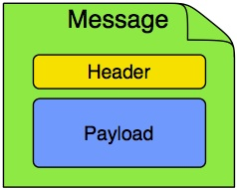
Integration Patterns (2/10)
Message
Messages are the entities used by systems to communicate with each other when using messaging channels.
Messages flow in one direction from a sender to a receiver, as illustrated in figure .
Messages have a body (a payload), headers, and optional attachments, as
illustrated in figure.
Messages are uniquely identified with an identifier
Message pattern forms the basis of abstraction to be implemented by different vendors

Slide 8
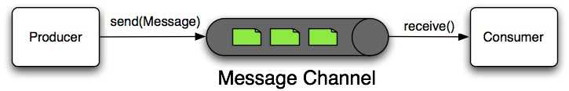
Integration Patterns (3/10)
Message Channel
Message Channel represents the "pipe" of a pipes-and-filters architecture
Producers send Messages to a channel, and consumers receive Messages from a channel.
A Message Channel may follow either Point-to-Point or Publish/Subscribe semantics.
The Message Channel therefore decouples the messaging components
Provides a convenient point for interception and monitoring of Messages.

Slide 9
Integration Patterns (4/10)
Message Endpoint
A Message Endpoint represents the "filter" of a pipes-and-filters architecture.
The endpoint's primary role is to connect application code to the messaging framework and to do so in a non-invasive manner.
Any component that can be connected to Message Channel(s) in order to send and/or receive Messages.
Endpoints
Transformer
Filter
Aggregator
Router
Splitter
Channel Adapter

Slide 10
Integration Patterns (5/10)
Message Transformer
Data transformation is a broad term that covers two types of transformation:
Data format transformation—The data format of the message body is transformed from one form to another. For example, a CSV record is formatted as XML.
Data type transformation—The data type of the message body is transformed from one type to another. For example a java.lang.String is transformed into a javax.jms.TextMessage.

Slide 11
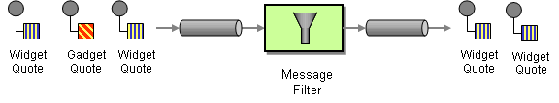
Integration Patterns (6/10)
Message Filters
Message filter is used to eliminate undesired messages from a channel based on a set of criteria.
The Message Filter has only a single output channel

Slide 12
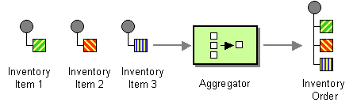
Integration Patterns (7/10)
Message Aggregator
The Aggregator is a special Filter that receives a stream of messages and identifies messages that are correlated.
the Aggregator publishes a single message distilled from the individual messages.

Slide 13
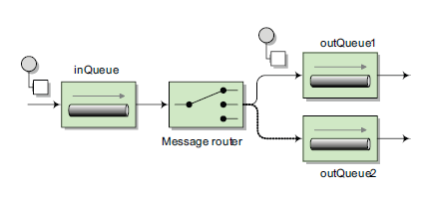
Integration Patterns (8/10)
Message Router
Message Router is responsible for deciding what channel or channels should receive the Message next (if any).
The decision is based upon the Message's content and/or metadata available in the Message Headers.
A Message Router is often used as a dynamic alternative to a statically configured output channel on an endpoint capable of sending reply Messages..

Slide 14
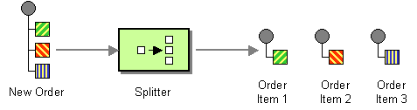
Integration Patterns (9/10)
Message Splitter
Splitter that consumes one message containing a list of repeating elements, each of which can be processed individually.
The Splitter publishes a one message for each single element (or a subset of elements) from the original message.

Slide 15
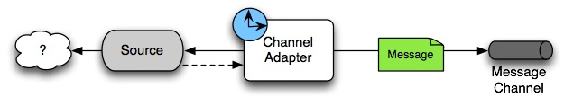
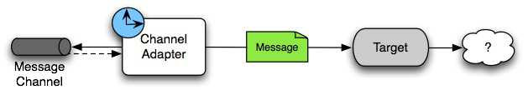
Integration Patterns (10/10)
Channel Adapter
A Channel Adapter is an endpoint that connects a Message Channel to some other system or transport.
Channel Adapters may be either inbound or outbound.
Channel Adapter will do some mapping between the Message and whatever object or resource is received-from or sent-to the other system (File, HTTP Request, JMS Message etc.).
Depending on the transport, the Channel Adapter may also populate or extract Message header values.

Slide 16
Why ESB
Today’s businesses aren’t run on a single monolithic system, and most businesses
have a full range of disparate systems.
Ever-increasing demand for those systems to integrate with each other and with external business partners and government systems.
Integration is hard and need to describe, document, and implement complex integration problems

Slide 17
Why ESB (1/3)
Reason | Description
Necessity to integrate applications | There must be a clear business need to integrate applications. Time-to-market and real-time reports are examples of business drivers.
Heterogonous environment | When you have to deal with lots of different technologies and protocols, there is a clear need for a central solution that’s made to deal with these challenges.
Reduction of total cost of ownership | IT departments are forced to cut maintenance costs to be able to satisfy demands for new products by the business departments. A central integration solution can help decrease the management and maintenance costs of the full application landscape.

Slide 18
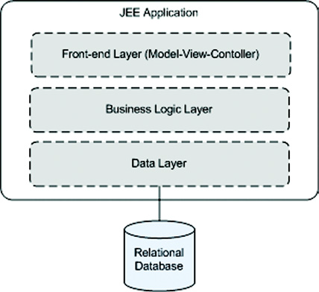
Why ESB (2/3)
Typical example of an application with a three-tier architecture. The application logic is divided into three layers, which can be distributed over multiple physical servers to
improve scalability and performance if necessary

Slide 19
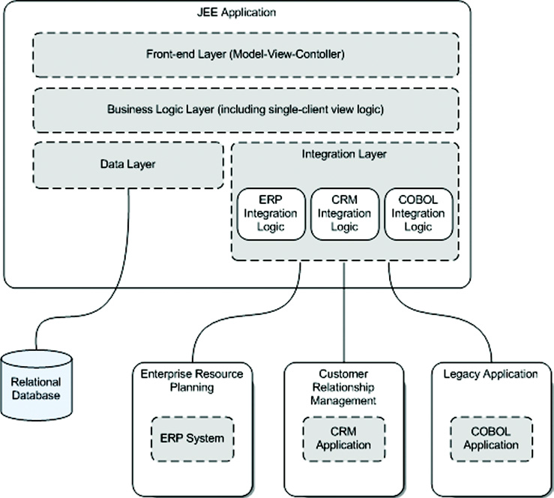
Why ESB (3/3)

Slide 20
ESB core functionality(1/2)
Reason
Description
Necessity to integrate applications
There must be a clear business need to integrate applications.
Time-to-me reports are examples of
business drivers.
Heterogonous environment
When you have to deal with lots of different technologies
and protocols, there is a clear need for a central solution
that’s made to deal with these challenges.
Reduction of total cost of ownership
IT departments are forced to cut maintenance costs to be
able to satisfy demands for new products by the business
departments. A central integration solution can help
decrease the management and maintenance costs of the
full application landscape.
ESB core functionality | Description
Location transparency | The ESB helps with decoupling the service consumer from the service provider location. The ESB provides a central platform to communicate with any application necessary without coupling the message sender to the message receiver.
Transport protocol conversion | An ESB should be able to seamlessly integrate applications with different transport protocols like HTTP(S) to JMS, FTP to a file batch, and SMTP to TCP.
Message transformation | The ESB provides functionality to transform messages from one format to the other based on open standards like XSLT and XPath.
Message routing | Determining the ultimate destination of an incoming message is an important functionality of an ESB that is categorized as message routing.
Message enhancement | An ESB should provide functionality to add missing information based on the data in the incoming message by using message enhancement.
Security | Authentication, authorization, and encryption functionality should be provided by an ESB for securing incoming messages to prevent malicious use of the ESB as well as securing outgoing messages to satisfy the security requirements of the service provider.
Monitoring and management | A monitoring and management environment is necessary to configure the ESB to be high-performing and reliable and also to monitor the runtime execution of the message flows in the ESB

Slide 21
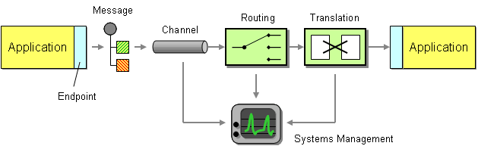
ESB core functionality(2/2)

Slide 22
Anti Patterns
Name | Description | Symptom | Solutions
Bad Workload Management | Poor distribution of work occurs when on server gets disproportionate share of work | Inconsistent performance leading to reduced throughput | Even Load balancing
Cacheless Cow | Caches can significantly improve performance but often neglected | Poor throughput | Dynamic Command Cache
The Golden Hammer | See unfamiliar technology as risky although the technology is better solution | Difficulty in maintaining the solution | Expanding the knowledge of developers through books, training, and user groups

Slide 23
Anti Patterns
Name | Description | Symptom | Solutions
Chatty Interface | Too many interactions between client and server | Poor performance | Use of facade
Round Trip | Too many remote connections with server to get the data | Poor throughput | Cache, Façade, stored procedures
Performance Afterthoughts | Poorly define performance plans and inattention to performance | Repeated software delivery with poor performance | Gather performance requirement, plan and address riskiest elements in architecture early

Slide 24
Anti Patterns
Name | Description | Symptom | Solutions
Excessive Coupling | Less coupling is generally better. If you code a method to perform a certain task, it should perform only that task | Excessive coupling happens when aspects like logging, caching etc. creep in | Use of AOP

